Slide 1
The CAEP Annual Planning & Fiscal Reporting Webinar
June 2020

Slide 2
Agenda
CAEP Planning
Annual plans
NOVA Annual Plan Processing
Fiscal Reporting in NOVA
Questions

Slide 3
CAEP Planning
The current 3 year plans were submitted in June 2019.
These are the regional plans to guide your consortium.
3 year plans drive the annual plans – due August 15th.
Annual plans drive the member work plans due September 30th.

Slide 4
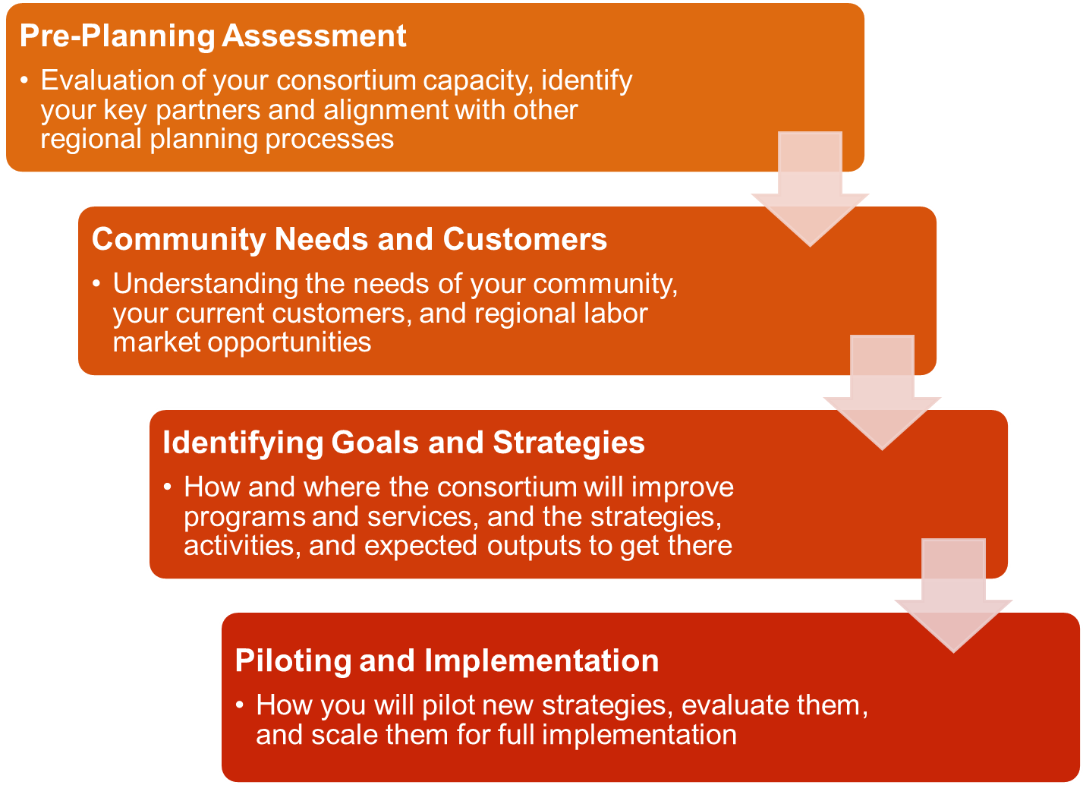

Slide 5
CAEP 20-21 Annual Plan
Same text boxes to complete in NOVA.
Aligns with the 3 year planning process.
Consortium must type in NOVA the responses to the annual planning prompts.
All members must certify the annual plan.
State Guidance will be released shortly.

Slide 6
CAEP Annual Plan Memo
Memo requires consortia to use the executive summary to highlight consortia responses to the following:
COVID-19
Budget Reductions
Systemic Racial Injustices

Slide 7
CAEP Annual Plan Memo (cont.)
COVID-19………in response to COVID-19, the Executive Summary should address how the consortium is serving students in a distance learning environment and meeting their learning needs, along with meeting staff, teacher, and faculty needs. Also, the Executive Summary should address how the consortium is responding to student supports (food, employment, clothing, health, shelter, public assistance, etc.).

Slide 8
CAEP Annual Plan Memo (cont.1)
Budget Reductions………the COVID-19 epidemic has drastically changed California’s budget outlook since the release of the Governor’s Budget on January 10…..The Executive Summary must demonstrate that consortium allocations are being strategic and responsive to the changes in the economy and to the impacts on adult education programs & students.

Slide 9
CAEP Annual Plan Memo (cont. 2)
Systemic Racial Injustices………Consortia in their executive summaries should describe any plans to examine the issue of their role in addressing structural racism within their membership and partners. We would encourage consortia and their members to examine the adult education student journeys by demographics. …What strategies and student supports can your consortium and its members use to ensure equitable student progress and success?

Slide 10
Regional Needs & Strategies
Keep in mind the three key areas mentioned as you examine and address the regional gaps.
List any strategies that will assist you in meeting the need to address those areas: COVID-19 (use of distance/remote learning), Budget Reductions (strategic use of funds), and Systemic Racial Injustices (ensuring equitable student progress & success).

Slide 11
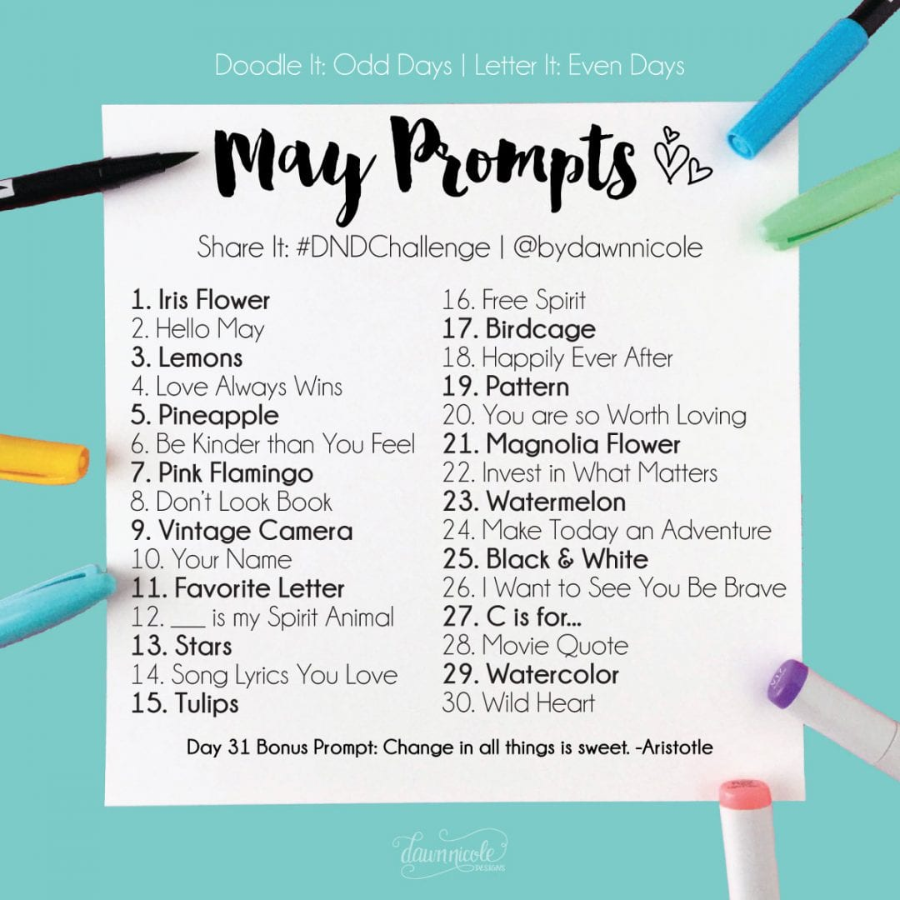
Review of Annual Plan Prompts

Slide 12
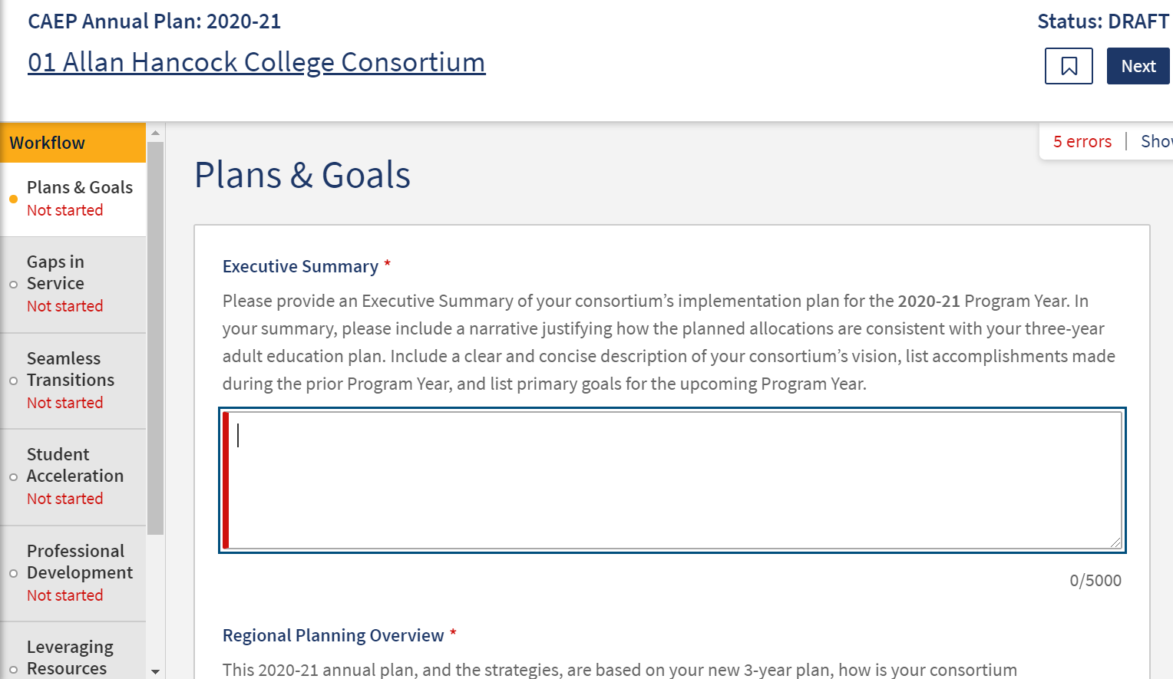

Slide 13
NOVA Annual Plan Tips
Review your 3-year plan.
Annual Plan strategies will become your member work plan objectives.
Make sure your strategies are broad enough for members to use in their work plans.
Work plans are supported by the member’s budget.
Notes:
S

Slide 14
NOVA Annual Plan Tips (cont.)
Consortium certification of annual plan and member work plans & budgets will satisfy State’s need for consortium & district approval to spend CAEP funding for the year.
Use the Fiscal Management section to explain your consortium’s carry over policies and how funds will be liquidated.
Notes:
S

Slide 15
NOVA Annual Plan Tips (cont. 1)
Annual plans must be approved in NOVA by all the consortium members.
Make sure you are in contact with your members about the 8/15/20 due date.
If you miss the 8/15 due date, it will delay your members from creating their work plans and budgets.
Notes:
S

Slide 16
Planning Resources
Planning Tools
https://resources.caladulted.org/
CAEP Consortium Self-Assessment Tool
https://caladulted.org/DownloadFile/656
CAEP Regional Fact Sheets
https://caladulted.org/2019FactSheets
US Skills Maps – Adult Literacy & Numeracy
https://nces.ed.gov/surveys/piaac/skillsmap/
Notes:
S

Slide 17
Notes:
S

Slide 18
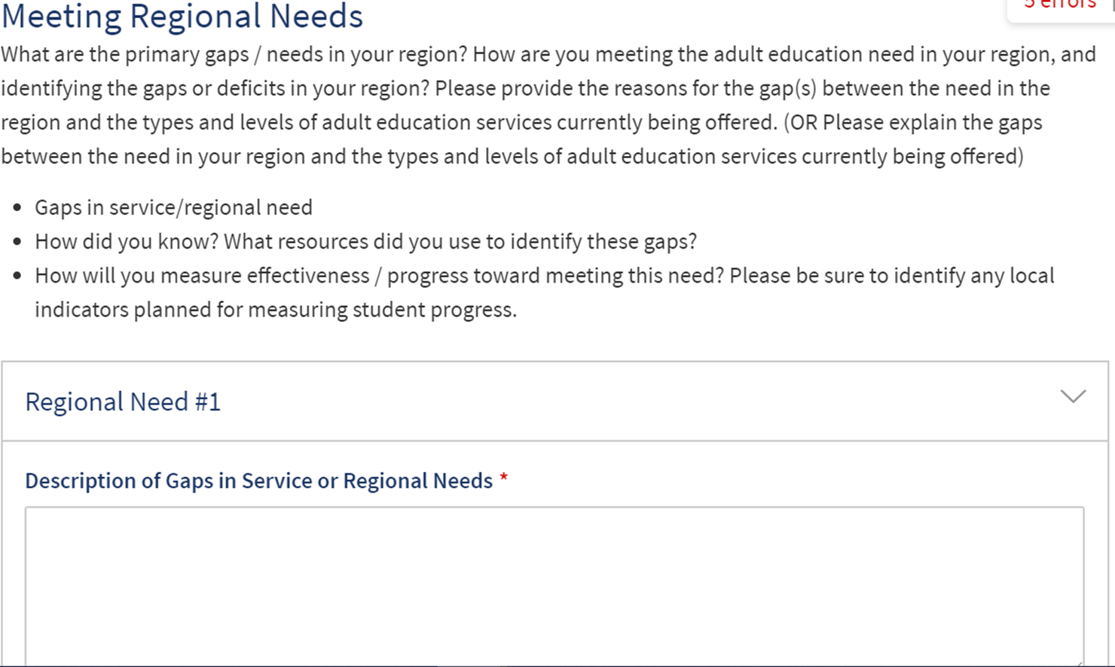
Notes:
S

Slide 19
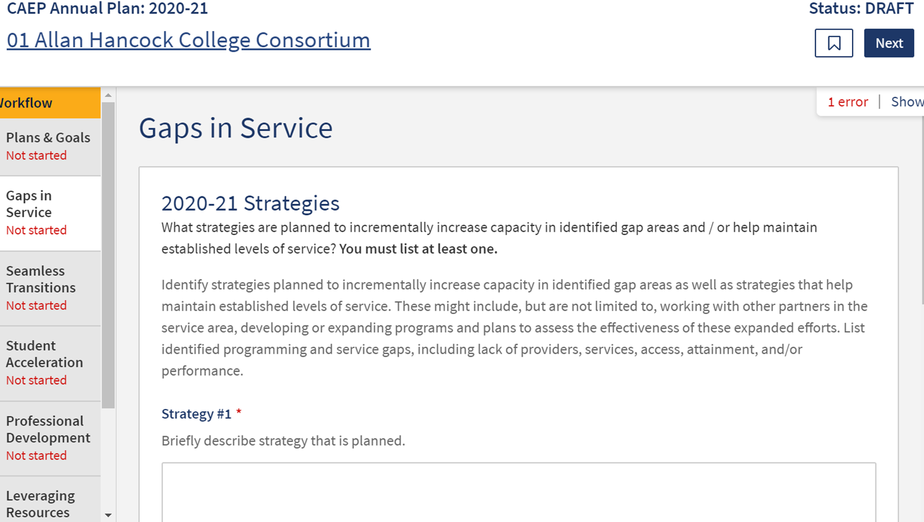
Notes:
S

Slide 20
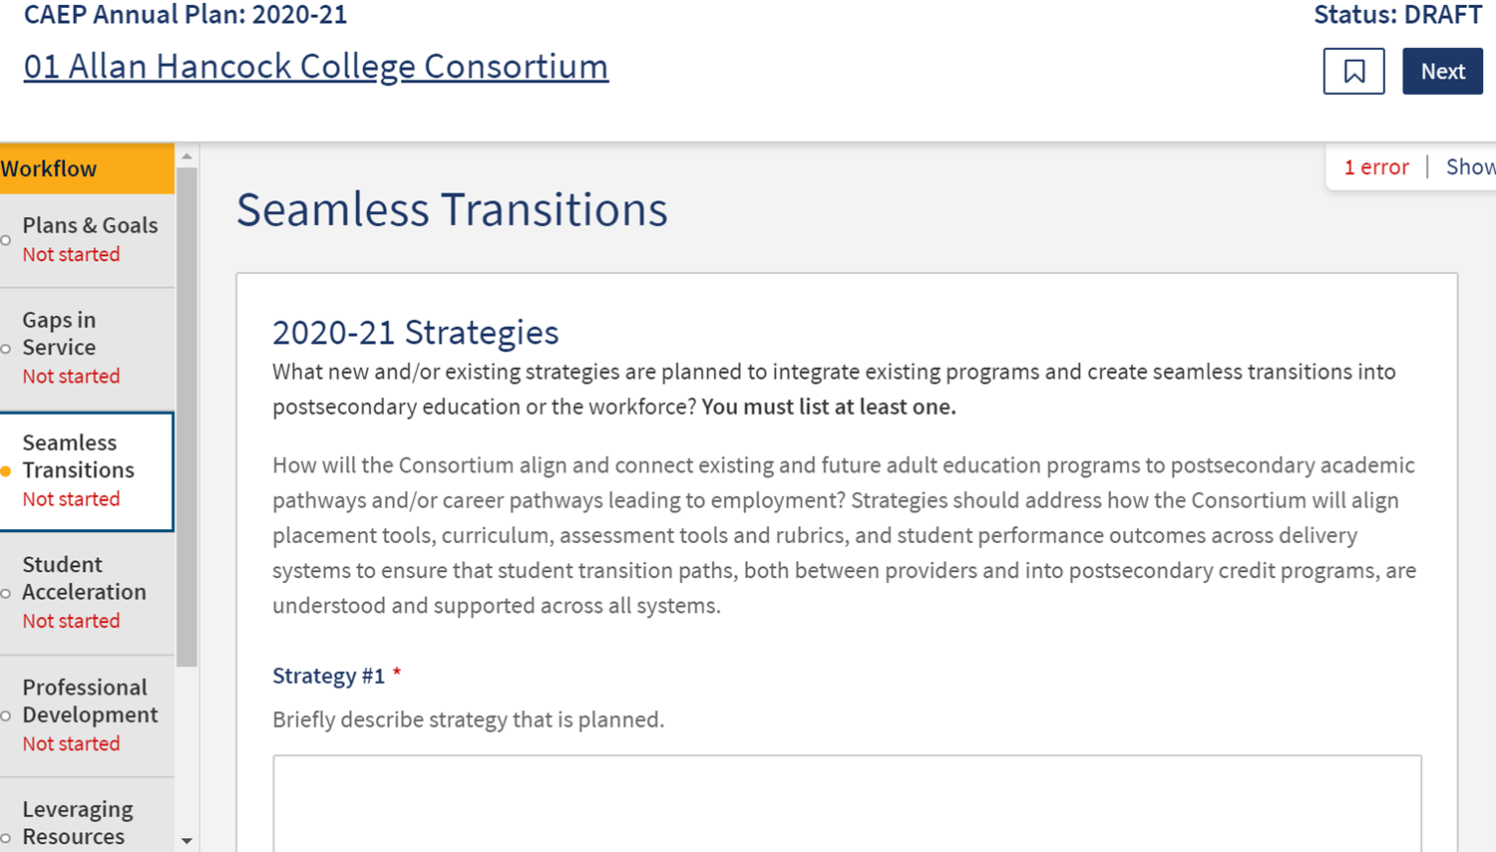
Notes:
S

Slide 21
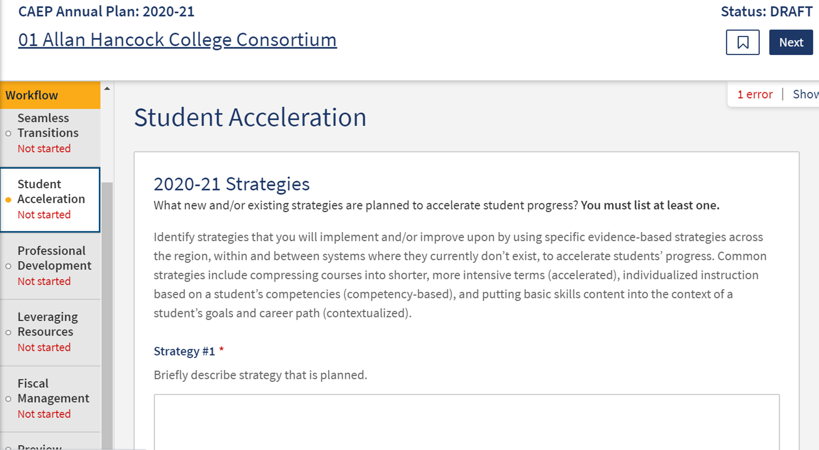
Notes:
S

Slide 22
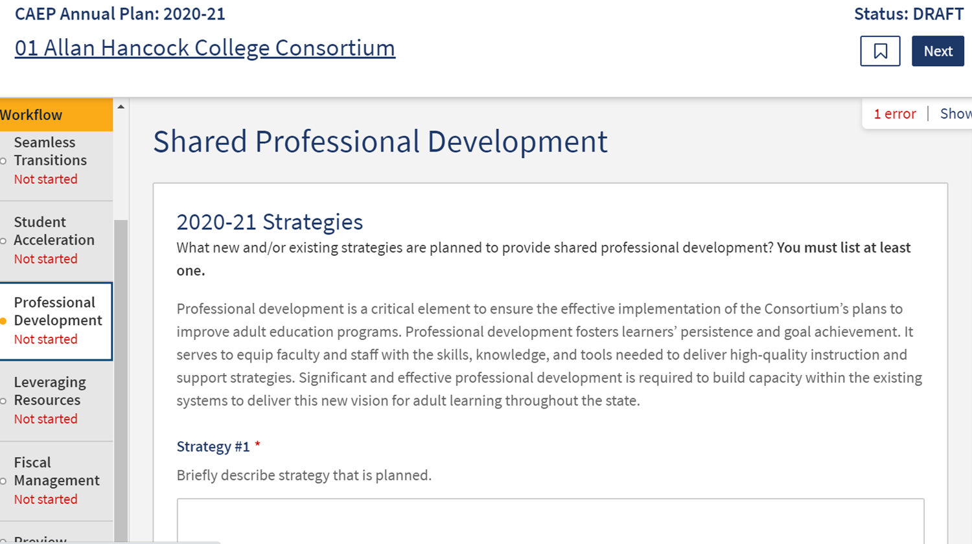
Notes:
S

Slide 23
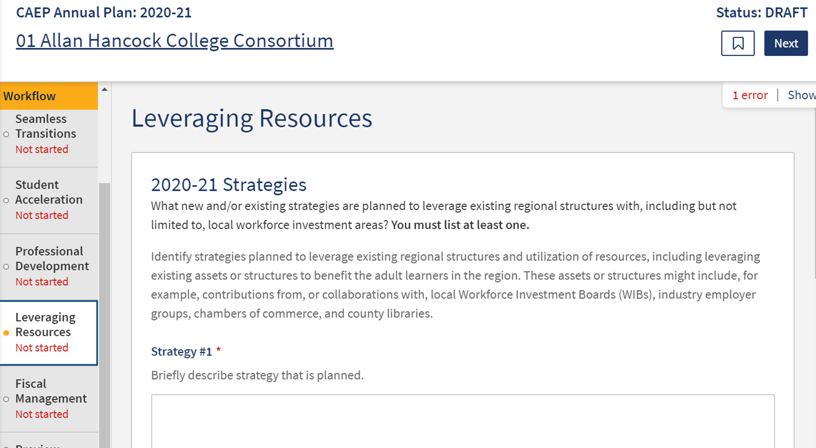
Notes:
S

Slide 24
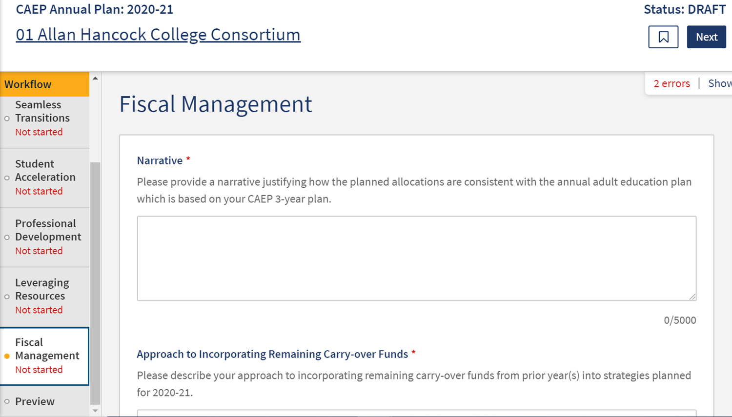
Notes:
S

Slide 25
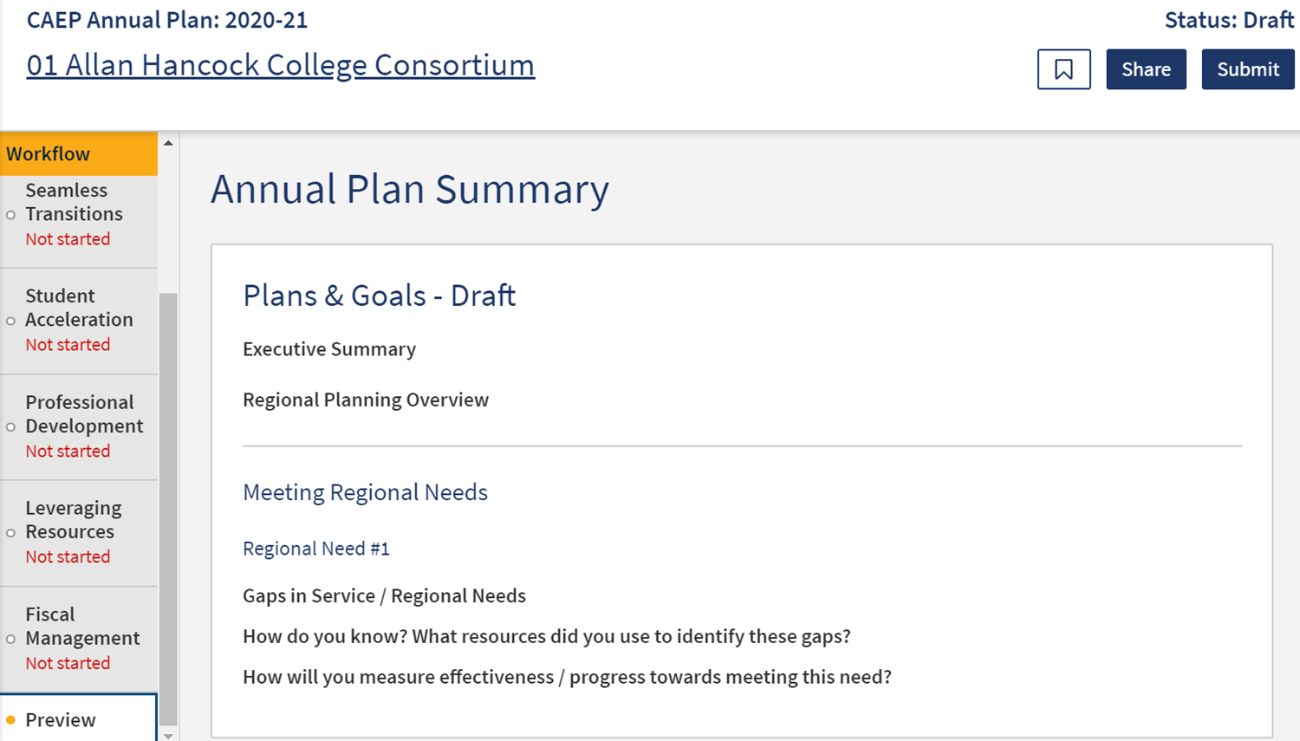
Notes:
S

Slide 26
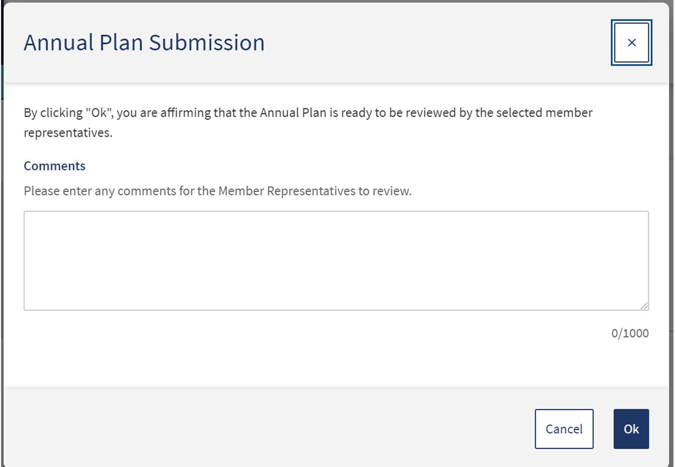
Notes:
S

Slide 27
Fiscal Reporting in NOVA
Notes:
S

Slide 28
Fiscal Reporting
Member budgets are based on work plans and the consortium annual plan.
Prior year carry-over will be included in member budgets & expense reporting.
All members must be up to date on their work plans, budgets & expense reporting in order to move into the next year and/or next quarter.

Slide 29
What’s FIFO?
FIFO = First In, First Out.
CAEP funds are 3 year funds.
State tracks CAEP funds via NOVA.
Member district must also track CAEP funds expenses via their accounting office.
NOVA = 3 year expense reporting.
Local accounting = 1 year expense reporting.

Slide 30
What’s FIFO? (cont.)
Sometimes the NOVA expenses will not match the local district accounting expenses.
Once a Q4 report is certified by the consortium in NOVA – we cannot reopen that year for any changes.
If expenses are missed – reconcile in the next year. It’s 3 year funding.

Slide 31
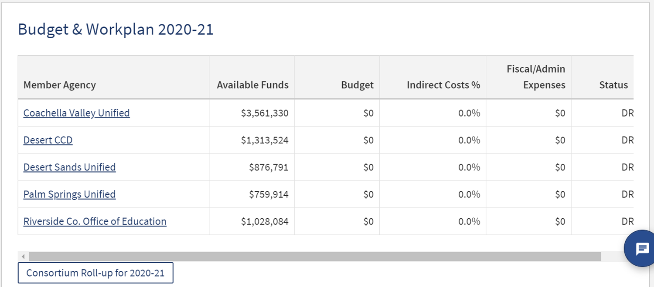

Slide 33
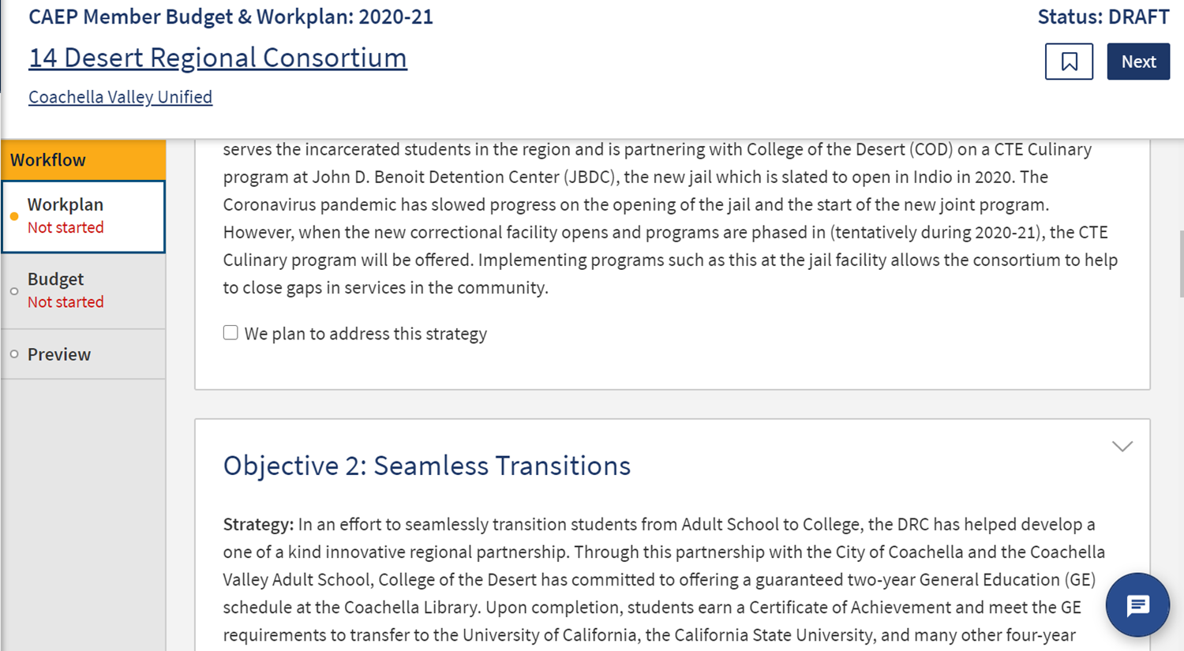

Slide 34
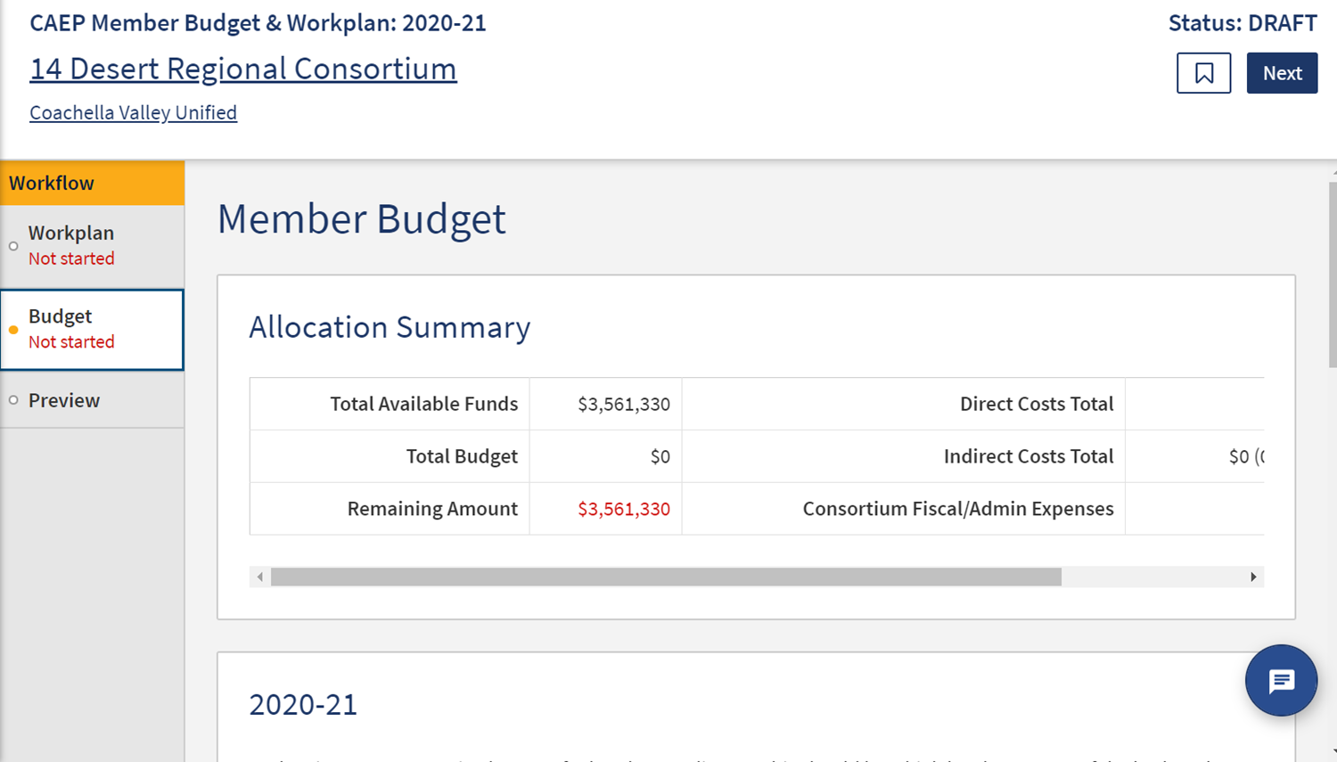

Slide 35
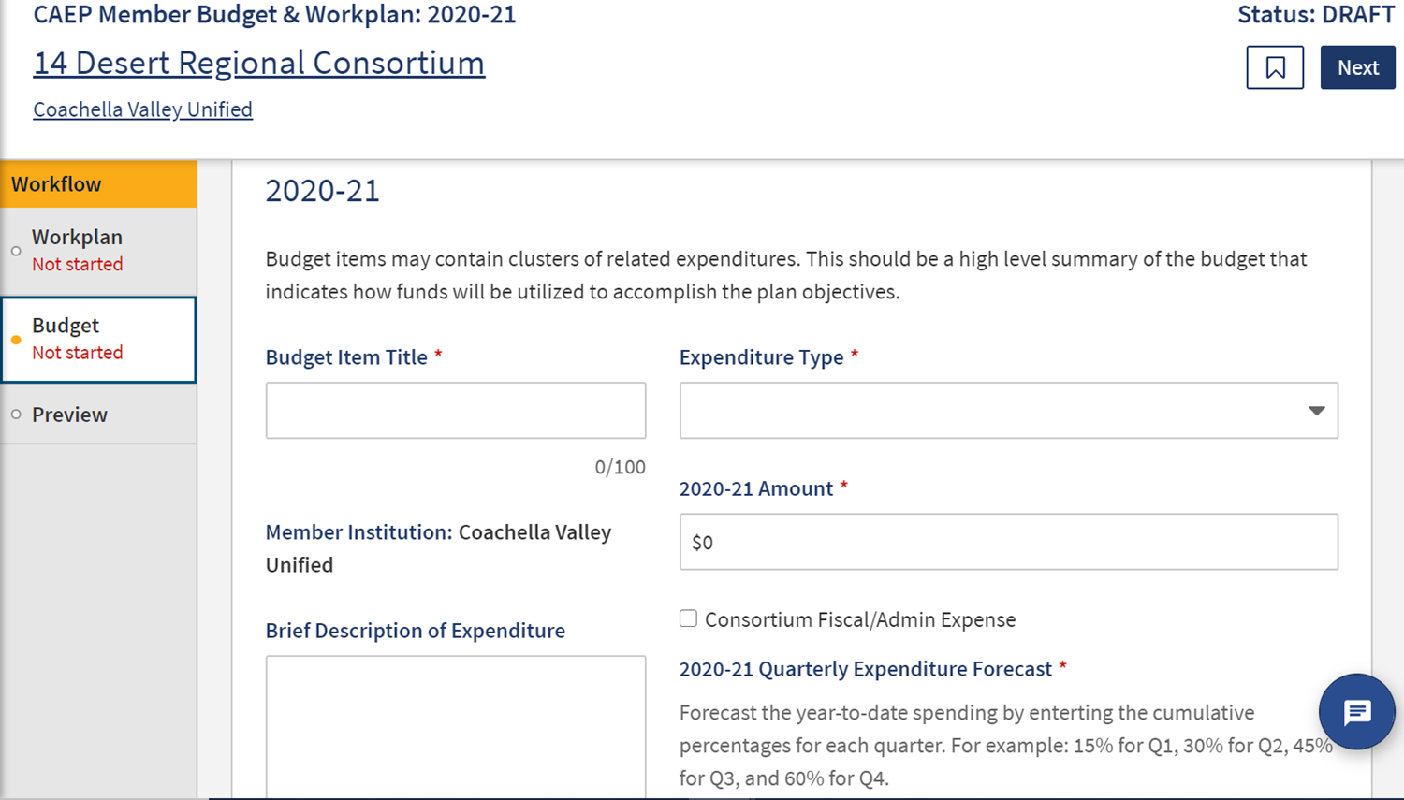

Slide 36
Wrap Up and Questions

Slide 37
Request Support from CAEP TAP

