Slide 1
Data and Accountability for 2020-21 and More
Dr. Carolyn Zachry and Javier Romero, CAEP Office
OTAN, WestEd and CASAS
August 5, 2020

Slide 2
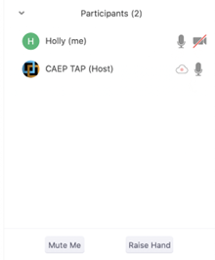

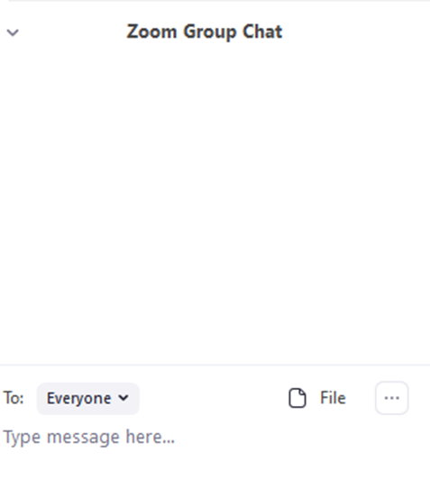


Zoom Room Controls
Everyone has the ability to speak…please raise your hand first
Everyone is muted upon entry
Feel free to communicate via the chat – even share files
You can use your camera…or not

Slide 3

COVID-19’s Effect on Adult Education
CAEP Overview for 2020-21
Distance Learning Strategies
Colleges using MIS Reporting for 2020-21
K12/COEs using TE Reporting for 2020-21
Questions/Answers

Slide 4

COVID-19’s Effect on CAEP Agencies
With most agencies closed for COVID-19, many agencies have quickly adapted to implementing distance learning options.

Slide 5
OCTAE Memorandums
OCTAE has disseminated Memorandum 20-3 (March 27, 2020) 20-4 (April 17, 2020) and 20-5 (May 29, 2020)
https://www2.ed.gov/policy/adulted/guid/memoranda.html
Posted on CASAS Website: https://www.casas.org/social-media-newsroom/2020/03/27/casas-testing-during-the-covid-19-pandemic

Slide 6
OCTAE Memorandums
Summary of OCTAE Memos:
Statewide performance reporting to the NRS is still required
For PY 2019-20 all states reported “Force Majeure”
States can now decide whether or not to allow remote testing
Each state that opts to allow remote testing submits its own remote testing plan to OCTAE
Memo 20-5 (5.29): participants can self-report into a federal EFL (Educational Functioning Level) without a pretest.
Memo 20-5 (5.29): a pretest is still required to achieve a pre/post-test MSG.

Slide 7

PY 2020-21 CAEP Program Structure: 5 Programs
Adult Basic & Secondary Education
English as 2nd Language
Career and Technical Education (CTE)
Adults with Disabilities
Parents/K12 Success

Slide 8
PY 2020-21 CAEP Program Structure
Five CAEP Main Program Areas
  ABE/ASE
  ESL
  CTE
  Adults with Disabilities
  Parents/K12 Student Success

Slide 9
PY 2020-21 CAEP Program Structure:
Primary Programs
Adult Basic & Secondary Education:
Basic Skills (ABE)
HSE (HiSET, GED)
HS Diploma
English as Second Language (ESL/ELL)
Career and Technical Education (CTE)
CTE
Short Term CTE
Pre-Apprenticeship
Workforce Preparation

Slide 10
PY 2020-21 CAEP Program Structure
Basic Education – includes both ABE and ASE
  Basic Skills (ABE)
  High School Equivalency (HSE)
  High School Diploma
CTE –includes three subcategories
  Short Term CTE
  Workforce Preparation
  Pre-apprenticeship

Slide 11
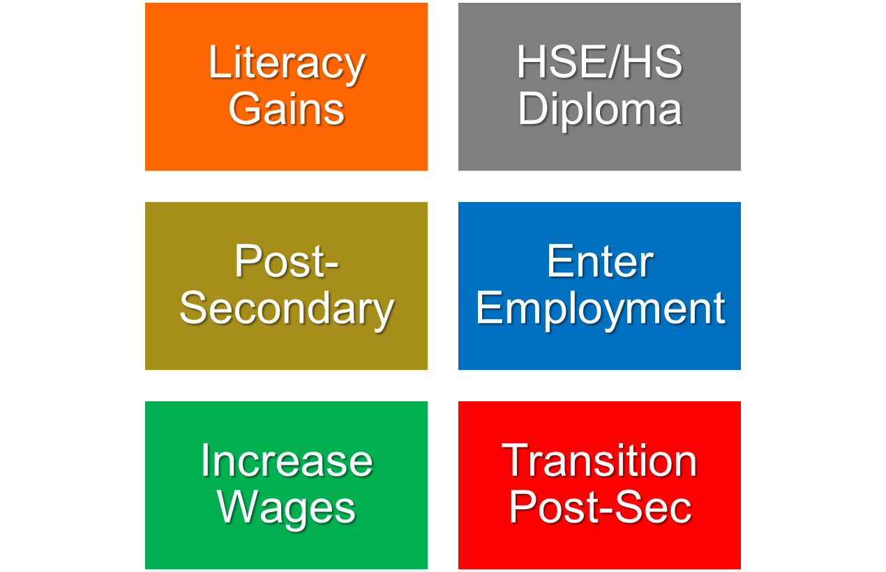
PY 2020-21 CAEP Program Structure:
AB 104 Outcomes

Slide 12
PY 2020-21 CAEP Program Structure
CAEP reports the number of “Adults Served” includes three categories:
  Service only students
  Students receiving 1-11 instructional contact hours
  Participants who received 12 or more instructional contact hours over a single program year.

Slide 13
PY 2020-21 CAEP Program Structure
Enrollment / Instructional Hours
  For K12/COE:
  If a class is identified as integrated, the hours will be divided equally between the programs designated for that record.
  If not integrated, or if the hours are split unevenly – the agency can create two classes, one for each instructional program represented.
  For Colleges: Additional exploration is required to review how colleges are coding such courses.

Slide 14
PY 2020-21 CAEP Program Structure
Enrollment / Instructional Hours
An instructional hour must meet OCTAE guidelines and be associated with an instructional program. Thereby, service hours must not be commingled with instructional hours.
CAEP will not track service hours.
CAEP will only report instructional hours for NOVA program area reporting.

Slide 15
PY 2020-21 CAEP Program Structure
Contact Hours Definition. Hours of instruction or instructional activity that the participant receives from the program. Instructional activity includes any program-sponsored activity designed to promote learning in the program curriculum, such as classroom instruction, assessment, tutoring, or participation in a learning lab. Time spent on assessment can be counted only if the assessment is designed to inform placement decisions, assess progress, or inform instruction. Time used simply to administer tests, such as the GED tests, cannot be counted as instructional activity.
https://www.nrsweb.org/sites/default/files/NRS_TA_Guide.pdf

Slide 16
Distance Education
Distance Learning
Distance Education—Formal learning activity where students and instructors are separated by geography, time, or both, for the majority of the instructional period.
Distance learning materials are delivered through a variety of media, including but not limited to, print, audio recording, videotape, broadcasts, computer software, Web-based programs, and other online technology.
Teachers support distance learners through communication by mail, telephone, e-mail, or online technologies and software.
(Pg. 59 NRS Technical Assistance Guide, https://nrsweb.org/sites/default/files/NRS-TA-Guide82019.pdf )

Slide 17



DL Strategies
Student
Blended and Distance
  Over or under 50%
Clock Time
Teacher Verification
Learner Mastery
IDEAL handbook
NRS Technical Assistance Guide (Page 47)

Slide 18

Resources & Tools
OTAN Website
  COVID-19 Field Support
  Webinars and slides (recorded and future)
  Teaching with Technology resources
  Curriculum Offers
  YouTube and membership
  Social Media ~Twitter, Facebook, and LinkedIn

Slide 19
CAEP MIS Reporting for Colleges (2020-21)

Slide 20


CAEP MIS Reporting for Colleges(2020-21)
MIS Data Collection: College Districts required to collect and enter all required CAEP adult learner student, enrollment, and other data into MIS
Data Uploads: Data uploads 0ccur as part of the colleges regular data upload to COMIS. There is no separate reporting process for college noncredit data.
WIOA Title II Reporting: Colleges receiving WIOA Title II funds must report quarterly through TOPSpro Enterprise as required by CDE
TE Reporting for Non-WIOA II Colleges: Colleges may ALSO use TOPSpro to report students who do not have a record in MIS
Primary Data Source: For every student with an MIS record, MIS is the PRIMARY VALIDATED source for student, course, enrollment, and outcome data

Slide 21
CAEP Reporting Requirements for Colleges(2020-21)
Colleges upload MIS enrollment files approximately 30 days after the end of each term. Applies to both quarters and semesters
These files include all credit and noncredit students at the college
Certain MIS records are not uploaded until the following academic year such as college awards
There are no separate reporting processes or deadlines for college programs to report their data
Colleges should capture all data relevant to their students and ensure it is entered completely into their local MIS system

Slide 22

CAEP Reporting Requirements or Colleges(2019-20)
EDGE CASE!
Not for Credit Courses or Third-Party Providers: Colleges using ‘not for credit’ courses funded by CAEP for adult learners or using third party providers for instruction should have those courses approved as non-credit courses.
Colleges providing services to students not registered for classes or using third party providers for services should enroll those students into the college to create MIS records for them regardless of whether they are taking courses.

Slide 23
Important MIS Elements – Students, Programs and Services
Instructional Programs
Student Identifiers – SB31 (FirstName), SB32 (LastName), SB03 (Birthdate), SB04 (Gender)
CB03 Course-TOP-Code – Identifies course discipline area and if CTE
CB04 Course Credit Status
CB21 Course-Prior-to-College-Level – Req for all math, Eng, ESL courses; Distinguishes ASE/ABE courses
CB22 Course-Noncredit Category – Identifies CAEP Program Areas (must use CB22 and CB03)
CB26 Course-Support-Course-Status
SX04 Enrollment-Grade – Used in calculating certain milestones/progress metrics
SX05 Enrollment-Positive-Attendance-Hours – Must track even if using census for apportionment
Services
SS16 Student-Noncredit-Initial-Orientation-Services
SS17 Student-Noncredit-Initial-Assessment-Services-Placement
SS18 Student-Noncredit-Counseling/Advisement-Services
SS19 Student-Noncredit-Education-Plan
SS20 Student-Noncredit-Success-Other-Services

Slide 24
Student Barriers to Employment
Reportable Individuals who had >1 instructional contact hour or received support services in the selected year are broken up into two categories:
Ever Flagged as having barriers to employment at any time up to and including the selected year:
  Cultural Barriers (SG18)
  English Language Learner (enrolled in ESL)
  Ex-Offender (SG15)
  Foster Youth (SG03)
  Low Income (SG14)
  Low Literacy (SG20)
  Flagged as having barriers to employment ONLY in the selected year:
  Displaced Homemaker (SV05)
  Homeless (SG16)
  Long Term Unemployed (SG17)
  Migrant Farmworker (SV09)
  Seasonal Farmworker (SG19)
  Exhausting TANF within 2 Years (SC18)
  Single Parent (SV04)
  NOTE: Make sure that the flags for the barriers only in the selected year are updated each year since students will need to be flagged in any term of the academic year to be included

Slide 25
MIS Reporting Issues – Educational Functioning Levels
Three ways LaunchBoard AE Pipeline Captures EFL Gains:
CB21 Course Progression: Student progression from a CB21 coded math, English, or ESL course into the next higher level course in the same discipline
SA07 MIS Data Element: Allows college to enter the student EFL level based on pre and post testing using an NRS approved testing instrument (fix for logic check with SA01, enter yyyy when prompted)
TOPSpro Enterprise: AE Pipeline uses EFL data from TE for WIOA Title II colleges using CASAS to report EFL data to CDE

Slide 26
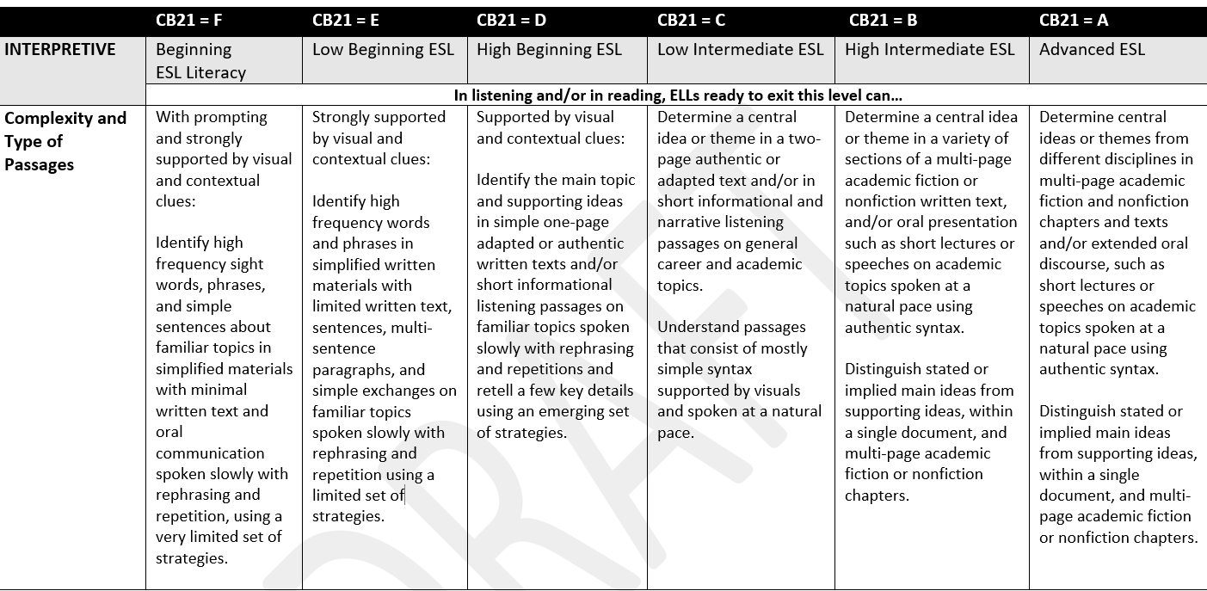
CB21/EFL Alignment

Slide 27
MIS Reporting Issues – Adults Served and Participants
CAEP Reports Data on Two Types of Students:
Adults Served: Any student with 1 or more instructional contact hours in a CAEP program or who receives a service. This roughly corresponds to the WIOA definition of a Reportable Individual)
Participants: Any student who receives 12 or more instructional contact hours of instruction across any CAEP program in the same program year
In order to be captured as either an adult served or a participant the student record must include first name, last name, date of birth, and gender
CASAS CAEP Reports include students with less than 1 instructional contact hour to help agencies vet their local data systems. These reports will not match the adults served counts in the LaunchBoard

Slide 28
MIS Reporting Issues – Special Admit Adult Education Students
SB554 passed by the legislature last year supports dual enrollment and special admit status for adult education students co enrolled in AE and college credit programs. There were two MIS changes associated with this legislation:
SB11- Student Basic Data Elements: Creates a new data flag in SB11 for “Adult Education Special Admit Student” (SB11-21000)
SB15 - Student Enrollment Status: Keeps the student from being identified as a first time student or continuing student to preserve future participation in college promise program (SB15-YYYY)

Slide 29
MIS Reporting Issues – WIOA Title II Colleges
College districts receiving WIOA Title II funding must continue to report complete data about their students into TOPSpro Enterprise
Conversely, college districts receiving WIOA Title II funding must keep complete MIS data records on their students even if they are also reporting using TOPSpro Enterprise for reporting Title II to CDE
The LaunchBoard uses both TE and MIS data to populate data in the LaunchBoard.

Slide 30

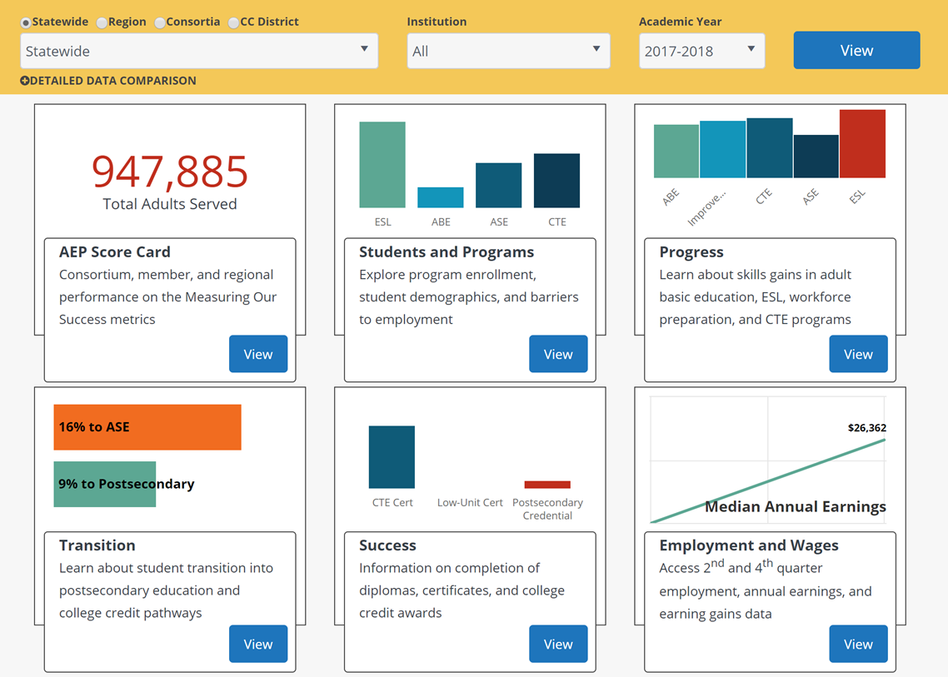
Adult Education Pipeline

Slide 31
CAEP Student Metric Buckets
Participation
Adults Served
Participants
Programs
Progress
EFL Attainment
Workforce Prep
Occup Skills
Transition
ABE/ESL to ASE
Transition to Postsecondary
Completion
Diploma/HSE
Postsecondary Credentials
Employment
Employment
Wage Gains
Living Wage
CAEP Metric Disaggregation
Race/Ethnicity
Gender
Age
Program Area
First Time/Cont

Slide 32
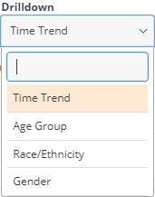
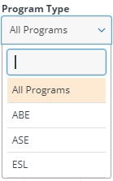
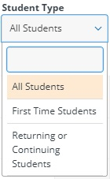

Disaggregations and Drilldowns
Age Group
Race/Ethnicity
Gender
Program (ABE/ASE/ESL/CTE)
First Time/Returning (3.0)
All
Metrics
Some
Metrics
Note: Drilldowns work together. Therefore, a user can see how many first time ASE students or returning ABE females students met the metric outcome

Slide 33
New Metrics and Views in Build 3
Adults served with 1-11 instructional contact hours
Service only students
Participants in Workforce Preparation
First Time Participants (by program area)
Returning or Continuing Participants
Participants taking courses in more than one program area
Participants taking courses at more than one adult school
Subsequently took transfer level math or English
Year to Year Persistence
Community College District view

Slide 34
Data and Metric Alignment
Alignment with CASAS/TE Calculations
  Aligned program, population, and outcome definitions
  Lowered age to include 16 and over for TE and COMIS data
  CASAS/WestEd review of TE calculations to validate AE 3.0 construction
  Decision made NOT align to CAEP definition for Reportable Individuals since students with 0 < 1 program or contact hours are not included unless the student was flagged as receiving services
Alignment with Student Success Metrics
  Alignment of Adult Ed/ESL and Short Term CTE journey metrics with existing CAEP definitions

Slide 35
User Interface & Resource Improvements
  User Interface support enhancements to improve understanding of metrics and calculations
  Better dedicated AE resources to improve reporting & understanding of data processes and usage
Build 4 with 2019/2020 Data – March 1, 2021
Professional Development – 2020-21
  Using LB Data for Program Improvement and Planning
  Noncredit Code Alignment: Improving noncredit program and student coding to improve outcomes
  CB21 and AB705: Creating stronger course sequences to college level courses and programs
  CTE Pathways: Using the adult ed CTE mapping data to improve adult education career outcomes
AE Pipeline
2020-21
Metrics & Data Elements
  Cohort based metrics
  Review data element changes w CO

Slide 36
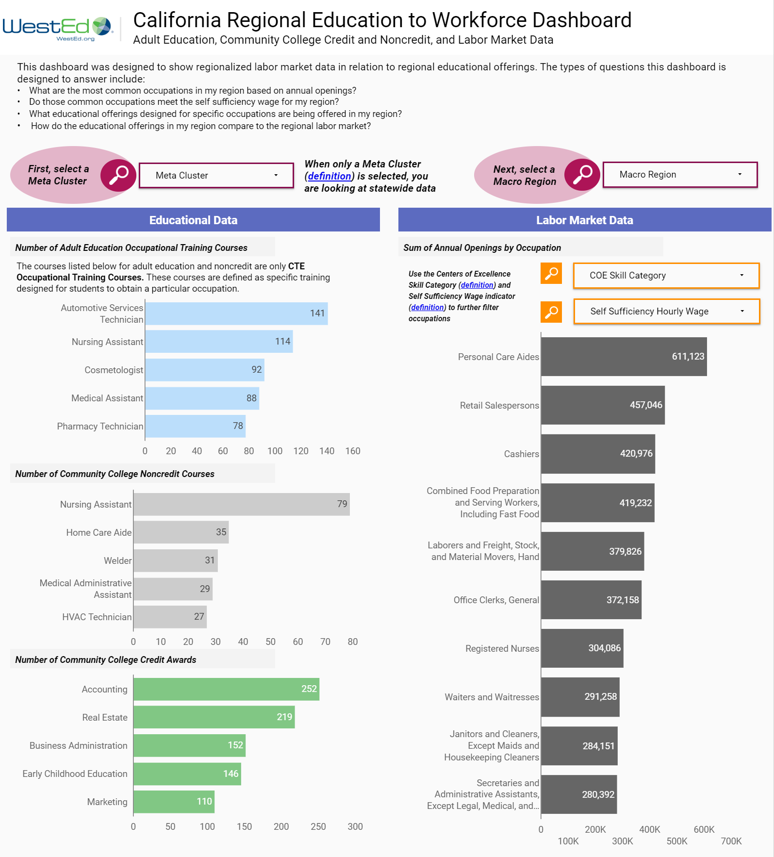
Adult Ed
Education
To Workforce
Dashboard
August 6, 2020
11 am to Noon
Register at
Caladulted.org

Slide 37
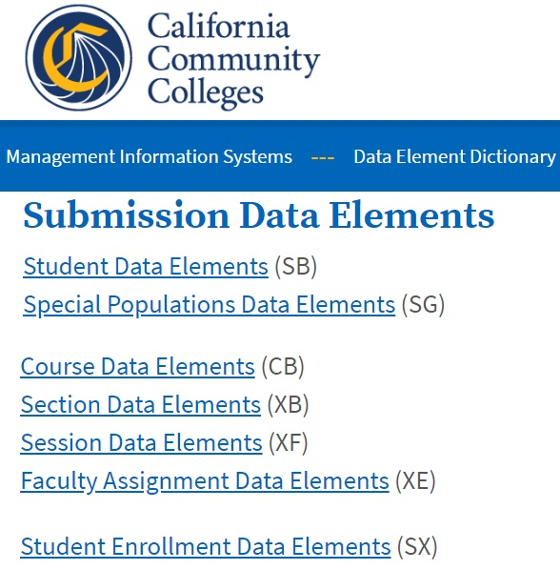
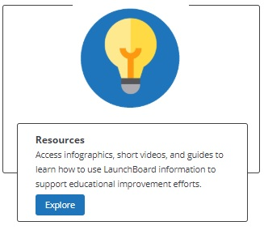
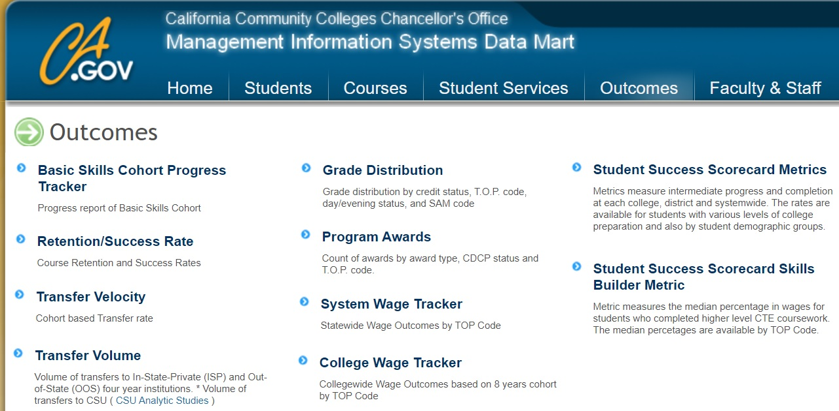

Resources
COMIS Data Element Dictionary (back on the CO website) https://webdata.cccco.edu/ded/ded.htm
California Adult Education https://caladulted.org
Chancellor’s Office Datamart
  https://datamart.cccco.edu/Outcomes/Default.aspx
CASAS https://casas.org
LaunchBoard Resources
  https://launchboard-resources.wested.org/resources?t_id=all
LaunchBoard and Noncredit FAQ Available on LaunchBoard Resources, caladulted.org, and RP listservs

Slide 38
K-12/COE
Reporting for PY 20-21

Slide 39
WIOA Alignment to AB 104
The WIOA Performance Indicators, along with the 5 types of MSG, comprise the framework for the six AB 104 outcomes:
Indicators:
Employment
Wages
MSGs:
Literacy gain
Secondary
Post-Secondary
Training Milestone
Skills Progression
AB 104 Outcomes:
Improved literacy skills
Completion of high school diplomas or their recognized equivalents
Completion of postsecondary
Placement into jobs
Improved wages
Post Secondary Transition

Slide 40
CAEP Outcomes
Literacy Gains
HSE/HS Diploma
Post-Secondary
Enter Employment
Increase Wages
Transition
Pre/Post Level Completion
Carnegie Units /HS Credits
CDCP Certificate
Occupational Skills Gain
Workforce Preparation
High School Diploma
Passed GED
Passed HiSET
Passed TASC
College Degree – AA, AS, BA, BS
Graduate Studies
Training Credential
Occupational Licensure/Certificate
Apprenticeship
Get a Job
Retain a Job
Enter Military
Increase Wages
Get a Better Job
Transition to ASE
Transition to Post-Secondary/CTE
Transition to Post-Secondary/College

Slide 41
Literacy Gains
AEBG Outcome | Recording Method
Pre/Post-Test Gains | Enter pre/post-test results
Carnegie Units | No “bubble” but via self reported level
CDCP Certificate | Mastered course competencies Skills Progression
Occupational Skills Gain | Met Work based Project Training Milestone
Workforce Preparation | Acquired Workforce Readiness

Slide 42
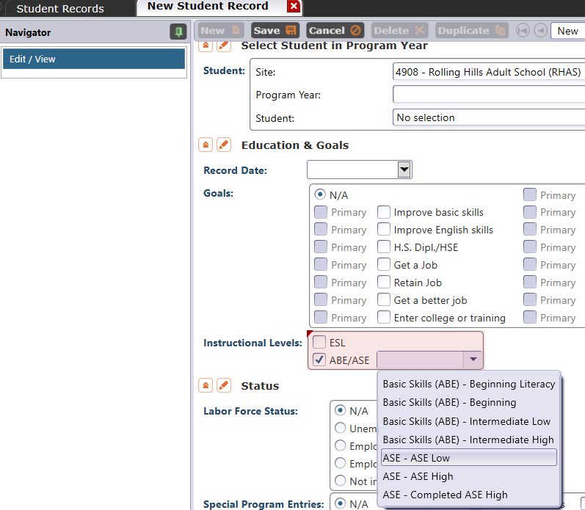
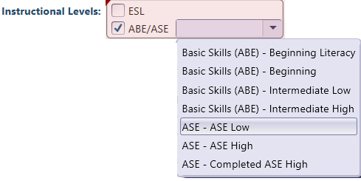
Literacy Gains – HS Credits
In TE, go to Records – Students – Records and refer to Instructional Levels:
Select ASE Low upon enrollment
Select ASE High later in the year once student progresses to the 11th or 12th grade level

Slide 43
Literacy Gains – CTE Related Outcomes
Occupational Skills Gain:
Usually suggests accomplishment of a portion of a longer term program
  For example: a student enrolls in a long term welding program in CTE, which is five semesters/five modules long. The student passes a skills check/written test that indicates the student is ready to finish Module I and enroll in Module II.
Workforce Prep Outcome:
Usually suggests completion of a shorter term program
  For example: a student enrolls and completes a 15 hour instructional module on job search strategies. The student earns documentation such as an informal certificate at the end of the instructional module.

Slide 44
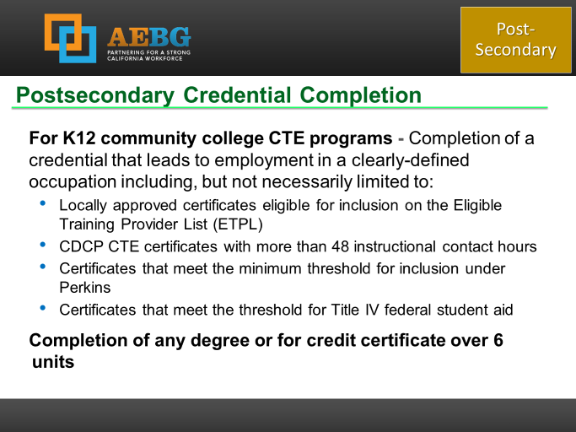
Occupational Outcomes: Post-Secondary vs. Literacy Gains
Post-Secondary:
Attained Credential
Occupational licensure
Occupational certificate
Literacy Gains:
Occupational Skills Gain
Workforce Prep Milestone
Post-Secondary =
Completion of a longer term program
“Literacy Gains” =
Partial completion of a longer term program
Completion of a shorter term program

Slide 45
Passing Knowledge-Based Exam
The Skills Progression MSG has now been replaced by Passage of an Exam.
Learner passes an exam during the year that is required for a job, or that demonstrates progress in attaining technical or occupational skills.
Exam can be a hands on occupational skills demonstration, written test, standardized pre/post-test, or other method of assessment that clearly demonstrates skill progression or attainment.

Slide 46
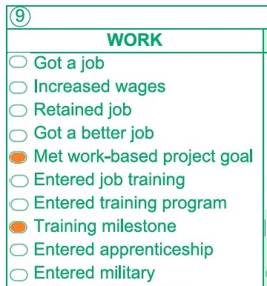
MSG’s for CTE
The Passage of Exam Measurable Skills Gain for WIOA I aligns with the CAEP Occupational Skills Gain.
  When a student achieves an Occupational Skills Gain, that now entails that the student passes an exam such as work skills demonstration

Slide 47
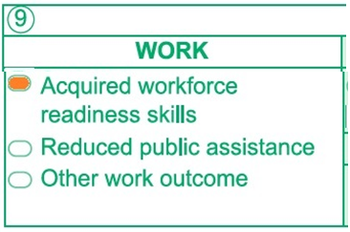
MSG’s for CTE
The Passage of Exam Measurable Skills Gain for WIOA I aligns with the CAEP Workforce Preparation Outcome
  Workforce Preparation Outcome should include some documentation of work skills progression or attainment.

Slide 48
Literacy Gains Outcomes – COVID-19 Update
Mark when CAEP learners achieve outcomes in Distance Learning classes.
Record achievements already attained before closures
Use “passage of exam” process for CTE MSG’s as a guide for recording student achievement.
  Student passes informal exam such as a (virtual) class assessment, written assignment, or oral interview
  Completes skills demonstration in workforce preparation activities
Literacy Gains

Slide 49

Literacy Gains Outcomes– COVID-19 Update
Passes (virtual) class assessment, written assignment, or oral interview
Learner Mastery
Educational Software
Local Program Milestones

Slide 50
Literacy Gains Outcomes– COVID-19 Update
Completes skills demonstration in workforce preparation activities
EL Civics/IET
Transitions
EL Co-Enrollment

Slide 51
Transition
AEBG Title | Update Record
Transition to ASE | No “bubble” but via instructional program
Transition to Post-Secondary/CTE | Entered job training Entered training pgm Entered apprenticeship
Transition to Post-Secondary/College | Enrolled in secondary Transition to credit

Slide 52
Transition
From:
To:
K12 Adult Education
(ABE, ASE, ESL)
K12 Adult Ed CTE
CC CTE
Non Credit CC
(ABE, ASE, ESL)
For Credit CC
Transition to CTE
Transition to for credit

Slide 53
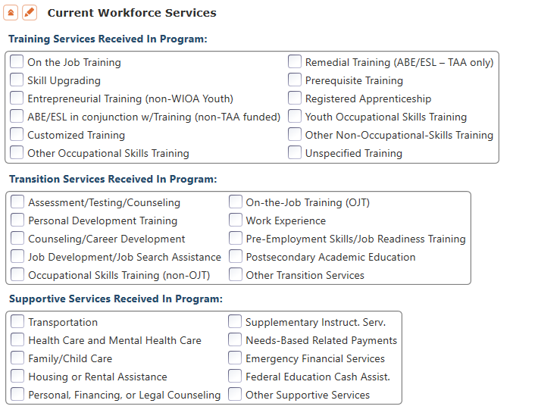
CAEP Short Term Services
Record short term services such as counseling or mentorship that may be received outside of the classroom.
Supportive Services
Training Services
Transition Services

Slide 54
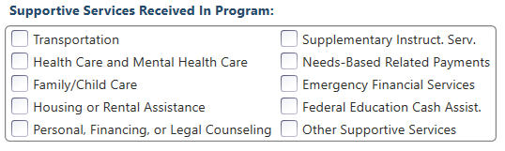
Supportive Services
Services that better enable an individual to participate in adult education activities, or related activities such as WIOA Title I -- such as transportation, child care, dependent care, housing, and personal needs

Slide 55
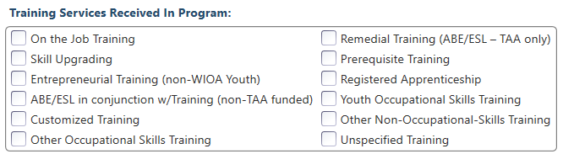
Training Services
Services that help individuals:
Select programs that relate to economic priorities in local planning region
Enroll/meet minimum qualifications for longer term employment and/or employment training programs
Services administered to individuals who have been determined to:
Be unlikely to obtain/retain employment
Be in need of additional services in order to attain economic self-sufficiency/permanent employment
Have skills sufficient to enroll in appropriate training program that provides skills necessary for self-sufficiency

Slide 56
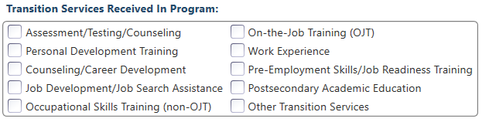
Transition Services
Services that help individuals:
Facilitate successful transition from school to postsecondary life, such as attaining employment, enrolling in college, or accessing designated pre-employment transition services.
Provide opportunities to receive training and other services necessary to achieve competitive employment or postsecondary enrollment

Slide 57
CAEP Short Term Services – COVID-19 Update
Record short term services received outside of the classroom.
Current Examples:
Additional Health Care needs & requirements
Financial services
Services to assist with new software applications
Skill upgrades to work remotely
Job seeking skills

Slide 58
CAEP Short Term Services– COVID-19 Update
Record short term services received outside of the classroom.
Current Examples:
Prerequisite training
Assessment/Testing
Job Readiness Training
Emergency Financial Services
Health Care Services

Slide 59
CAEP Short Term Services
Supportive Services
Transition Services
Training Services
Transportation
Child Care
Personal Counseling
Financial Assistance
Assessment (other than required pre/post)
Academic/Career Counseling
Job Development
Student Orientation
Community Support Training (OSHA, CPR, etc.)
Prerequisite Training

Slide 60
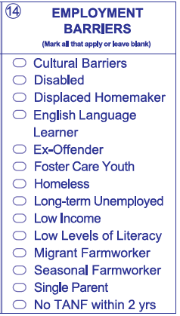
Student Barriers to Employment
Agencies will record barriers to employment for all CAEP students at intake.
CAEP student barriers and their definitions will align with federal WIOA II barriers to employment.
As part of the federal alignment, ABE/ASE and ESL learners will automatically tie into specific barriers
For Workforce Preparation/Workforce Re-Entry – learners are no longer tied to any specific barriers, and no longer tied to 55 + years of age.

Slide 61

Immigrant Integration AB2098

Slide 62
AB 2098 – Immigrant Integration
Consortia may report additional measures for assessing the effectiveness of programs in meeting the needs of immigrant learners seeking integration in civic and community life.
The TE CAEP Summary now has a new column that reports Immigrant Integration Indicators (I³) outcomes.
TE now includes reports that relates EL Civics COAAPs with Immigrant Integration goal areas.

Slide 63
AB 2098 – Immigrant Integration
Key Points About AB 2098:
We already serve this population
WIOA II grantees report EL Civics outcomes
EL Civics effectiveness is shown through these metrics
Most of the data is already there
This is not a mandate

Slide 64
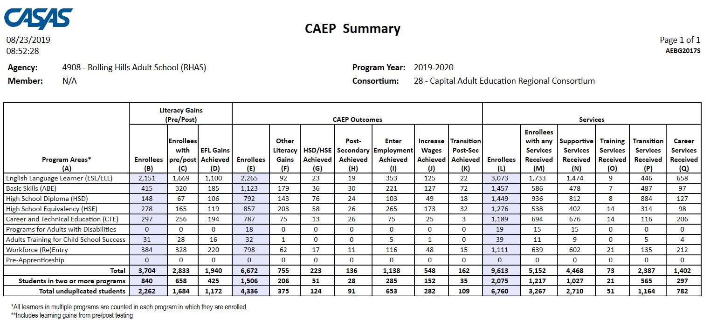
Displays outcomes in three separate sections:
Literacy Gains (Pre/Post) using NRS Table 4 guidelines
Other AB 104 outcomes using WIOA II reporting requirements but not pre/post
Services Received that do not impose WIOA II reporting requirements

Slide 65
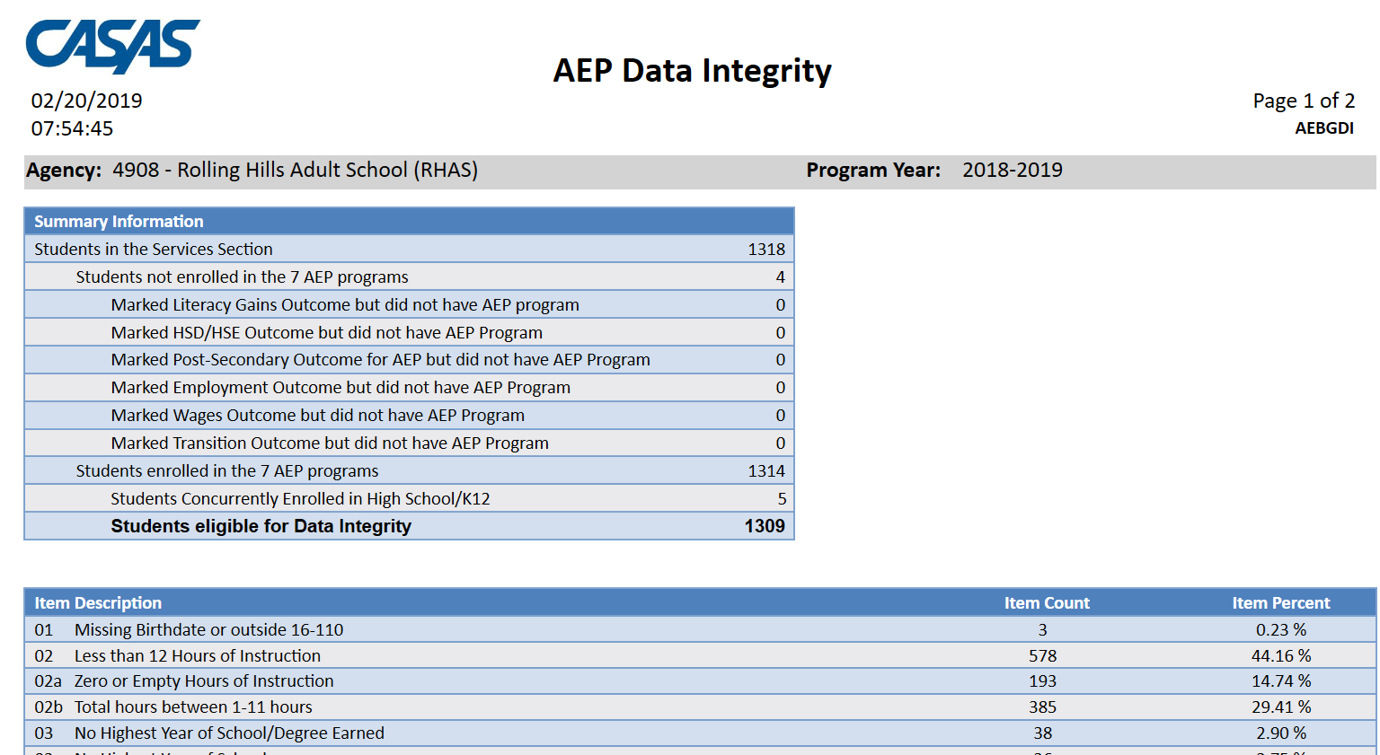
AEP Data Integrity displays 27 different data elements related to the AEP instructional programs and outcomes.
Item Description lists 27 data elements that may prevent or contribute to official AEP outcomes.
The DIR displays the item count and percentage for each listed item.
Item Percent = Item Count ÷ # of Students Enrolled in 7 AEP Programs

Slide 66

Literacy Gains
Employment
Secondary
Wages
Post-Secondary
Transition

Slide 67
In TE go to Records--Students--Records

Slide 68
Updates to Resources and Materials

Slide 69


BOY Letter for PY 2020-21
This letter includes the data submission requirements for all CAEP agencies.
COMING SOON!

Slide 70
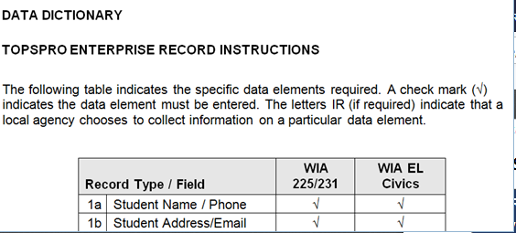
2020-21 CAEP Data Dictionary
Home > Training and Support > CASAS Peer Communities > California Accountability >
A new 2020-21 CAEP Data Dictionary is available on the CASAS Website to help CAEP meet requirements.
20-21 version includes several enhancements and updates.

Slide 71
Data Submission Calendar
CAEP Program Year Reporting
 | Date Range | Reporting Deadline
First Quarter | July 1 – Sept 30 | October 31, 2020
Second Quarter | July 1 – Dec 31 | January 31, 2021
Third Quarter | July 1 – Mar 31 | April 30, 2021
Fourth Quarter-EOY | July 1 – June 30 | August 1, 2021

Slide 72
TE Quarterly Data Submission Wizard
Beginning first quarter of PY 2020-21, agencies will use the TE Quarterly Data Submission Wizard to submit quarterly data, including the Data Integrity Report (DIR).
Agencies will no longer send separate pdf copies of the DIR when completing quarterly data requirements.

Slide 73
CASAS Assessments
Authorized for NRS for 2020-21
ABE and ASE only:
CASAS GOALS Reading and Math
ESL only:
Life and Work Listening
Life and Work Reading
Secondary Level Assessment (SLA):
  Language Arts 513-14
POWER, AA-AAAAA not authorized for NRS, but are authorized for CA reporting

Slide 74


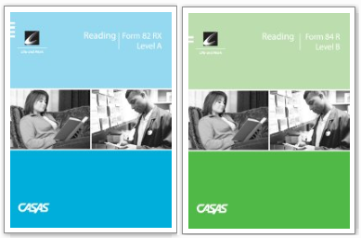

Use of Assessment Modalities
ABE/ASE: Use Reading or Math CASAS GOALS series
ESL: Use Life and Work Reading or Listening

Slide 75
Use of Assessment Modalities
ABE/ASE: Use Reading or Math GOALS series
Pre- and post-test pairs must always be from the same test modality.
If using CASAS GOALS, both the pretest and the post-test must use the same test series. Cannot match GOALS with any other CASAS test series.

Slide 76
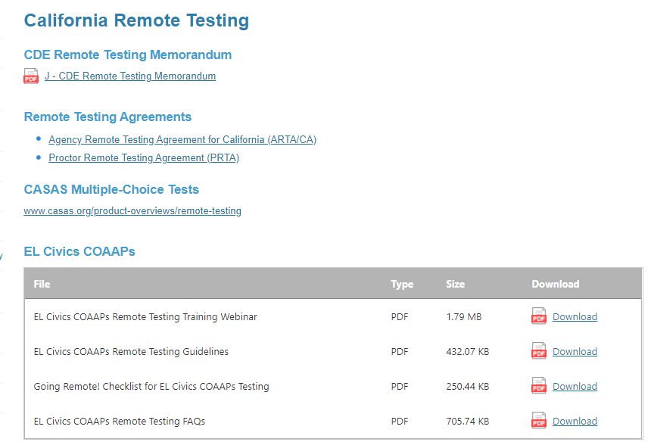
Remote Testing
The CDE has decided to permit California agencies to implement remote testing.
For more information, go to the California Remote Testing page on the CASAS Website:
https://www.casas.org/training-and-support/casas-peer-communities/california-adult-education-accountability-and-assessment/california-remote-testing

Slide 77
CASAS Reading Level Indicator (RLI)
Available at no cost only to eTests/TE users.
Results are shown as “Estimated NRS EFL” for ABE or ESL. No scale scores are given.
It is NOT an NRS-approved test and may NOT be used for pre- or post-testing to achieve MSGs.
The Reading Level Indicator (RLI) is Form 601R.
The RLI will be released in early to mid-August.

Slide 78
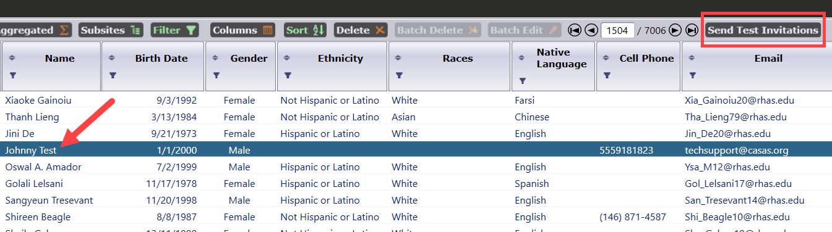
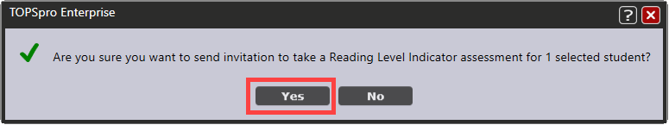
About the CASAS RLI
Initiate the RLI by selecting students in TE’s Student Demographics lister.
Click the Send Test Invitations button.

Slide 79
I3 Reports in TE
TE now includes Immigrant Immigration Indicator (I3) reports that track EL Civics COAAPs outcomes and relate them to Immigrant Integration goals.

Slide 80
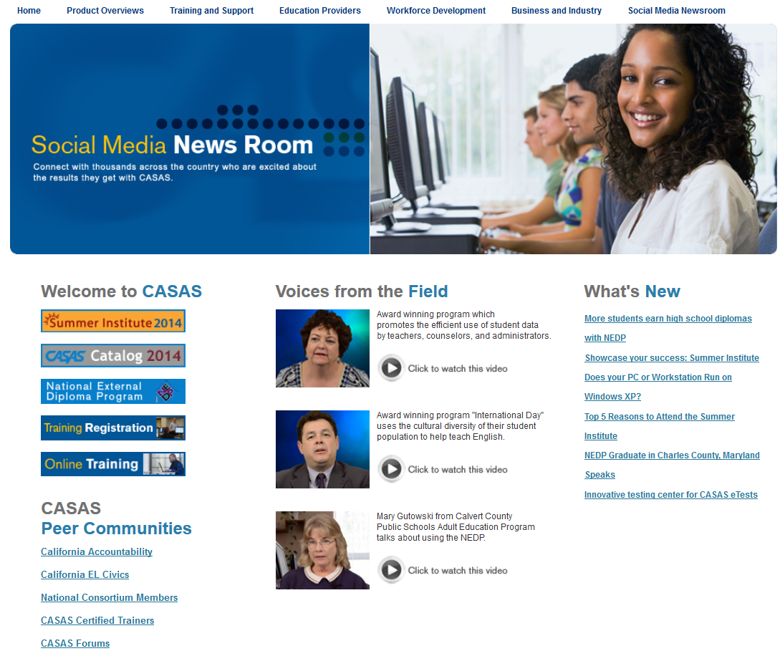

CASAS Web Site
What’s New
Online Registration
California Accountability
AEBG Web page
CASAS Forums
Download Centers
www.casas.org

Slide 81
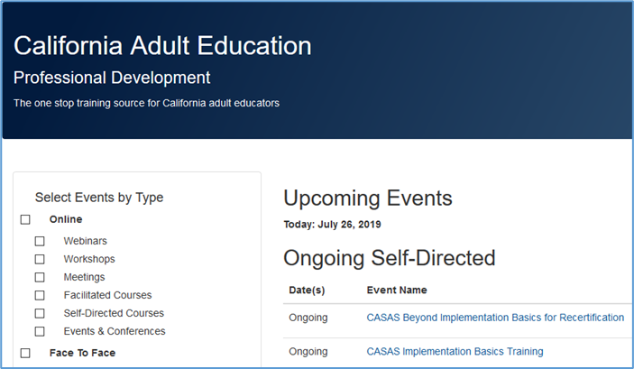
Online Training Registration
Register for all face to face and Web-based trainings on the CAEP TAP Website:
https://www.caadultedtraining.org/

Slide 82
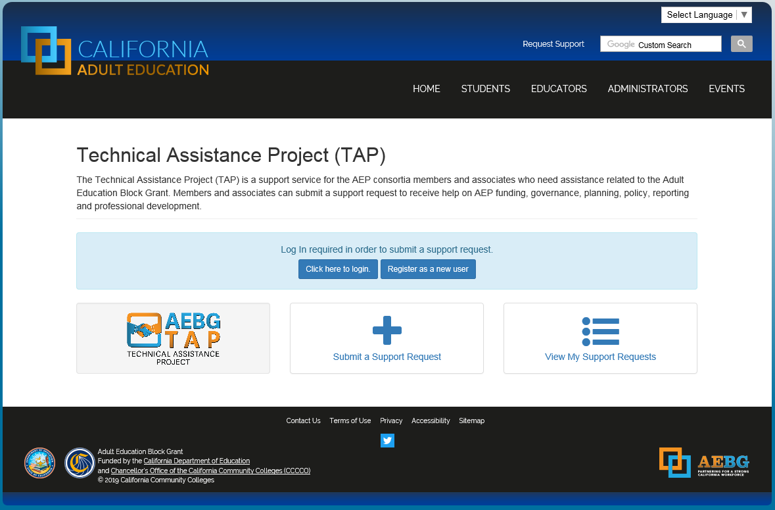
Request Support from CAEP TAP

Slide 83

Wrap Up and Questions

