Slide 1





Avoiding the Road to Nowhere
Mapping Pathways from Adult Education into College and Career
August 6th, 2020
Randy Tillery, WestEd
Project Director, Workforce Development & Postsecondary Education
rtiller@wested.org
Allie Bollella, WestEd
Project Coordinator, Educational Data Systems
abollel@wested.org

Slide 2

Postsecondary Education & Workforce Group
The Postsecondary Education and Workforce Development Group at WestEd strengthens the role of higher education, workforce, and economic development programs to improve student access and outcomes in higher education and increases economic mobility for low income families and communities.

Slide 3
Some of Our Lines of Work
Leading intersegmental planning with colleges, K12, adult education, and workforce development
Development of data tools for continuous improvement in postsecondary education and workforce development
Assisting colleges on implementation of Guided Pathways and systems that increase student equity and outcomes
Leading conversations on the use of data to increase educational success and economic mobility

Slide 4
Today
CA Adult Education Program Outcomes
CAEP Pathways Mapping Project
Purpose, methodology, structure
Education to Career Data Tool
Live Demonstration of Data Tool

Slide 5
California Adult Education Program
897,325 K12/NC Adult Learners
71 Consortia Colleges & K12 Schools
CAEP, WIOA, Perkins, Noncredit
Dept of Ed & Chancellors Office
Outcomes (AB104, 2015)
Adults Served by Consortia
Improved Literacy Skills
Completion of High School Diploma or Equivalent
Completion of postsecondary certificates, degrees, or training programs
Employment
Wage Increases
Transition into Postsecondary Education
Notes:
Adult Education students include K12 adult education and college noncredit students.

Slide 6
CAEP CTE Mapping Project - Purpose
Understand the continuum of courses offered by adult education and noncredit practitioners
Look at the relationship between adult education and credit programs and regional labor markets
Support local pathway development for consortia and conversations about how to better track pathway data for CAEP students

Slide 7


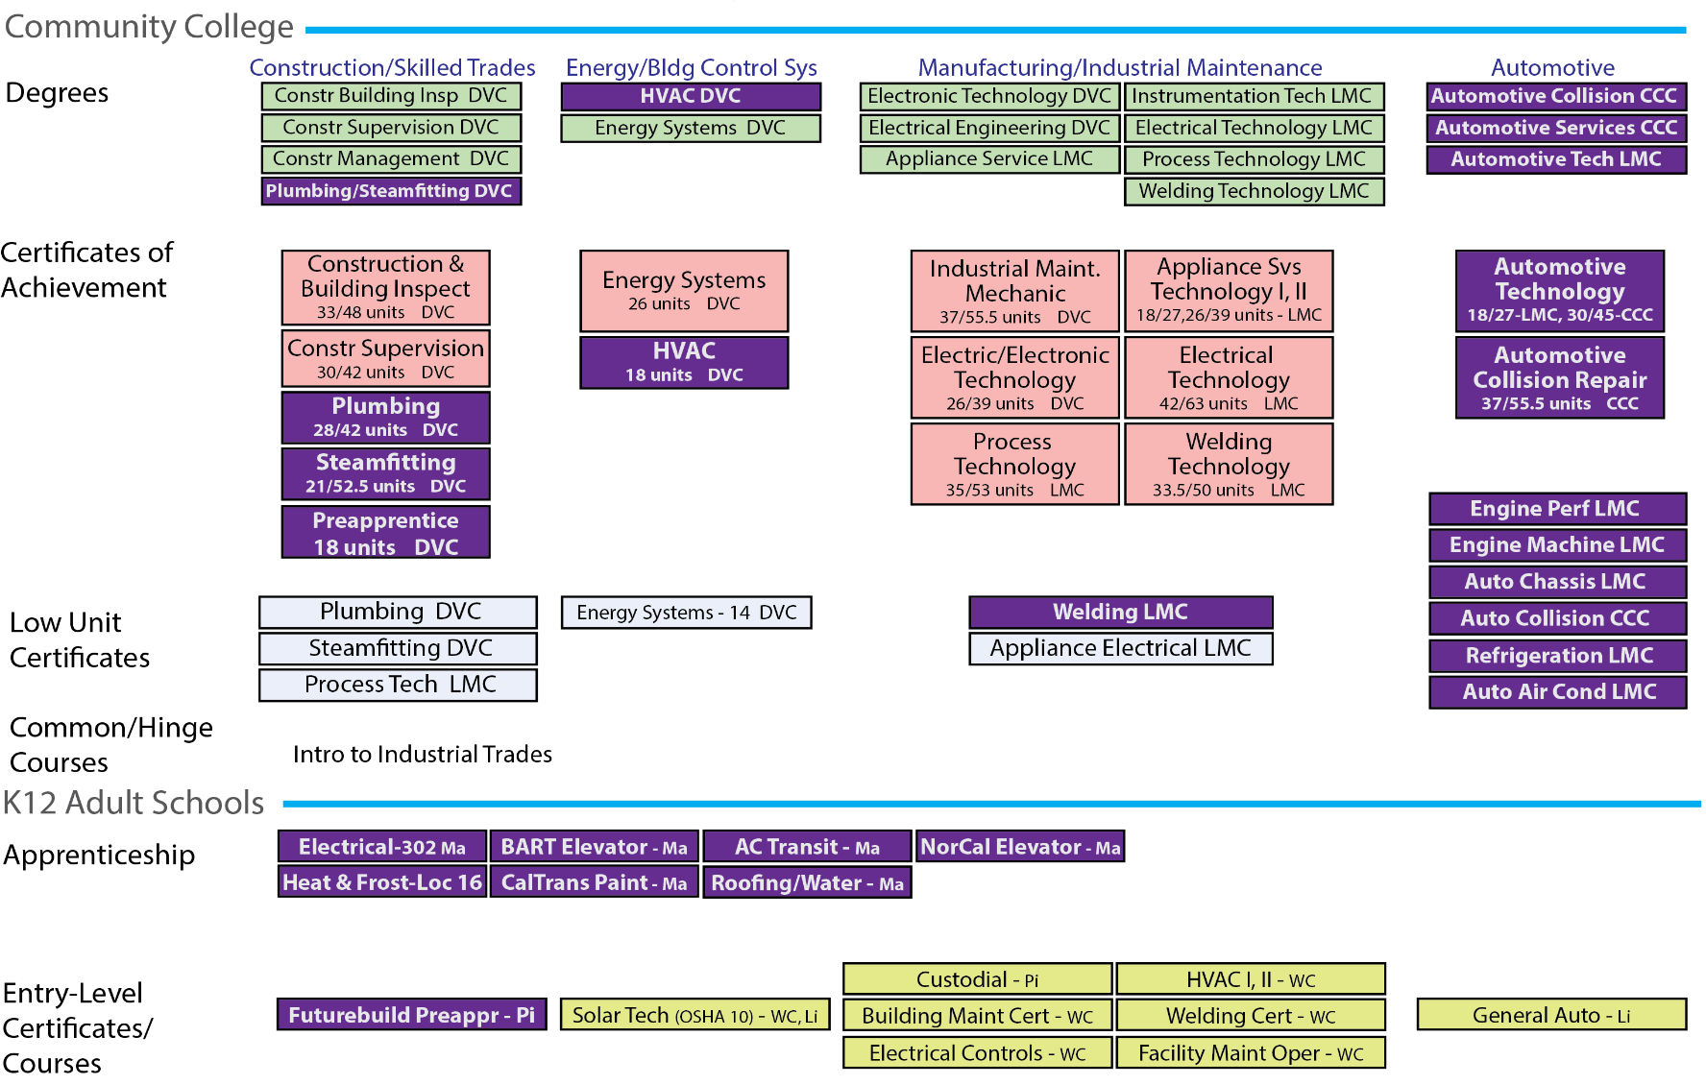



Industrial Trades Offerings
What we Offer
Mapping Offerings that can inform local pathway and curriculum development

Slide 8
Methodology
Develop a data structure for coding CTE courses
Gathered K12 adult course catalogues and scraped data about courses, certificates and programs of study
Downloaded college noncredit information from CO Curriculum Inventory and employment data using EMSI
Analysis and organization of the data into infographics and visualizations
Conduct snapshot vetting interviews with a limited number of practitioners – 14 interviews were conducted (2 per region)
Development of reports and data tools

Slide 9
Field Structure
Notes:
Note that alignment with Community Colleges as well as Certifications and Apprenticeships have limited data.

Slide 10
Scope and scale
Scanned 521 institutions including every CAEP consortium member & additional community providers relevant to the study
225 agencies providing CTE and Workforce Preparation Courses
Over 7000 course offerings by community college noncredit, Adult Ed K12, and select other agencies (ROP’s, CBO’s)

Slide 11
Organization: Course Types
Adult Education Course Type Categorization Methodology
Categorized into SOC and Meta Clusters | Occupational Training | Teaching towards an identified occupation, certificate, state licensure. Often includes work-based learning. Higher level of instructional hours (150+). Course description notes preparing students for a specific occupation.
 | Occupational Skills Builder | May include a certificate in a specific skill or a certificate of completion (i.e. Adobe Professional Certificate). Generally intermediate level of instructional hours (10-150). Includes recertification for professional occupations (i.e. CNA recertification) or refresher courses. Geared towards an industry but not necessarily an occupation Course description notes occupational title of currently employed candidates who may want these skills.
 | Career Exploration | Does not include required introductory courses as part of a required occupational program. Course description notes exploring or introducing a particular industry. Generally low level of instructional hours (5-40)
Stand Alone | Workforce Preparation | Basic skills unrelated to a specific industry or occupation (i.e. keyboarding). Basic soft skills unrelated to a specific industry or occupation (i.e. Communicating in the workplace). Basic certificates per WIOA II guidelines (i.e. ServSafe, OSHA). Generally low level of instructional hours (5-40).

Slide 12
Organization – Occupational Clusters

Slide 13
Summary AE Data –
Occupational Training and
Occupational Support Courses

Slide 14
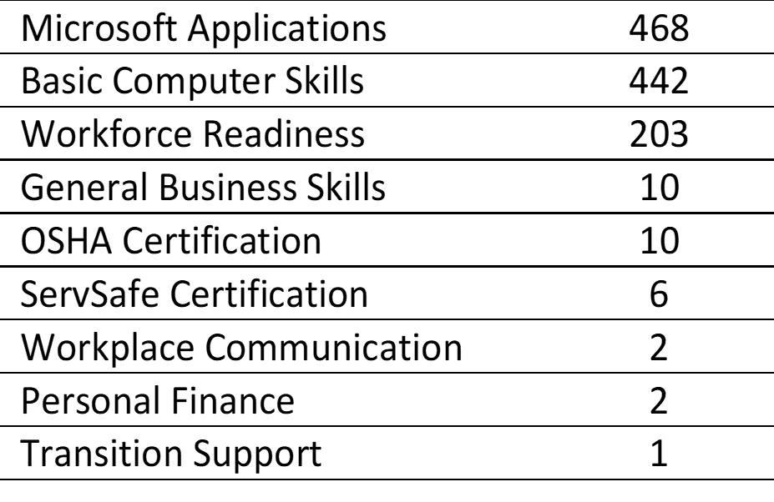
Summary AE Data –
Workforce Preparation
Courses
Course Type
Number

Slide 15
Summary Adult Education Data – Career Exploration

Slide 16
Comparison Sets and Grain Size:
After organization into course types and clusters, data was organized into cluster groupings with comparison data sets to support alignment conversations
K12 Adult Education CTE Offerings
Noncredit CTE offerings
Community College CTE Offerings
Occupations based on educational level – middle skill, below middle skill, above middle skill, no skill required
Segmentation of data into statewide and regional views

Slide 17
Statewide Meta-
Cluster Summaries

Slide 18
Statewide Meta- Cluster Summaries

Slide 19
Statewide Meta-Cluster Summaries

Slide 20
Statewide
Meta-
Cluster
Summaries

Slide 21
Statewide Meta-Cluster Summaries

Slide 22
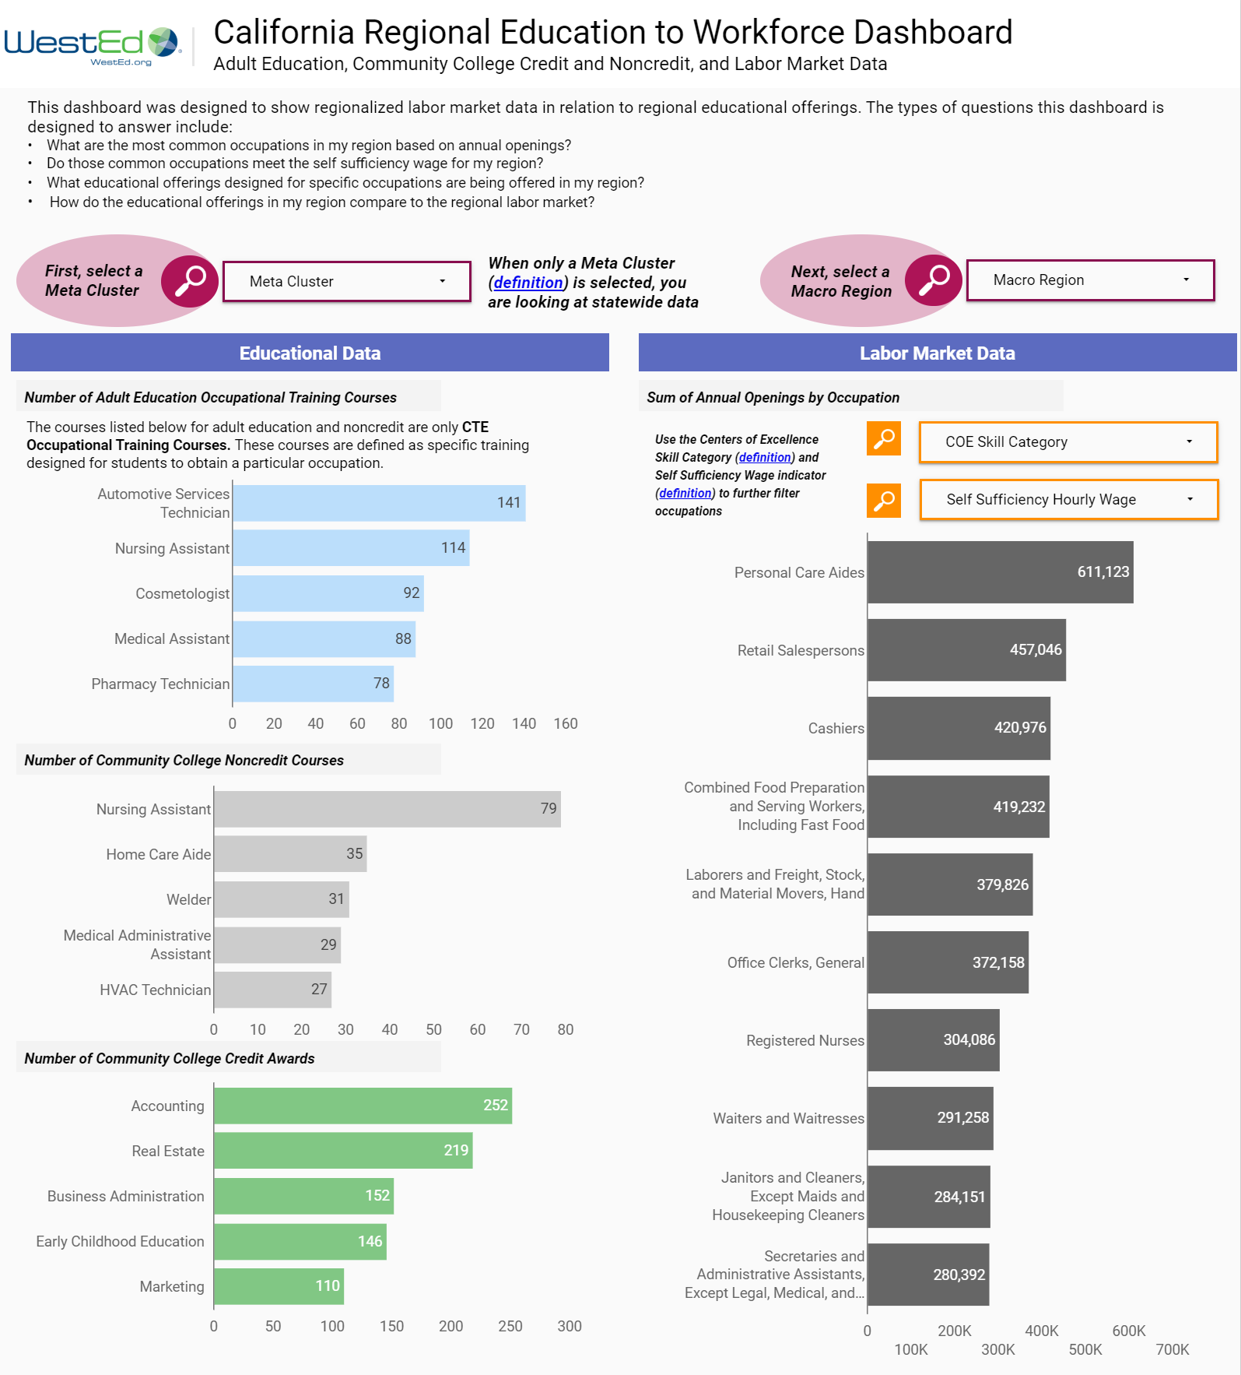
Adult Ed
Education
To Workforce
Dashboard
Dashboard: https://bit.ly/CAEPcourses
Public Data Set:
https://wested.box.com/v/201920AECourses
Notes:
Dashboard: https://bit.ly/CAEPcourses
Public Data Set: https://wested.box.com/v/201920AECourses

Slide 23
Live Demo

Slide 24
Next Steps
Complete summary report for release
State level professional development and release of the data and tools for use by researchers and practitioners
Ongoing engagement with practitioners to refine the tool and update the underlying dataset
Exploration of how to improve data collection to embed pathway and alignment data into the LaunchBoard AE Pipeline.

