Slide 1
CAEP Accountability Basics 2020-21
COVID-19’s Effect on Adult Education
CAEP Programs Overview for 2020-21
CAEP Alignment to WIOA Title II
Outcomes and Services
Distance Learning Strategies
Questions/Answers
Notes:
Carolyn

Slide 2
COVID-19’s Effect on CA WIOA II Agencies
With most agencies closed for COVID-19, many agencies are quickly adapting to implementing distance learning options.
Below is a resource page that provides help to agencies responding to COVID-19
https://otan.us/resources/covid-19-field-support/
Here is a link to a set of FAQ’s
https://otan.us/media/h2saiwpj/faqs-031820.pdf

Slide 3

OCTAE Memorandums
OCTAE has disseminated Memorandum 20-3 (March 27, 2020) 20-4 (April 17, 2020) and 20-5 (May 29, 2020)
https://www2.ed.gov/policy/adulted/guid/memoranda.html
Posted on CASAS Website: https://www.casas.org/social-media-newsroom/2020/03/27/casas-testing-during-the-covid-19-pandemic
Notes:
Carolyn

Slide 4
OCTAE Memorandums
Summary of OCTAE Memos:
Statewide performance reporting to the NRS is still required
For PY 2019-20 all states reported “Force Majeure”
States can now decide whether or not to allow remote testing
Each state that opts to allow remote testing submits its own remote testing plan to OCTAE
Memo 20-5 (5.29): participants can self-report into a federal EFL (Educational Functioning Level) without a pretest.
Memo 20-5 (5.29): a pretest is still required to achieve a pre/post-test MSG.
Notes:
Carolyn

Slide 5

Evolution of CAEP Program Structure
AEBG Program Areas
Five Main CAEP Program Areas
  ABE/ASE
  ESL
  CTE
  Adults with Disabilities
  Parents/K12 Success
  Pre-Apprenticeship
  Workforce Re-Entry
  ABE/ASE
  ESL
  CTE
  Adults with Disabilities
  Parents/K12 Student Success
Notes:
Carolyn

Slide 6
PY 2020-21 CAEP Program Structure
Basic Education – includes both ABE and ASE
  Basic Skills (ABE)
  High School Equivalency (HSE)
  High School Diploma
CTE –includes three subcategories
  Short Term CTE
  Workforce Preparation
  Pre-apprenticeship
Notes:
Javier

Slide 7
PY 2020-21 CAEP Program Structure: 5 Programs
Adult Basic & Secondary Education
English as 2nd Language
Career and Technical Education (CTE)
Adults with Disabilities
Parents/K12 Success
Notes:
Carolyn

Slide 8
PY 2020-21 CAEP Program Structure:
Primary Programs
Adult Basic & Secondary Education:
Basic Skills (ABE)
HSE (HiSET, GED)
HS Diploma
English as Second Language (ESL/ELL)
Career and Technical Education (CTE)
CTE
Short Term CTE
Pre-Apprenticeship
Workforce Preparation
Notes:
Javier

Slide 9
PY 2020-21 CAEP Program Structure:
Primary Programs
Adult Basic & Secondary Education:
Basic Skills (ABE)
HSE (HiSET, GED)
HS Diploma
Notes:
Javier

Slide 10
PY 2020-21 CAEP Program Structure:
Primary Programs
English as Second Language (ESL/ELL)
Notes:
Javier

Slide 11
PY 2020-21 CAEP Program Structure:
Primary Programs
Career and Technical Education (CTE)
CTE
Short Term CTE
Pre-Apprenticeship
Workforce Preparation
Notes:
Javier

Slide 12
PY 2020-21 CAEP Program Structure:
Primary Programs
In PY 2019-20, Pre-Apprenticeship and Workforce Preparation were moved under the Career and Technical Education (CTE) umbrella.
Workforce Re-Entry became Workforce Preparation.
Career and Technical Education (CTE)
CTE
Short Term CTE
Pre-Apprenticeship
Workforce Preparation
Notes:
Javier

Slide 13
Workforce Preparation
Program providing short term workforce skills to populations with barriers to economic success.
There are no specific hours requirements for Workforce Preparation – however Workforce Preparation classes are typically short term and focus on general workplace skills rather than a specific occupation (like CTE.)
Notes:
Javier

Slide 14
Workforce Preparation
Program providing short term workforce skills to populations with barriers to economic success.
There are no longer any age or barriers to employment requirements for this CAEP program.
Workforce Preparation can focus on a specific learning population, but can also be open to anyone.
Notes:
Javier

Slide 15
Pre-Apprenticeship
  Approved training and curriculum based on industry standards and approved by a documented registered apprenticeship partner
  Recruitment, educational, and pre-vocational strategies that prepare under-represented, disadvantaged, or low-income individuals to meet the entry requirements of one or more registered apprenticeship programs
  Meaningful hands-on training that does not displace existing paid employees
Formal direct entry or articulation agreements with its registered apprenticeship partners
Notes:
Javier

Slide 16
Breakdown of CAEP Programs Under CTE
Career and Technical Education (CTE)
CTE – Long term/occupation specific
Short Term CTE – short term/occupation specific
Pre-Apprenticeship – Long term/occupation specific
Workforce Preparation – Short term/not occupation specific

Slide 17
Adults with Disabilities
Mark instructional program = Adults with Disabilities if the participant is enrolled in a specialized program designed specifically for adults with intellectual/ developmental disabilities.
For participants with disabilities who are enrolling in other adult education programs, mark “Disabled” under Barriers to Employment in combination with the appropriate instructional program.
Notes:
Javier

Slide 18
Adults with Disabilities
  For learners with developmental/intellectual disabilities, agencies can use the AA-AAAAA Adult Life Skills series or the POWER performance based assessment to measure pre/post gains for intellectual disabilities.
  For students with learning and physical disabilities, agencies can use any approved assessment and provide approved testing accommodations.
Notes:
Javier

Slide 19
Parents Supporting Students in K12 Success
  Providing education and training to adults, typically parents and-or community members, to help school-aged children succeed in school.
  Mark “Adults supporting K12 student success”
Notes:
Javier

Slide 20
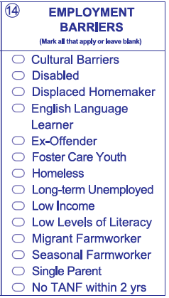
Student Barriers to Employment
Agencies will record barriers to employment for all CAEP students at intake.
CAEP student barriers and their definitions will align with federal WIOA II barriers to employment.
As part of the federal alignment, ABE/ASE and ESL learners will automatically tie into specific barriers
For Workforce Preparation/Workforce Re-Entry – learners are no longer tied to any specific barriers, and no longer tied to 55 + years of age.
Notes:
CASAS

Slide 21
PY 2020-21 CAEP Program Structure
Enrollment / Instructional Hours
  If a class is identified as integrated, the hours will be divided equally between the programs designated for that record.
  If not integrated, or if the hours are split unevenly – the agency can create two classes, one for each instructional program represented.
Notes:
Javier

Slide 22
PY 2020-21 CAEP Program Structure
Enrollment / Instructional Hours
An instructional hour must meet OCTAE guidelines and be associated with an instructional program. Thereby, service hours must not be commingled with instructional hours.
CAEP will not track service hours.
CAEP will only report instructional hours for NOVA program area reporting.
Notes:
Javier

Slide 23
PY 2020-21 CAEP Program Structure
Contact Hours Definition. Hours of instruction or instructional activity that the participant receives from the program. Instructional activity includes any program-sponsored activity designed to promote learning in the program curriculum, such as classroom instruction, assessment, tutoring, or participation in a learning lab. Time spent on assessment can be counted only if the assessment is designed to inform placement decisions, assess progress, or inform instruction. Time used simply to administer tests, such as the GED tests, cannot be counted as instructional activity.
https://www.nrsweb.org/sites/default/files/NRS_TA_Guide.pdf
Notes:
Javier

Slide 24
Distance Education
Distance Learning
Distance Education—Formal learning activity where students and instructors are separated by geography, time, or both, for the majority of the instructional period.
Distance learning materials are delivered through a variety of media, including but not limited to, print, audio recording, videotape, broadcasts, computer software, Web-based programs, and other online technology.
Teachers support distance learners through communication by mail, telephone, e-mail, or online technologies and software.
(Pg. 59 NRS Technical Assistance Guide, https://nrsweb.org/sites/default/files/NRS-TA-Guide82019.pdf )
Notes:
OTAN Instructional period – this is the length of the COURSE (I.e. full year, 18 week semester, 9 week, 6 week summer course.
Resources: from the CASAS California Adult Education Accountability and Assessment:
https://www.casas.org/training-and-support/casas-peer-communities/california-adult-education-accountability-and-assessment

Slide 25

WIOA Titles I, II, III, and IV
WIOA Title I: Adult, Dislocated Worker, and Youth
WIOA Title II: Adult Education and Literacy (AEFLA)
WIOA Title III: Wagner-Peyser/One-stops
WIOA Title IV: Vocational Rehabilitation

Slide 26
WIOA Alignment to AB 104
The WIOA Performance Indicators, along with the 5 types of MSG, comprise the framework for the six AB 104 outcomes:
Indicators:
Employment
Wages
MSGs:
Literacy gain
Secondary
Post-Secondary
Training Milestone
Skills Progression
AB 104 Outcomes:
Improved literacy skills
Completion of high school diplomas or their recognized equivalents
Completion of postsecondary
Placement into jobs
Improved wages
Post Secondary Transition
Notes:
CASAS

Slide 27
CAEP Outcomes
Literacy Gains
HSE/HS Diploma
Post-Secondary
Enter Employment
Increase Wages
Transition
Pre/Post Level Completion
Carnegie Units /HS Credits
CDCP Certificate
Occupational Skills Gain
Workforce Preparation
High School Diploma
Passed GED
Passed HiSET
Passed TASC
College Degree – AA, AS, BA, BS
Graduate Studies
Training Credential
Occupational Licensure/Certificate
Apprenticeship
Get a Job
Retain a Job
Enter Military
Increase Wages
Get a Better Job
Transition to ASE
Transition to Post-Secondary/CTE
Transition to Post-Secondary/College
Notes:
CASAS

Slide 28
Literacy Gains
AEBG Outcome | Recording Method
Pre/Post-Test Gains | Enter pre/post-test results
Carnegie Units | No “bubble” but via self reported level
CDCP Certificate | Mastered course competencies Skills Progression
Occupational Skills Gain | Met Work based Project Training Milestone
Workforce Preparation | Acquired Workforce Readiness
Notes:
CASAS

Slide 29
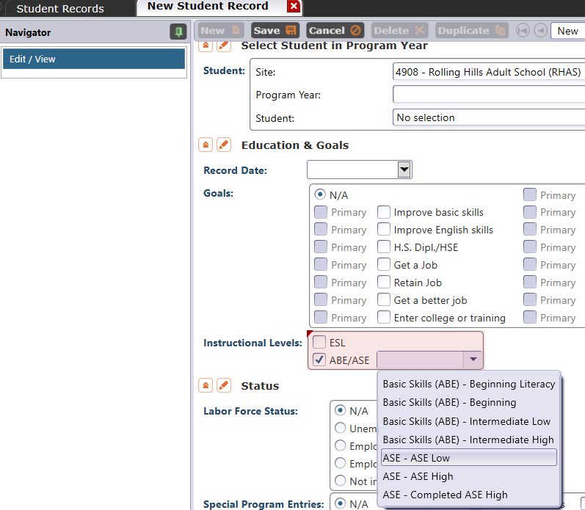
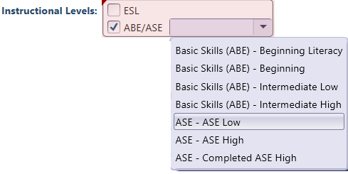
Literacy Gains – HS Credits
In TE, go to Records – Students – Records and refer to Instructional Levels:
Select ASE Low upon enrollment
Select ASE High later in the year once student progresses to the 11th or 12th grade level
Notes:
CASAS

Slide 30
Literacy Gains – CTE Related Outcomes
Occupational Skills Gain:
Usually suggests accomplishment of a portion of a longer term program
  For example: a student enrolls in a long term welding program in CTE, which is five semesters/five modules long. The student passes a skills check/written test that indicates the student is ready to finish Module I and enroll in Module II.
Workforce Prep Outcome:
Usually suggests completion of a shorter term program
  For example: a student enrolls and completes a 15 hour instructional module on job search strategies. The student earns documentation such as an informal certificate at the end of the instructional module.
Notes:
CASAS

Slide 31
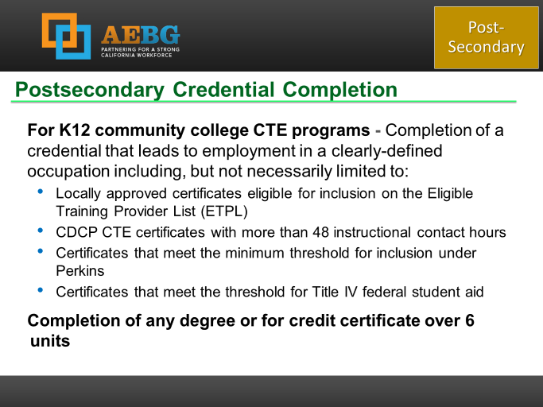
Occupational Outcomes: Post-Secondary vs. Literacy Gains
Post-Secondary:
Attained Credential
Occupational licensure
Occupational certificate
Literacy Gains:
Occupational Skills Gain
Workforce Prep Milestone
Post-Secondary =
Completion of a longer term program
“Literacy Gains” =
Partial completion of a longer term program
Completion of a shorter term program
Notes:
CASAS

Slide 32

High School Diploma/HSE
  Earned high school diploma
Passed GED
Passed HiSET

Slide 33
Post-Secondary
Postsecondary Credential Completion
Post-Secondary
        For K12 community college CTE programs - Completion of a credential that leads to employment in a clearly-defined occupation including, but not necessarily limited to:
          Locally approved certificates eligible for inclusion on the Eligible Training Provider List (ETPL)
          CDCP CTE certificates with more than 48 instructional contact hours
          Certificates that meet the minimum threshold for inclusion under Perkins
          Certificates that meet the threshold for Title IV federal student aid
          Completion of any degree or for credit certificate over 6 units

Slide 34
Post-Secondary
Post-Secondary
Postsecondary Credential Completion
        Workforce preparation (work readiness) or occupational safety certificates (e.g. OSHA or Safeserve) ARE NOT counted for completion under this metric
        These outcomes should count as short term services, or Workforce Preparation outcomes -- not Post-Secondary outcomes

Slide 35
Transition
AEBG Title | Update Record
Transition to ASE | No “bubble” but via instructional program
Transition to Post-Secondary/CTE | Entered job training Entered training pgm Entered apprenticeship
Transition to Post-Secondary/College | Enrolled in secondary Transition to credit
Notes:
CASAS

Slide 36
Transition
From:
To:
K12 Adult Education
(ABE, ASE, ESL)
K12 Adult Ed CTE
CC CTE
Non Credit CC
(ABE, ASE, ESL)
For Credit CC
Transition to CTE
Transition to for credit
Notes:
CASAS

Slide 37
Enter Employment and Increase Wages
Enter Employment
Increase Wages
  CAEP will use methods to collect employment and wages data:
  Data match with EDD using Social Security Number (SSN)
  Self report through TE
  Self report through survey

Slide 38
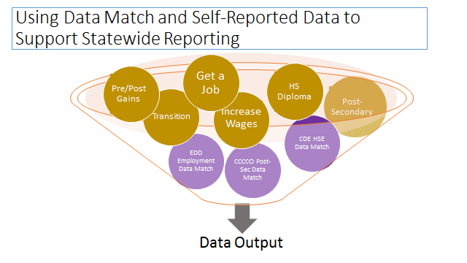

Slide 39
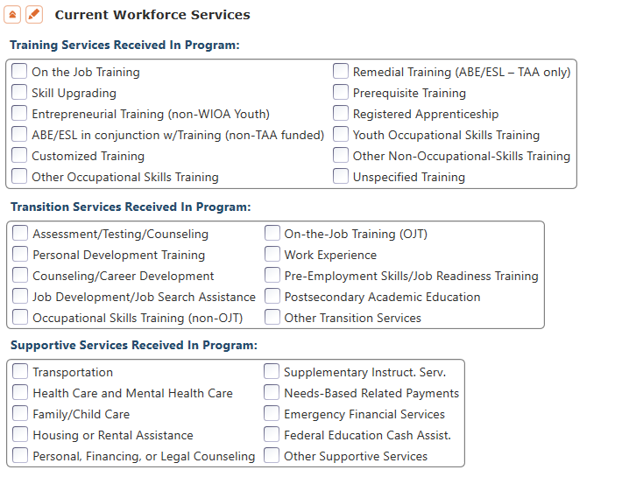
CAEP Short Term Services
Record short term services such as counseling or mentorship that may be received outside of the classroom.
Supportive Services
Training Services
Transition Services
Notes:
CASAS

Slide 40
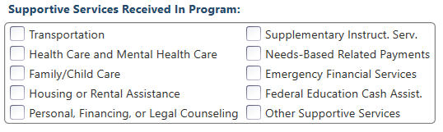
Supportive Services
Services that better enable an individual to participate in adult education activities, or related activities such as WIOA Title I -- such as transportation, child care, dependent care, housing, and personal needs
Notes:
CASAS

Slide 41
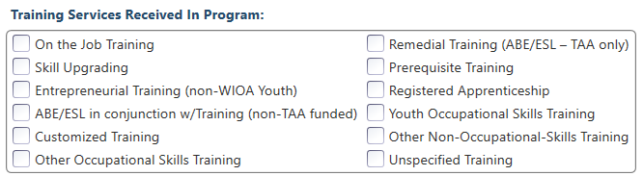
Training Services
Services that help individuals:
Select programs that relate to economic priorities in local planning region
Enroll/meet minimum qualifications for longer term employment and/or employment training programs
Services administered to individuals who have been determined to:
Be unlikely to obtain/retain employment
Be in need of additional services in order to attain economic self-sufficiency/permanent employment
Have skills sufficient to enroll in appropriate training program that provides skills necessary for self-sufficiency
Notes:
CASAS

Slide 42
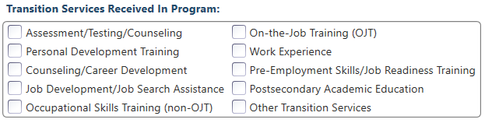
Transition Services
Services that help individuals:
Facilitate successful transition from school to postsecondary life, such as attaining employment, enrolling in college, or accessing designated pre-employment transition services.
Provide opportunities to receive training and other services necessary to achieve competitive employment or postsecondary enrollment
Notes:
CASAS

Slide 43
CAEP Short Term Services – COVID-19 Update
Record short term services received outside of the classroom.
Current Examples:
Additional Health Care needs & requirements
Financial services
Services to assist with new software applications
Skill upgrades to work remotely
Job seeking skills
Notes:
CASAS

Slide 44
CAEP Short Term Services– COVID-19 Update
Record short term services received outside of the classroom.
Current Examples:
Prerequisite training
Assessment/Testing
Job Readiness Training
Emergency Financial Services
Health Care Services
Notes:
CASAS

Slide 45
CAEP Short Term Services
Supportive Services
Transition Services
Training Services
Transportation
Child Care
Personal Counseling
Financial Assistance
Assessment (other than required pre/post)
Academic/Career Counseling
Job Development
Student Orientation
Community Support Training (OSHA, CPR, etc.)
Prerequisite Training
Notes:
CASAS

Slide 46
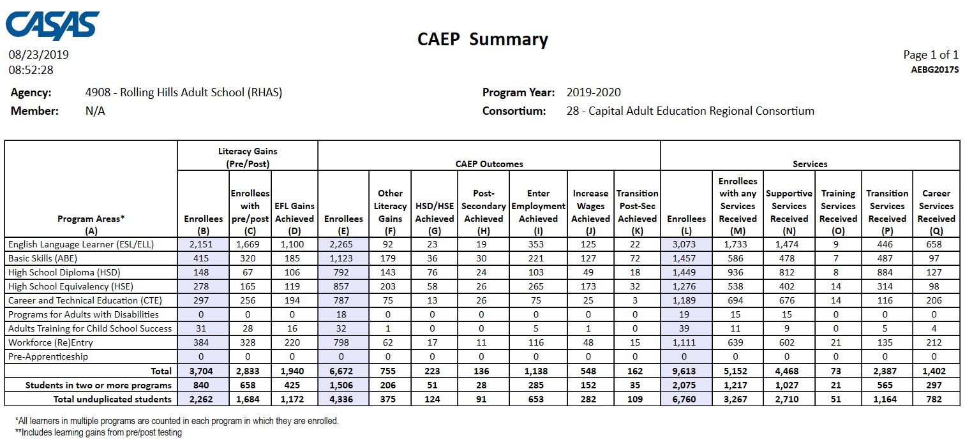
Displays outcomes in three separate sections:
Literacy Gains (Pre/Post) using NRS Table 4 guidelines
Other AB 104 outcomes using WIOA II reporting requirements but not pre/post
Services Received that do not impose WIOA II reporting requirements
Notes:
CASAS

Slide 47
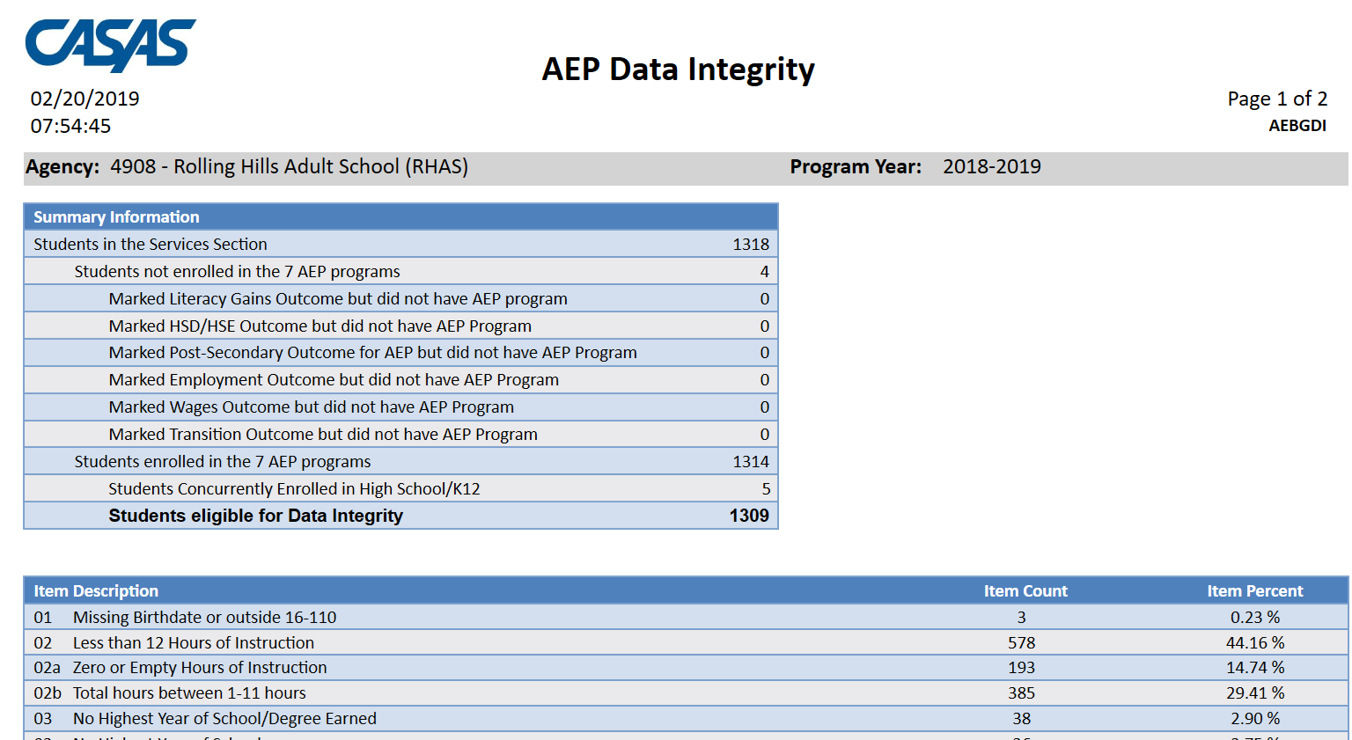
AEP Data Integrity displays 27 different data elements related to the AEP instructional programs and outcomes.
Item Description lists 27 data elements that may prevent or contribute to official AEP outcomes.
The DIR displays the item count and percentage for each listed item.
Item Percent = Item Count ÷ # of Students Enrolled in 7 AEP Programs
Notes:
CASAS

Slide 48

I3 Reports in TE
TE now includes Immigrant Immigration Indicator (I3) reports that track EL Civics COAAPs outcomes and relate them to Immigrant Integration goals.
Notes:
CASAS

Slide 49

Literacy Gains
Employment
Secondary
Wages
Post-Secondary
Transition
Notes:
CASAS

Slide 50
In TE go to Records--Students--Records
Notes:
CASAS

Slide 51
Updates to Resources and Materials
Notes:
CASAS

Slide 52

BOY Letter for PY 2020-21
This letter includes the data submission requirements for all CAEP agencies.
Notes:
CASAS

Slide 53
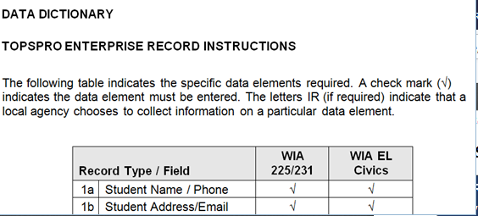
2020-21 CAEP Data Dictionary
Home > Training and Support > CASAS Peer Communities > California Accountability >
A new 2020-21 CAEP Data Dictionary is available on the CASAS Website to help CAEP meet requirements.
20-21 version includes several enhancements and updates.

Slide 54
Data Submission Calendar
CAEP Program Year Reporting
 | Date Range | Reporting Deadline
First Quarter | July 1 – Sept 30 | October 31, 2020
Second Quarter | July 1 – Dec 31 | January 31, 2021
Third Quarter | July 1 – Mar 31 | April 30, 2021
Fourth Quarter-EOY | July 1 – June 30 | August 1, 2021
Notes:
CASAS

Slide 55
TE Quarterly Data Submission Wizard
Beginning first quarter of PY 2020-21, agencies will use the TE Quarterly Data Submission Wizard to submit quarterly data, including the Data Integrity Report (DIR).
Agencies will no longer send separate pdf copies of the DIR when completing quarterly data requirements.
Notes:
CASAS

Slide 56
CASAS Assessments
Authorized for NRS for 2020-21
ABE and ASE only:
CASAS GOALS Reading and Math
ESL only:
Life and Work Listening
Life and Work Reading
Secondary Level Assessment (SLA):
  Language Arts 513-14
POWER, AA-AAAAA not authorized for NRS, but are authorized for CA reporting
Notes:
CASAS

Slide 57


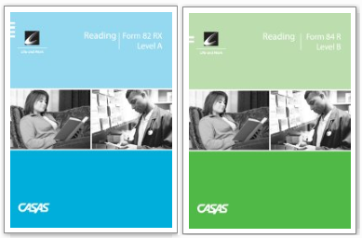

Use of Assessment Modalities
ABE/ASE: Use Reading or Math CASAS GOALS series
ESL: Use Life and Work Reading or Listening
Notes:
CASAS

Slide 58
Use of Assessment Modalities
ABE/ASE: Use Reading or Math GOALS series
Pre- and post-test pairs must always be from the same test modality.
If using CASAS GOALS, both the pretest and the post-test must use the same test series. Cannot match GOALS with any other CASAS test series.
Notes:
CASAS

Slide 59
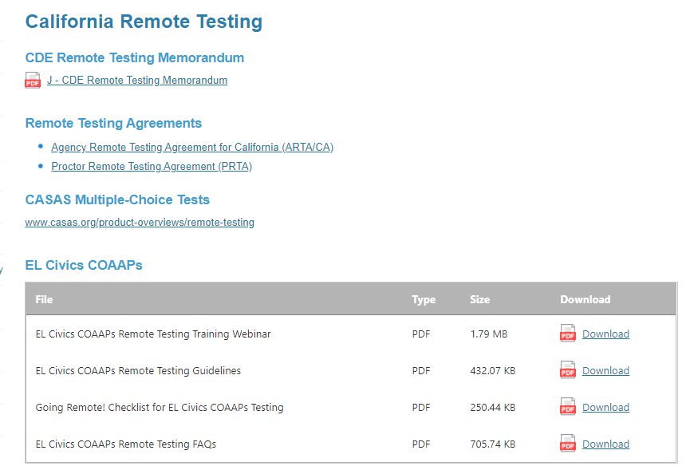
Remote Testing
The CDE has decided to permit California agencies to implement remote testing.
For more information, go to the California Remote Testing page on the CASAS Website:
https://www.casas.org/training-and-support/casas-peer-communities/california-adult-education-accountability-and-assessment/california-remote-testing
Notes:
CASAS

Slide 60
CASAS Reading Level Indicator (RLI)
Available at no cost only to eTests/TE users.
Results are shown as “Estimated NRS EFL” for ABE or ESL. No scale scores are given.
It is NOT an NRS-approved test and may NOT be used for pre- or post-testing to achieve MSGs.
The Reading Level Indicator (RLI) is Form 601R.
Notes:
CASAS

Slide 61
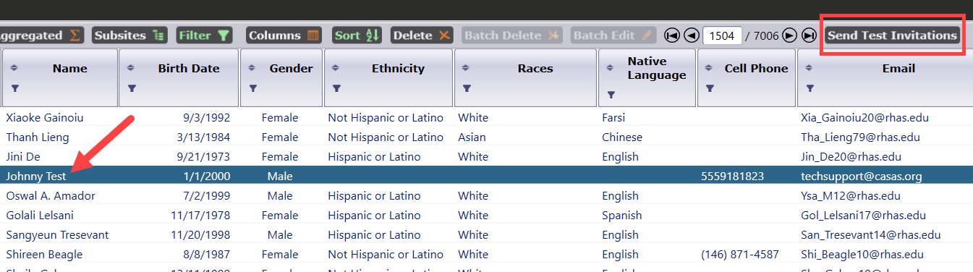
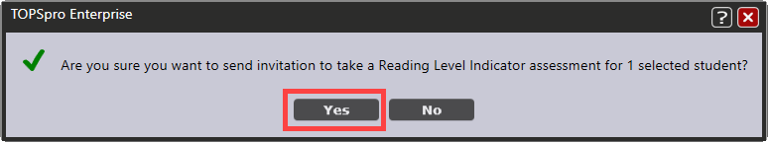
About the CASAS RLI
Initiate the RLI by selecting students in TE’s Student Demographics lister.
Click the Send Test Invitations button.
Notes:
CASAS

Slide 62
Literacy Gains Outcomes – COVID-19 Update
Mark when CAEP learners achieve outcomes in Distance Learning classes.
Record achievements already attained before closures
Use “passage of exam” process for CTE MSG’s as a guide for recording student achievement.
  Student passes informal exam such as a (virtual) class assessment, written assignment, or oral interview
  Completes skills demonstration in workforce preparation activities
Literacy Gains
Notes:
CASAS

Slide 63

Literacy Gains Outcomes– COVID-19 Update
Passes (virtual) class assessment, written assignment, or oral interview
Learner Mastery
Educational Software
Local Program Milestones
Notes:
CASAS

Slide 64
Literacy Gains Outcomes– COVID-19 Update
Completes skills demonstration in workforce preparation activities
EL Civics/IET
Transitions
EL Co-Enrollment
Notes:
CASAS

Slide 65
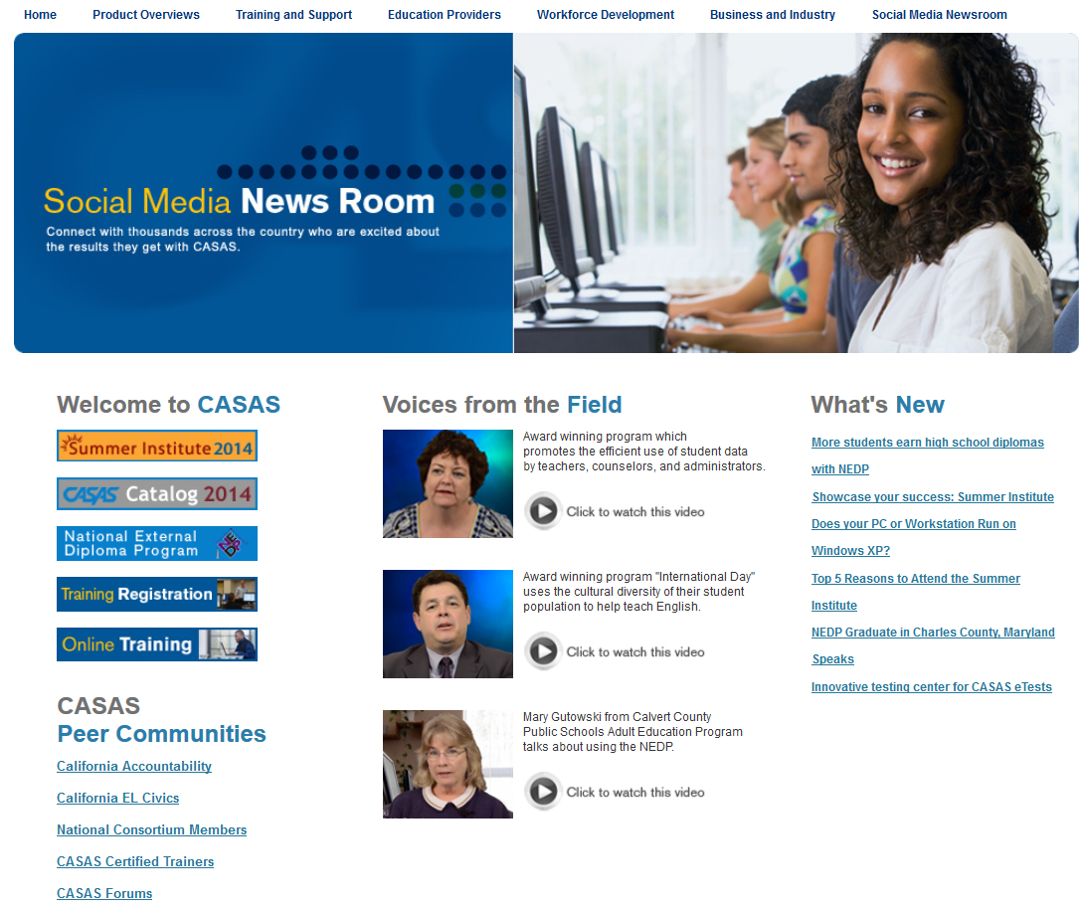

CASAS Web Site
What’s New
Online Registration
California Accountability
AEBG Web page
CASAS Forums
Download Centers
www.casas.org
Notes:
CASAS

Slide 66
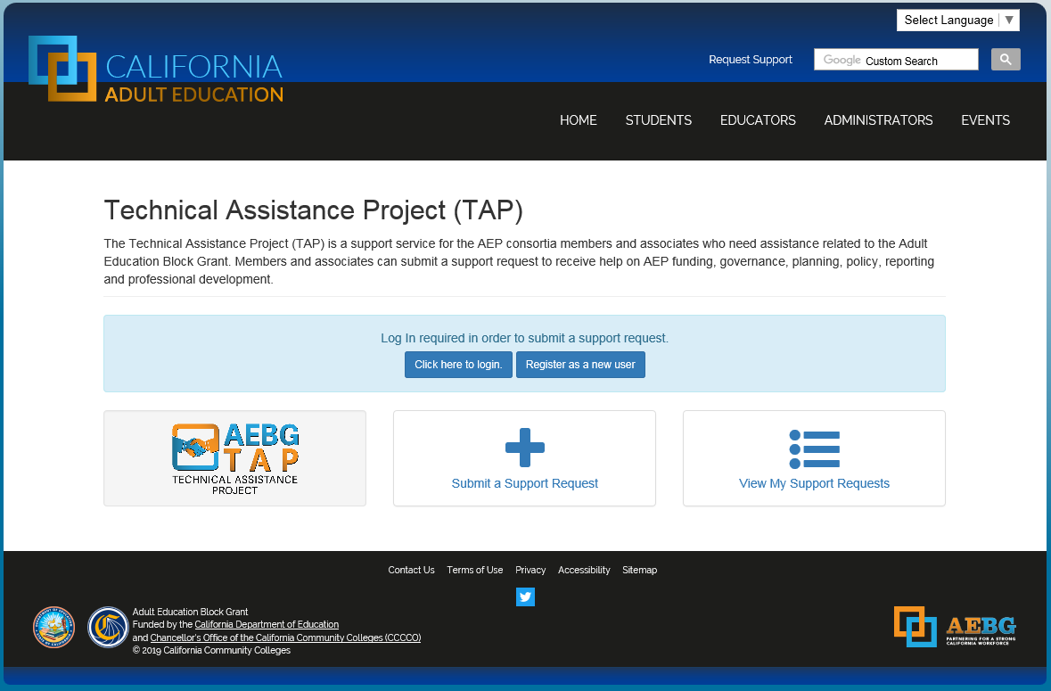
Request Support from CAEP TAP
Notes:
TAP

