Slide 1
AEBG CFAD Webinar
2017-18
March 9, 2018

Slide 2
Agenda
18-19 AEBG Allocation Process
CFAD Timeline
Allocation Options
CFAD Deliverables
CFAD Amendments
NOVA AEBG - Step by Step – screen shots
NOVA tips for beginners
NOVA AEBG expense reporting & due dates
Open Discussion

Slide 3
18-19 AEBG Allocation Process
January – Governor’s Budget is Released
February – AEBG Preliminary Allocation are released at the consortium level (includes COLA)
March-April – consortium members have public meetings (Brown Act) to discuss 18-19 allocation of funds.
May 2 – CFADs are due in NOVA.
June – Legislative approval
July 1 – Governor signs
August – schedules are send to State Controllers for disbursement

Slide 4
CFAD Timeline
Review preliminary allocation amounts for 18-19 (totals).
Set up public meetings for discussion of allocating funds.
Get on the agenda for any local board approval.
Give yourself plenty of time for members to certify the CFAD in NOVA.
Get this all done by May 2, 2018.
Failure to have CFAD certified by May 2, 2018 – will force the state to use prior year allocation percentages.

Slide 5
Allocation Options
Allocations options for the COLA:
Across the board increase for all members.
Allocation based on need in the community.
Help fund new members.
Reflect member carry over from prior year.
Factor in any member reductions.
Help fund next year projects that need resources.
All options are acceptable – as long as it has 100% agreement by the consortium membership.

Slide 6
CFAD Deliverables
Creation of the CFAD showing the 2018-19 distribution of funds to each member of the consortium.
A narrative justifying how the planned allocations are consistent with the extended three-year plan.
Certification by each member of the CFAD information in NOVA.
Designation by the consortium of the fiscal structure for 2018-19 - fiscal agent or direct-funded.

Slide 7
CFAD Amendments
Should be called allocation amendments as the CFAD is only used for the beginning of each fiscal year to allocate funds.
Consortia may adjust and amend allocations throughout the program year.
Keep in mind – direct funded members must beware of cash flow issues during the 11 month state disbursement process (if they choose to make allocation amendments during this time).

Slide 8
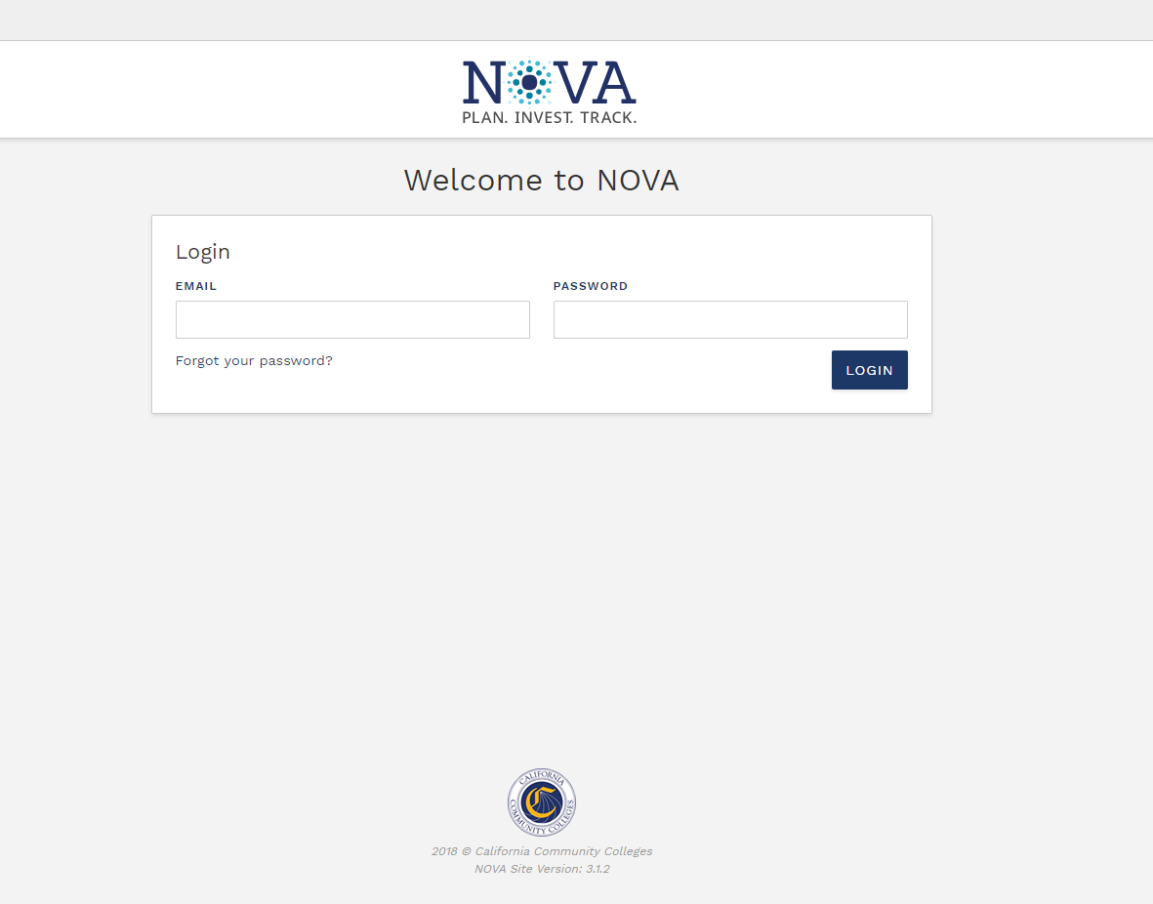

Slide 9
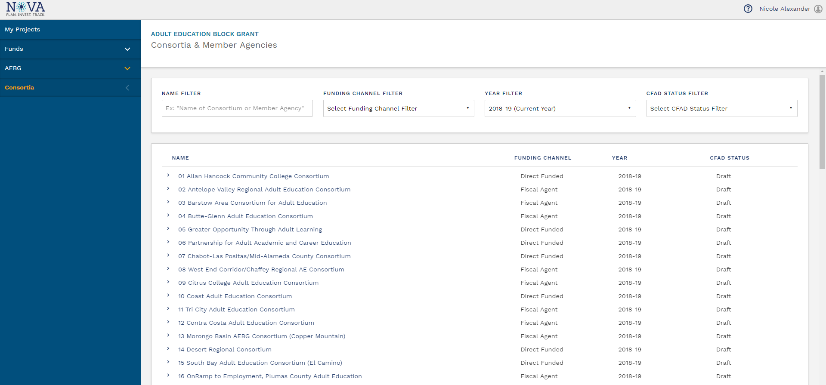

Slide 10
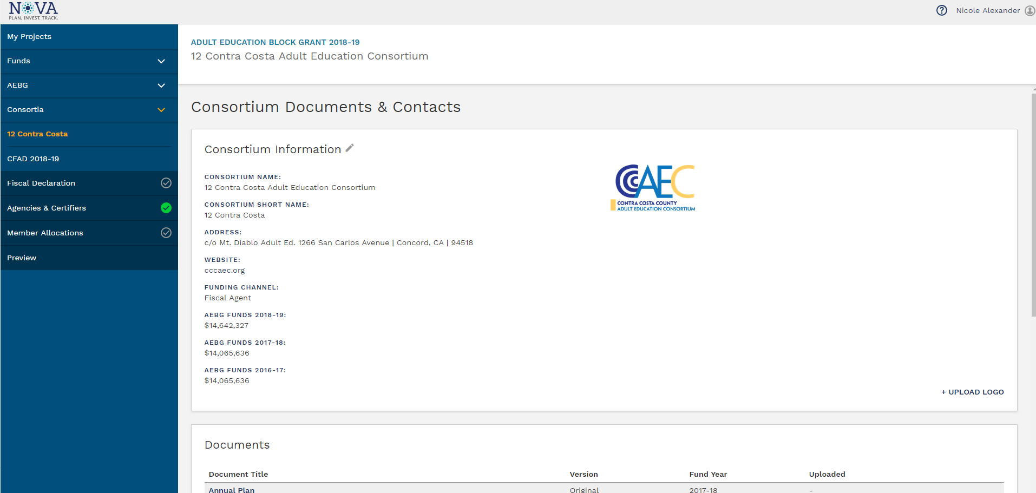

Slide 11
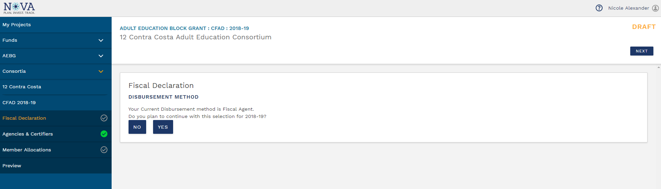
Fiscal Declaration Section

Slide 12
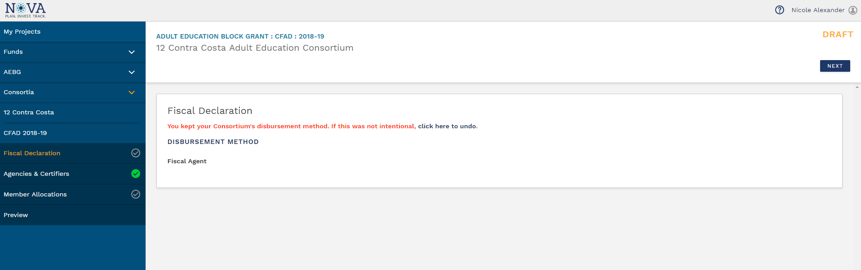
Selecting Yes for Fiscal Declaration
(continues with current disbursement method)

Slide 13
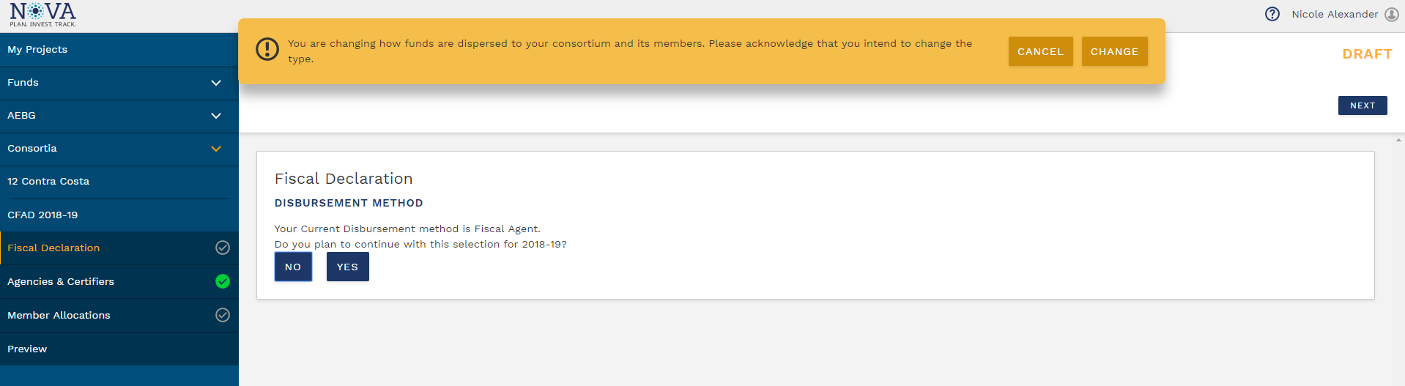
Selecting No for Fiscal Declaration
(changes disbursement method)

Slide 14
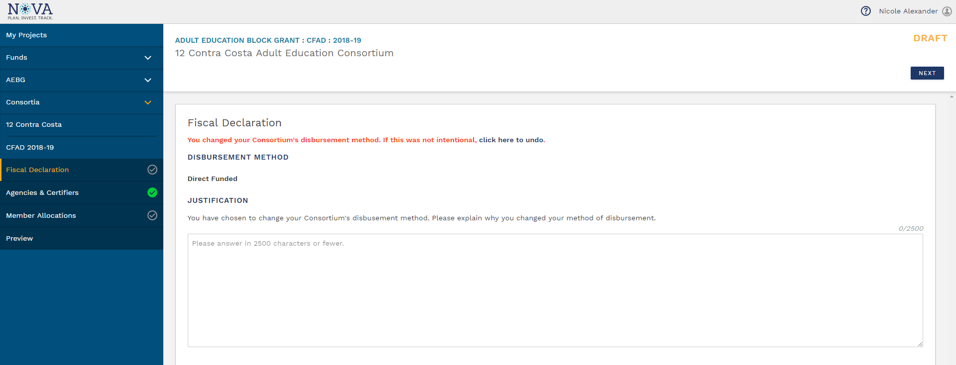
Selecting No for Fiscal Declaration
(changes disbursement method)

Slide 15
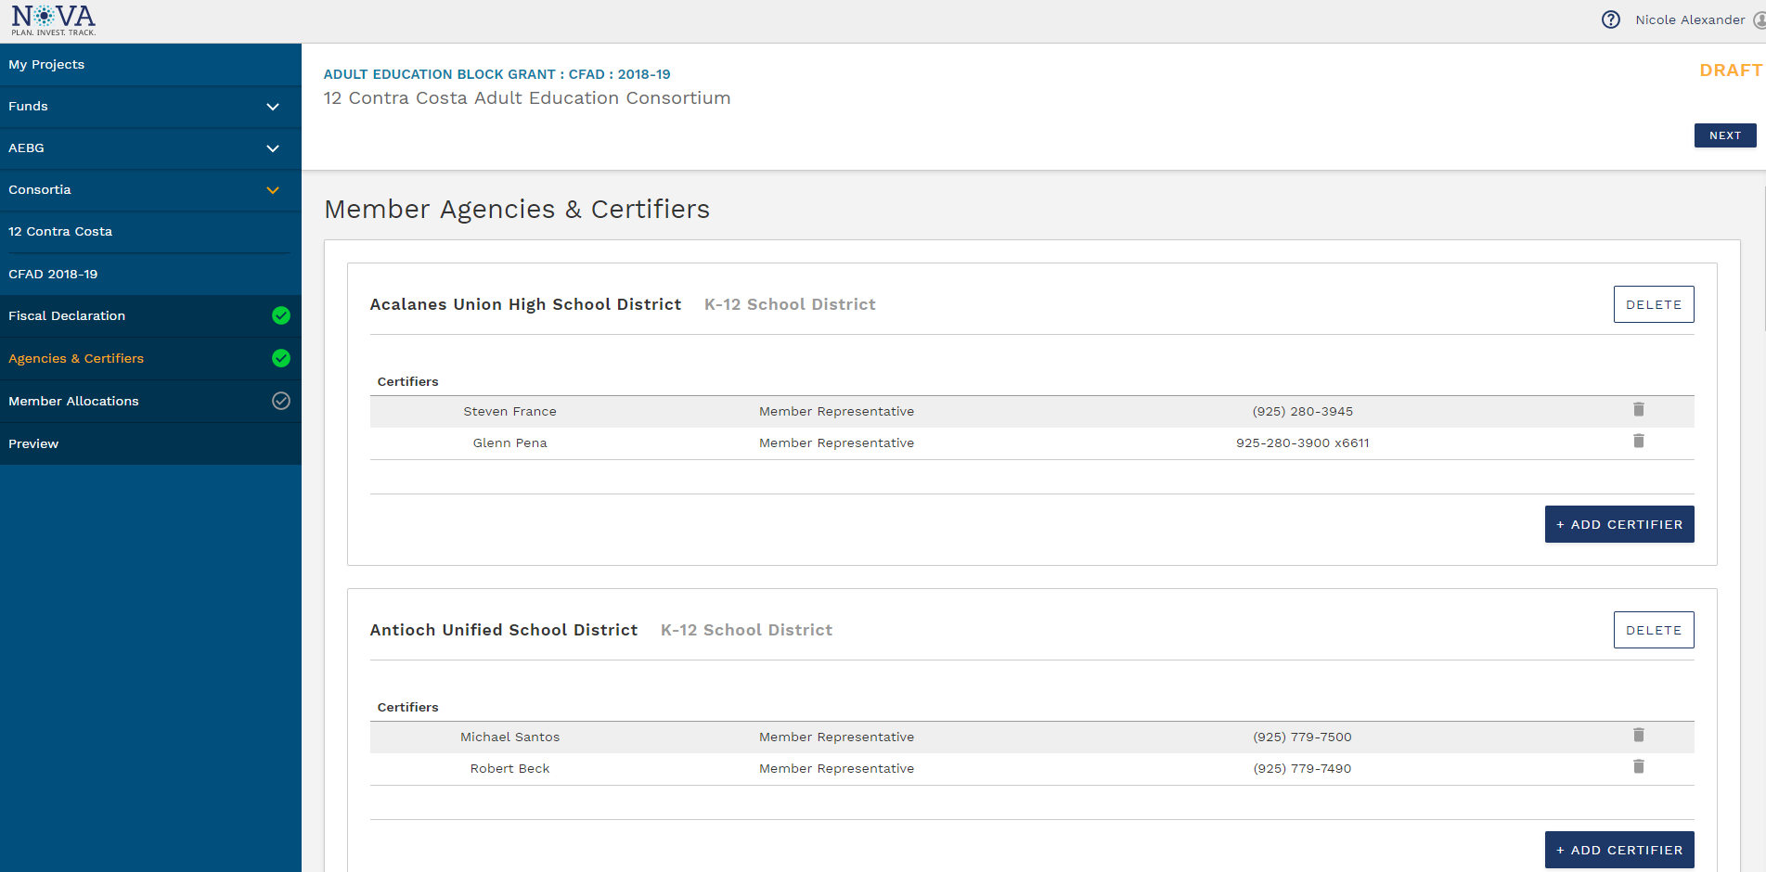
Agencies and Certifiers Section

Slide 16
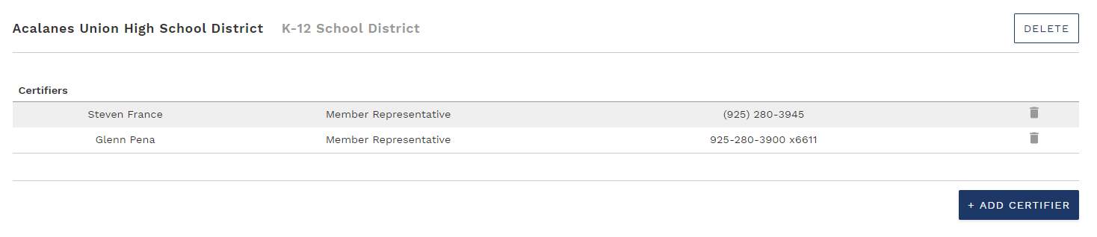
Adding and Removing Certifiers

Slide 17
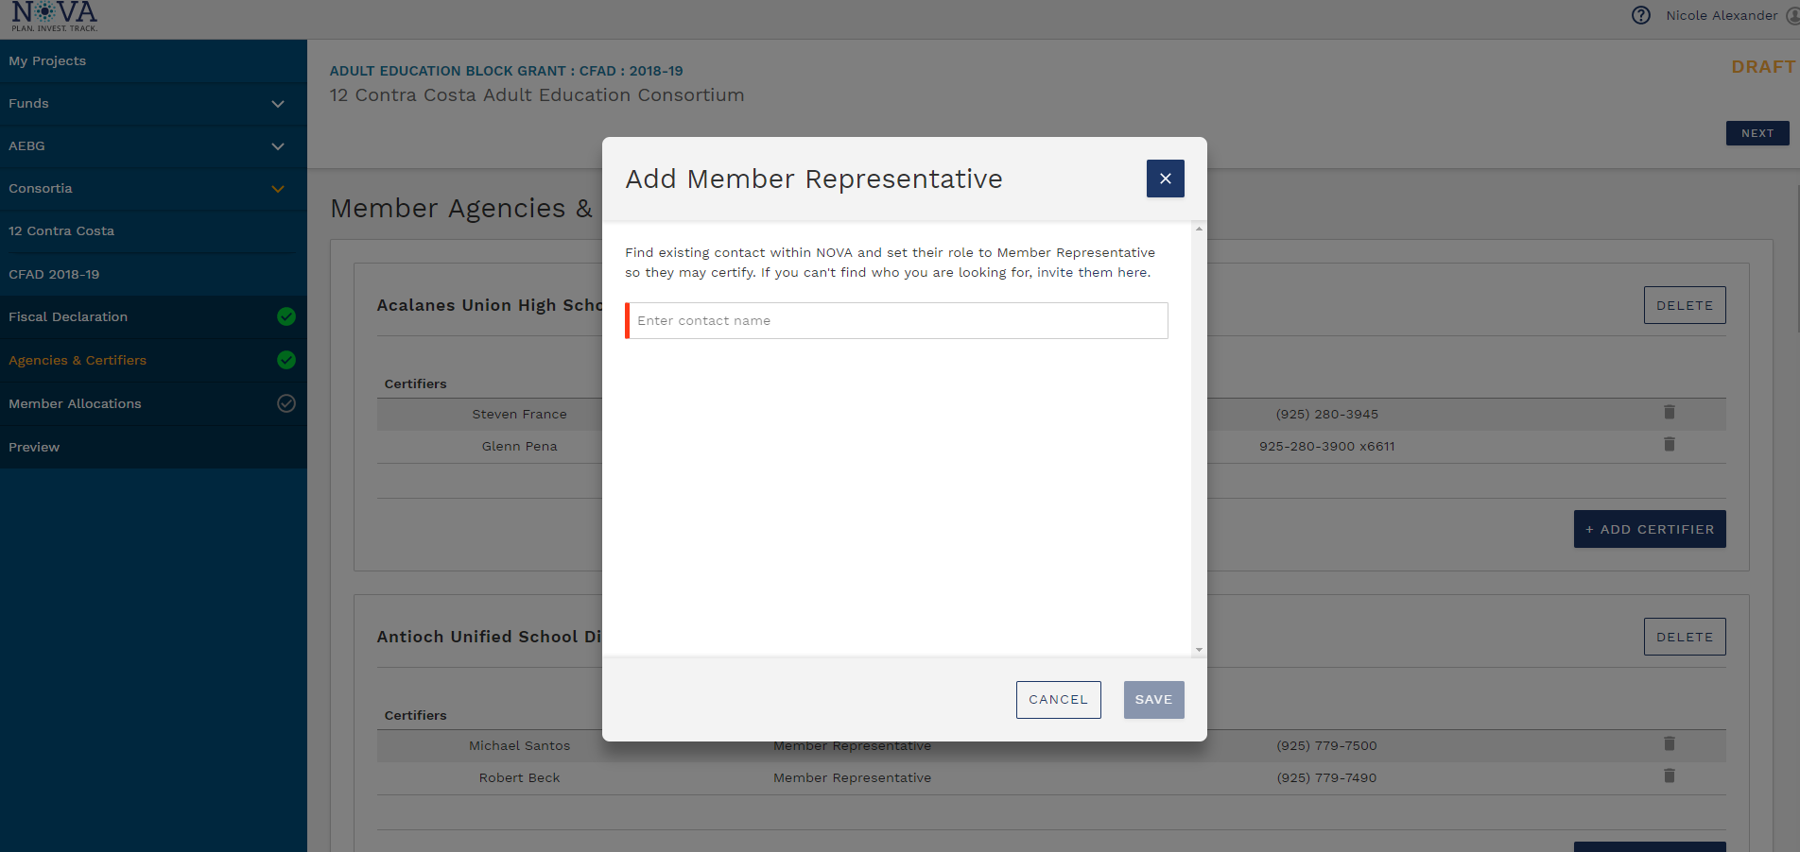
Adding Certifiers

Slide 18
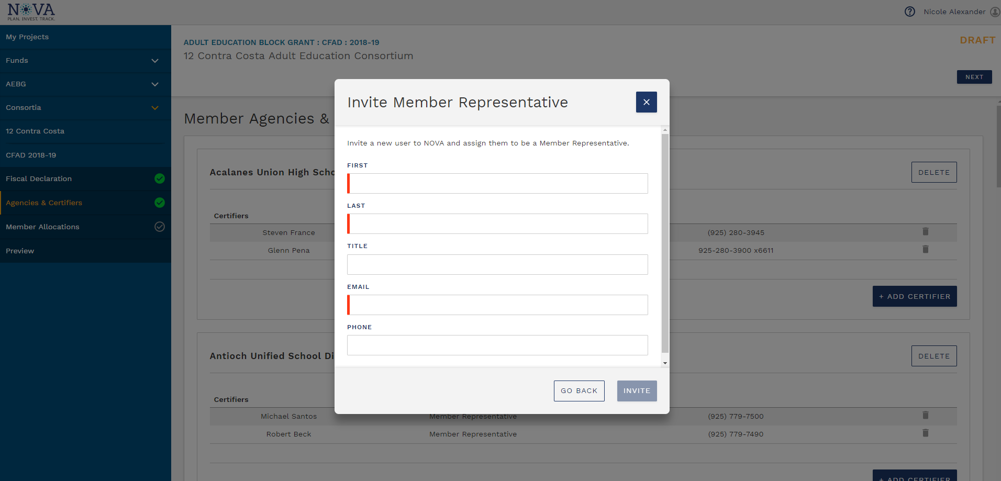
Adding Certifiers

Slide 19
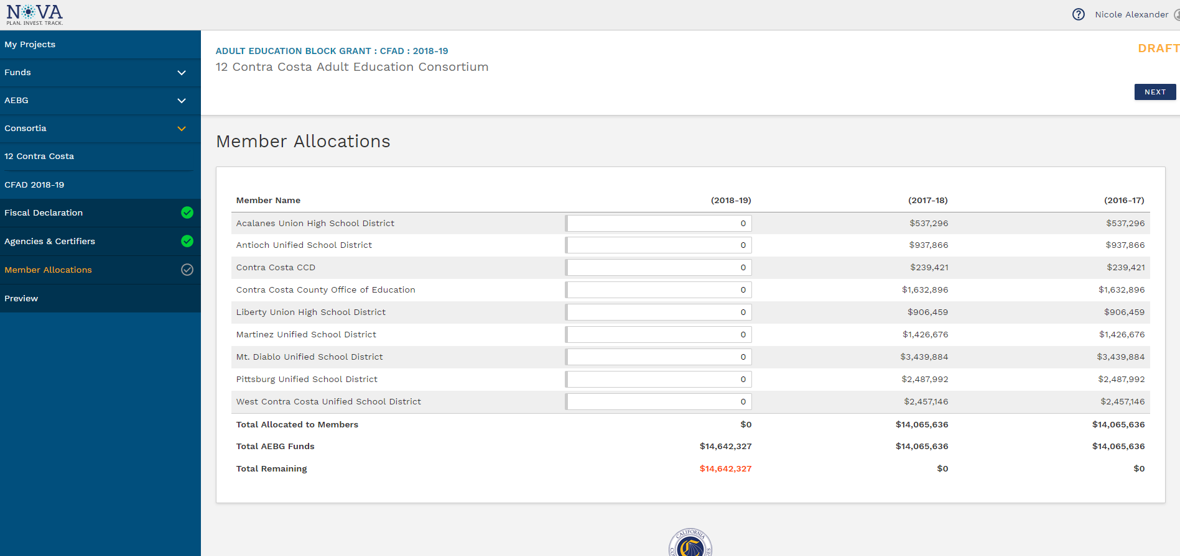
Member Allocations Section

Slide 20
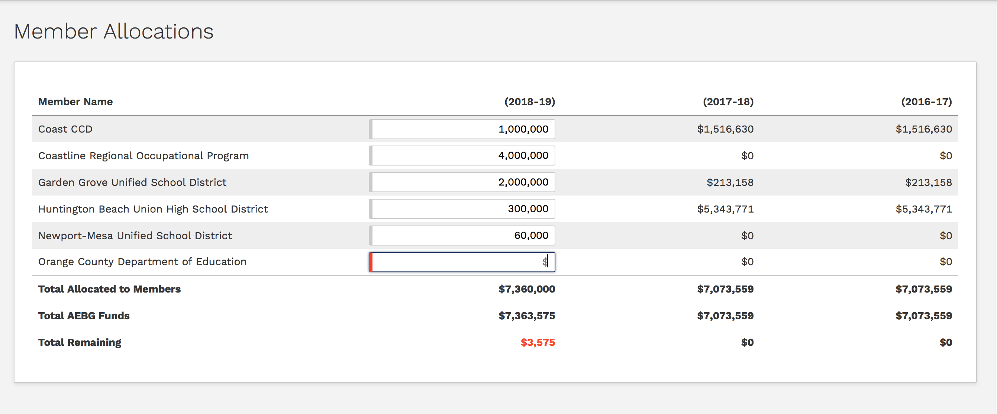
Member Allocations Section

Slide 21
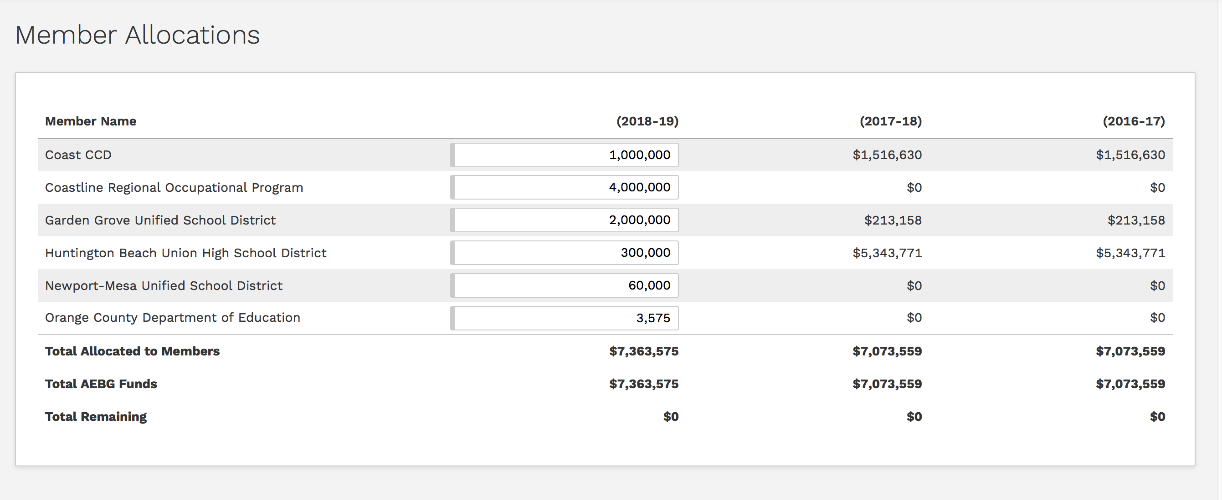
Member Allocations Section

Slide 22
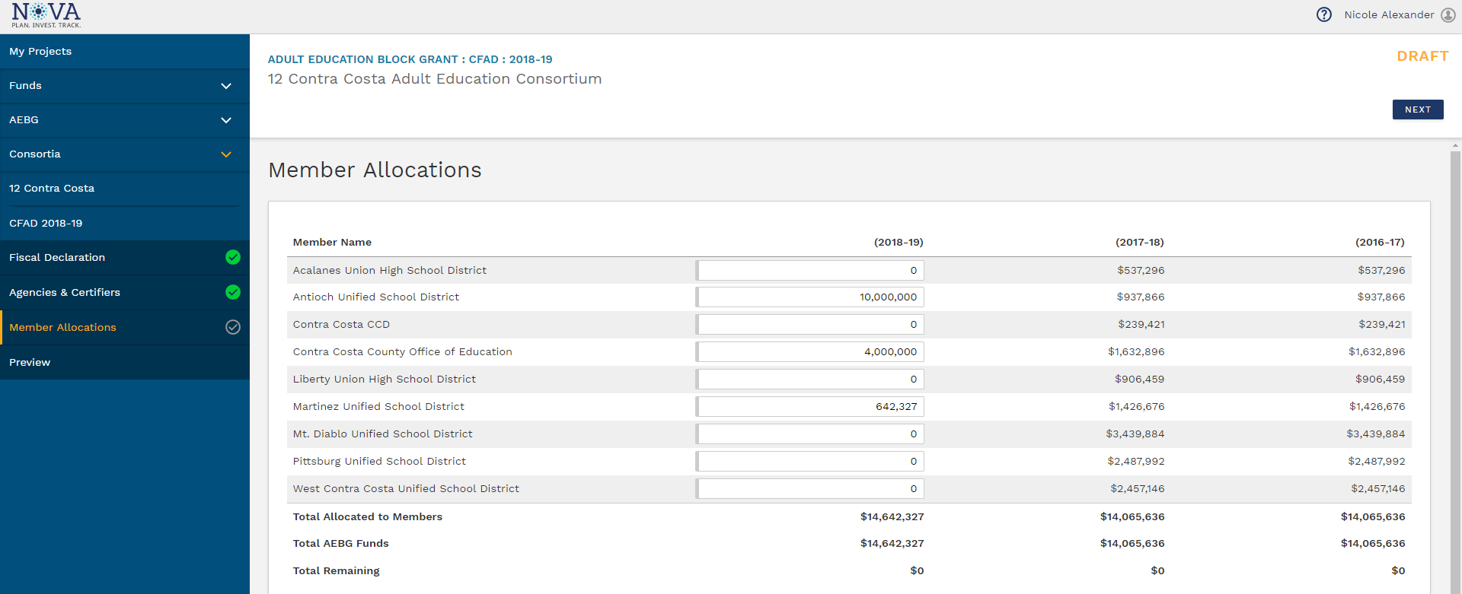
Member Allocations Section

Slide 23
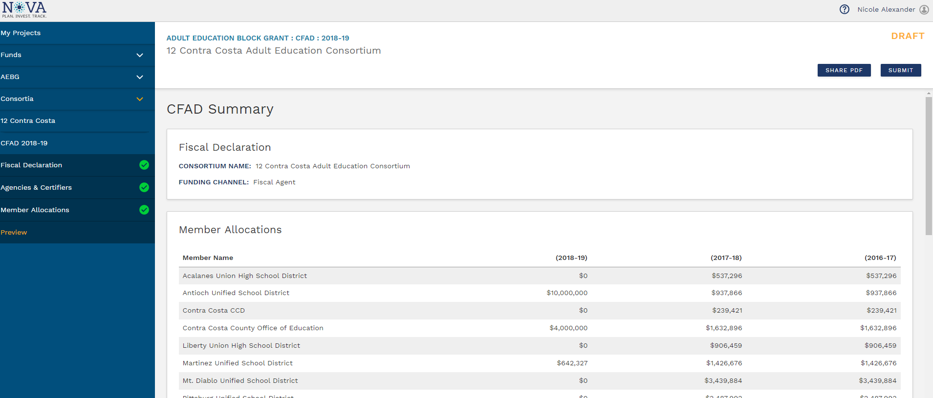
Preview and Submit Section

Slide 24
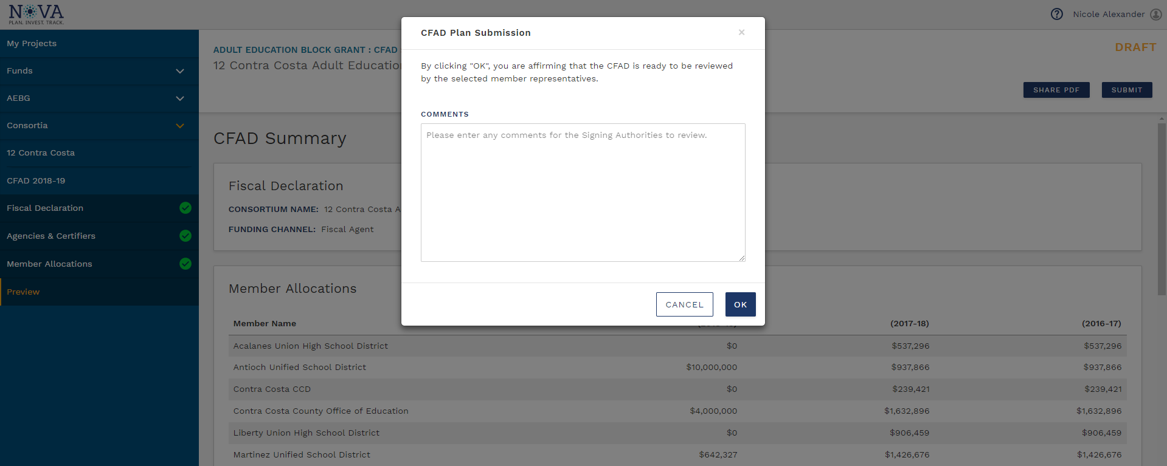
Preview and Submit Section

Slide 25
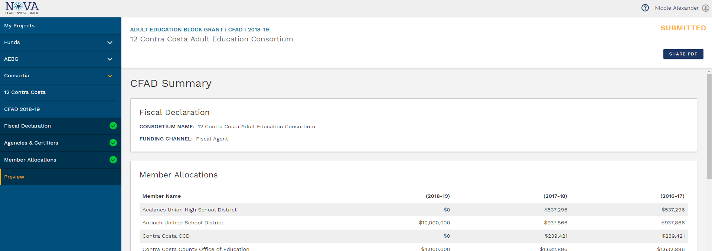
Preview and Submit Section

Slide 26
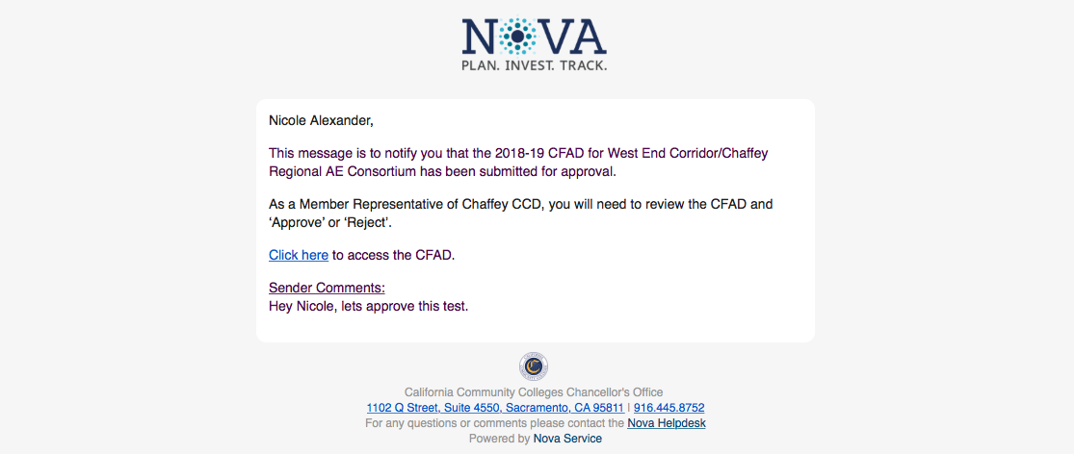
Member Review and Approval Process

Slide 27
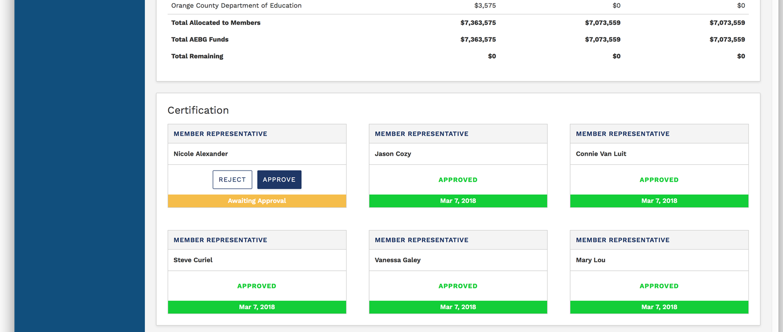
Member Review and Approval Process

Slide 28
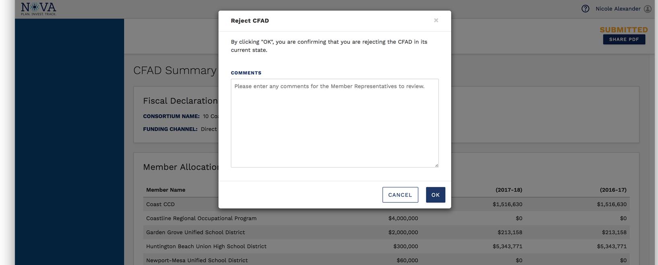
Member Rejection of CFAD

Slide 29
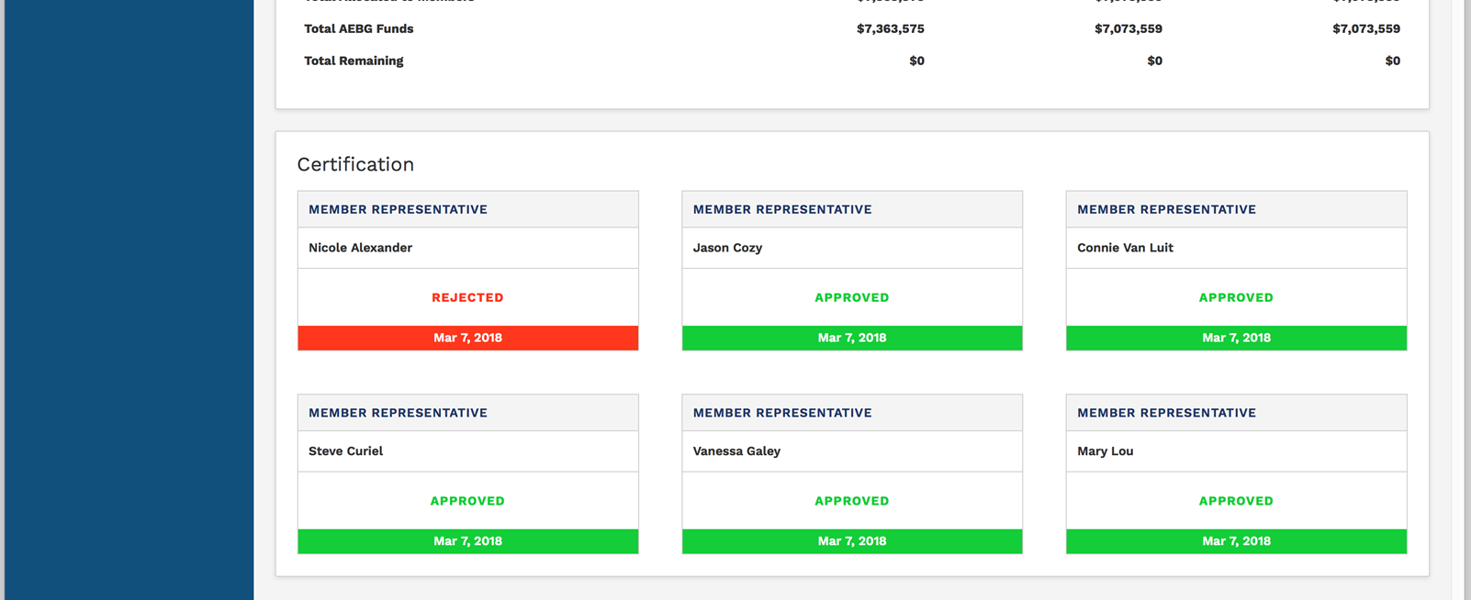
Member Review and Approval Process

Slide 30
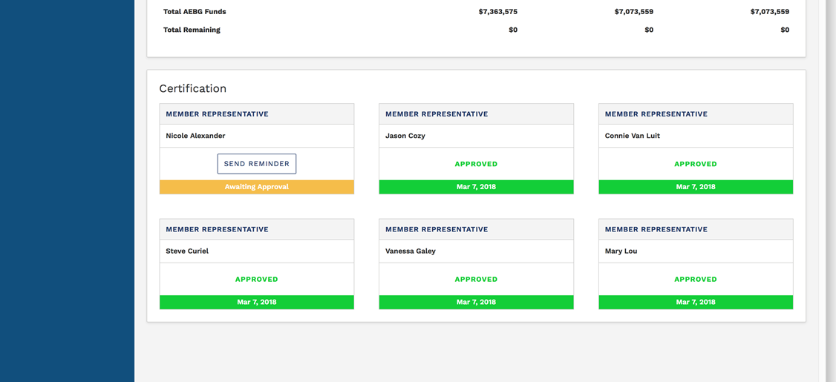
Member Review and Approval Process

Slide 31
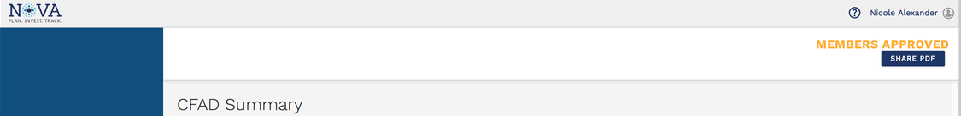
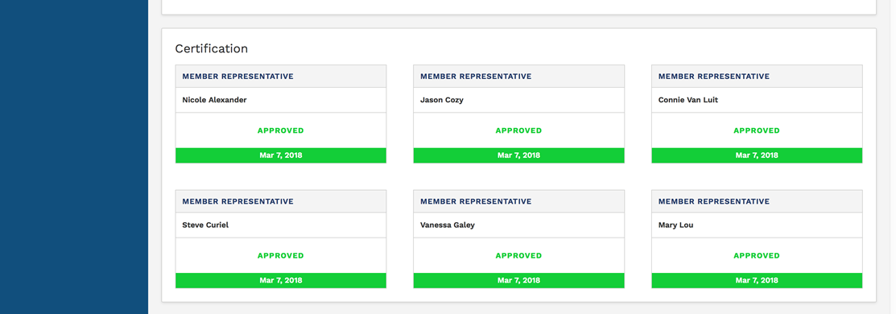
Member Review and Approval Process

Slide 32
NOVA Expense Reporting
Currently working on programming.
Member expenses reports & budget changes – Q1, Q2, & Q3 – all due by June 1st .
Consortium will approve by June 30th.
Members can make budget changes during the expense reporting process (15% threshold).
Targets – 60% of 16-17 carry-over and 17-18 new funds must be spent by Q4.
Failure to meet targets will result in a corrective action plan.

Slide 33
Consortium Administrative Function
Consortia oversight is required of member’s budgets & expenditure reporting as it pertains to the 3 year and annual plans.
Consortia may use up to 5% administrative cap to pay for the oversight activities.
Applies to fiscal agent and direct funded consortia.
Oversight option must be agreed to and approved by consortium membership.

Slide 34
Consortium Oversight Consists of an assessment of each member:
Assessment of the member’s ability to meet the AEBG requirements.
Review general assurances (basic member requirements) signed off by each member as part of the annual plan process.
Review bylaws, charters, and governance for additional member requirements.

Slide 35
Consortium Oversight Consists of an evaluation of each member:
Using the 3 year plan, annual plan, AEBG student data, and other resources available– evaluate the following:
Evaluation of program needs as identified to meet the needs of the community (needs based)
Evaluation of current levels & types of services (enrollment, outcomes)
Evaluation of funds provided to members (cost effective)
Evaluation of member effectiveness (overall effectiveness)

Slide 36
Questions to ask…..
    How do you know your member is being effective?
    How do you know your member is making a difference?
    How do you know your member is doing what they said they would do?
    How do you know that your member’s actions are addressing those educational needs?
    How do you know your member is meeting any enrollment or outcome targets agreed upon within the consortium?

Slide 37
NOVA Due Dates- 2018
June 1st - Member expenses reports & budget changes due – Q1, Q2, & Q3.
August 15th - 18-19 Annual plans due in NOVA.
September 1st - Member end of the year Financial Reports due. (Consortium certification by 9/30)
September 30th - 18-19 Member work plans & budgets due. (Consortium certification by 10/31)
December 1st – Q1 (18-19) expenses due by member (Consortium certification by 12/31).

Slide 38
AEBG Web Site
http://aebg.cccco.edu/Home

Slide 39
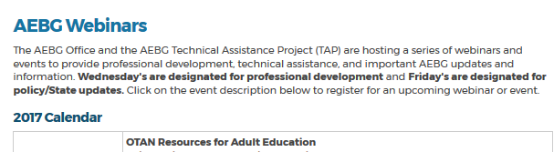
AEBG TAP
The AEBG Technical Assistance Program (TAP) provides professional development resources for all AEBG agencies statewide.
tap@aebg.org

