Slide 1
AEBG CFAD Webinar
2017-18
April 6, 2018

Slide 2
Agenda
18-19 Allocation Process
CFAD Criteria & Timeline
CFAD Processing & Deliverables
CFAD Q & A
NOVA AEBG CFAD Screen Shots & more
Allocation Amendments
NOVA AEBG Allocation Amendment Screen Shots
Update on expense reporting & due dates
Open Discussion

Slide 3
18-19 AEBG Allocation Process
January – Governor’s Budget is Released
February – AEBG Preliminary Allocation are released at the consortium level (includes COLA)
March-April – consortium members have public meetings (Brown Act) to discuss 18-19 allocation of funds.
May 2 – CFADs are due in NOVA.
June – Legislative approval
July 1 – Governor signs
August – schedules are send to State Controllers for disbursement

Slide 4
CFAD Criteria
The CFAD process meets the legislative requirement to have AEBG funding disbursed within 45 days of the Governor signing the state budget.
The CFAD is a one-time process due once a year on May 2nd.
The CFAD is used to by the State AEBG Office to document prior year allocations.
The CFAD is also used set up AEBG funding disbursement to direct funded and fiscal agent consortia.

Slide 5
CFAD Timeline
Review preliminary allocation amounts for 18-19 (totals).
Set up public meetings for discussion of allocating funds.
Get on the agenda for any local board approval.
Give yourself plenty of time for members to certify the CFAD in NOVA.
Get this all done by May 2, 2018.
Failure to have CFAD certified by May 2, 2018 – will force the state to use prior year allocation percentages.

Slide 6
CFAD Processing
In addition to the regular CFAD processing, the 18-19 COLA would be an across the board increase for all members.
If members are in agreement, you could use other options:
Allocation based on need in the community.
Help fund new members.
Reflect member carry over from prior year.
Factor in any member reductions.
Help fund next year projects that need resources.
Members have to be 100% in agreement to use an other option, instead of the across the board COLA increase.

Slide 7
CFAD Deliverables
Creation of the CFAD showing the 2018-19 distribution of funds to each member of the consortium.
A narrative explaining any fiscal changes – structure, fiscal agent, or prior year allocation amounts.
Designation by the consortium of the fiscal structure for 2018-19 - fiscal agent or direct-funded.

Slide 8
CFAD Q & A
Q: What happens if we miss the May 2nd deadline?
A: The State will use the prior year CFAD allocations (in case of the COLAs – a proportional percentage).
Q: If all the consortium members approve a change to the allocations, can a consortium change member allocations after May 2 in NOVA?
A: Yes. I will cover that under Allocation Amendments.
Q: Can we out vote a member that doesn't’ want to go along with a different allocation option?
A: No. Decision making bylaws do not apply to the CFAD processes. AB104 legislation is clear on prior ear funding.

Slide 9
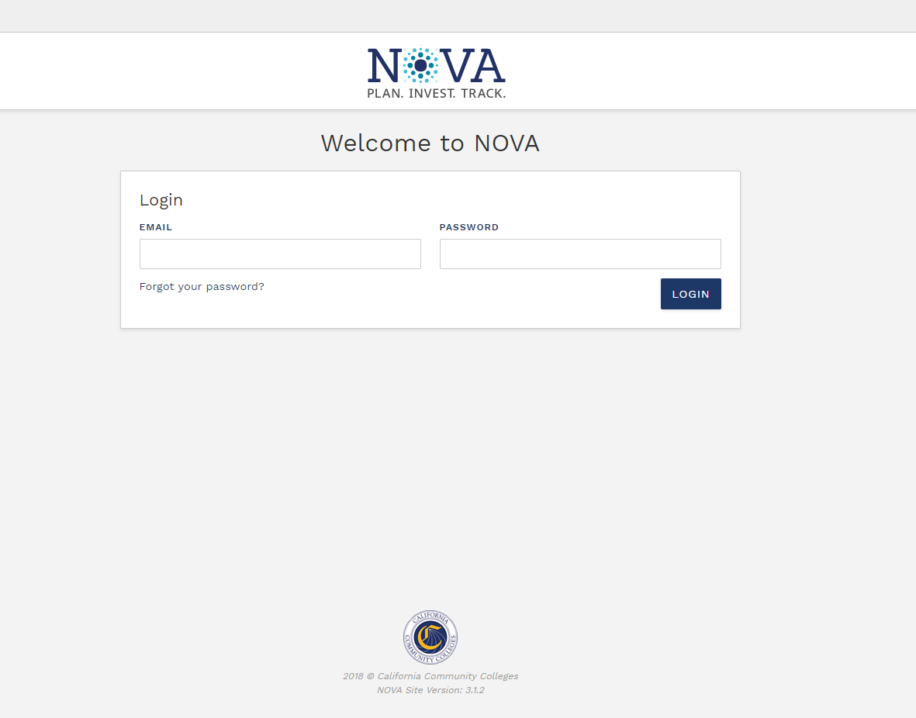

Slide 10
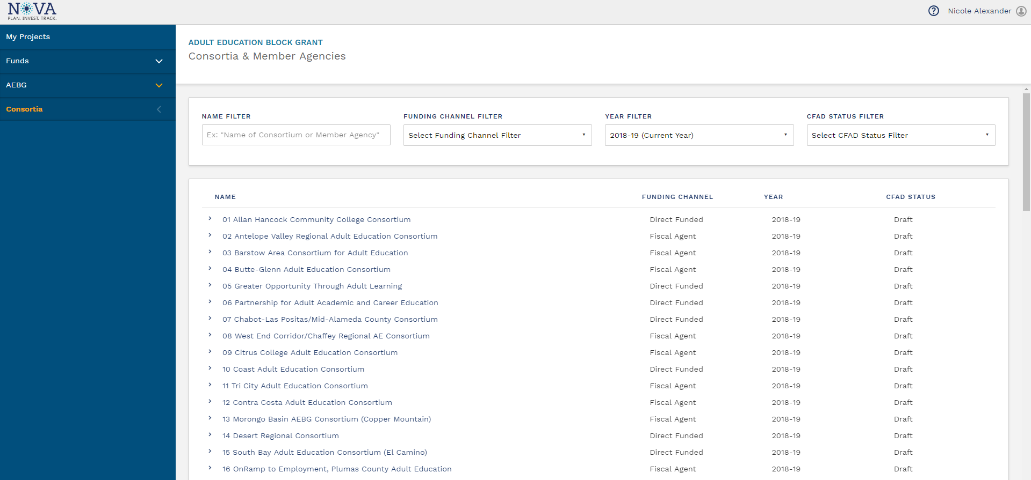

Slide 11
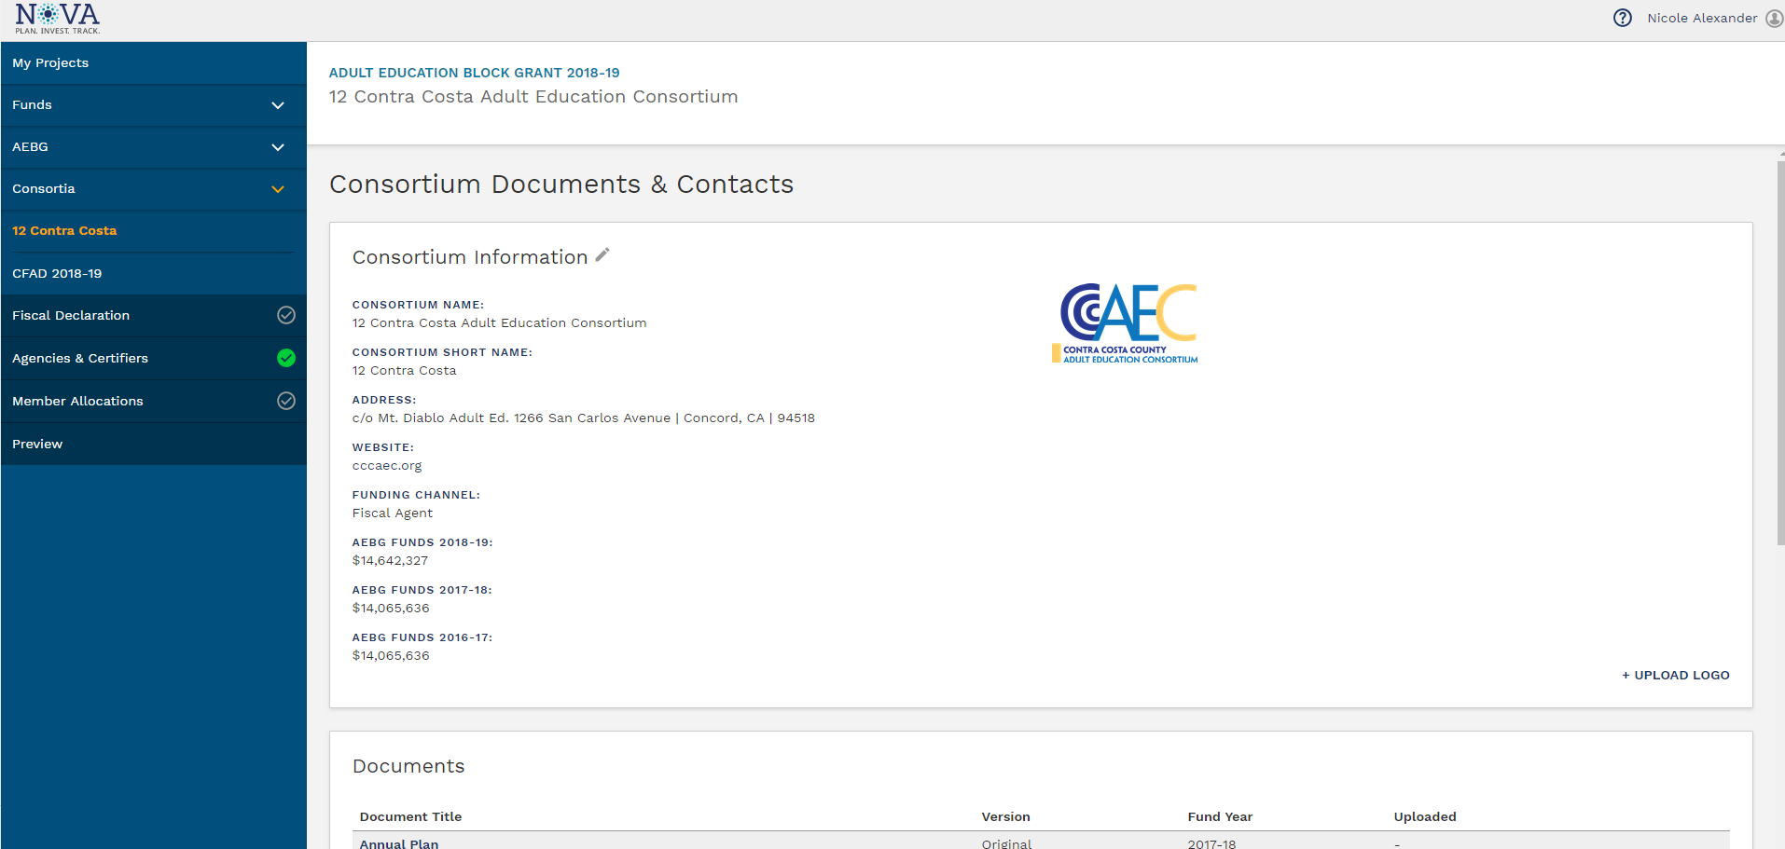

Slide 12
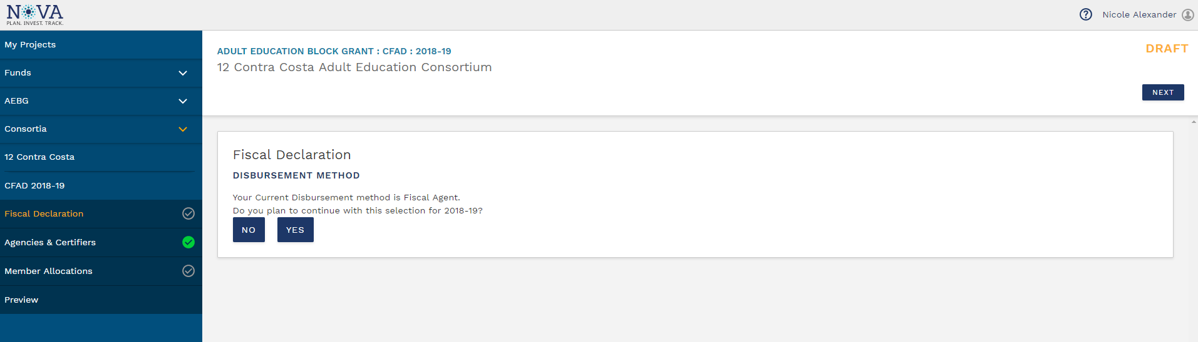
Fiscal Declaration Section

Slide 13
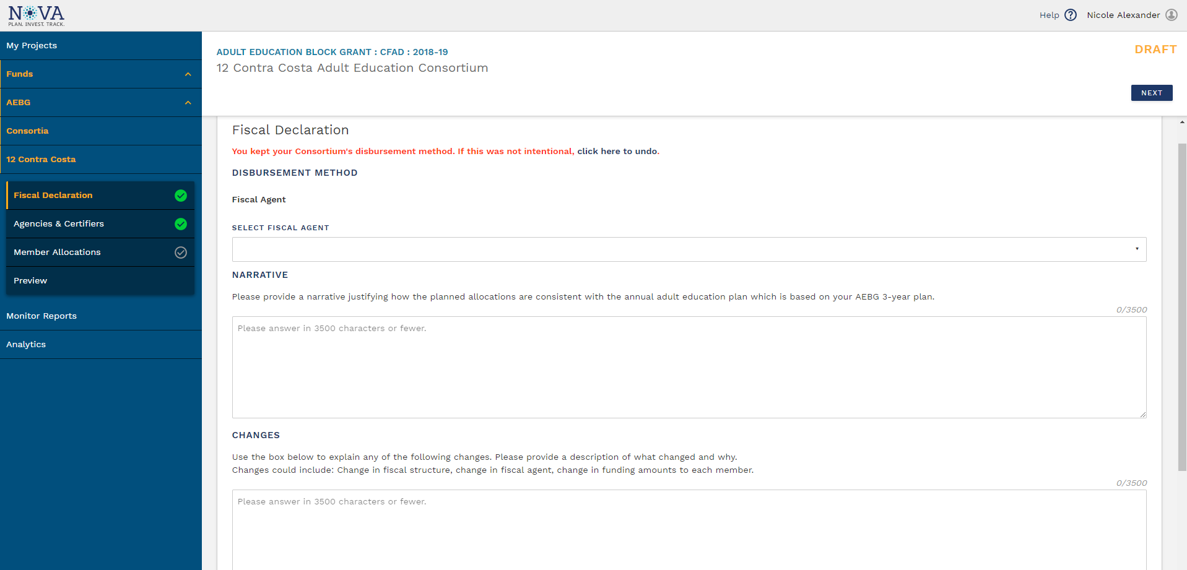
Selecting Yes for Fiscal Declaration
(continues with current disbursement method)

Slide 14
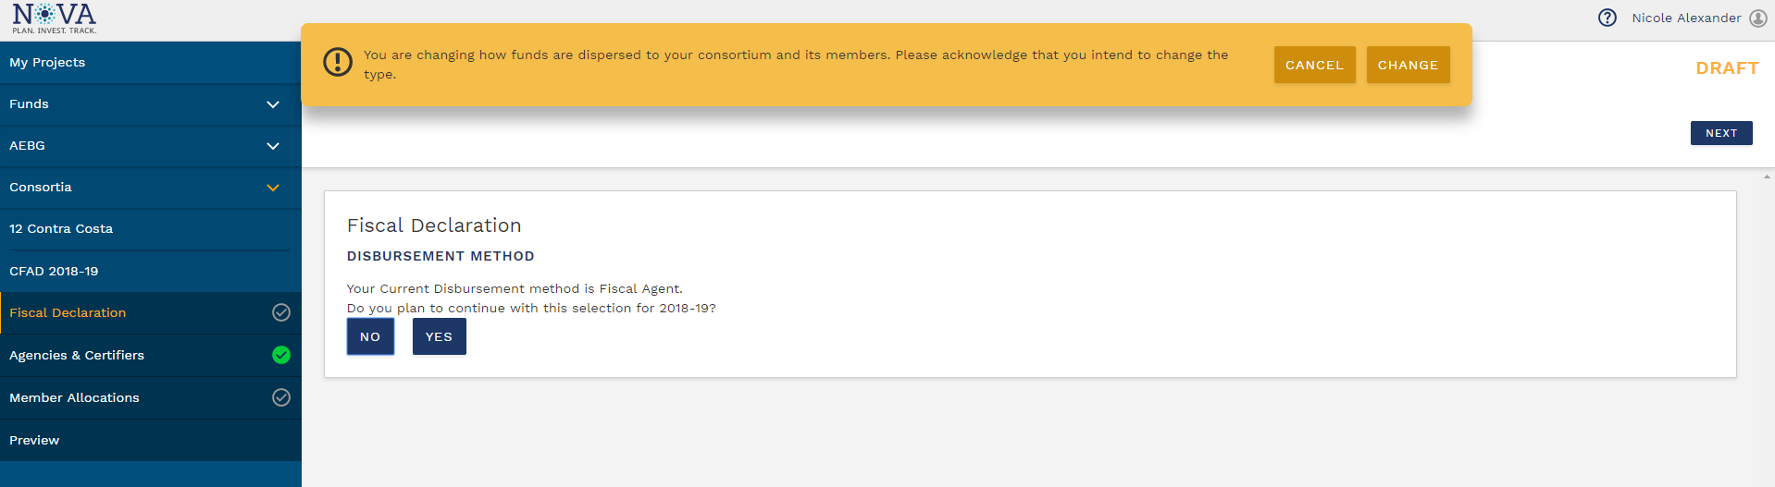
Selecting No for Fiscal Declaration
(changes disbursement method)

Slide 15
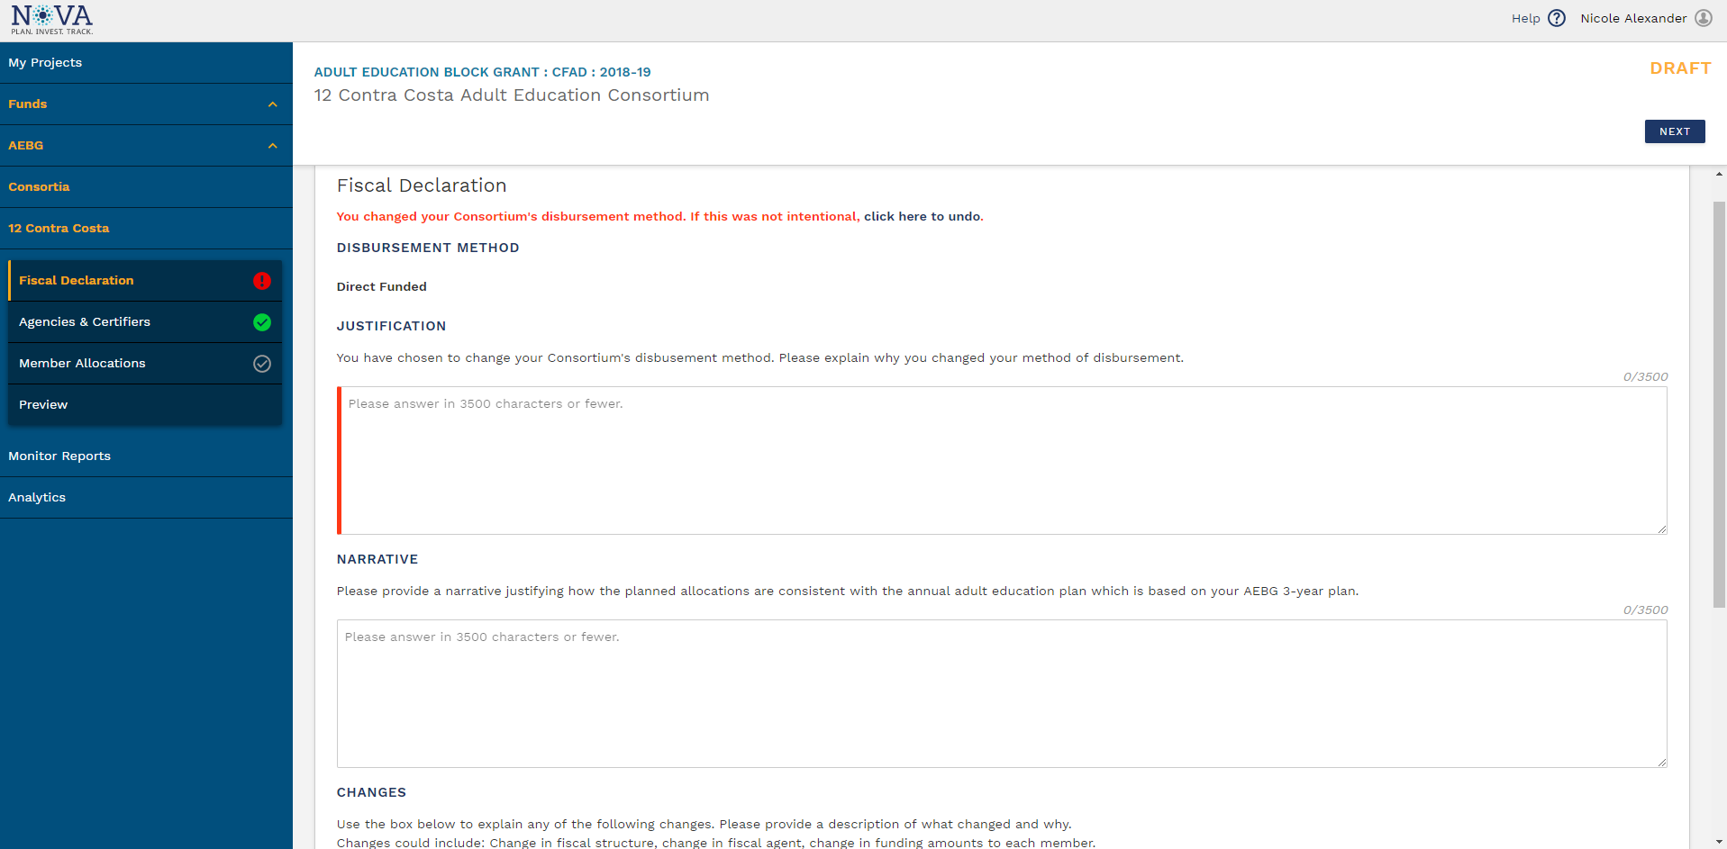
Selecting No for Fiscal Declaration
(changes disbursement method)

Slide 16
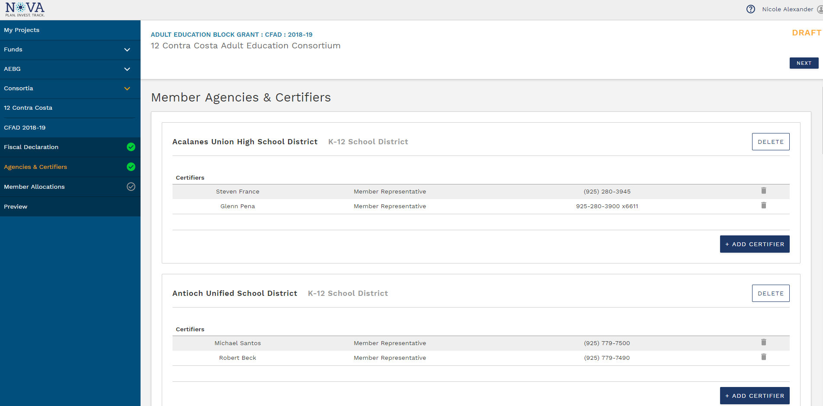
Agencies and Certifiers Section

Slide 17
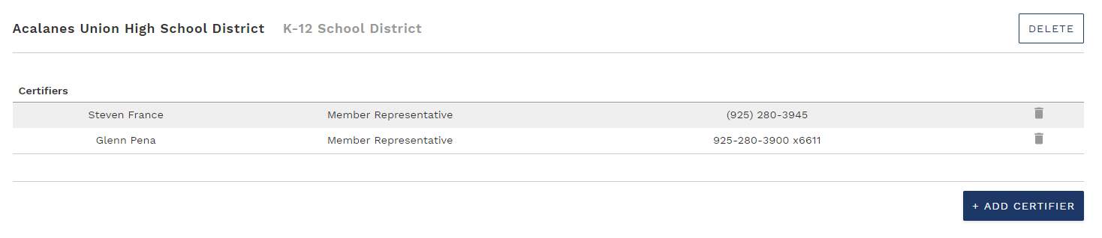
Adding and Removing Certifiers

Slide 18
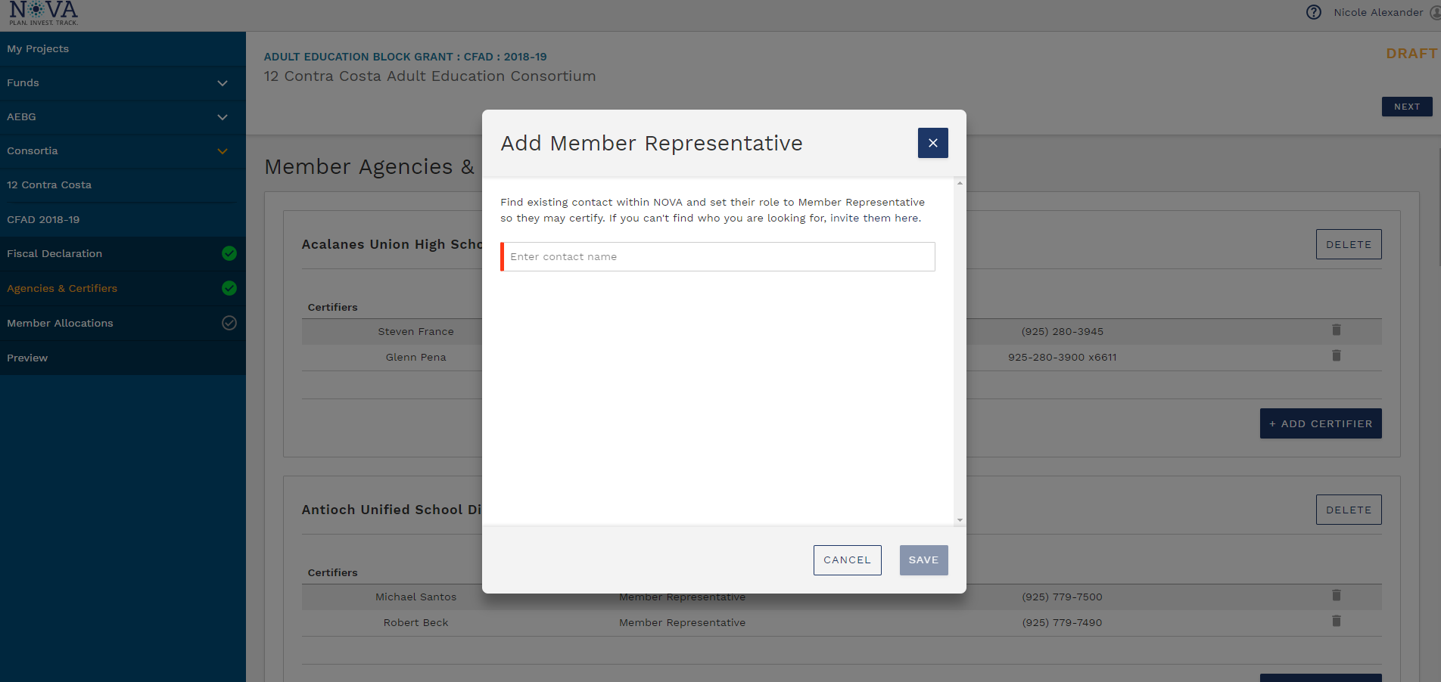
Adding Certifiers

Slide 19
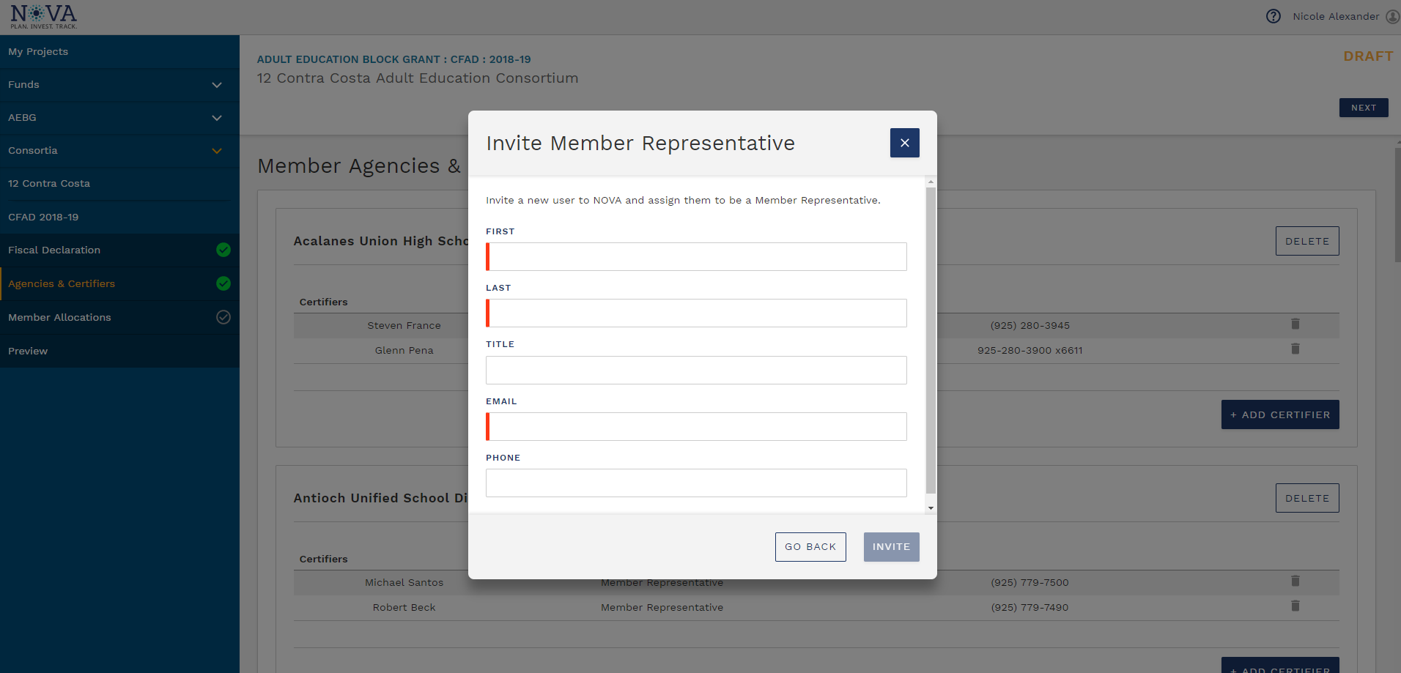
Adding Certifiers

Slide 20
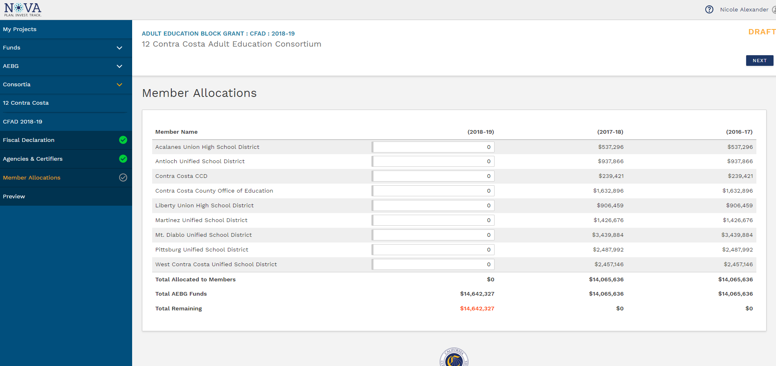
Member Allocations Section

Slide 21
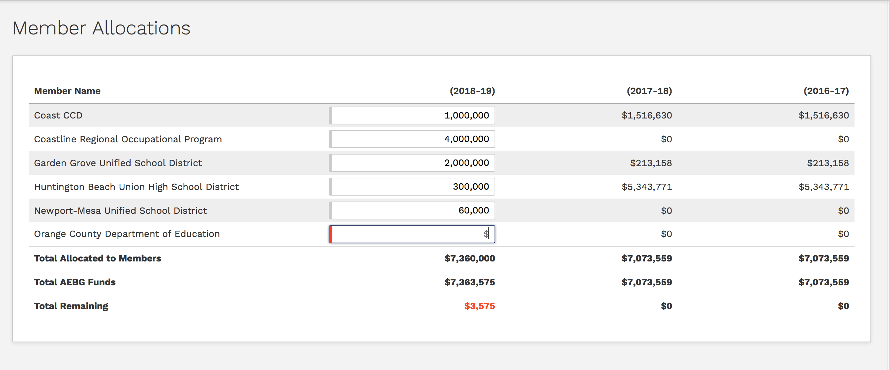
Member Allocations Section

Slide 22
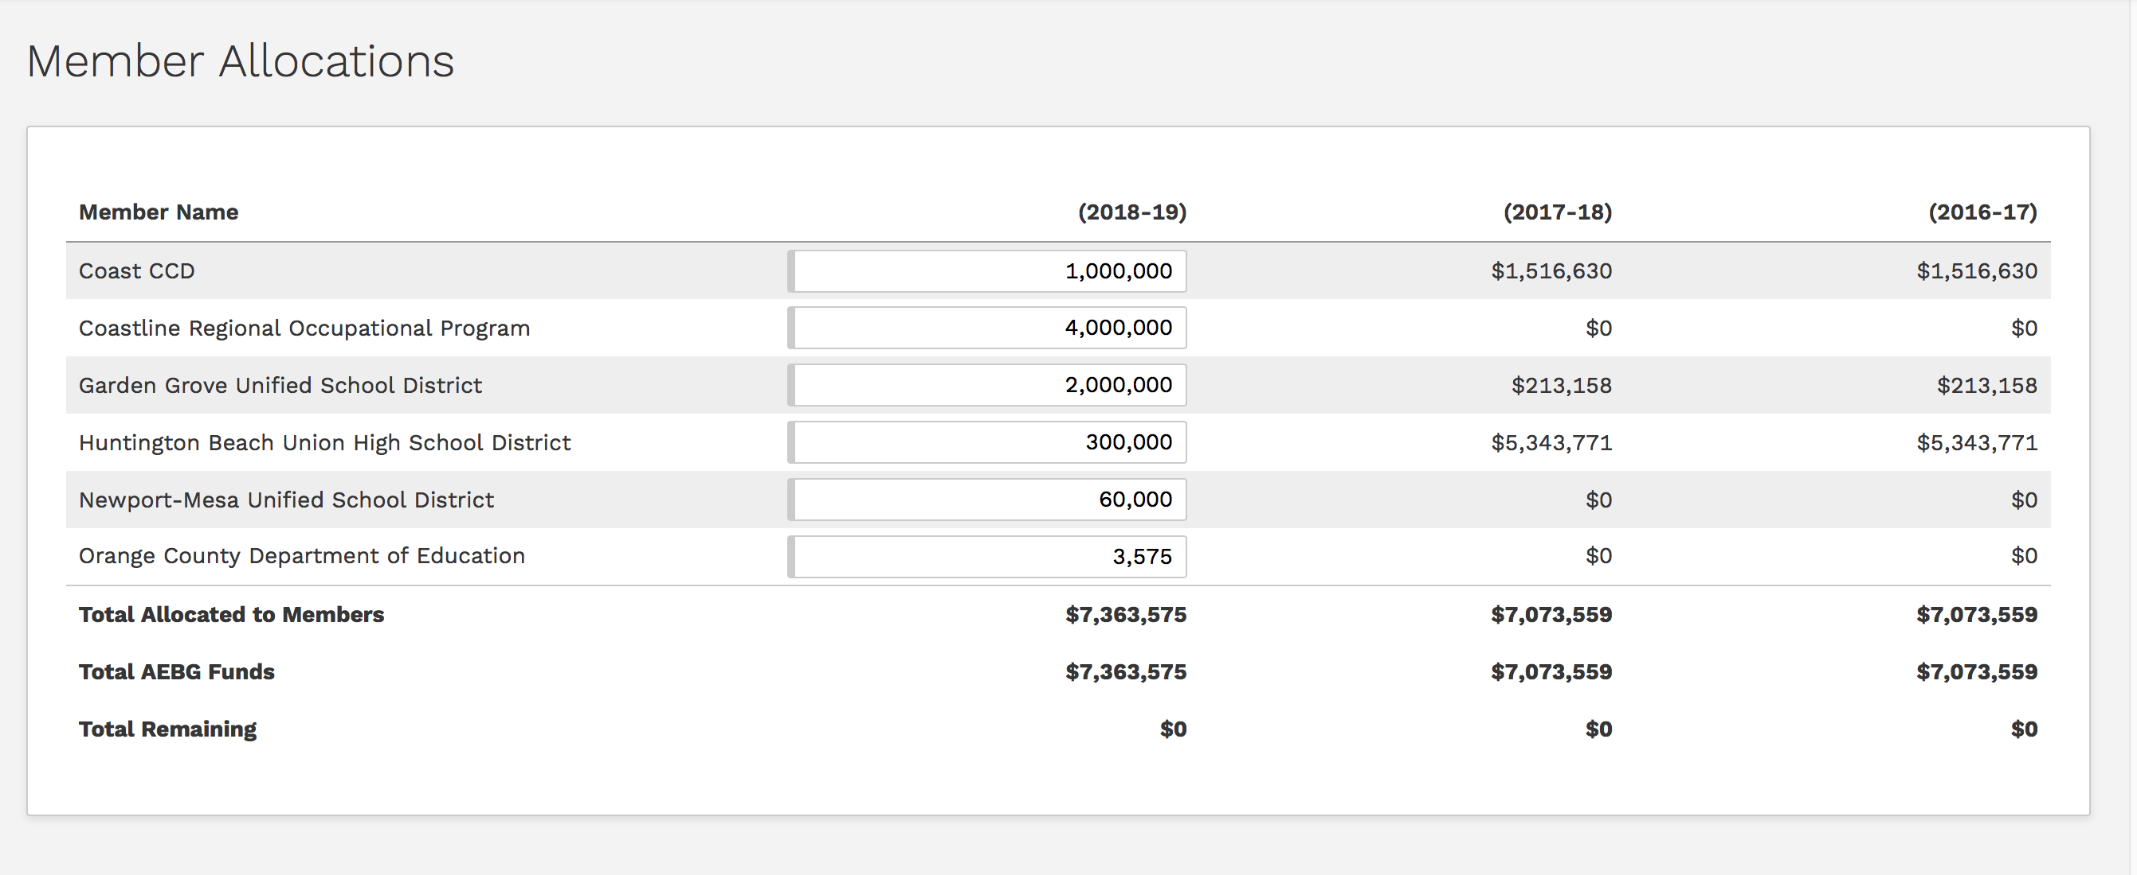
Member Allocations Section

Slide 23
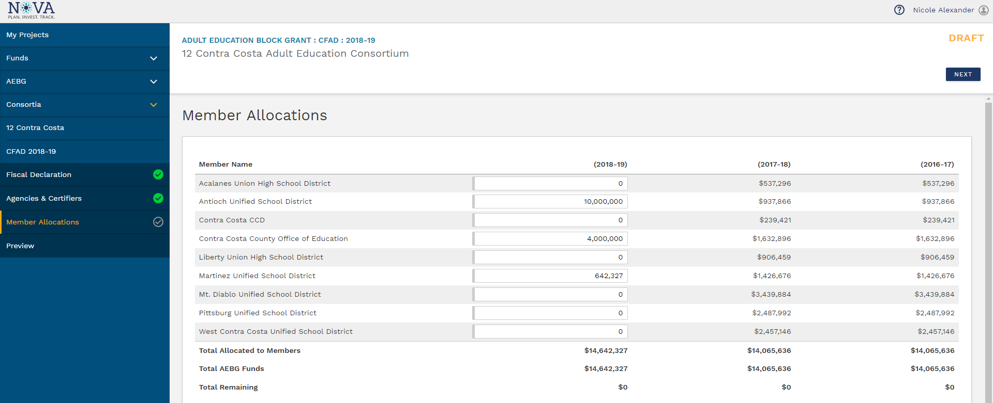
Member Allocations Section

Slide 24
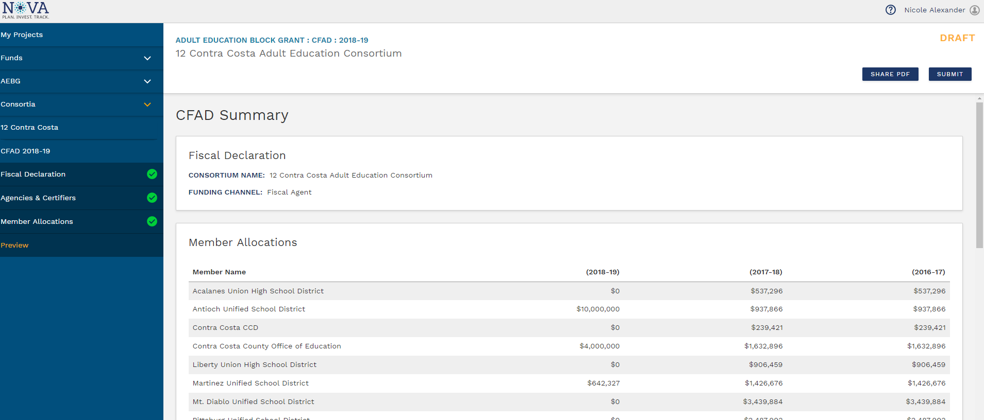
Preview and Submit Section

Slide 25
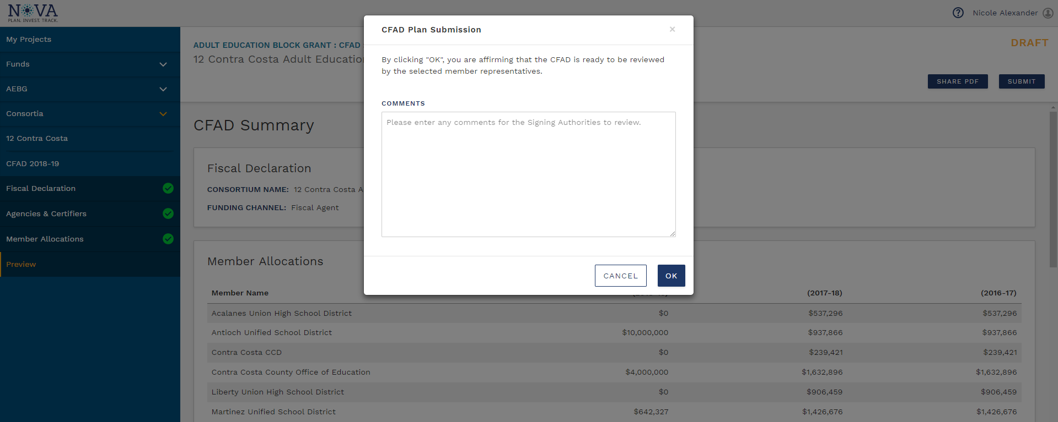
Preview and Submit Section

Slide 26
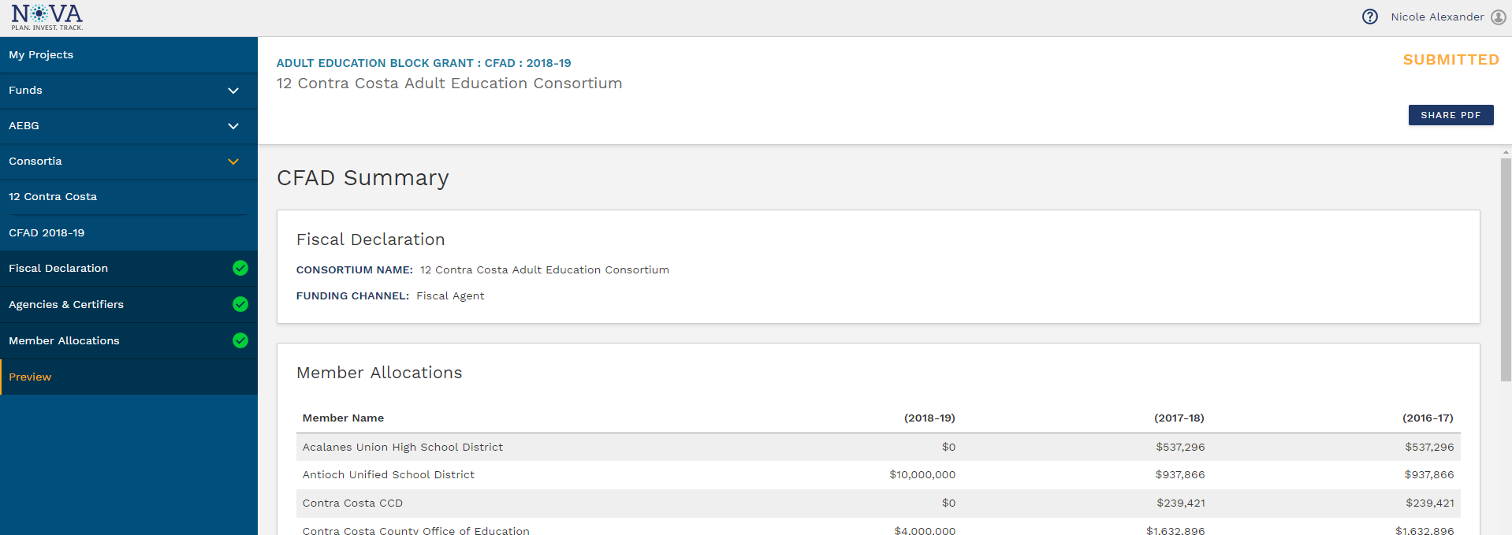
Preview and Submit Section

Slide 27
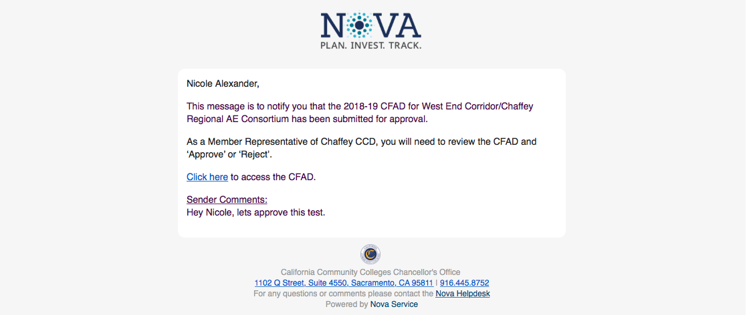
Member Review and Approval Process

Slide 28
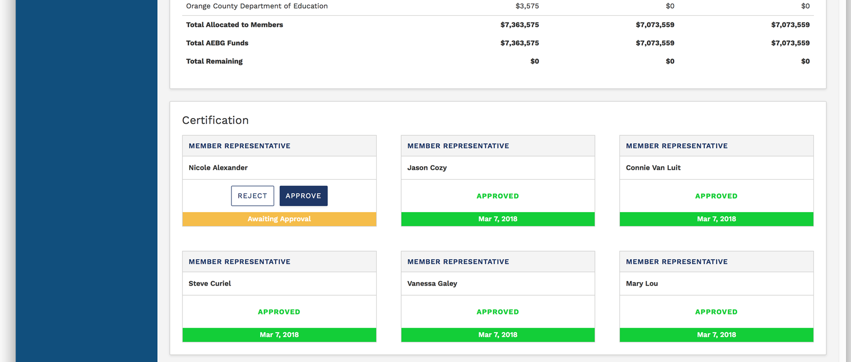
Member Review and Approval Process

Slide 29
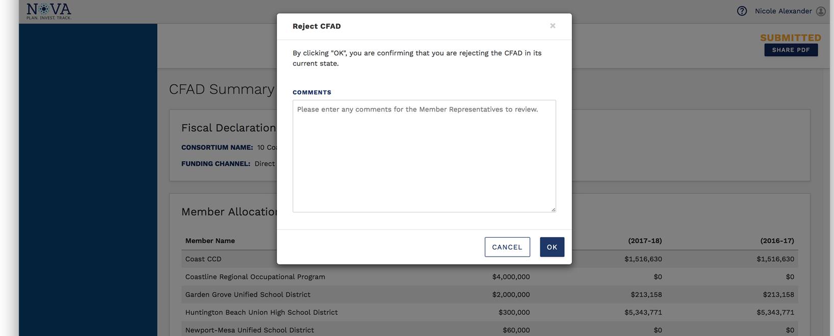
Member Rejection of CFAD

Slide 30
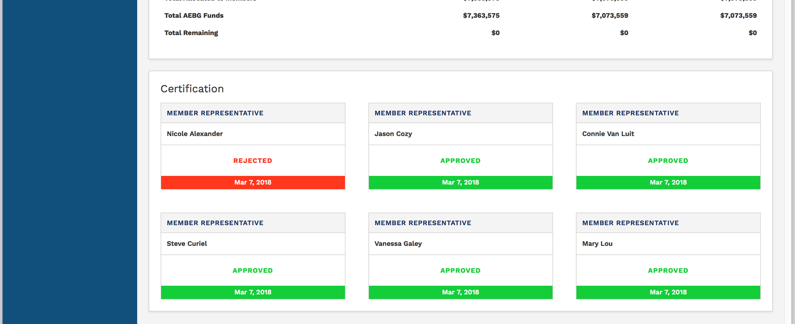
Member Review and Approval Process

Slide 31
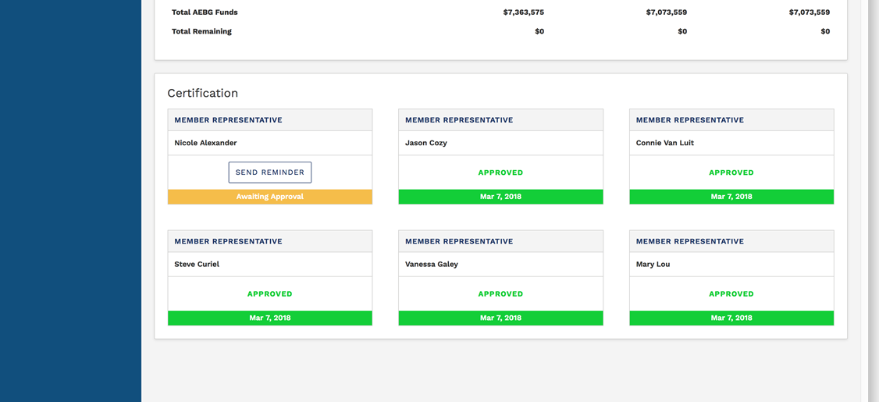
Member Review and Approval Process

Slide 32
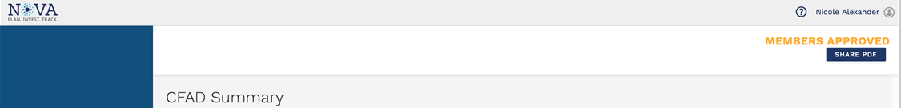
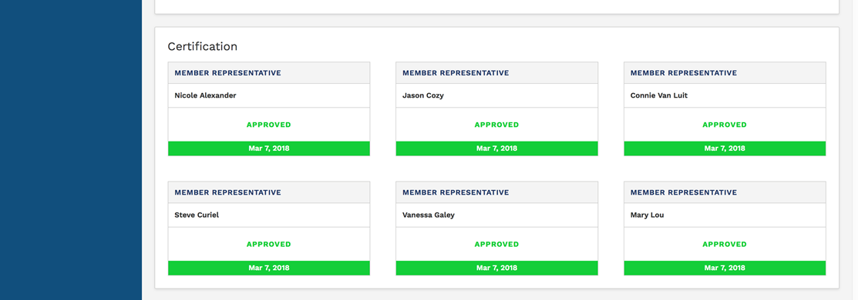
Member Review and Approval Process

Slide 33
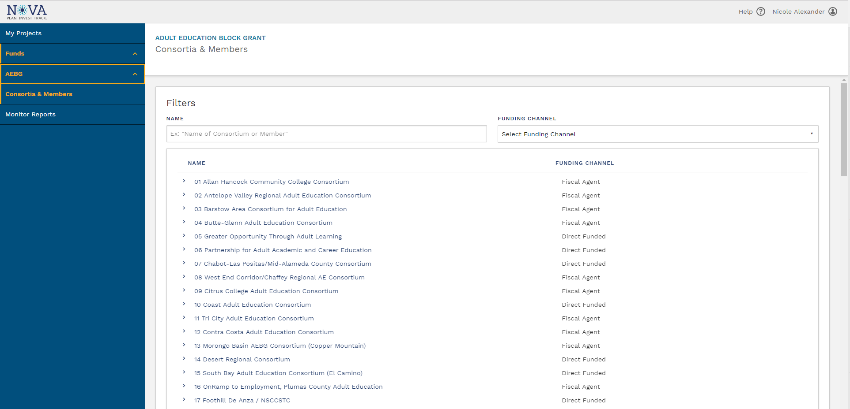
Coming Soon: Updated Navigation

Slide 34
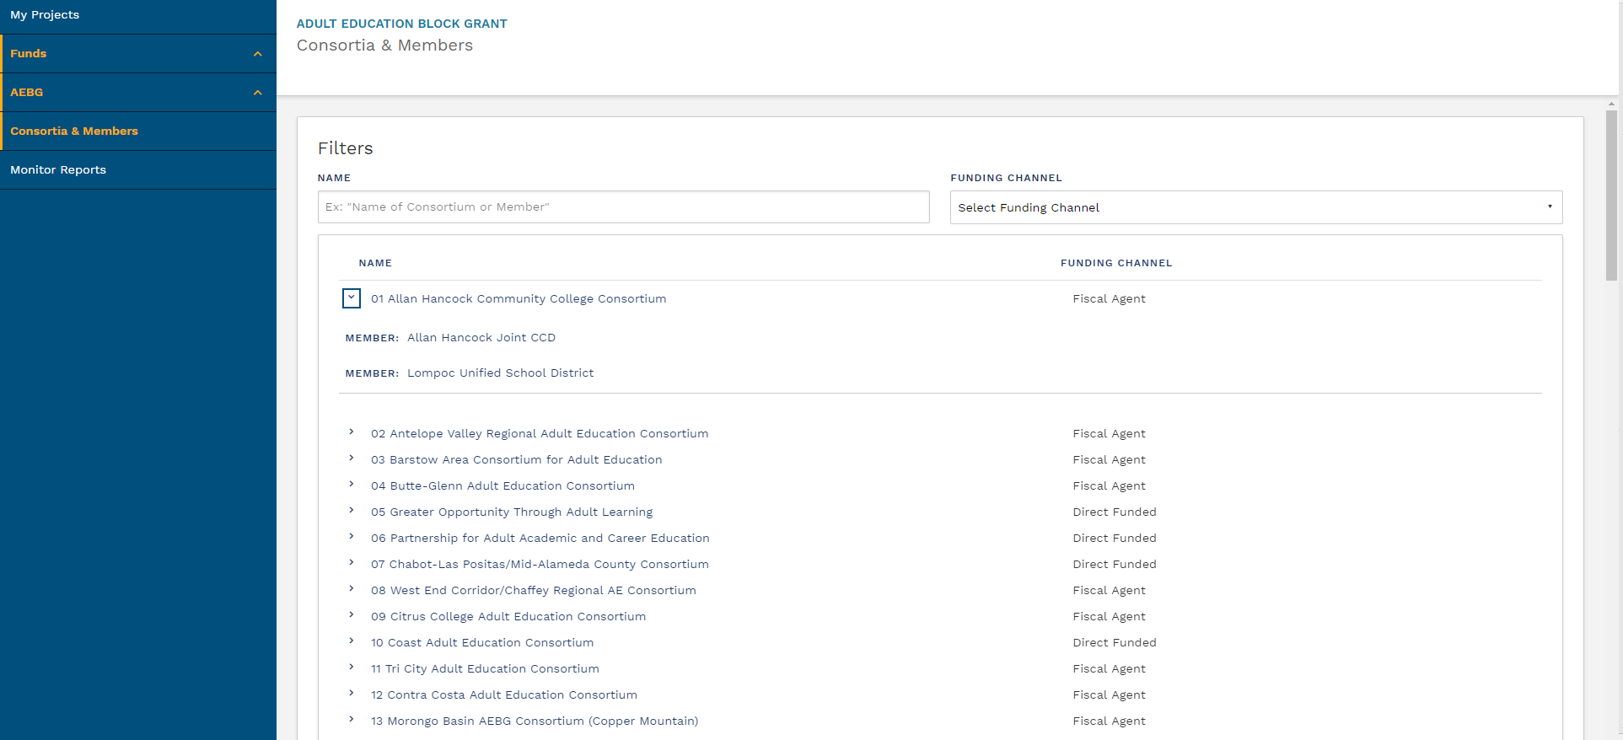
Coming Soon: Updated Navigation

Slide 35
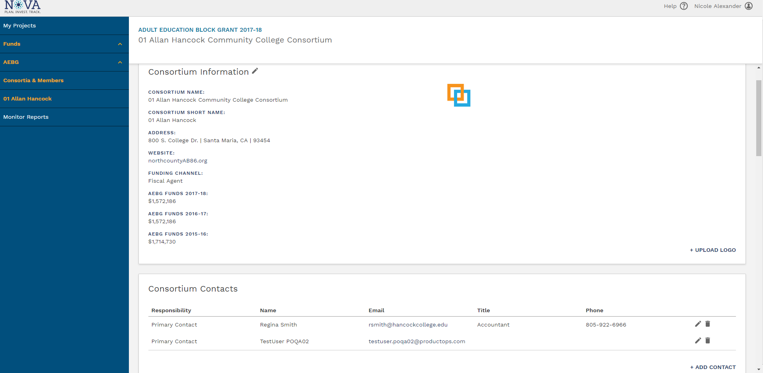
Coming Soon: Main Consortium Page

Slide 36
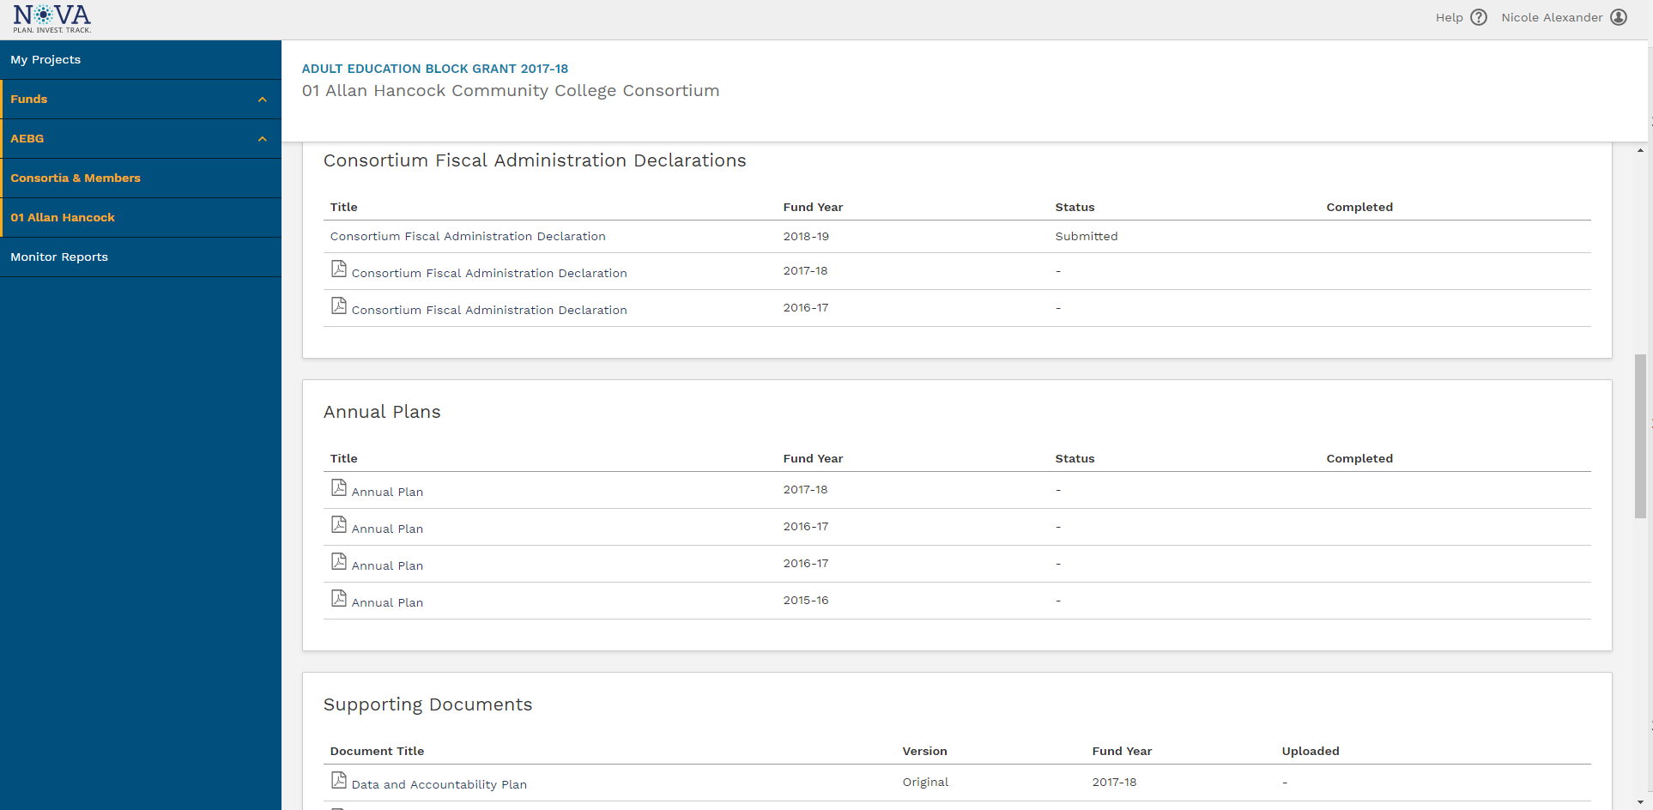
Coming Soon: Main Consortium Page

Slide 37
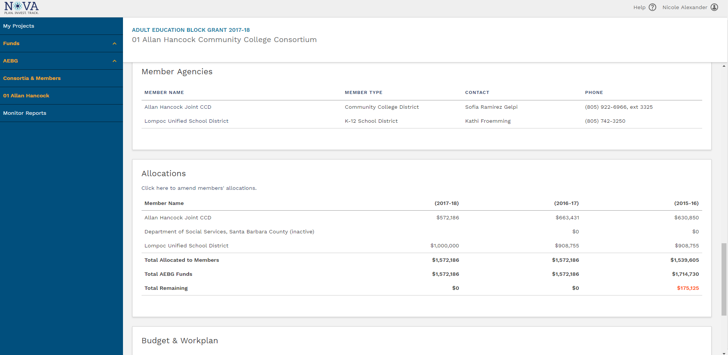
Coming Soon: Main Consortium Page

Slide 38
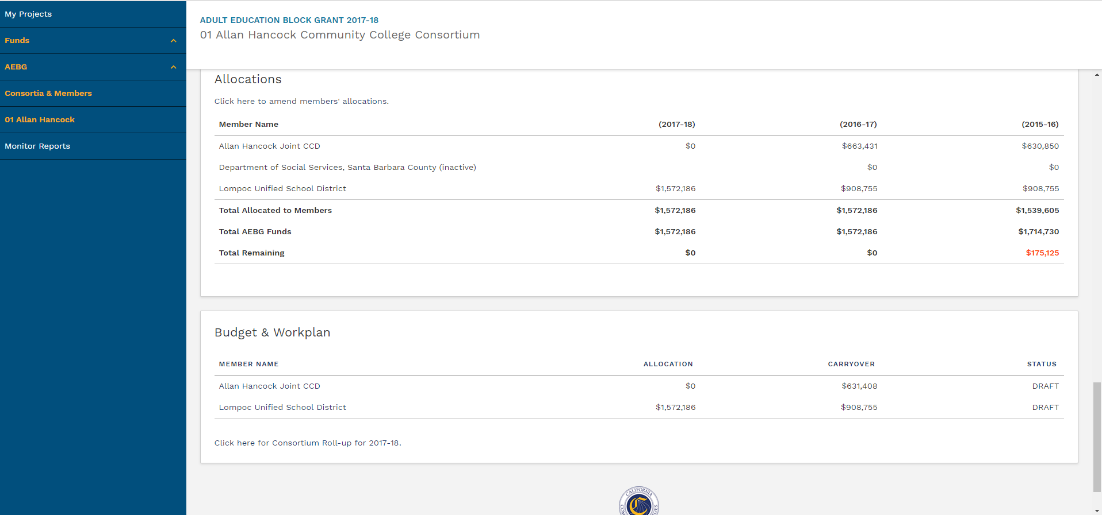
Coming Soon: Main Consortium Page

Slide 39
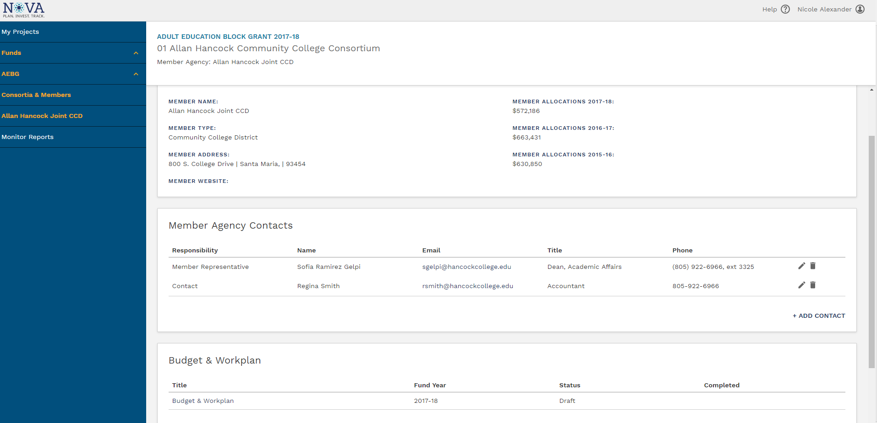
Coming Soon: Member Agency Page

Slide 40
AEBG Allocation Amendments

Slide 41
AEBG Allocation Amendments
AEBG member allocations can be amended after the CFAD is submitted, and consortia can adjust allocations throughout the year (with consent of its membership) based on member activities, carry over, regional needs, etc.
These adjustments do not impact or change the CFAD as that is a one-time, once-a-year process.
Also, the adjustments do not affect the prior year allocations by member.

Slide 42
AEBG Allocation Amendments (cont.)
Direct Funded: Keep in mind, if you are direct funded, it will be difficult to amend allocations for members during the August-June disbursement process from the State Controllers to County Offices to Member Districts.
The members would have the transfer funds to other members as the State will not alter the disbursement schedules once the May 2nd CFAD is submitted.

Slide 43
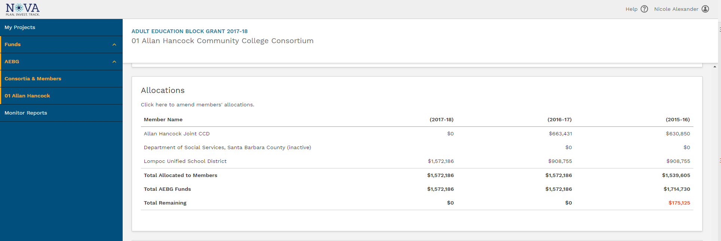
Coming Soon: Allocation Amendments

Slide 44
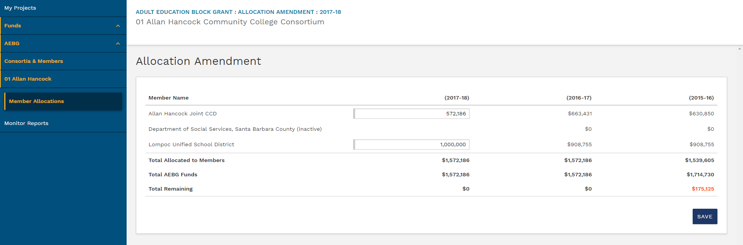
Coming Soon: Allocation Amendments

Slide 45
NOVA AEBG Expense Reporting
Preview

Slide 46
NOVA Due Dates- 2018
June 1st - Member expenses reports & budget changes due – Q1, Q2, & Q3.
August 15th - 18-19 Annual plans due in NOVA.
September 1st - Member end of the year Financial Reports due. (Consortium certification by 9/30)
September 30th - 18-19 Member work plans & budgets due. (Consortium certification by 10/31)
December 1st – Q1 (18-19) expenses due by member (Consortium certification by 12/31).

Slide 47
NOVA Expense Reporting
Currently working on programming. Dates are sill subject to change.
Member expenses reports & budget changes – Q1, Q2, & Q3 – all due by June 1st .
Consortium will approve by June 30th.
Members can make budget changes during the expense reporting process (15% threshold).
Targets – 60% of 16-17 carry-over and 17-18 new funds must be spent by Q4.
Failure to meet targets will result in a corrective action plan.

Slide 48
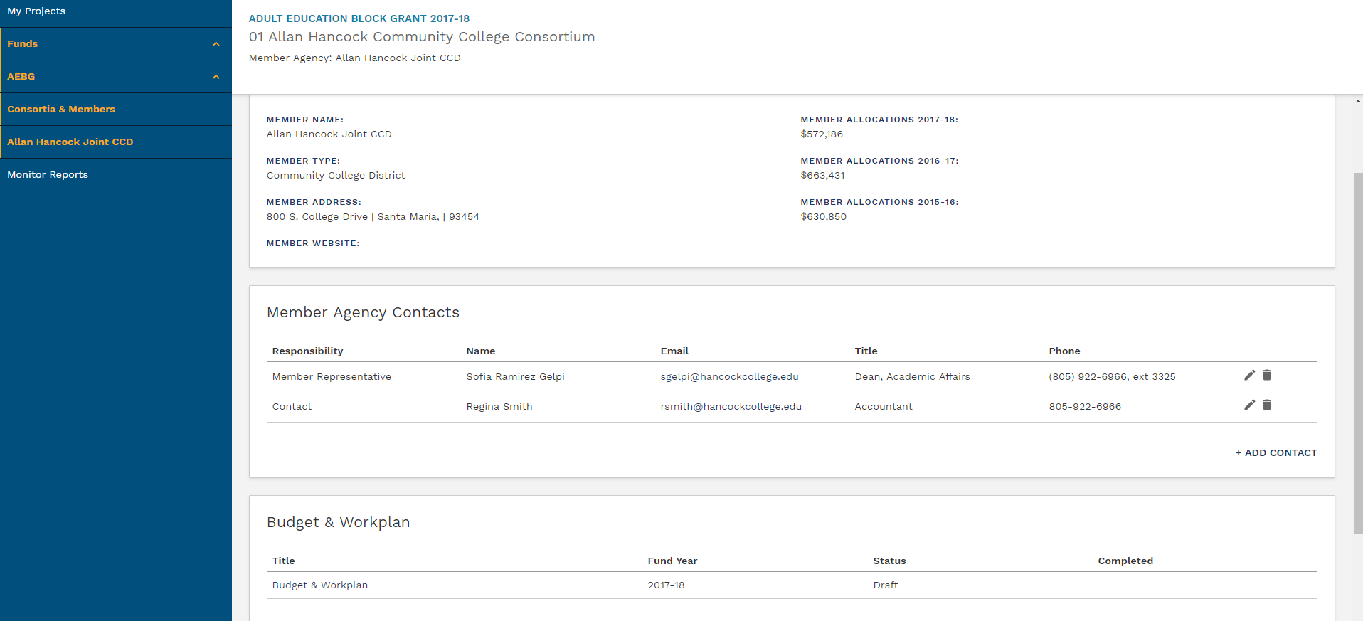
Coming Soon: Budget Revisions

Slide 49
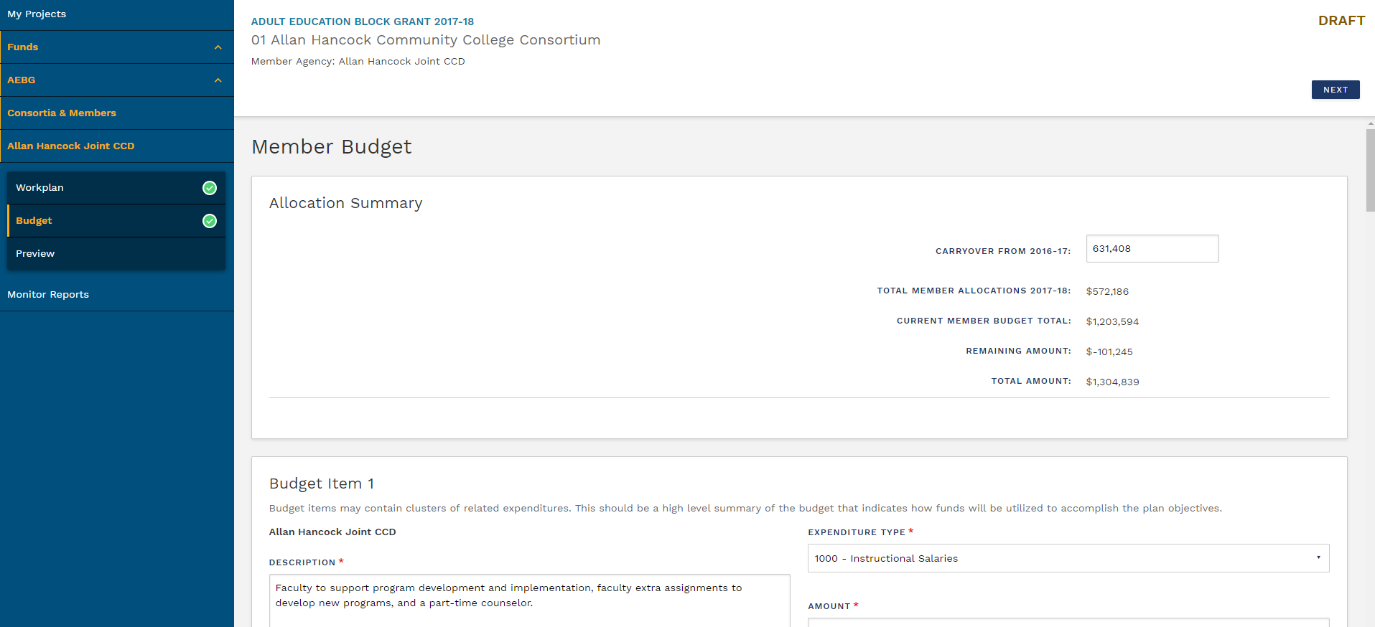
Coming Soon: Budget Revisions

Slide 50
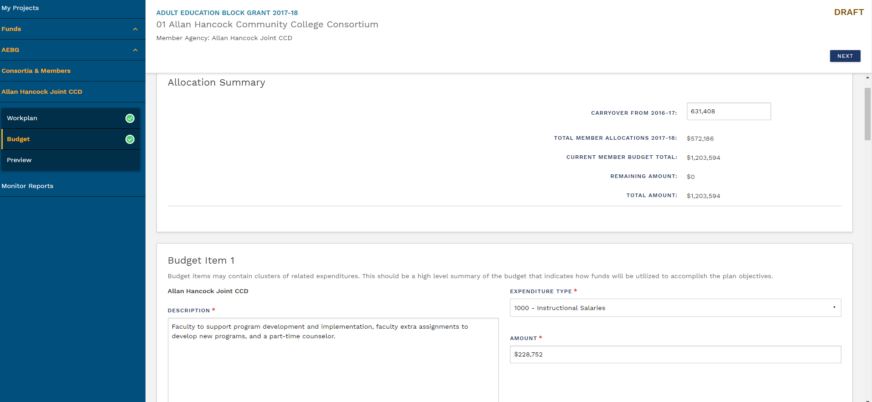
Coming Soon: Budget Revisions

Slide 51
NOVA End of the Year Financial Report
Expenses by program area for 17-18 (estimated)
Leveraged resources and fees charged for 17-18
Consortium level budget, expenses (program & admin/indirect), what activities the consortium performed, what members contributed to the consortium budget.
Q4 and final expenses for the program year
Carry over funds from 17-18 into 18-19
Corrective action plan for not meeting 60% target spending of carry-over & current year funds

Slide 52
AEBG Web Site
http://aebg.cccco.edu/Home

Slide 53
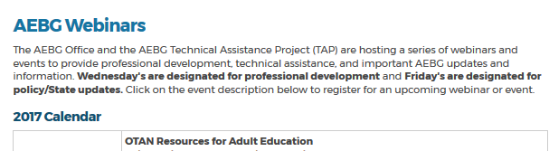
AEBG TAP
The AEBG Technical Assistance Program (TAP) provides professional development resources for all AEBG agencies statewide.
tap@aebg.org

