Slide 1
AEBG NOVA Webinar
2017-18 & 2018-19
September 14, 2018

Slide 2
Agenda
Technical Update
Budget Revisions
4Q Expense reporting
Target Spending
Close Out 16-17
18-19 Member Budget & Workplan
3 Year Plan Submission

Slide 3

Technical Update

Slide 4
Deadline Extensions
4Q expense reporting and certification has been extended 30 days.
18-19 member budget & workplans submission and certification has been extended 30 days.
Q1 expense reporting by members has not changed – still 12/1/18.

Slide 5
Deadline Extensions
4Q expense reporting was 9/1 now 10/1.
18-19 member budget & workplans submission was 9/30 now 10/30.
Q1 expense reporting by members has not changed – still 12/1/18.

Slide 6
Deadline Reminders
Data & Accountability funds – program ends 12/31/18.
Budget revisions are due by 12/17/18.
All activities end 12/31/18.
Final expense report due 1/31/19.
Close Out due February 2019.
All reporting in the Chancellor’s MIS webex system (old system).
Passwords are needed.

Slide 7
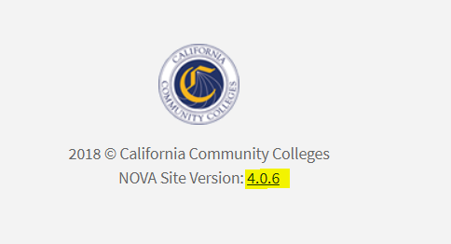

Slide 8
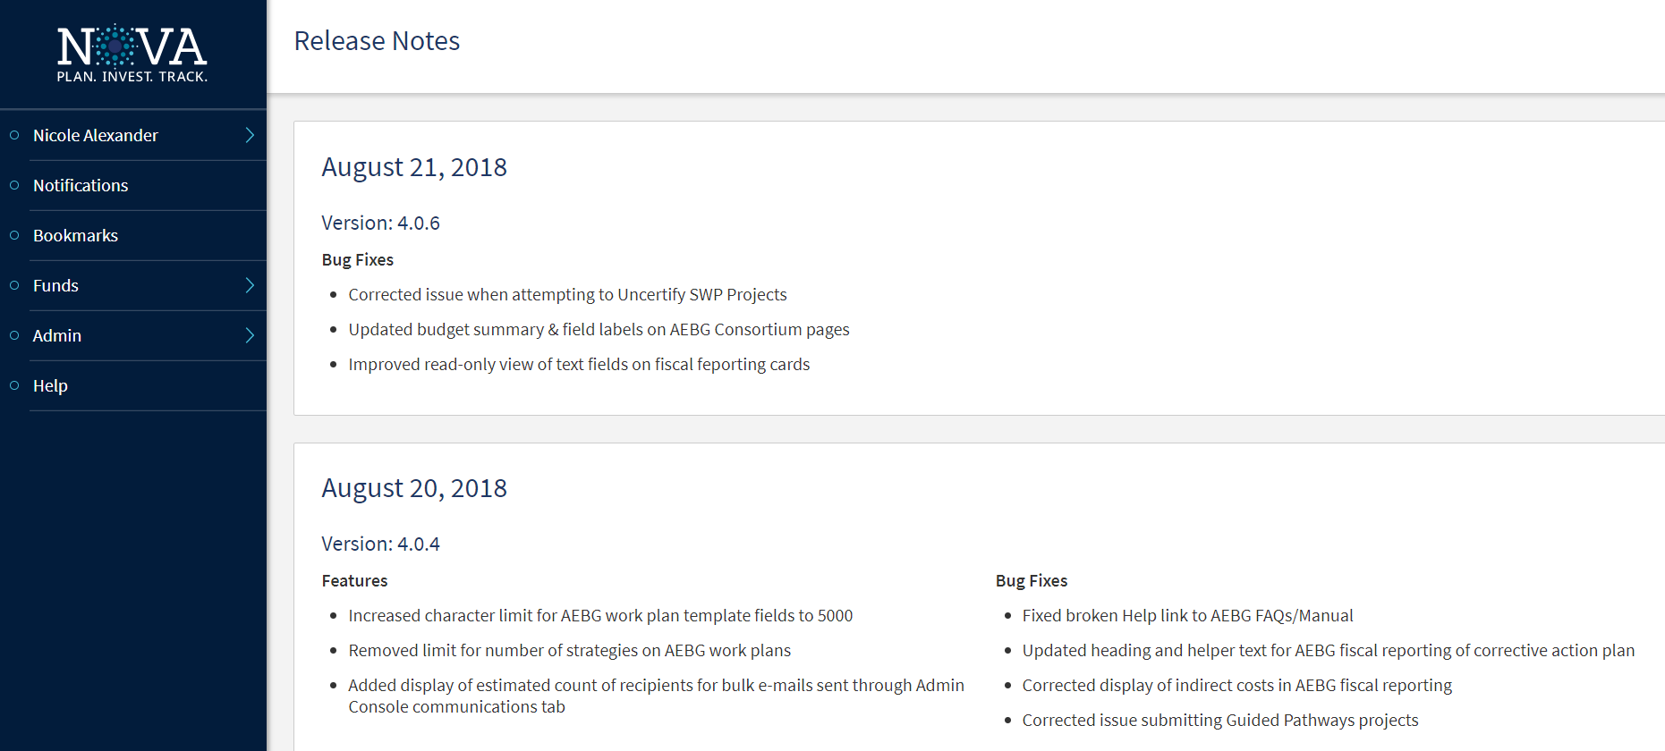
NOVA Release Notes

Slide 9
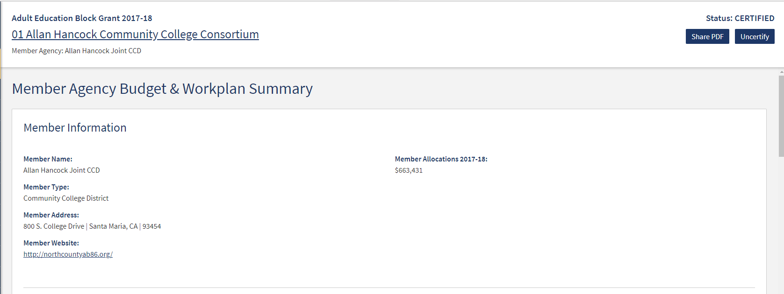
Budget Revisions

Slide 10

Expense Reporting

Slide 11
4Q Expenses- 2017-2018
Must be positive numbers – no negatives…..
Expenditure report cannot be submitted if expenditures exceed the allocated amount for a given object code (no negative balances).

Slide 12
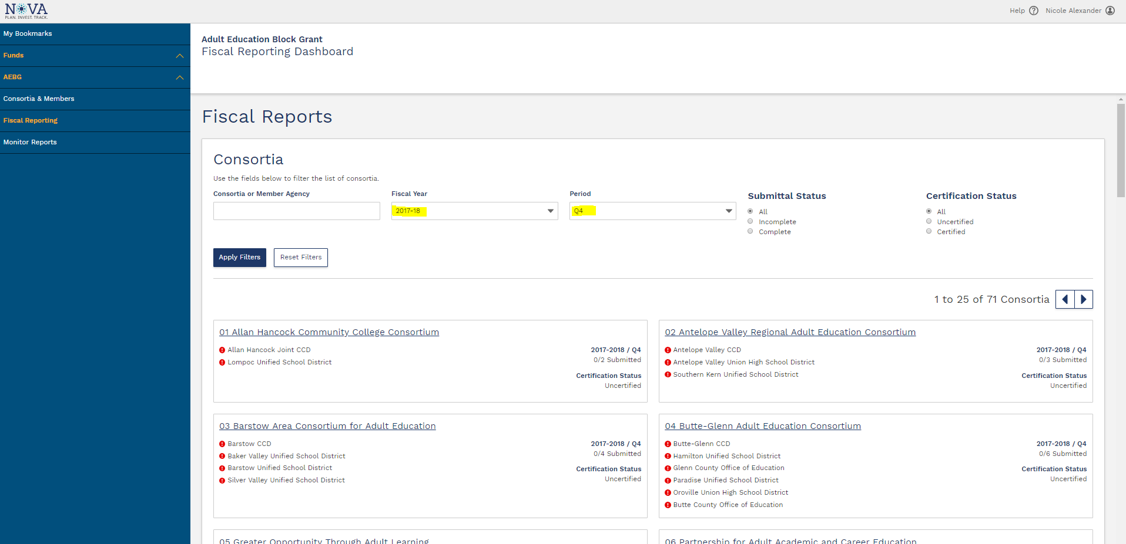
Expenditure Reporting
12

Slide 13
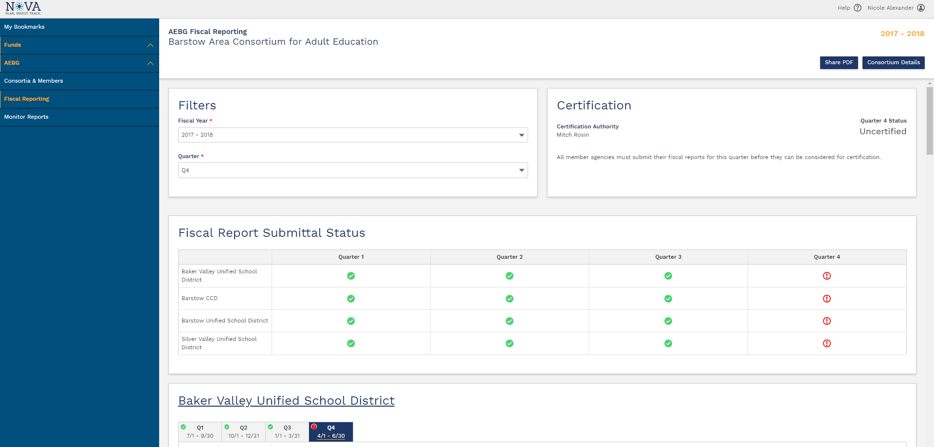
Expenditure Reporting
13

Slide 14
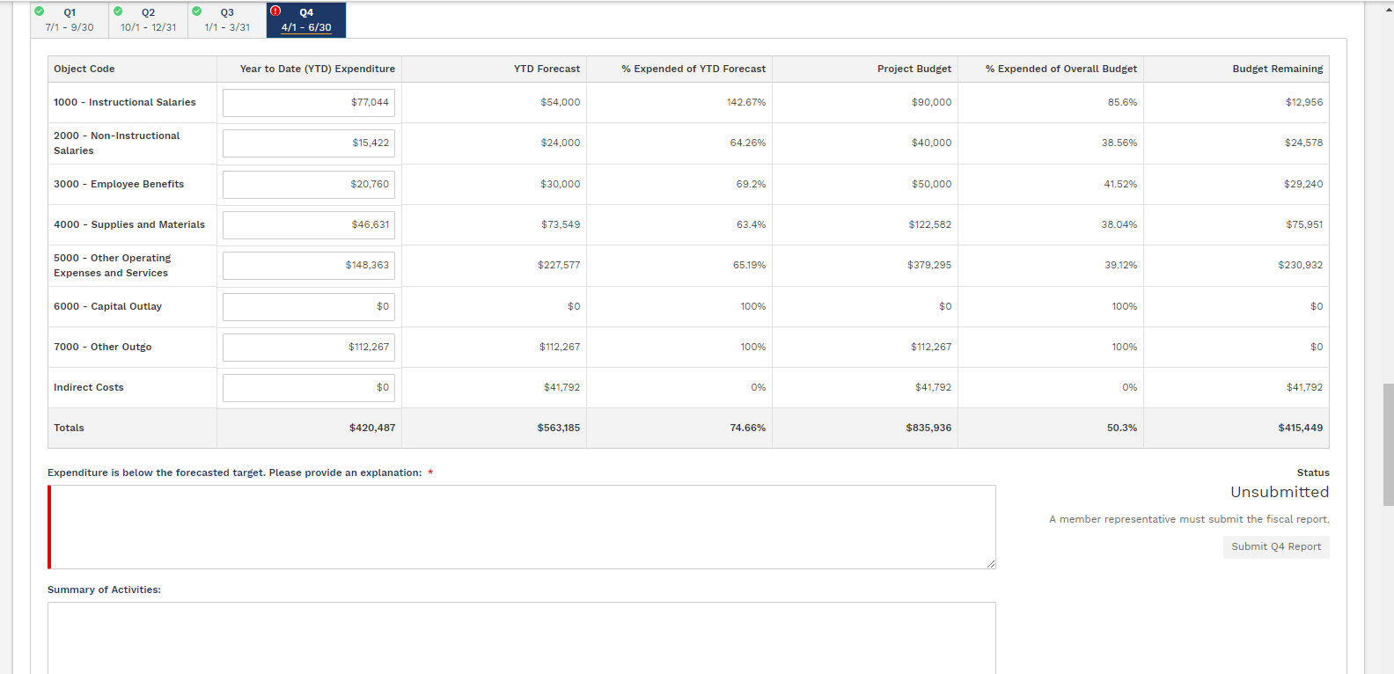
Expenditure Reporting
14

Slide 15
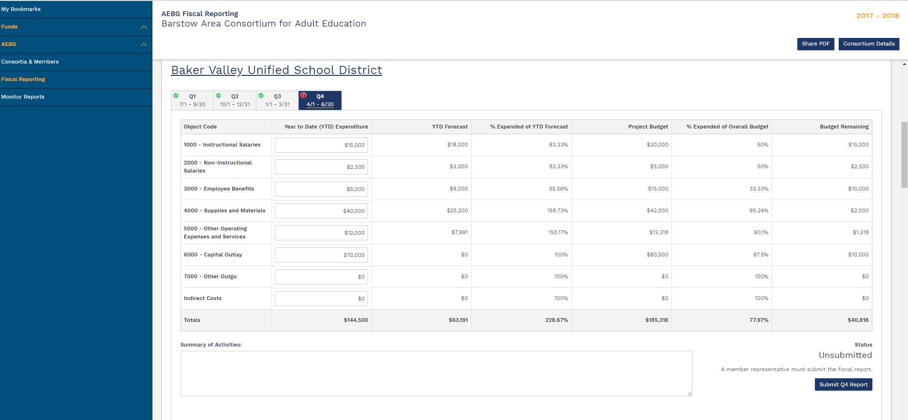
Expenditure Reporting
15

Slide 16
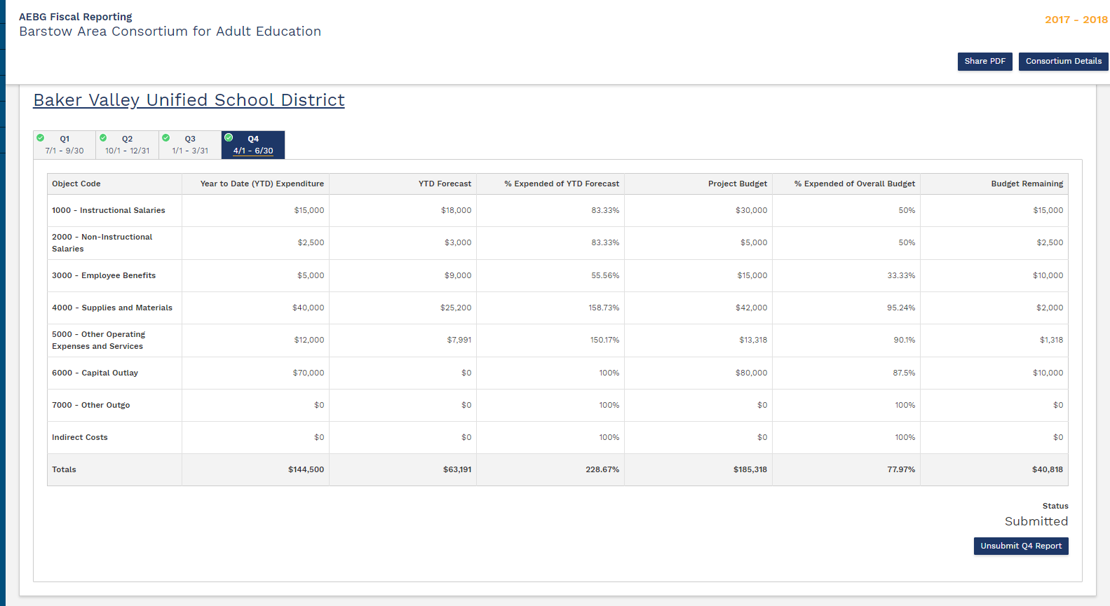
Expenditure Reporting
16

Slide 17
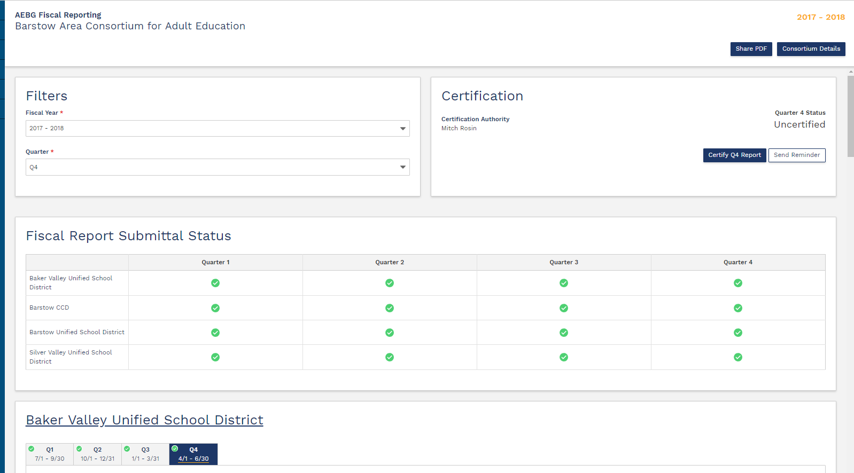
Expenditure Reporting
17

Slide 18
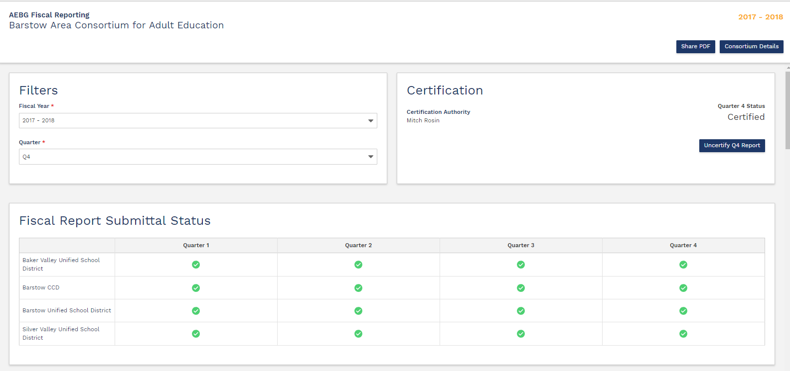
Expenditure Reporting
18

Slide 19


NOVA Targets

Slide 20
NOVA Targets
To continue to spend down 16-17 carry over funds to 12-31-18 – you will need a corrective action plan. Same will apply to 17-18 carry over for June 30, 2019.
This is completed via the narrative field for corrective action plan in the Q4 expenditure report.
Header title: “Corrective Action Plan: Expenditures fall below target. Please provide the action steps that will be taken to address this issue.”

Slide 21
NOVA Close Out
Keep in mind – AEBG/AEP funds still have a shelf life, they do expire, and we will be closing out every year.
For example: 16-17 funding.
Target spending June 30, 2018 – fully expended
With a corrective action plan – can extend to 12/31/18.
All activities related to 16/17 funds must cease by 12/31/18 (which is the end of the 2nd quarter of the SFY).

Slide 22
NOVA Close Out (cont.)
Q2 expense reports are due 3/1/19 with consortium approval due by 3/31/19.
NOVA will close out 16-17 funds in April of 2019. Each member will certify their close out.
Remaining 16-17 funds will be invoiced by the state and paid back by the member to the general fund.
The invoice process will take place in late April/May 2019.
State Accounting Offices will close the books on AEBG/AEP 16-17 funding in June 2019.

Slide 23
18-19 Member Budget & Workplan
Same as last year.
Click on the strategies listed in the annual plan.
Budget based on object codes.
Separate line for indirect at the member level.
Don’t combine the indirect for the member with the consortium administrative if you are a member holding funds for consortium activities. Place on different line items.

Slide 24
3 Year Planning Guidance
Draft Guidance was released last week for comment.
Very few comments have been received.
Webinars and workshops roll out next month.
Process training cohorts (Human Center Design) have already started.
Member resources required for the 3 year plan will be available through NOVA. Part of the total expenses by program area (operational costs) exercise due March of 2019.

Slide 25
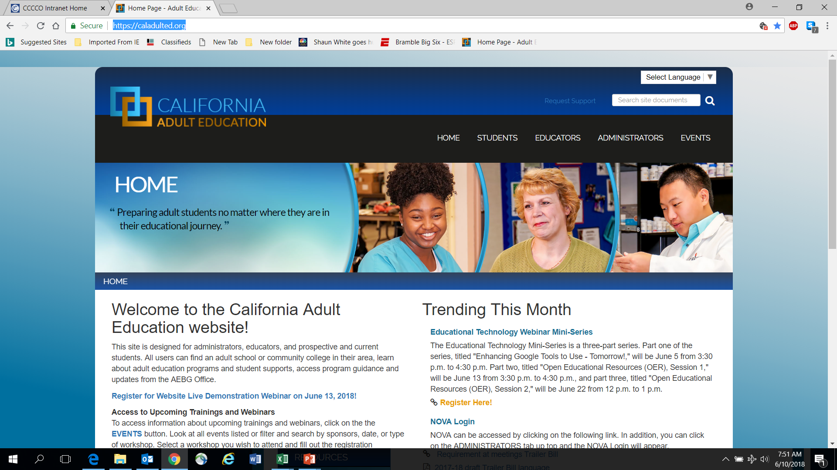
AEBG Web Site
https://caladulted.org/

Slide 26
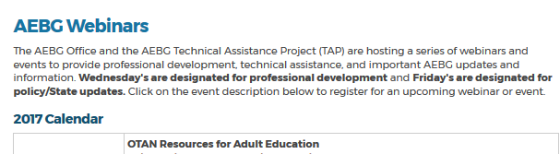
AEBG TAP
The AEBG Technical Assistance Program (TAP) provides professional development resources for all AEBG agencies statewide.

