Slide 1
CAEP CFAD Webinar
19-20 Allocation
April 5, 2019

Slide 2
Agenda
19-20 Allocation Process
CFAD Criteria & Timeline
CFAD Processing & Deliverables
CFAD Q & A
NOVA CFAD
Allocation Amendments
NOVA Allocation Amendment
Open Discussion

Slide 3
19-20 CAEP Allocation Process
January – Governor’s Budget is Released
February – CAEP Preliminary Allocation are released at the consortium level (includes COLA)
March-April – consortium members have public meetings (Brown Act) to discuss 19-20 allocation of funds.
May 2 – CFADs are due in NOVA.
June – Legislative approval
July 1 – Governor signs
August – schedules are send to State Controllers for disbursement

Slide 4
CFAD Criteria
The CFAD process meets the legislative requirement to have CAEP funding disbursed within 45 days of the Governor signing the state budget.
The CFAD is a one-time process due once a year on May 2nd.
The CFAD is used to by the State CAEP Office to document prior year allocations.
The CFAD is also used set up CAEP funding disbursement to direct funded and fiscal agent consortia.

Slide 5
CFAD Timeline
Review preliminary allocation amounts for 19-20 (totals).
Set up public meetings for discussion of allocating funds.
Get on the agenda for any local board approval.
Give yourself plenty of time for members to certify the CFAD in NOVA.
Get this all done by May 2, 2018.
Failure to have CFAD certified by May 2, 2018 – will force the state to use prior year allocation percentages.

Slide 6
CFAD Processing
In addition to the regular CFAD processing, the 19-20 COLA would be an across the board increase for all members.
If members are in agreement, you could use other options:
Allocation based on need in the community.
Help fund new members.
Reflect member carry over from prior year.
Factor in any member reductions.
Help fund next year projects that need resources.
Members have to be 100% in agreement to use an other option, instead of the across the board COLA increase.

Slide 7
CFAD Deliverables
Creation of the CFAD showing the 2019-20 distribution of funds to each member of the consortium.
A narrative explaining any fiscal changes – structure, fiscal agent, or prior year allocation amounts.
Designation by the consortium of the fiscal structure for 2019-20 - fiscal agent or direct-funded.

Slide 8
CFAD Q & A
Q: What happens if we miss the May 2nd deadline?
A: The State will use the prior year CFAD allocations (in case of the COLAs – a proportional percentage).
Q: If all the consortium members approve a change to the allocations, can a consortium change member allocations after May 2 in NOVA?
A: Yes. I will cover that under Allocation Amendments.
Q: Can we out vote a member that doesn't’ want to go along with a different allocation option?
A: No. Decision making bylaws do not apply to the CFAD processes. AB104 legislation is clear on prior year funding.

Slide 9
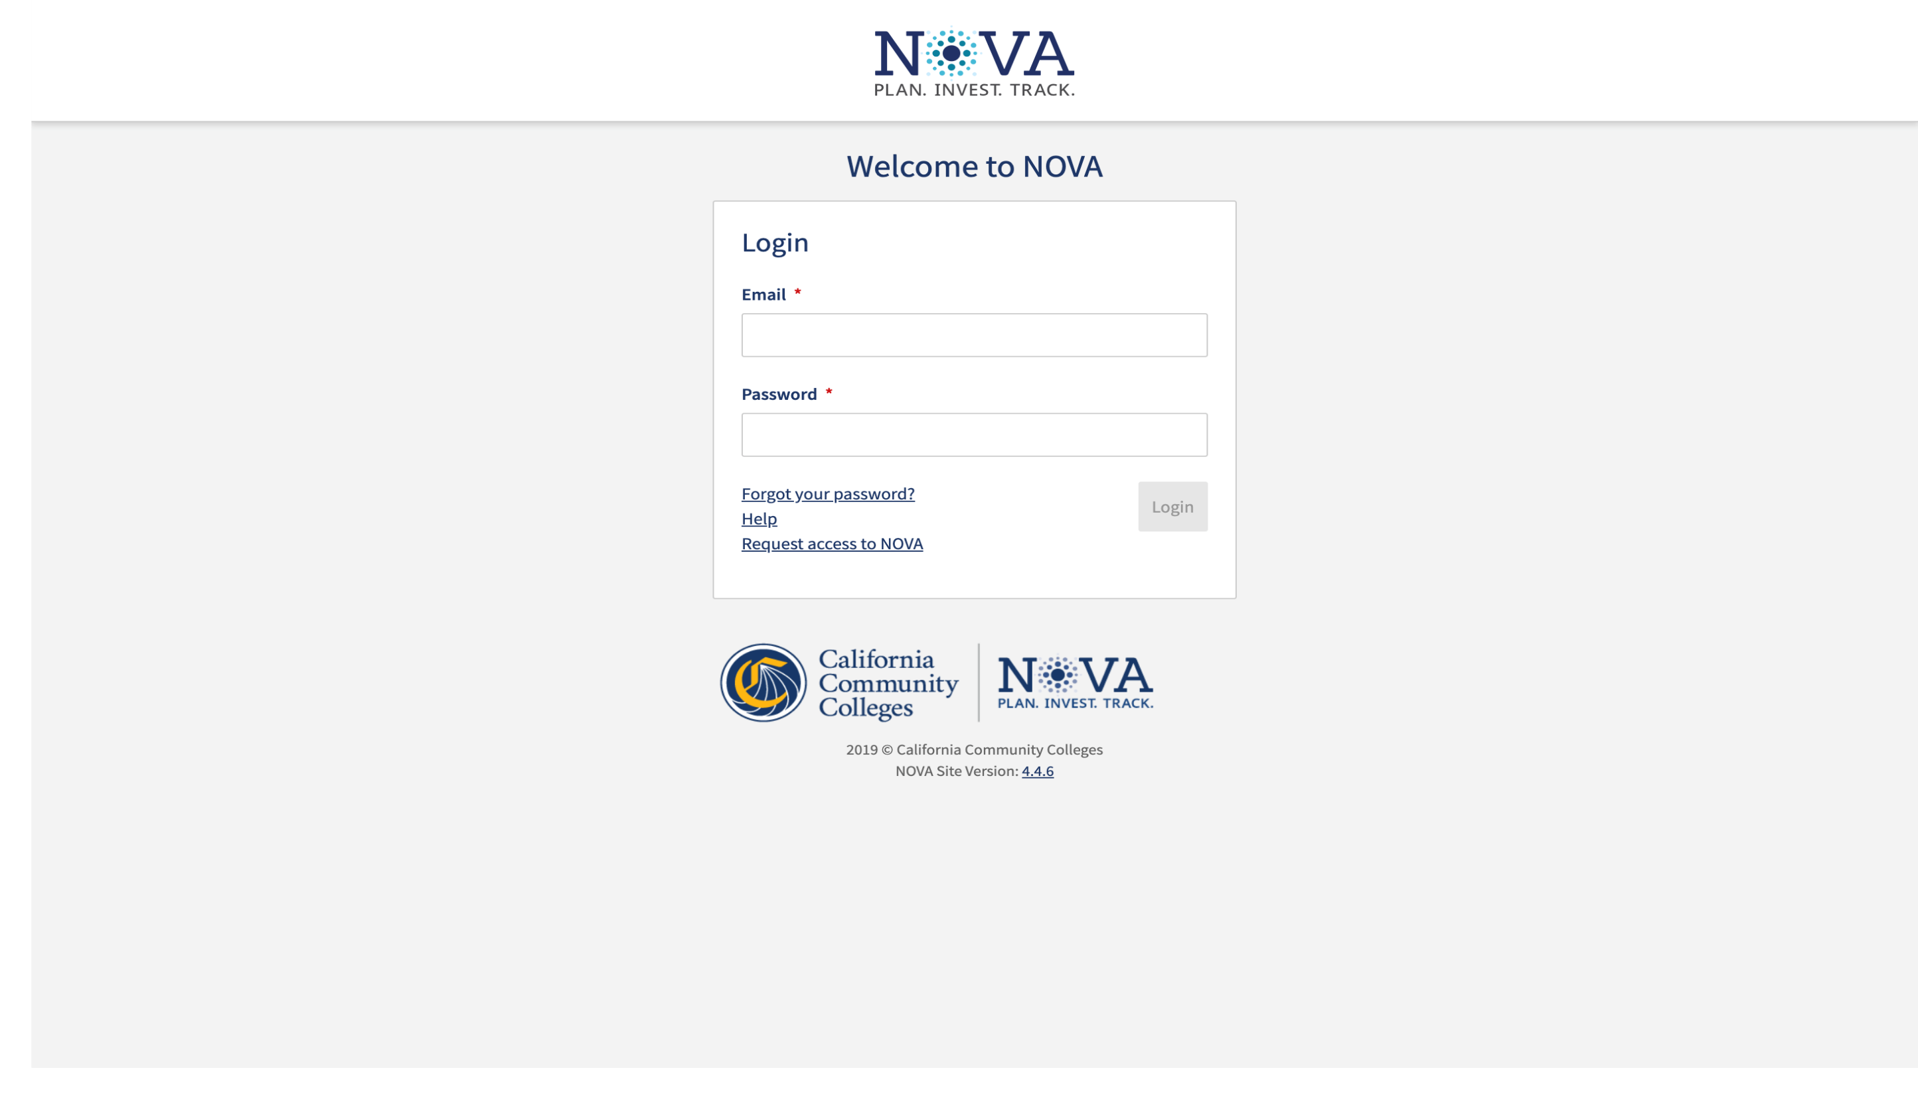

Slide 10
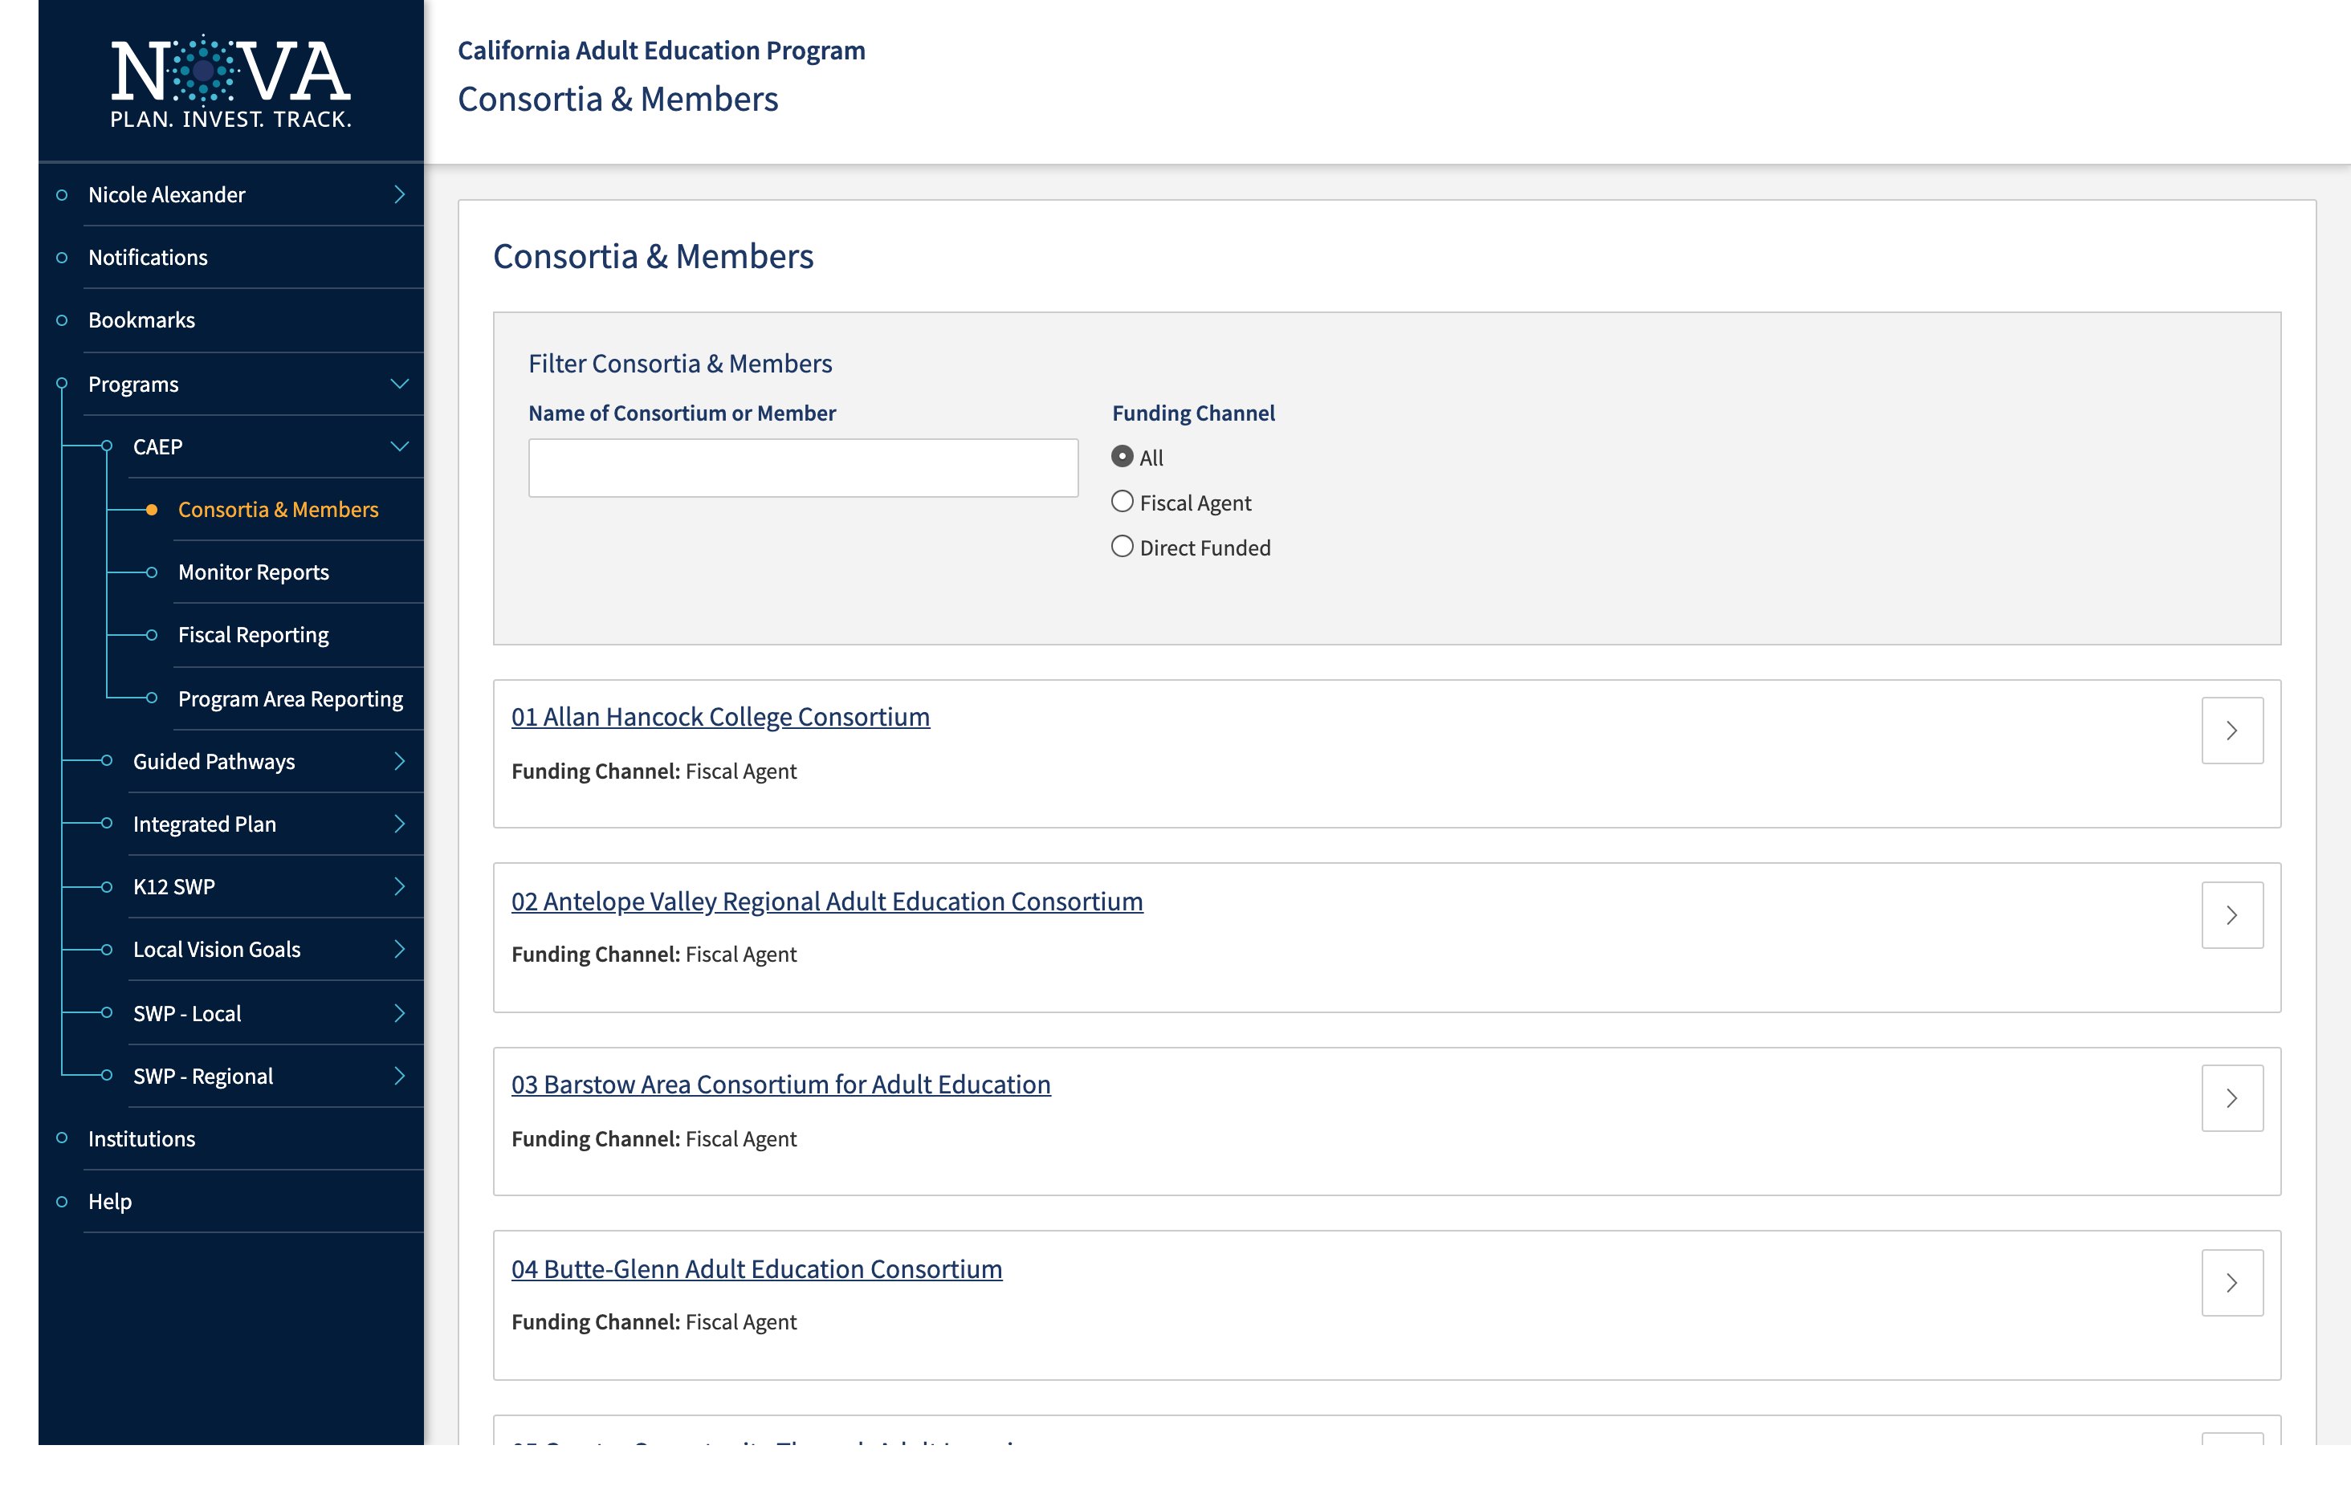

Slide 11
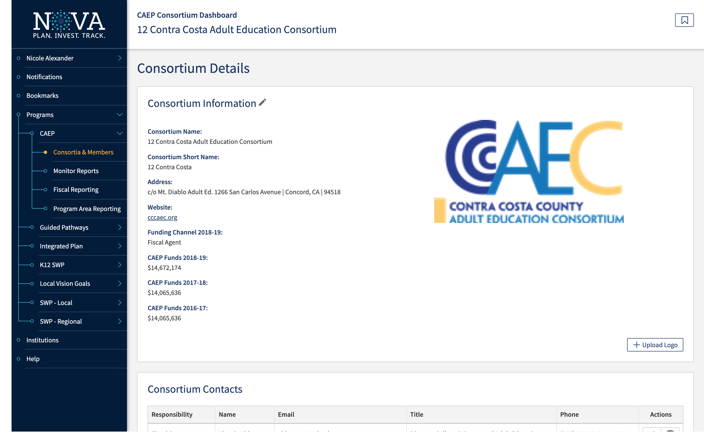

Slide 12
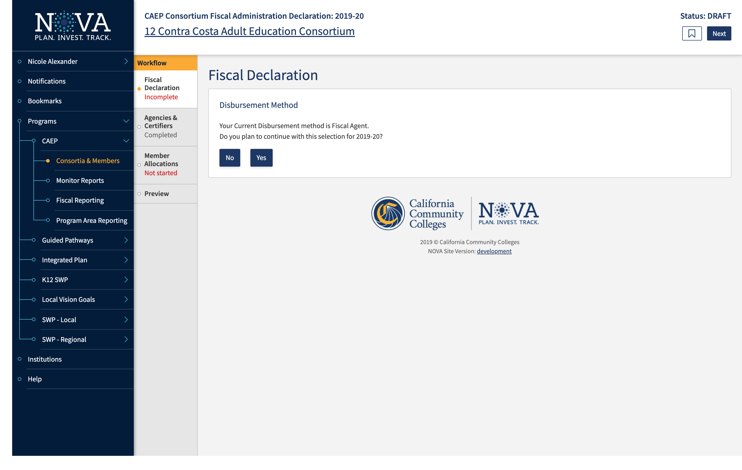

Slide 13
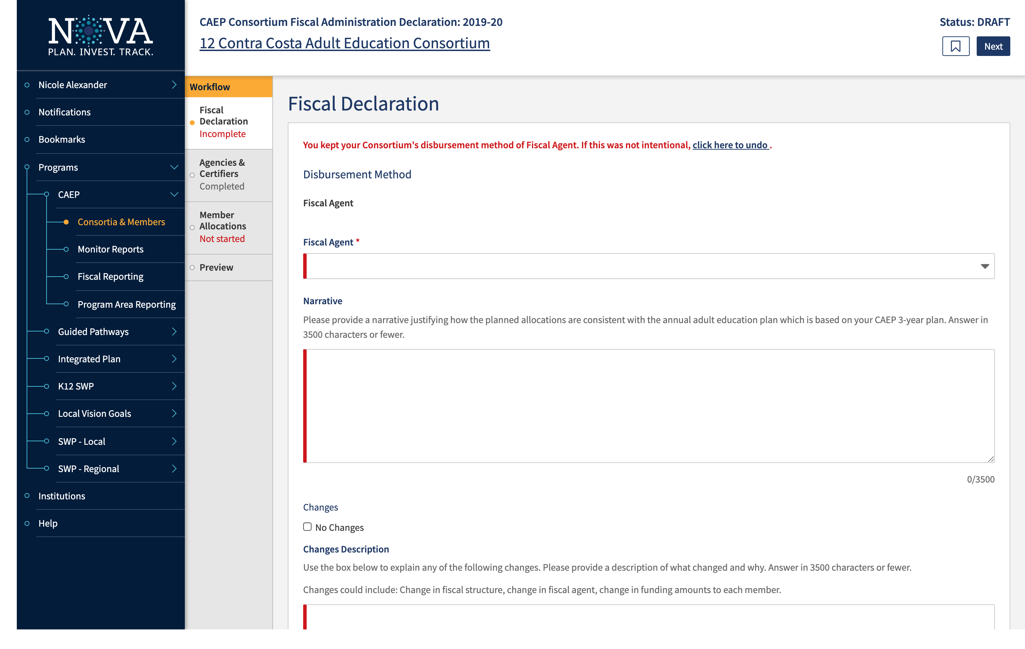

Slide 14
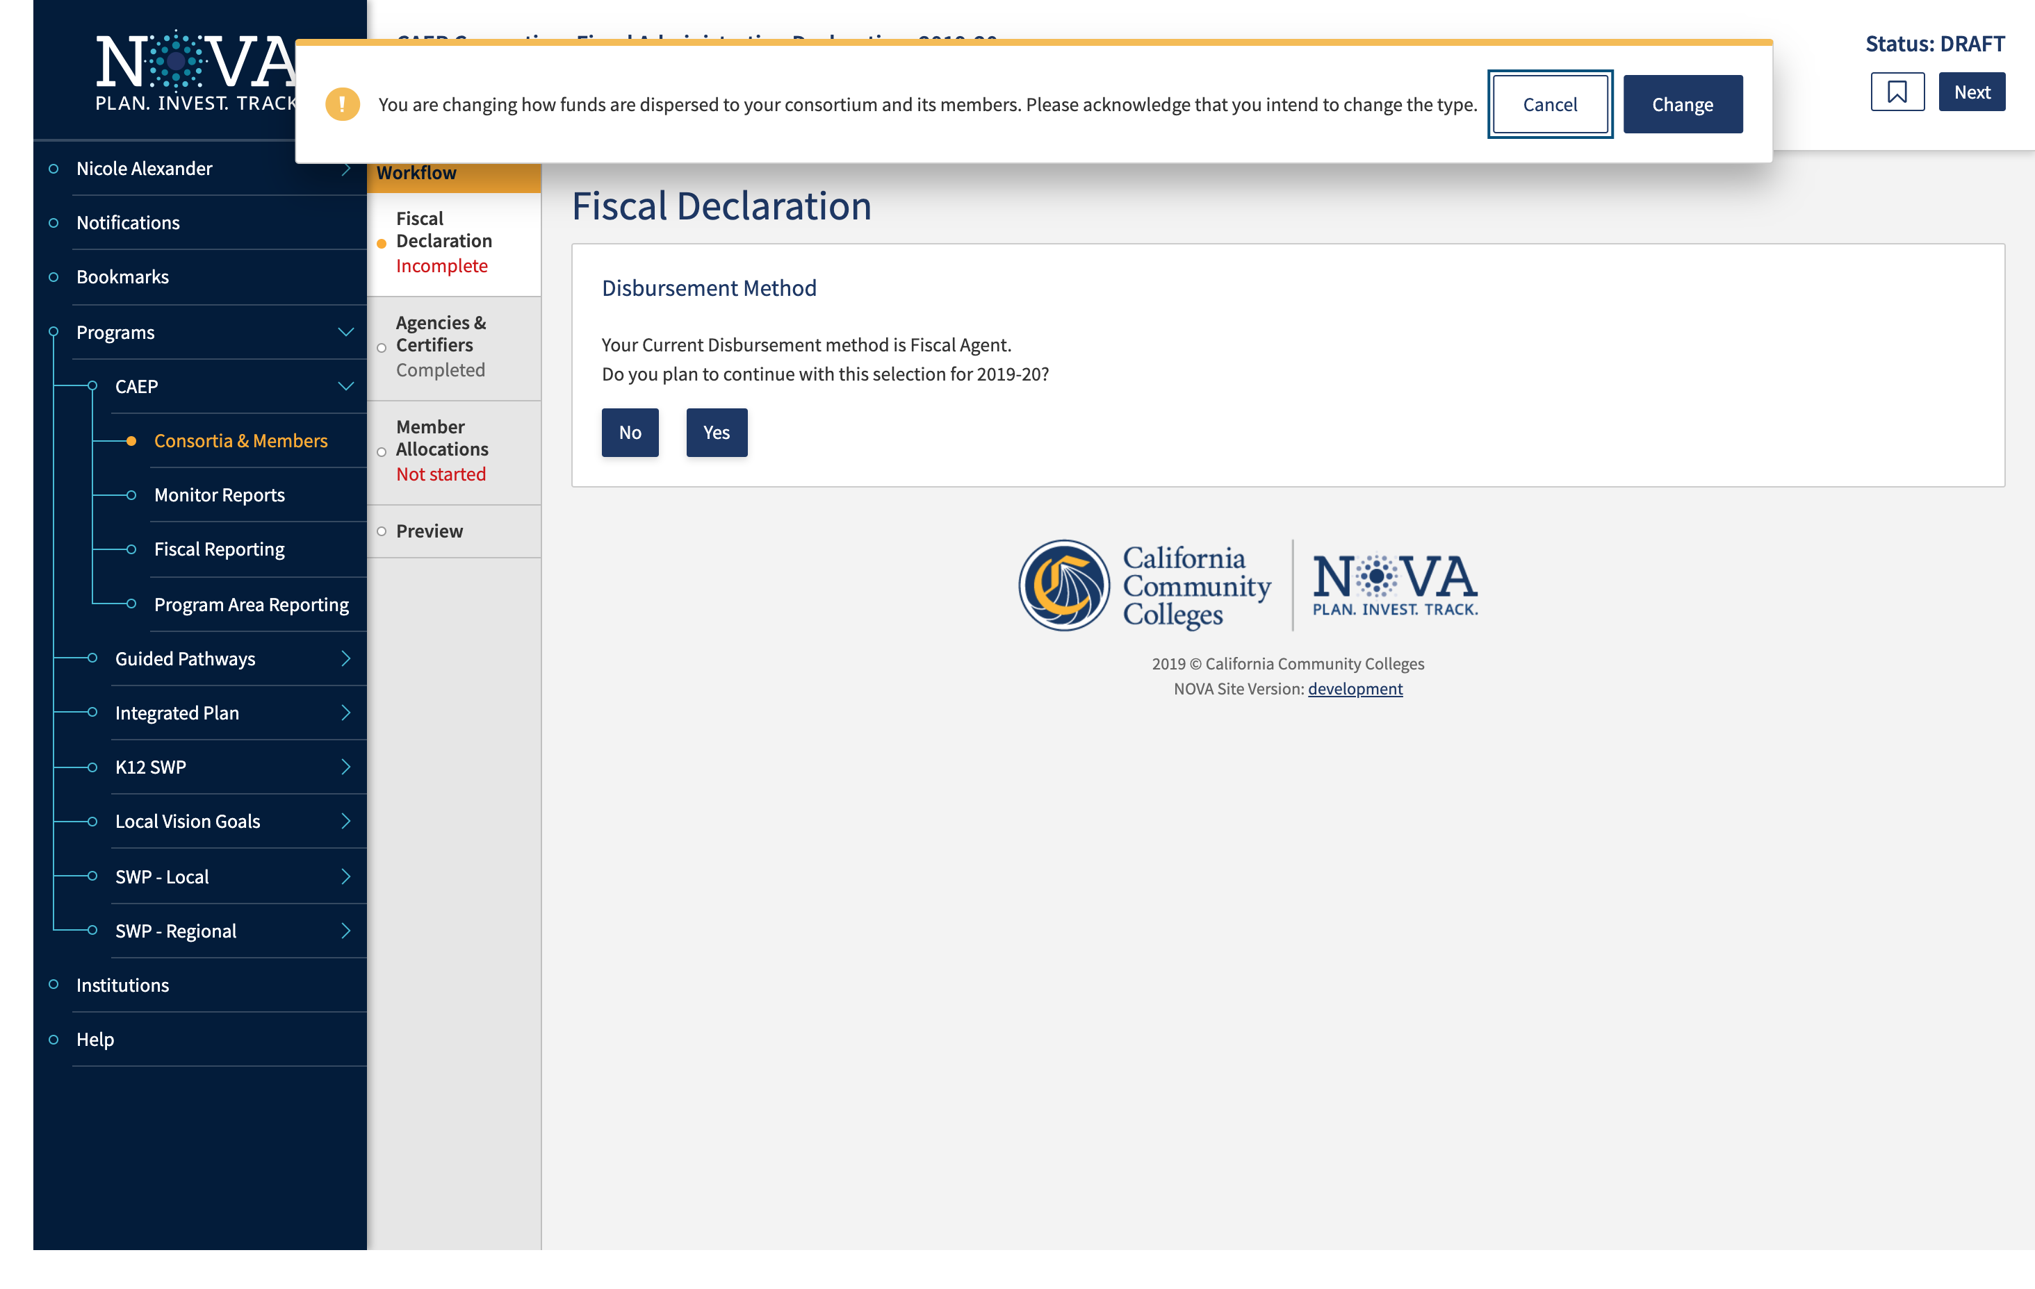

Slide 15
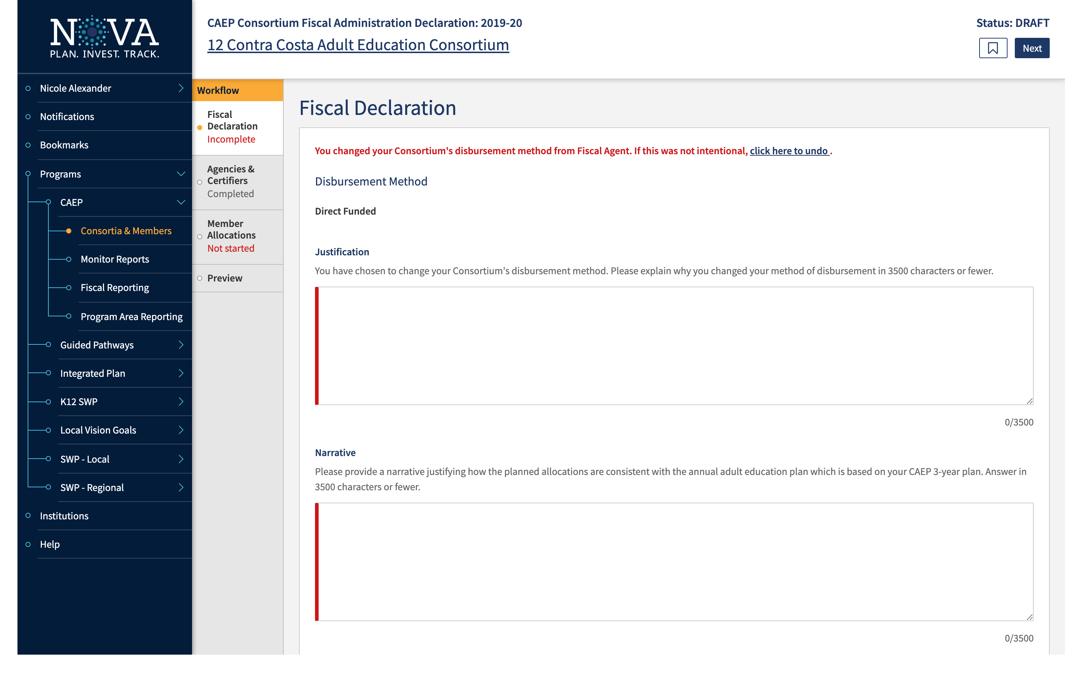

Slide 16
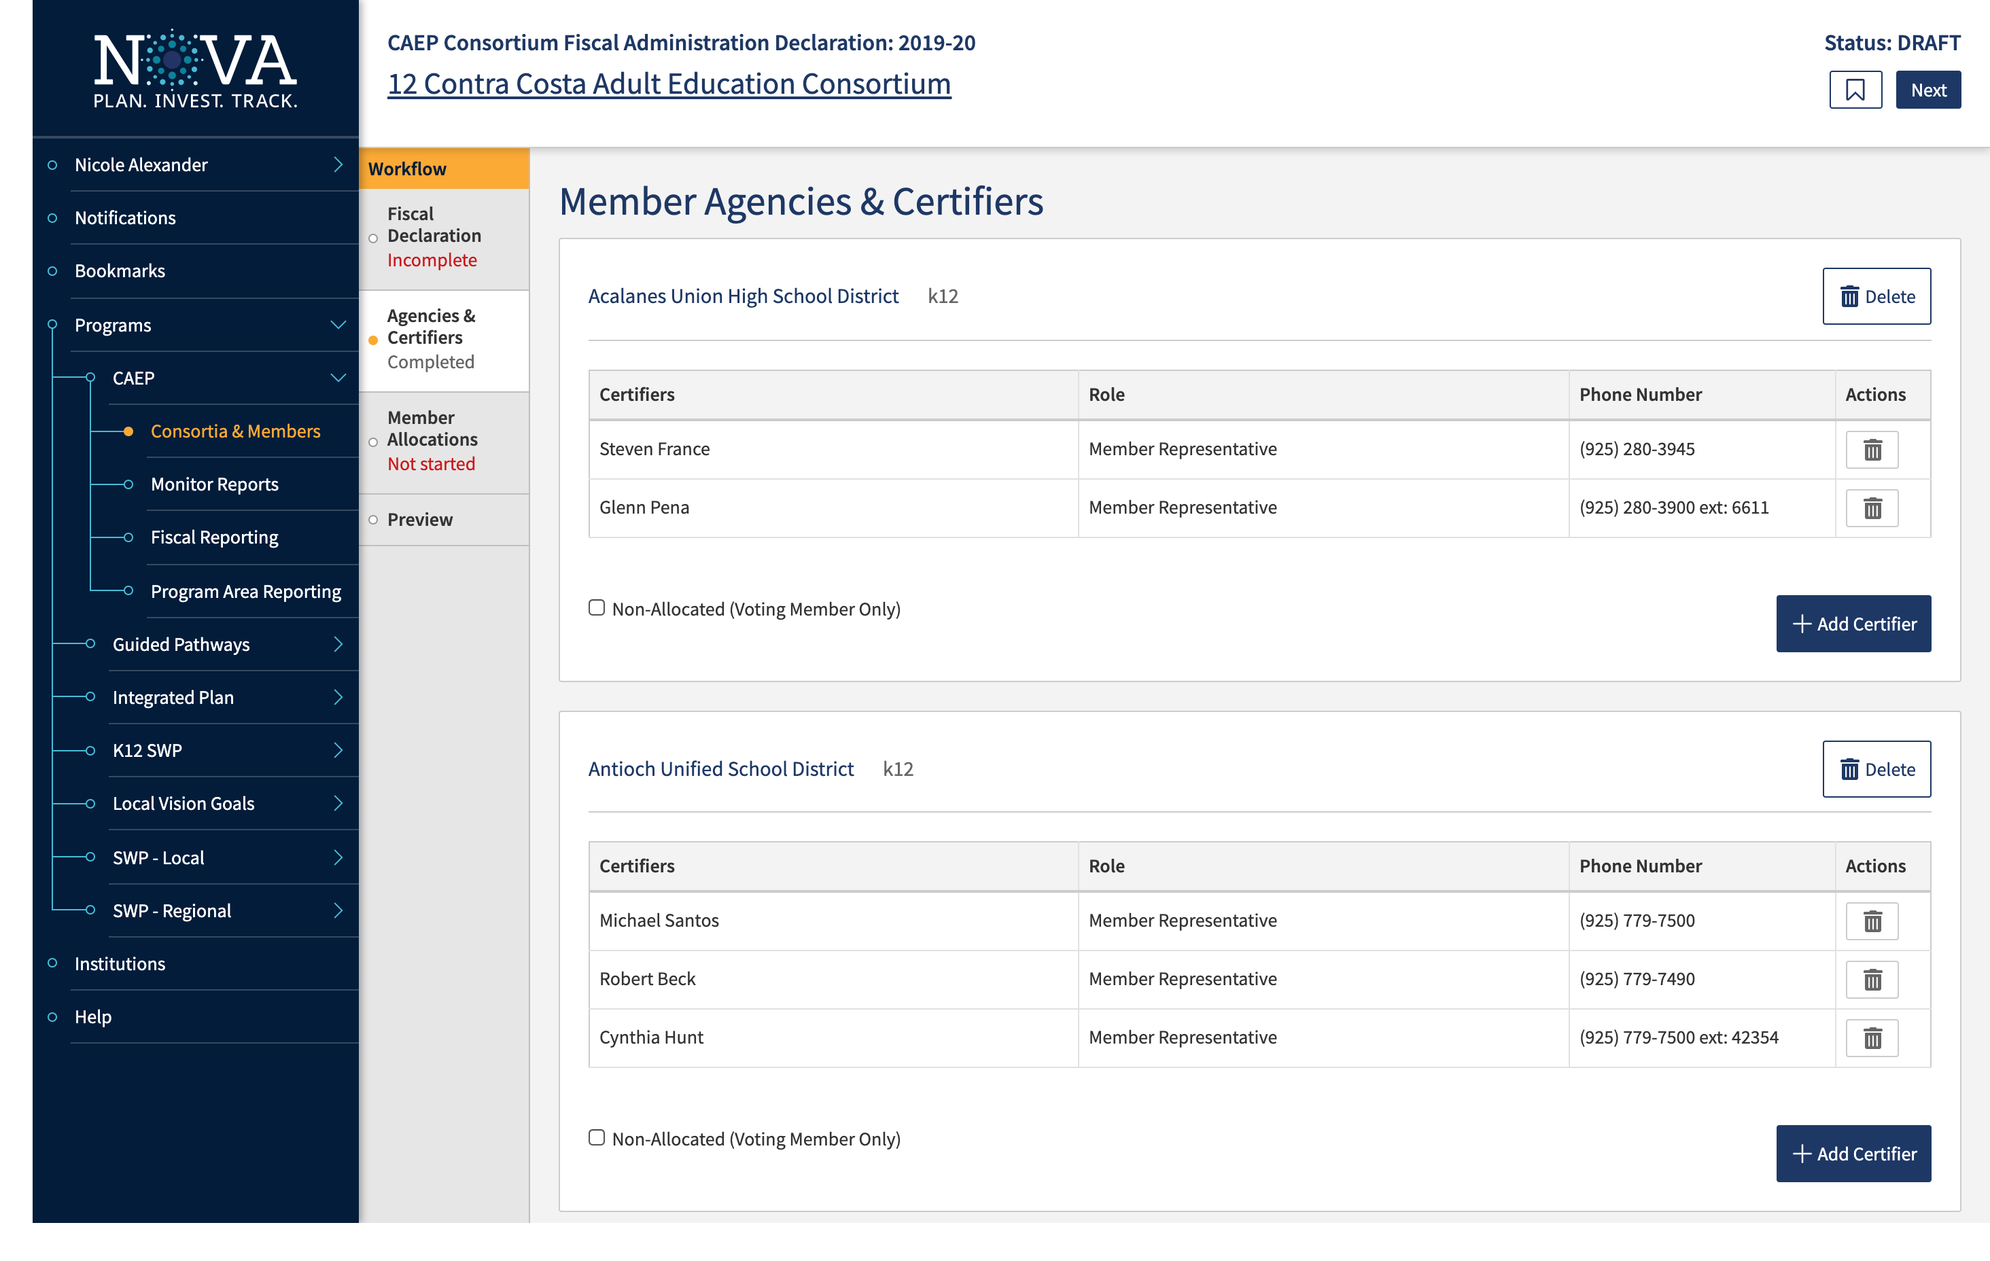

Slide 17
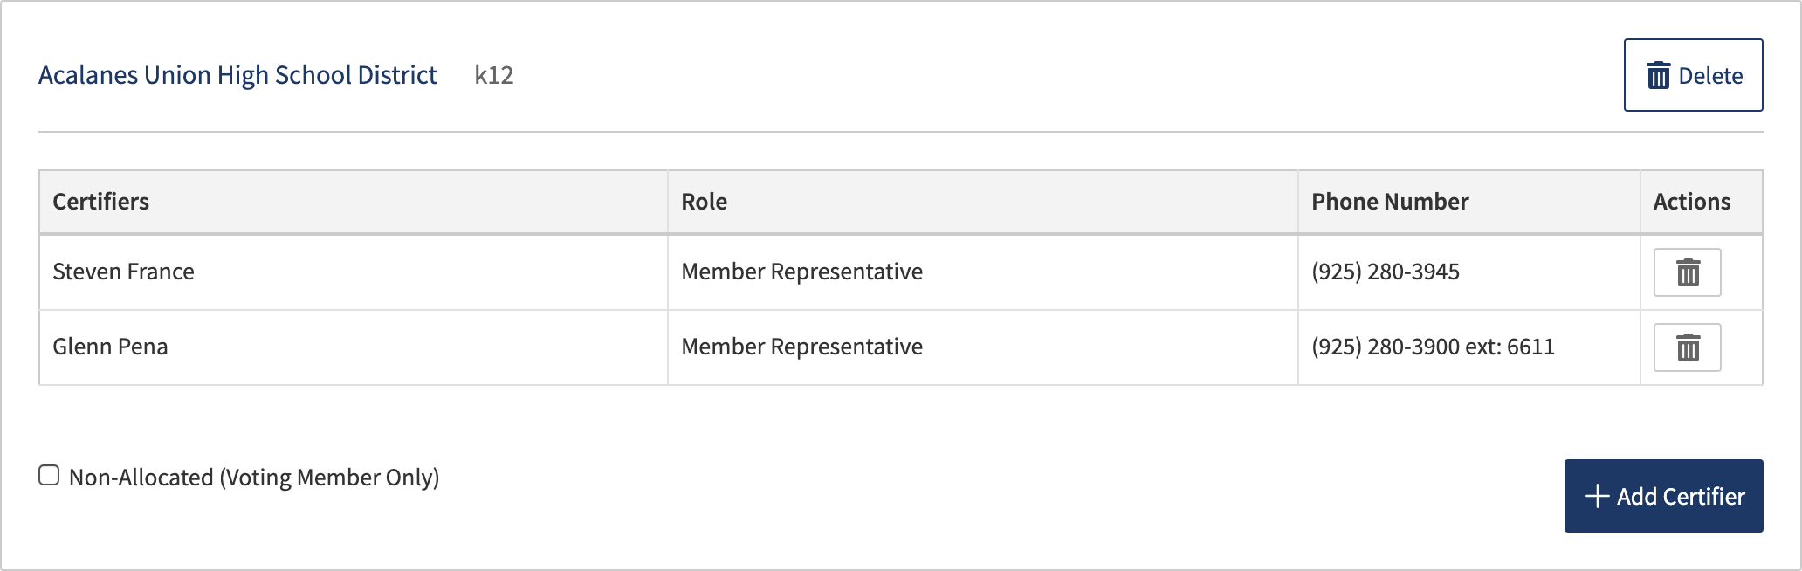

Slide 18
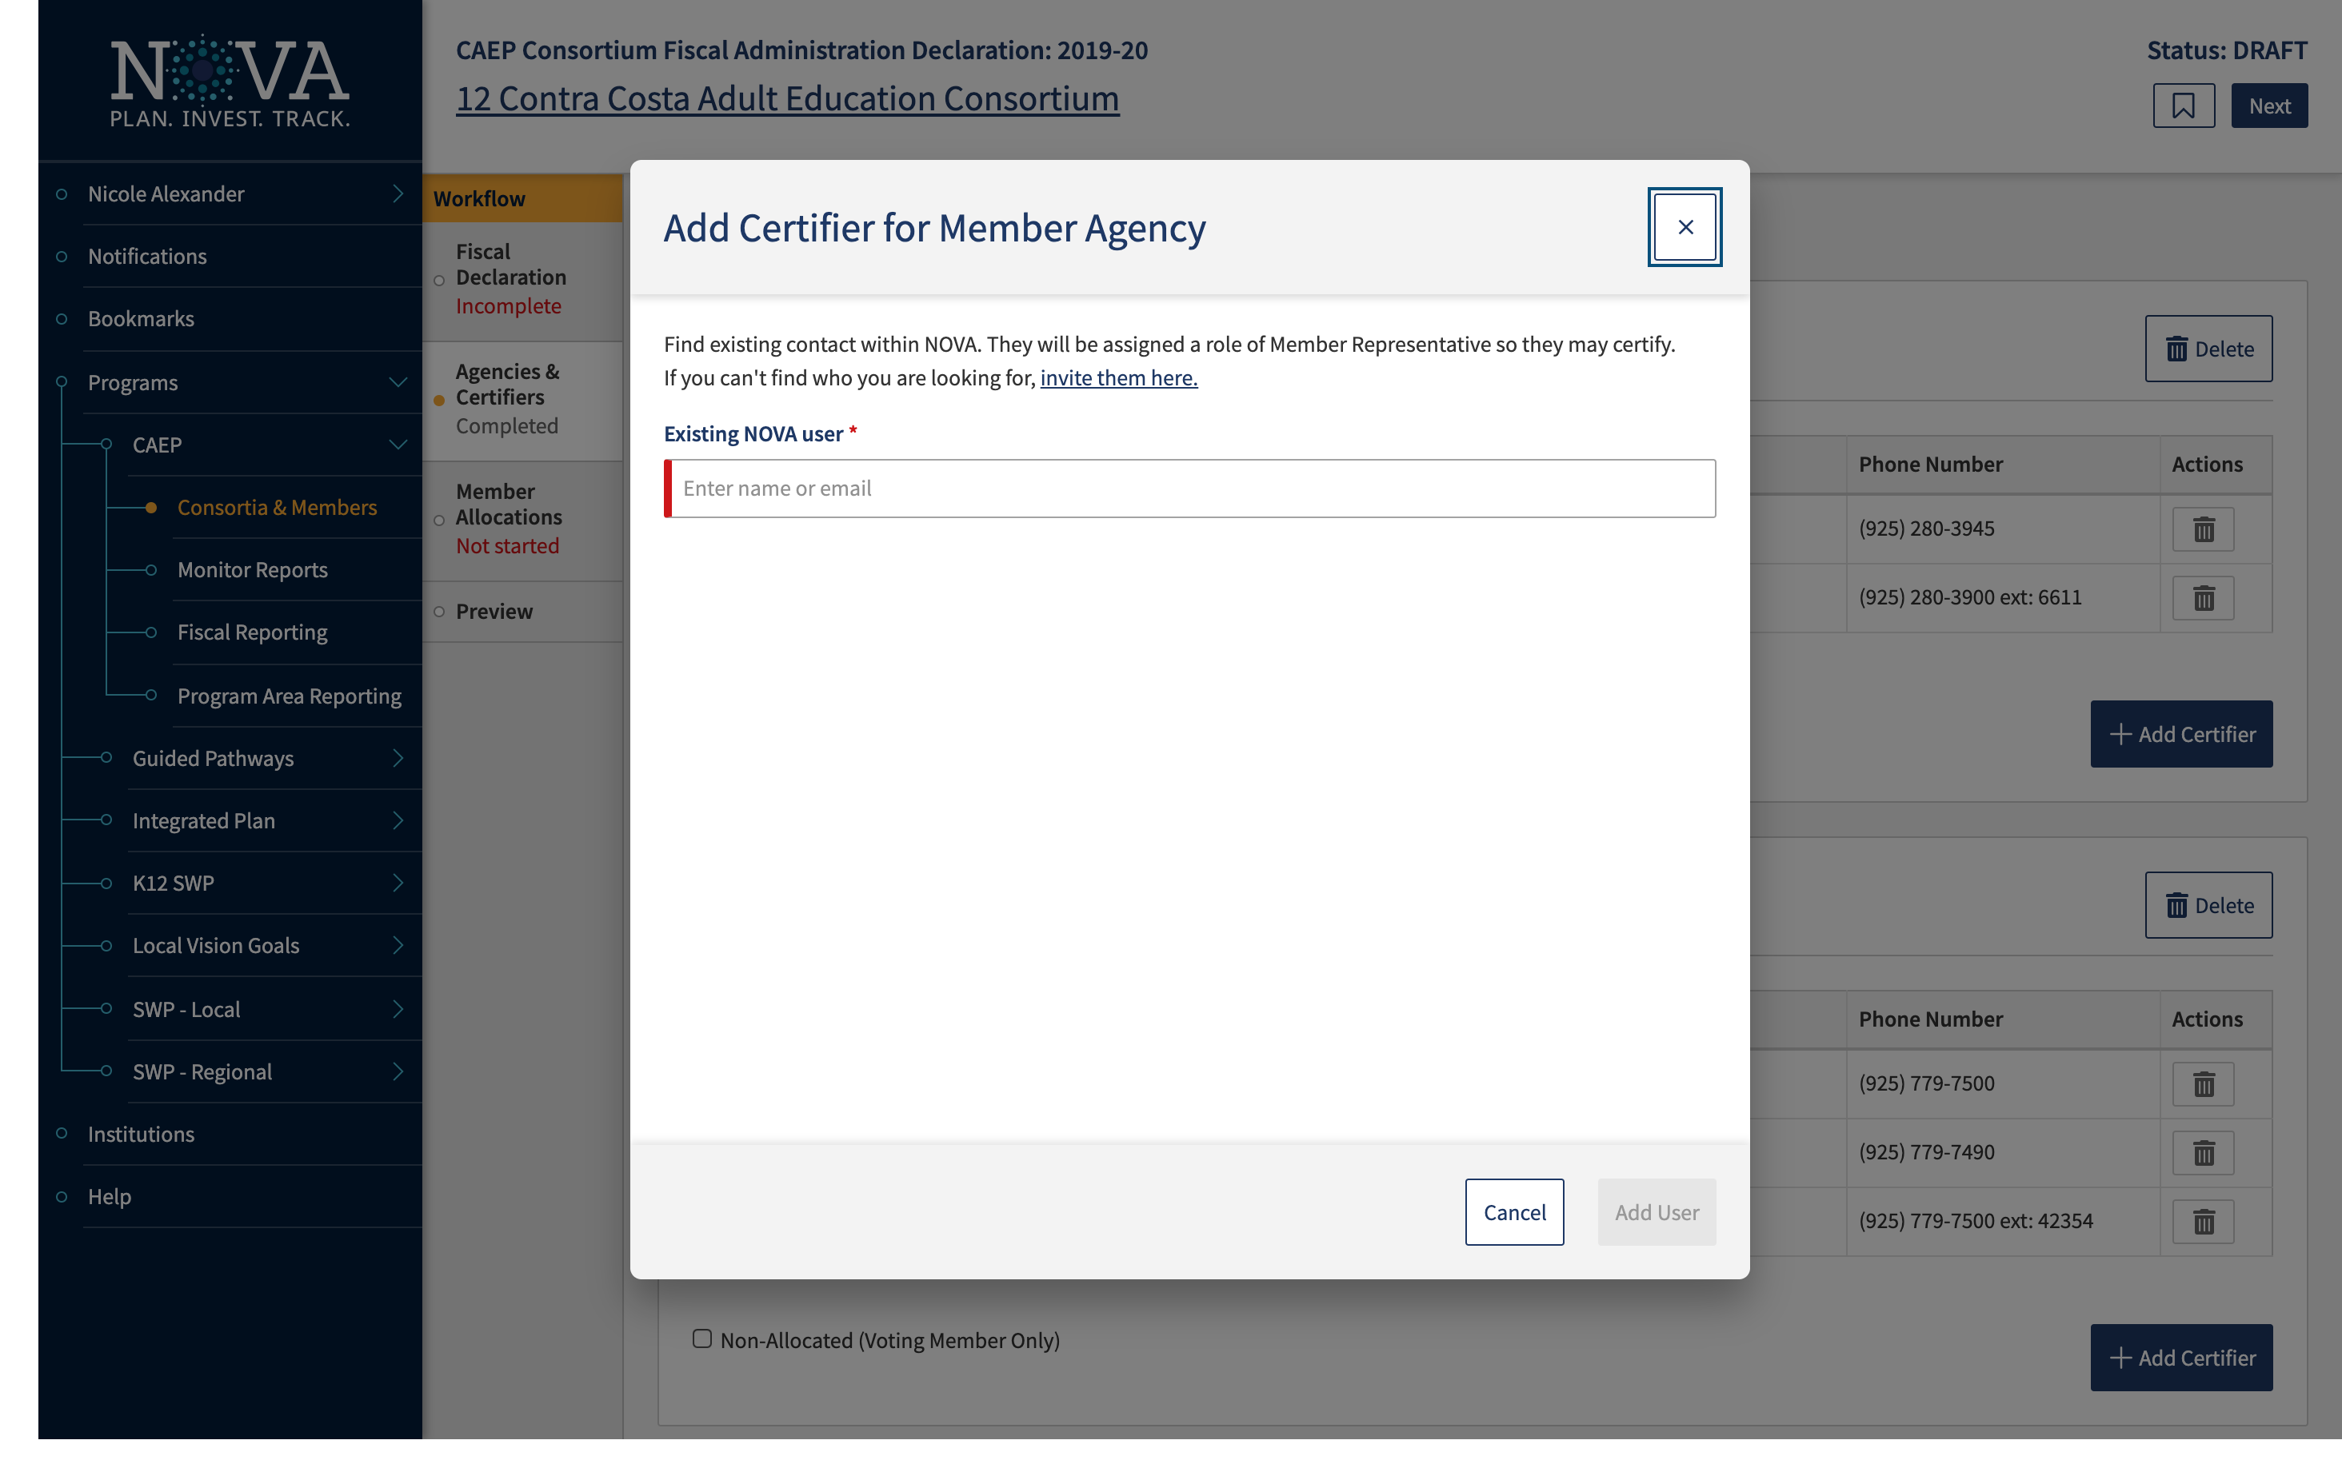

Slide 19
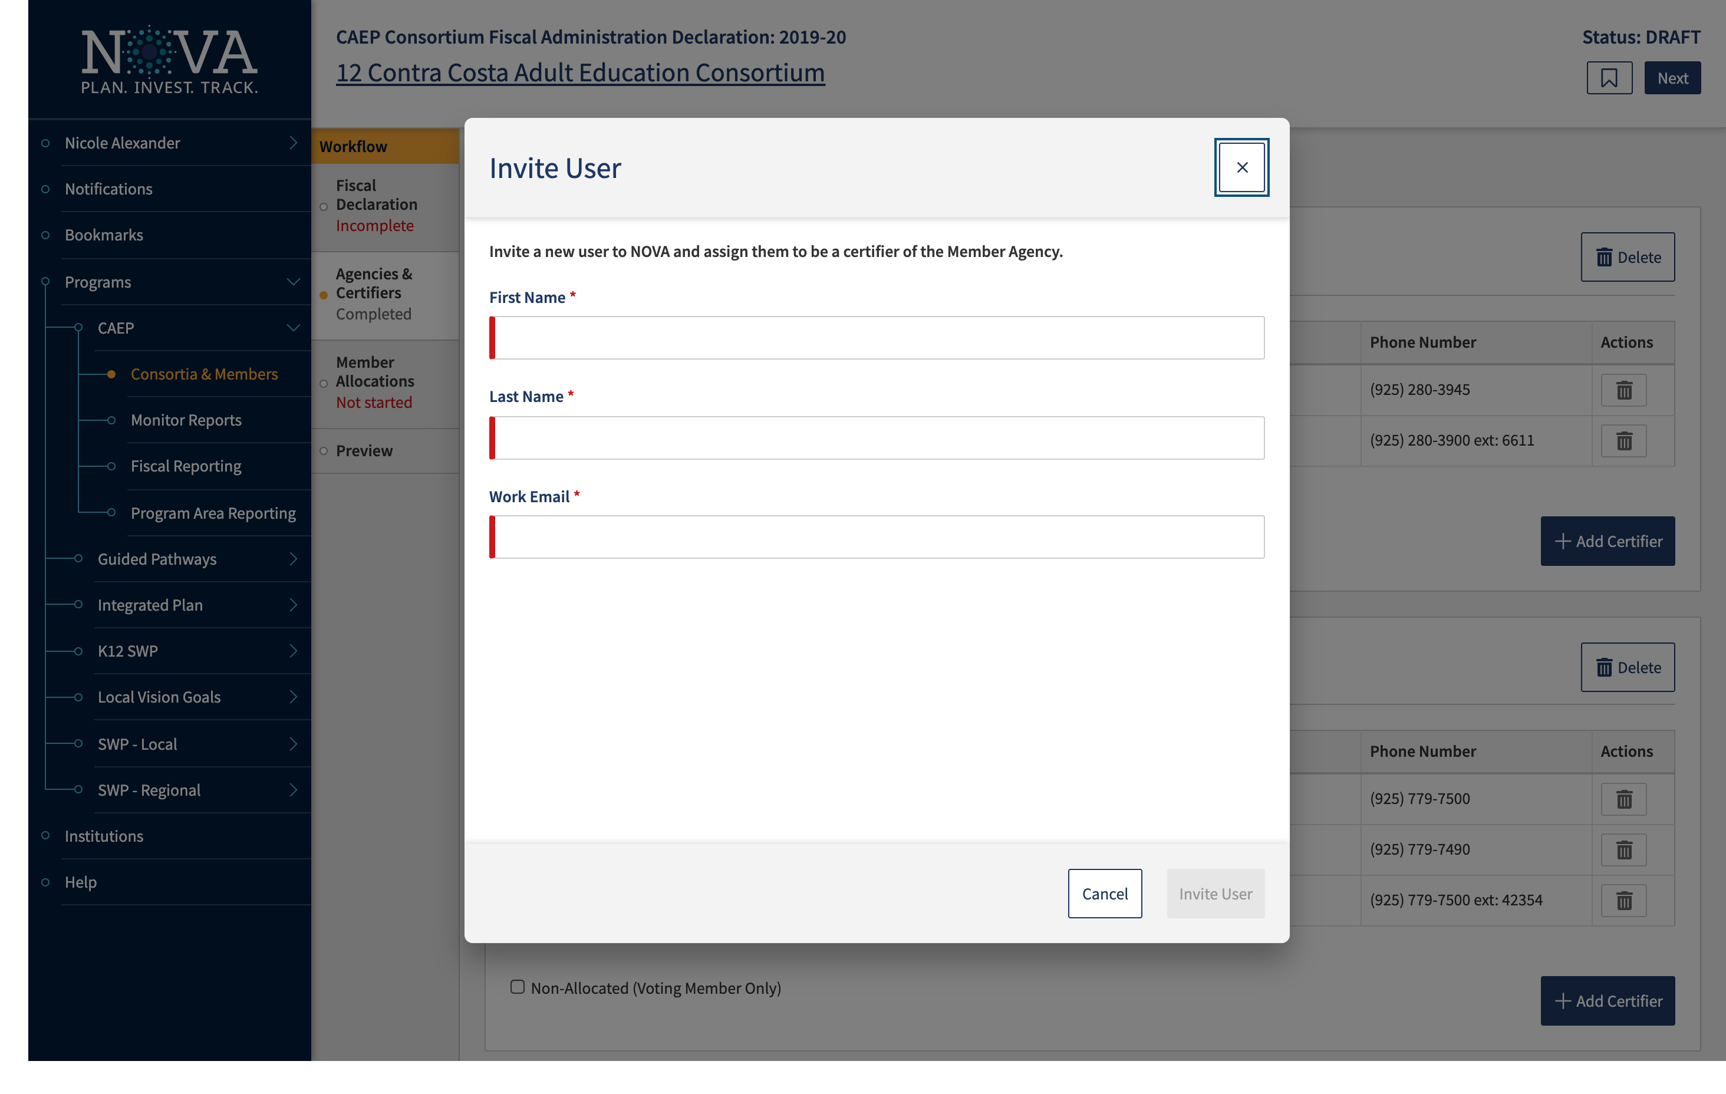

Slide 20
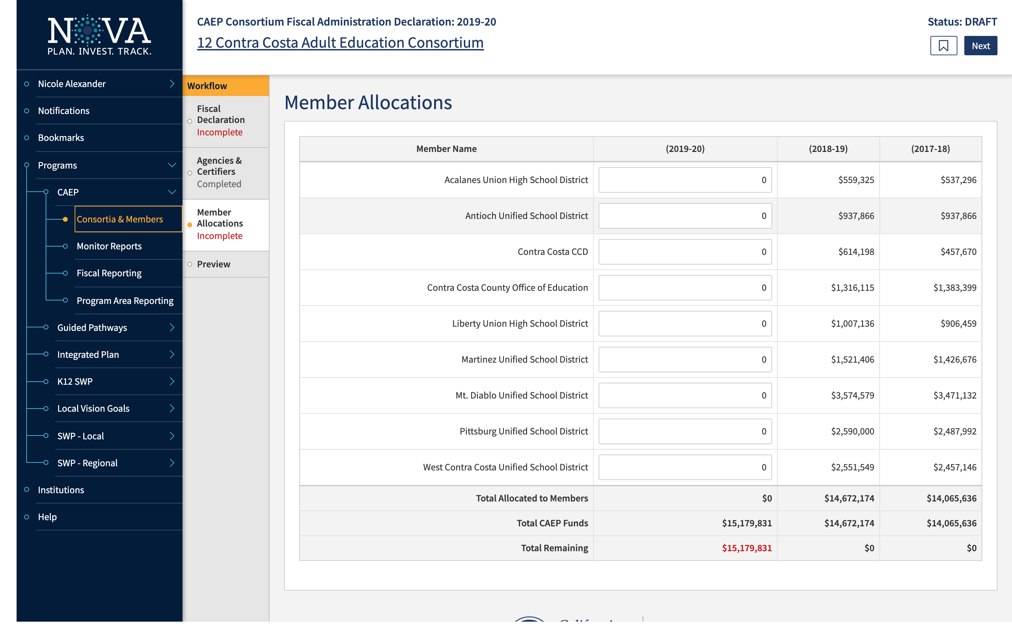

Slide 21
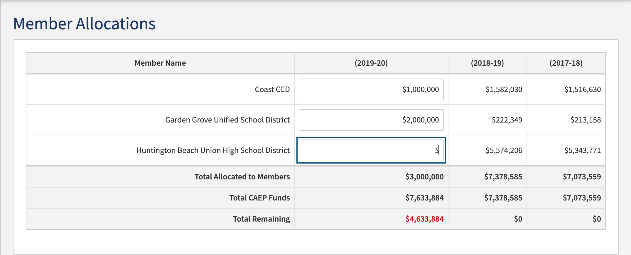

Slide 22
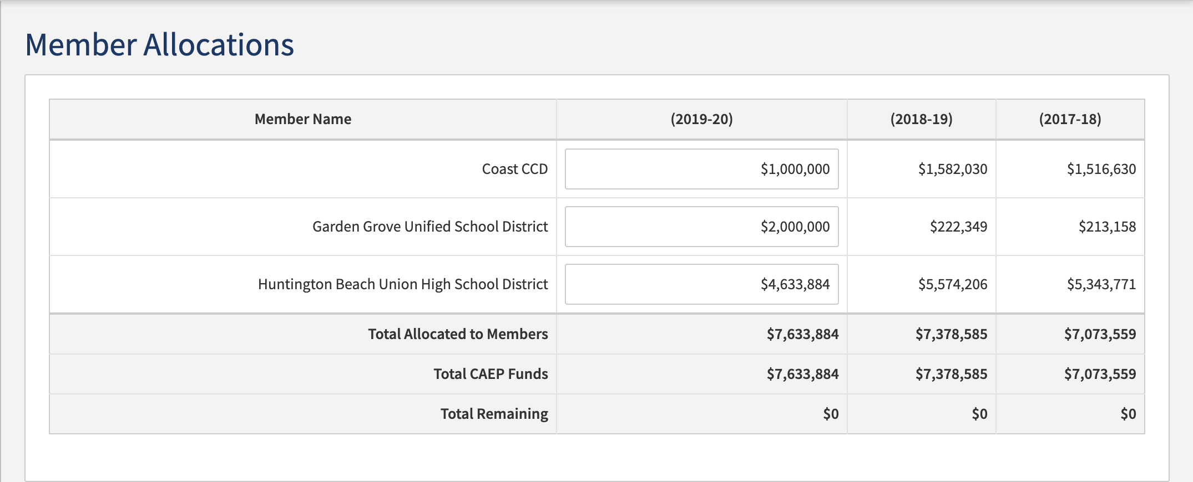

Slide 23
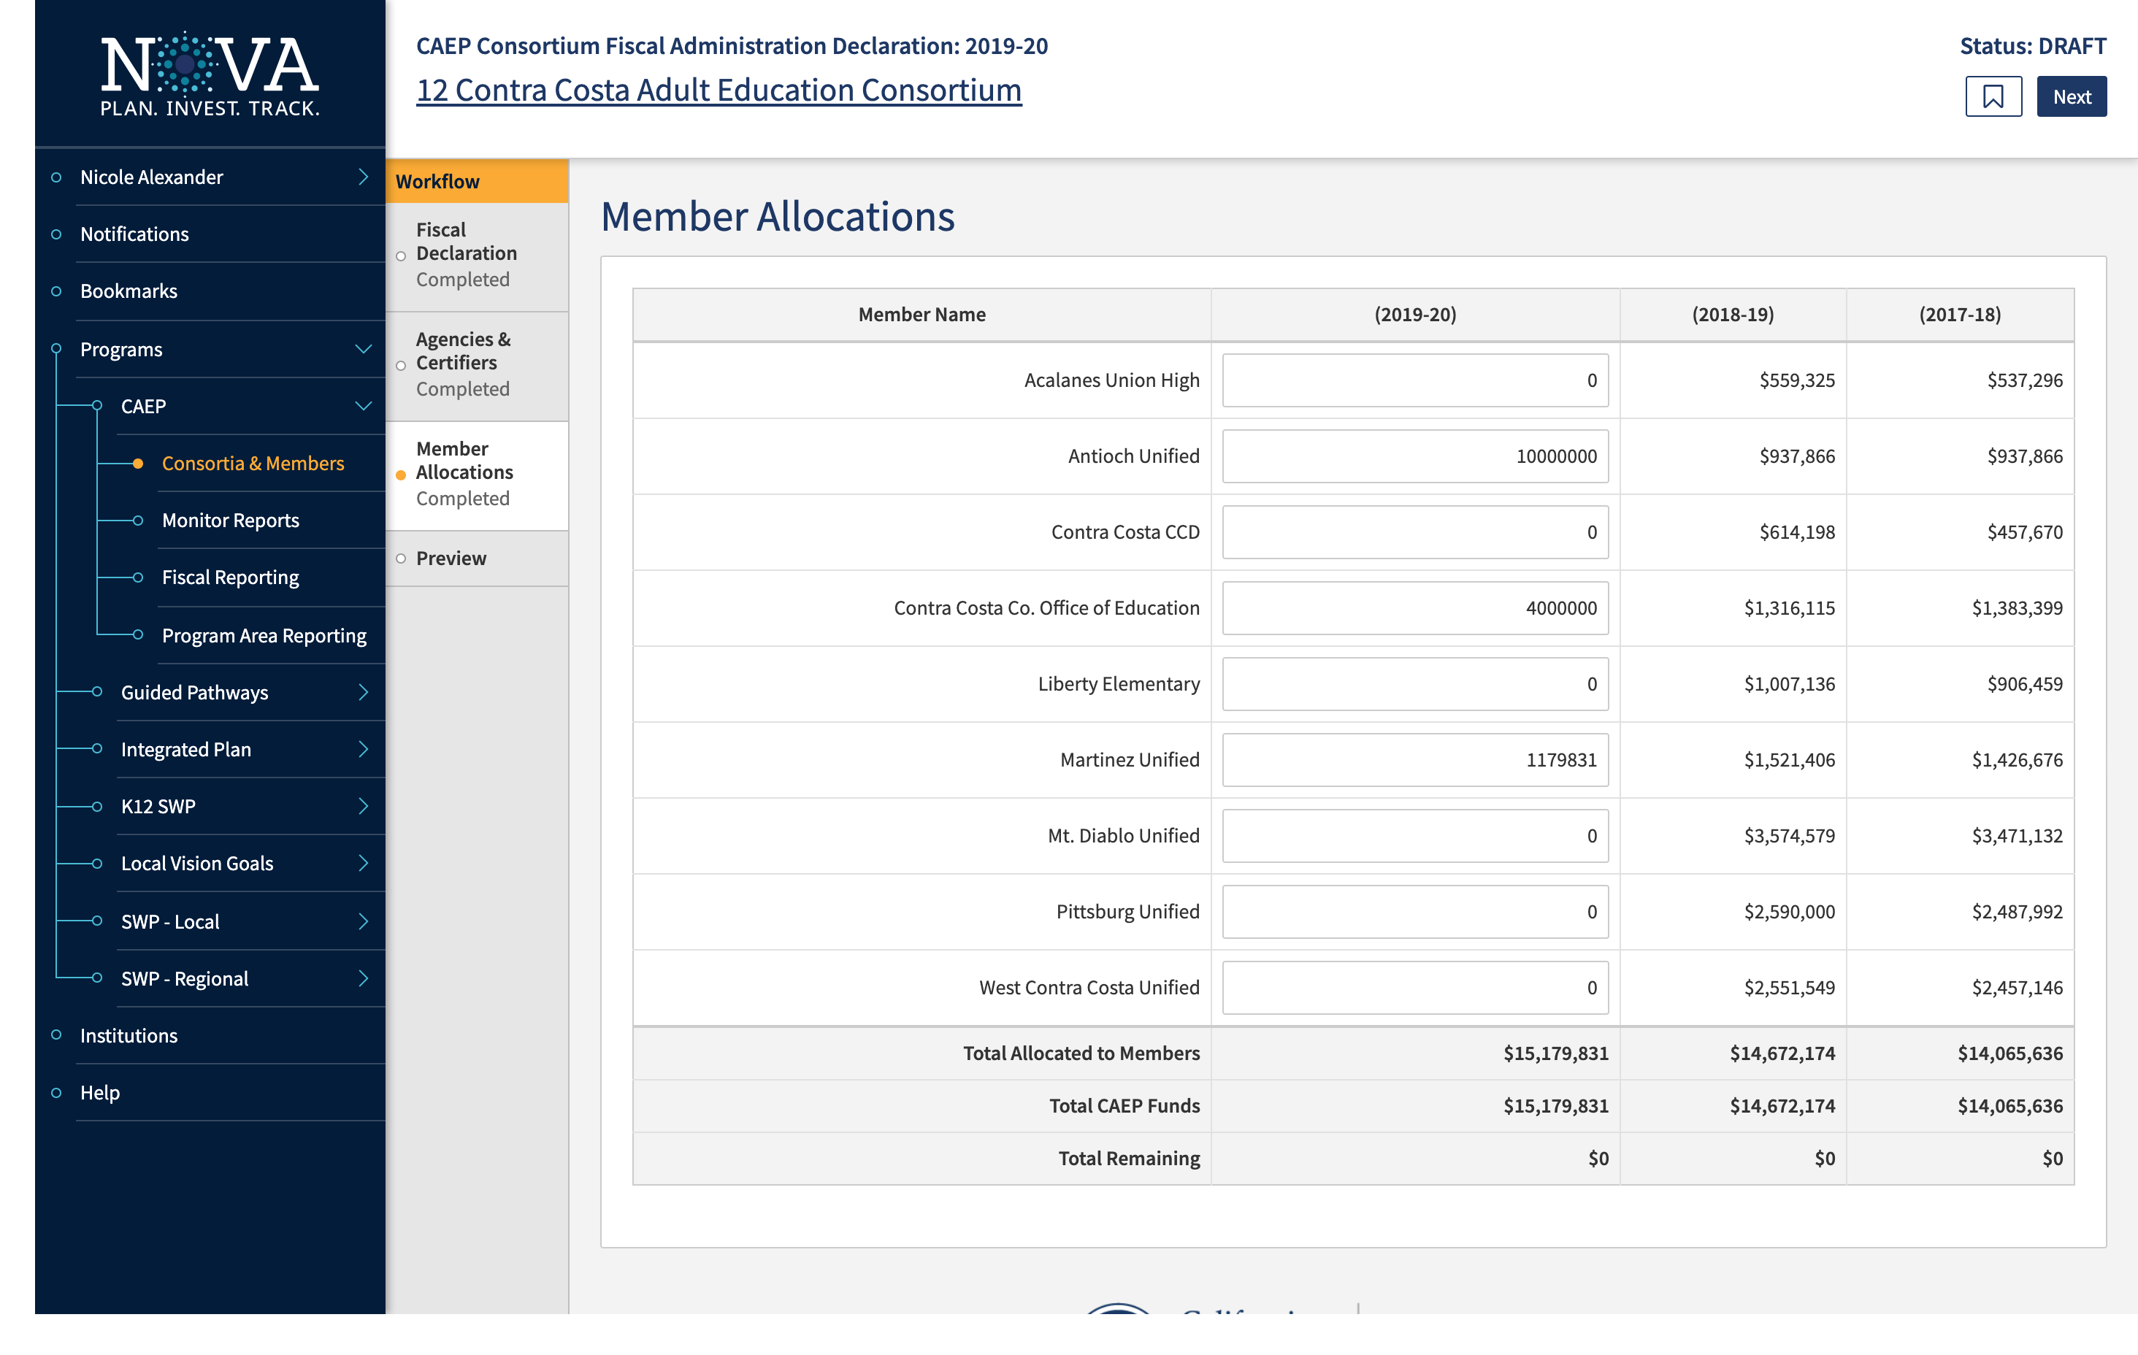

Slide 24
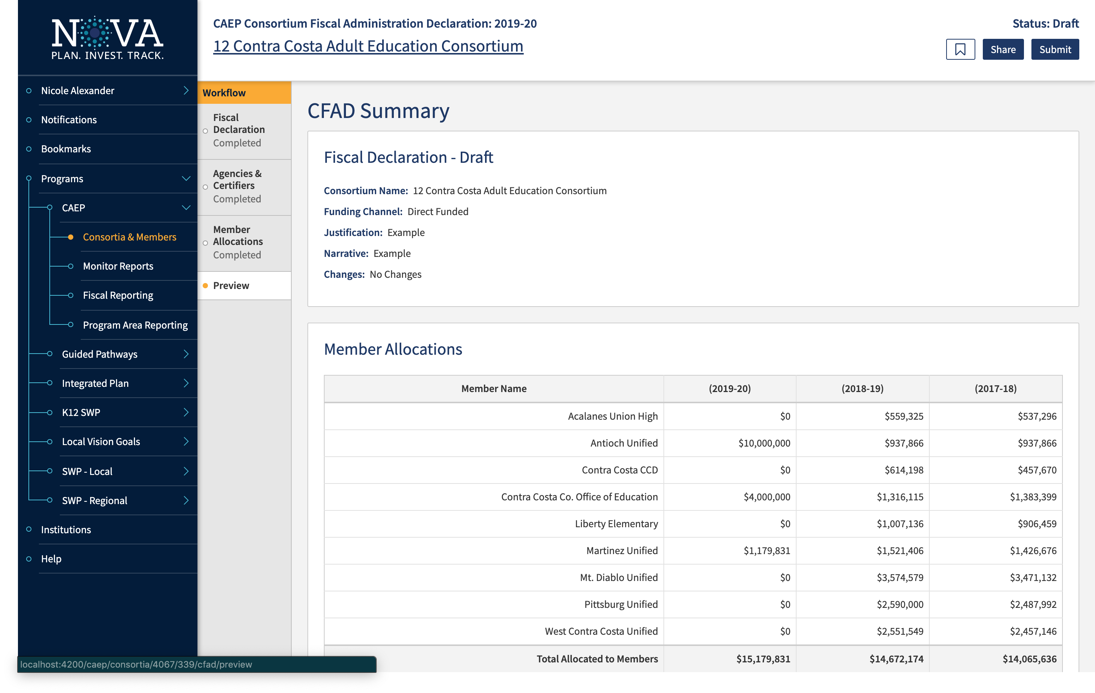

Slide 25
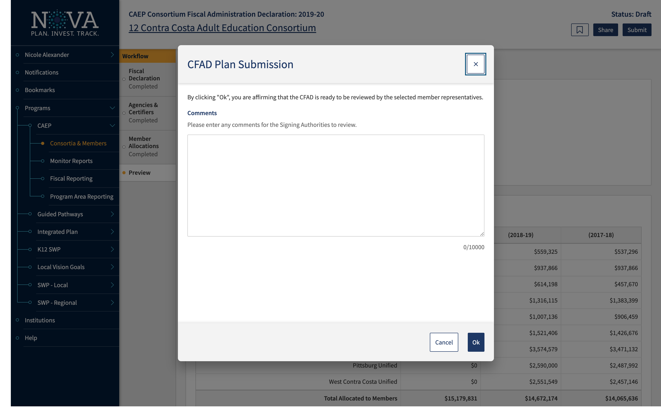

Slide 26
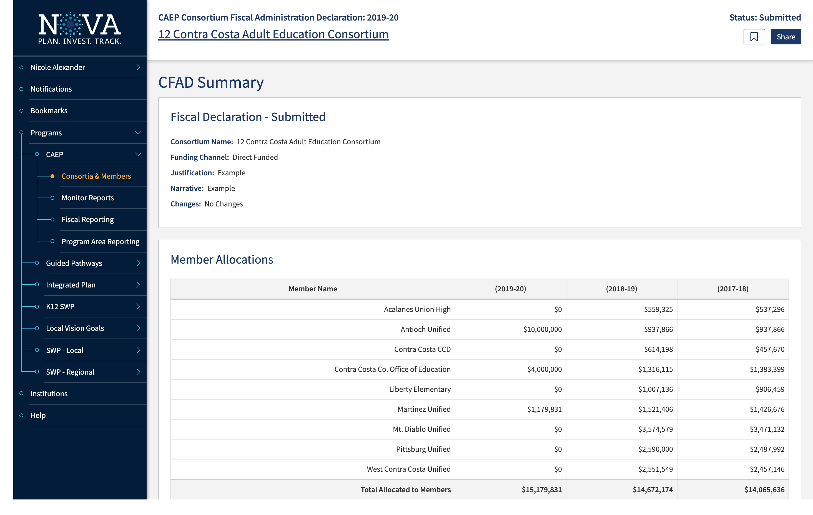

Slide 27
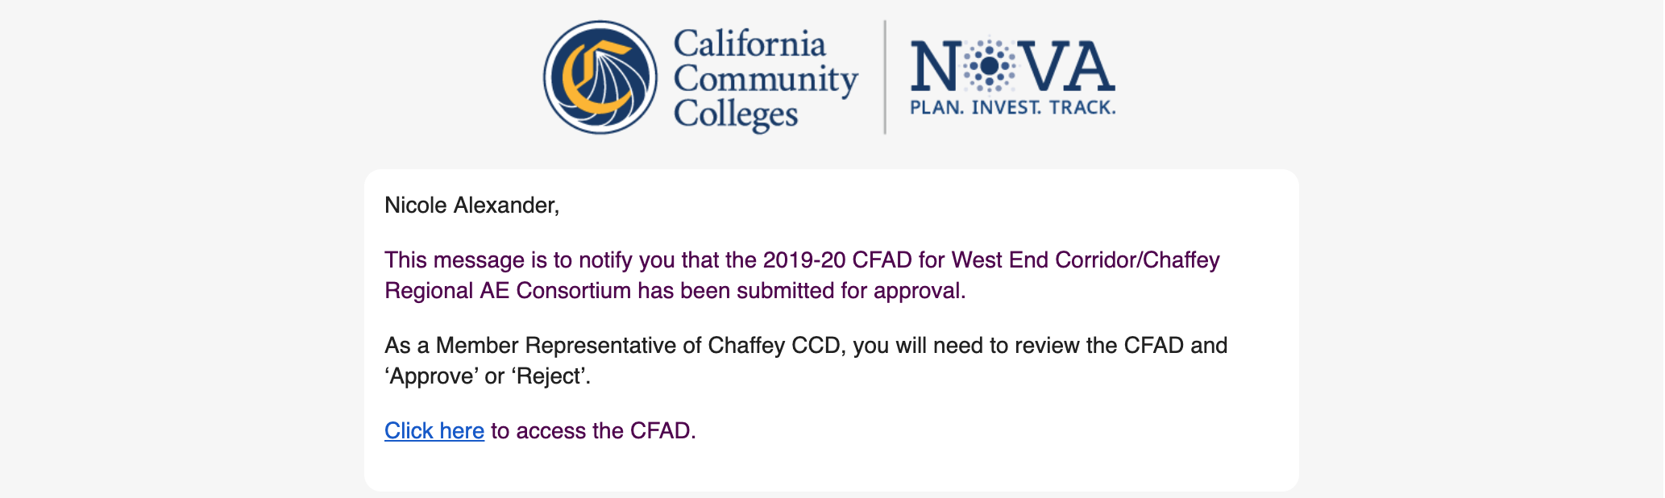

Slide 28
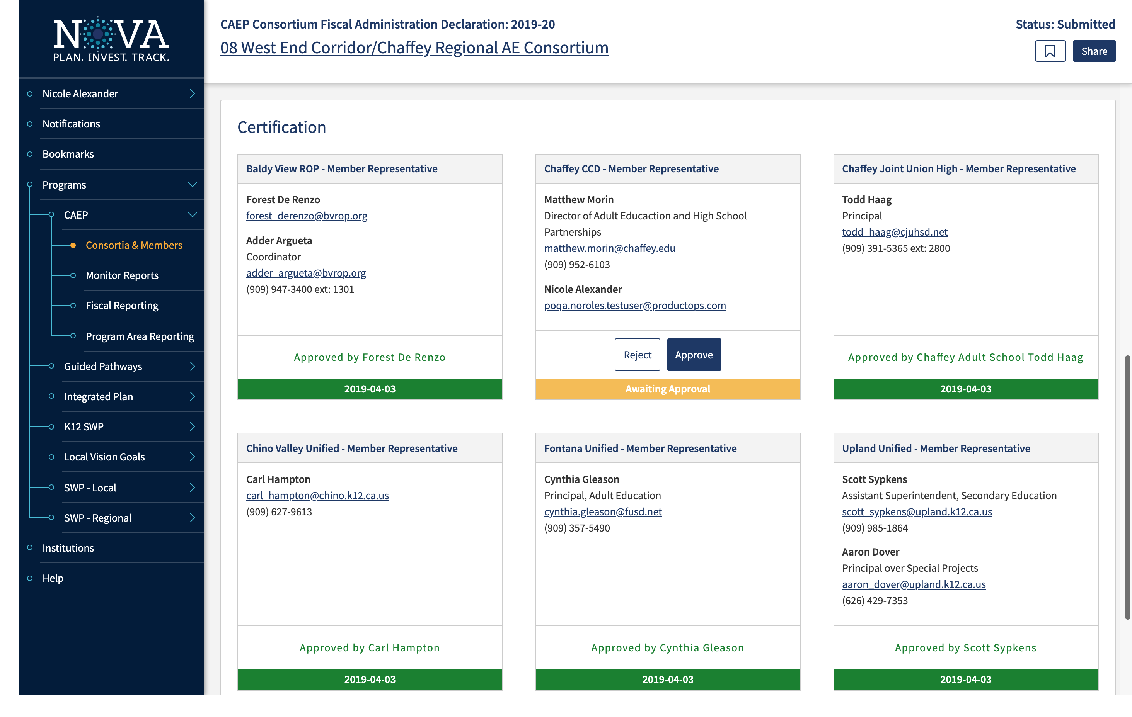

Slide 29
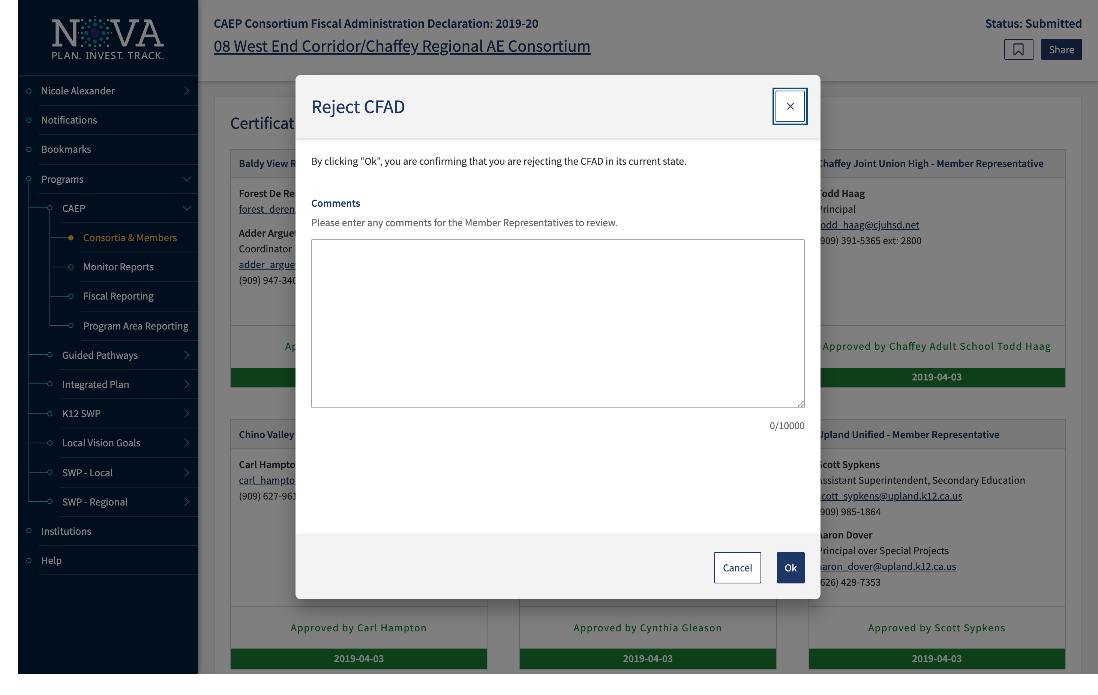

Slide 30
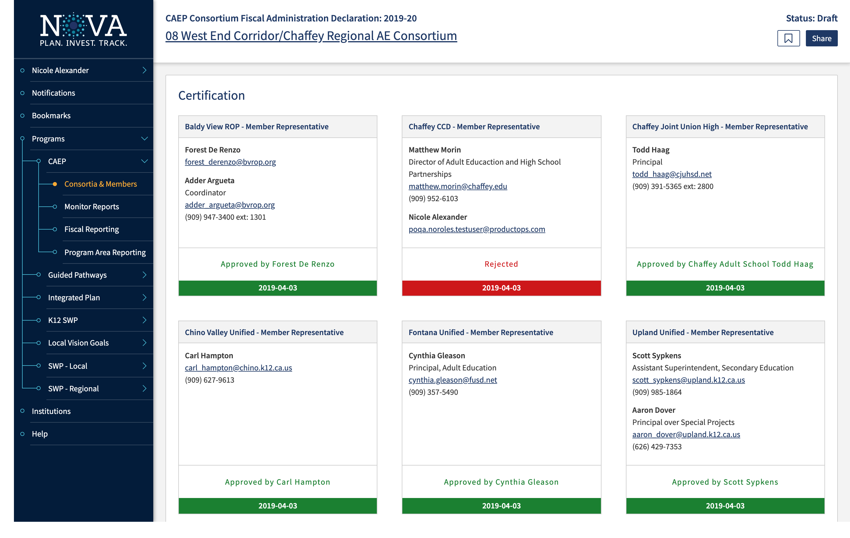

Slide 31
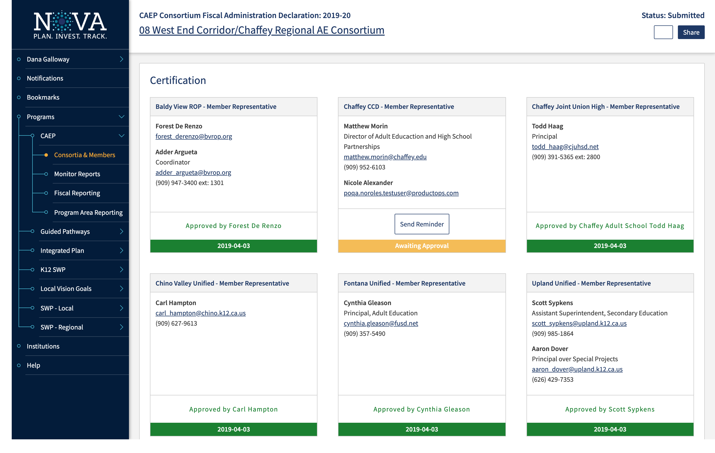

Slide 32
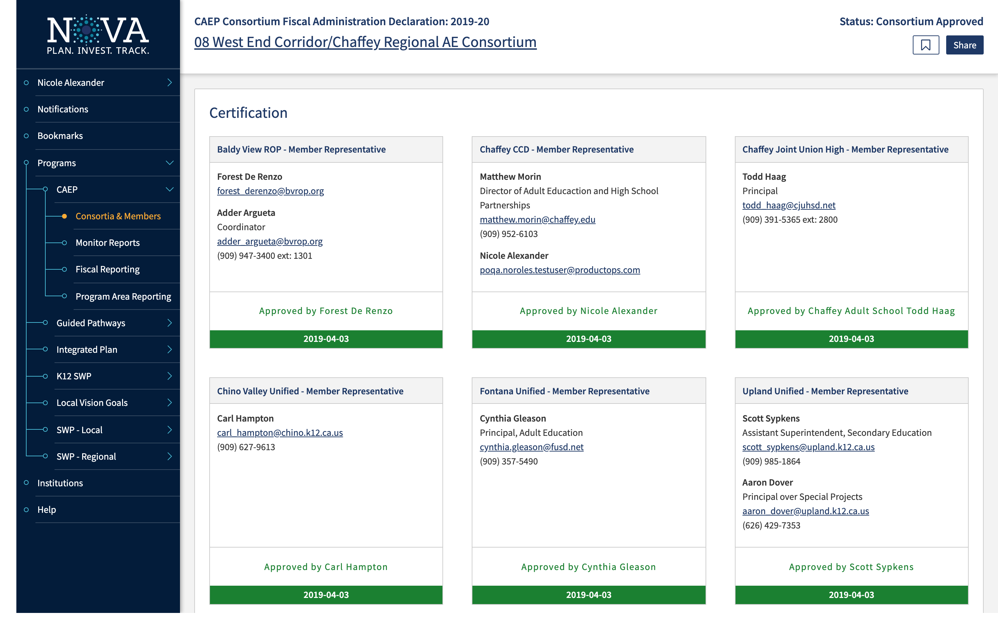

Slide 33
CAEP Allocation Amendments

Slide 34
CAEP Allocation Amendments
CAEP member allocations can be amended after the CFAD is submitted, and consortia can adjust allocations throughout the year (with consent of its membership) based on member activities, carry over, regional needs, etc.
These adjustments do not impact or change the CFAD as that is a one-time, once-a-year process.
Also, the adjustments do not affect the prior year allocations by member.

Slide 35
CAEP Allocation Amendments (cont.)
Direct Funded: Keep in mind, if you are direct funded, it will be difficult to amend allocations for members during the August-June disbursement process from the State Controllers to County Offices to Member Districts.
The members would have the transfer funds to other members as the State will not alter the disbursement schedules once the May 2nd CFAD is submitted.

Slide 36
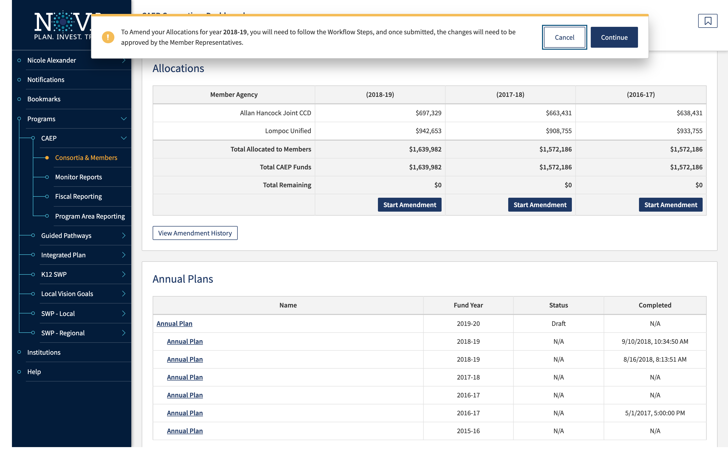

Slide 37
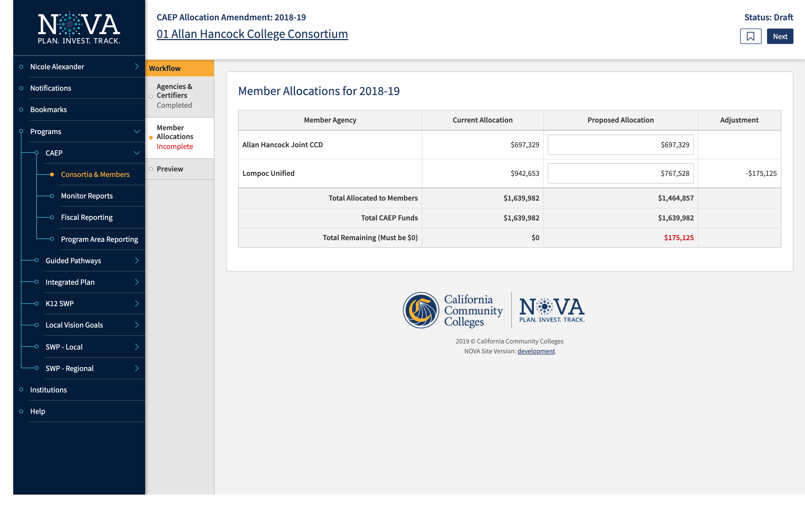

Slide 38
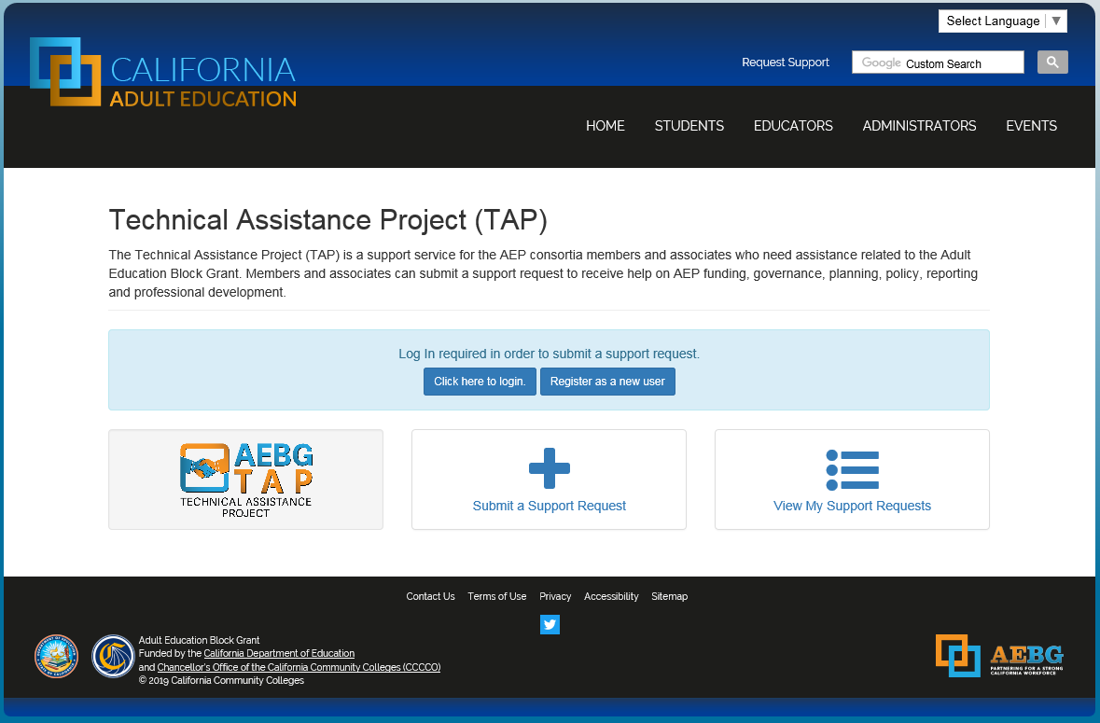
Request Support from CAEP TAP

Slide 39
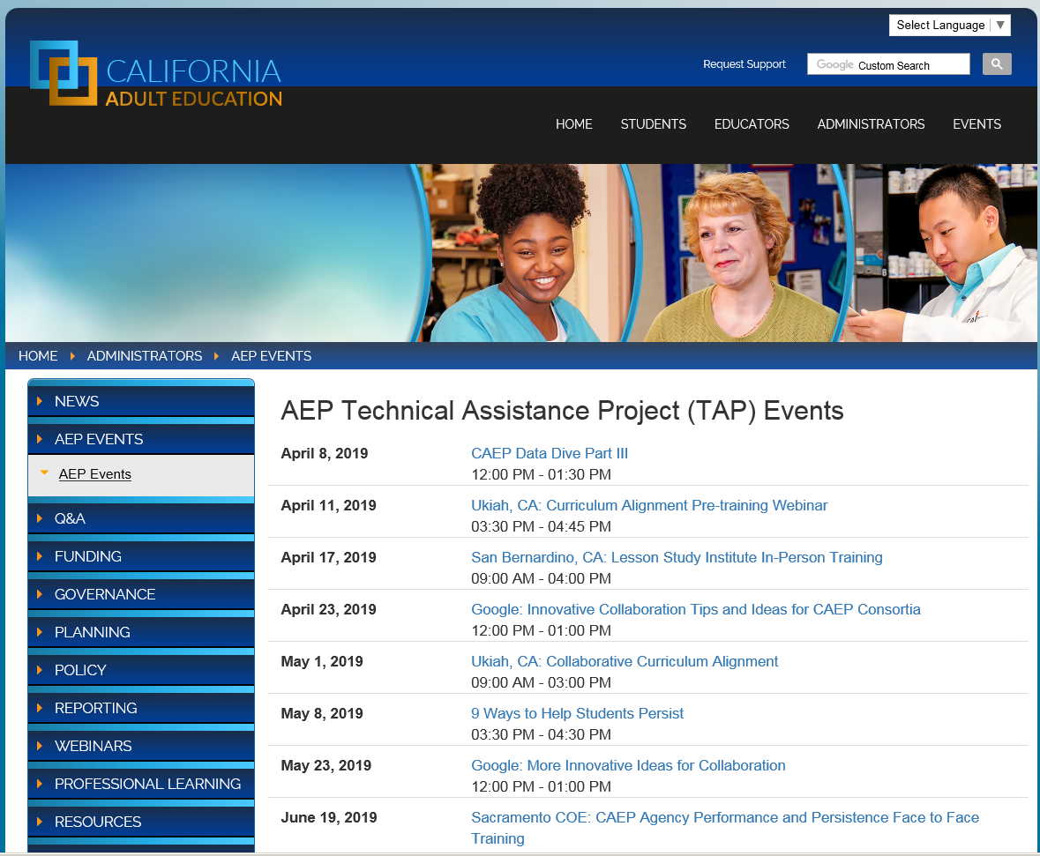
Upcoming Webinars and In-person Trainings

