Slide 1

NOVA Program Area Reporting Changes for 18-19 reporting

Slide 2
Agenda
Review of requirements
Review of changes
Opening Up the NOVA (walk through)
FAQs
Contact TAP

Slide 3
Reporting Requirements
All AEP members (K12 districts, county offices of education, joint powers authority, and community college districts) must submit in NOVA the total hours of instruction for program year 18-19 provided to students in the seven AEP program areas (adult education/noncredit).
All AEP members (K12 districts, county offices of education, joint powers authority, and community college districts) must submit in NOVA the total operational cost for program year 18-19 by fund source in the seven AEP program areas (adult education/noncredit).

Slide 4
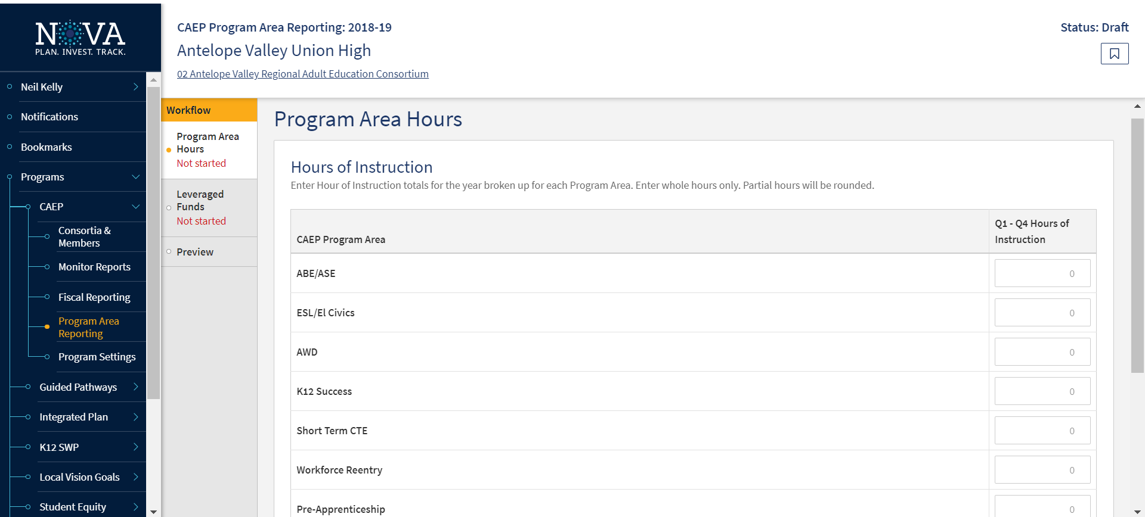

Slide 5
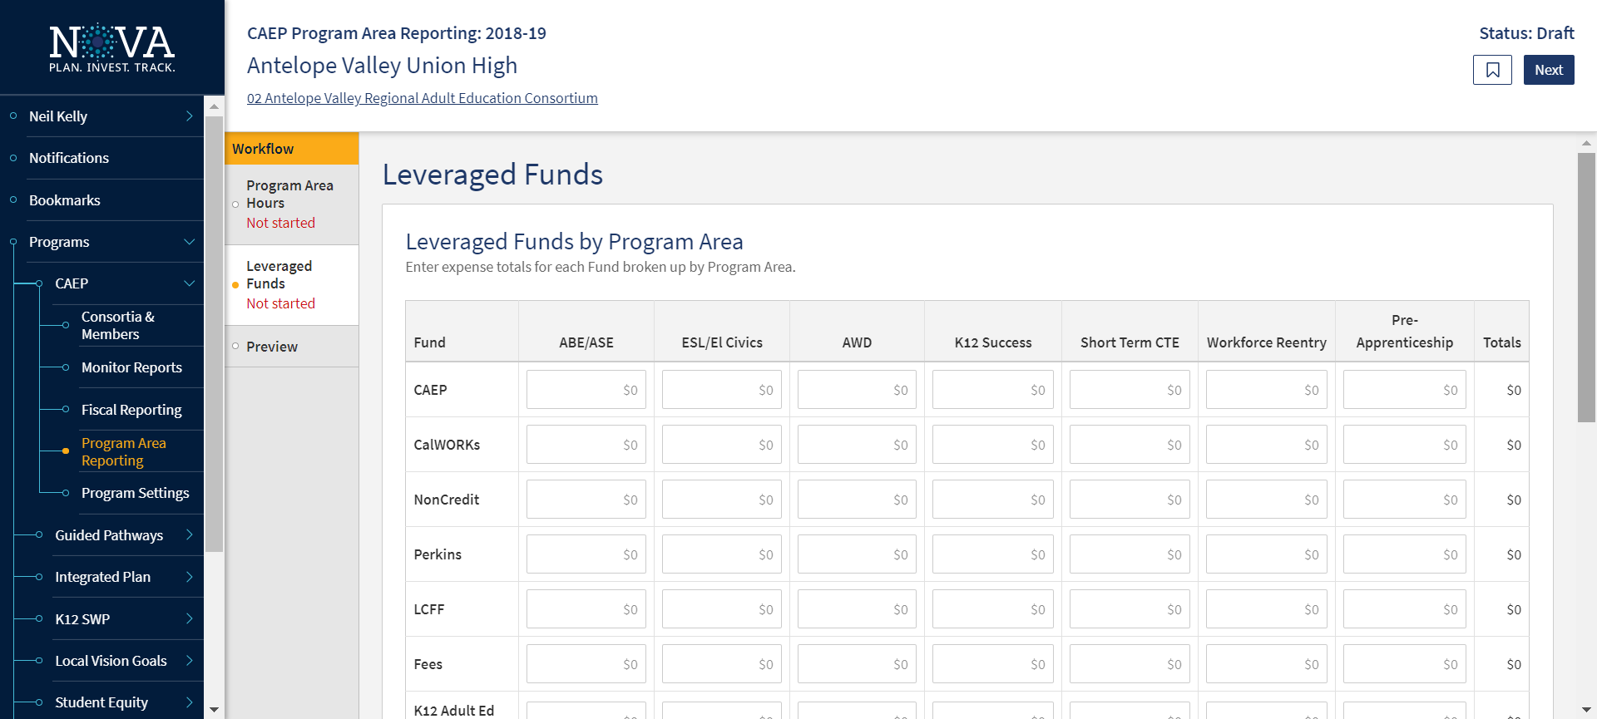

Slide 6
NOVA Program Area Reporting Timeline
September 1, 2019 – each consortia member will be asked to submit an estimated amount into for NOVA for the following:
  Program Year 18-19 – hours of instruction by program area.
  Program Year 18-19 – expenses by program area by fund source.

Slide 7
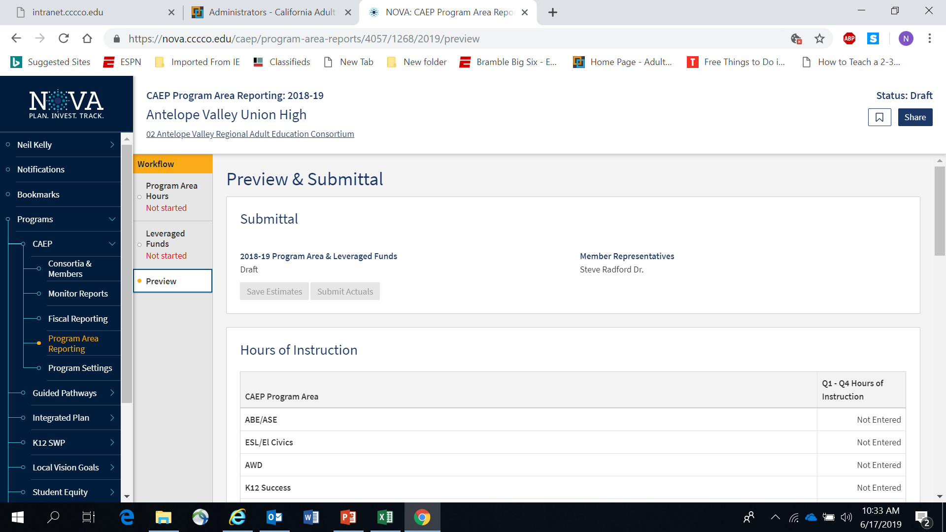

Slide 8
NOVA Program Area Reporting Timeline
December 1, 2019 – each consortia member will be asked to certify their amounts into for NOVA for the following:
  Program Year 18-19 – hours of instruction by program area.
  Program Year 18-19 – expenses by program area by fund source.

Slide 10
NOVA Program Area Reporting Updates
Program Area Clarification
Definition of an Instructional / Contact Hours
Integrated Course Hours Reporting
Service Hours
Reduction of the fund sources for reporting expenses
Alignment with WIOA on defining fees/program income and in-kind contributions

Slide 11
Reporting Changes for 18-19 Program Area Reporting in NOVA
Reporting of Program Areas
CAEP is still reporting by the Seven Program Areas.
But we want to avoid the duplication of hours between CTE and Workforce Reentry (now called Workforce Prep).
Workforce Reentry is not being used to collect barriers to employment (or characteristic demographics).

Slide 12
19-20 Reporting Changes
Enrollment / Instructional Hours
What is the definition of an instructional hour?
An instructional hour must meet OCTAE guidelines and be associated with an instructional program. Thereby, service hours must not be commingled with instructional hours.

Slide 13
Contact Hours
Definition. Hours of instruction or instructional activity that the participant receives from the program. Instructional activity includes any program-sponsored activity designed to promote learning in the program curriculum, such as classroom instruction, assessment, tutoring, or participation in a learning lab. Time spent on assessment can be counted only if the assessment is designed to inform placement decisions, assess progress, or inform instruction. Time used simply to administer tests, such as the GED tests, cannot be counted as instructional activity.
https://www.nrsweb.org/sites/default/files/NRS_TA_Guide.pdf
(page 57)

Slide 14
19-20 Reporting Changes
Tracking hours of instruction for integrated courses (ESL/CTE, ASE/CTE, ABE, CTE, etc.)
  For K12/COE:
  If a class is identified as integrated, the hours will be divided equally between the programs designated for that record.
  If not integrated, or if the hours are split unevenly – the agency can create two classes, one for each instructional program represented.
  For Colleges: Additional exploration is required to review how colleges are coding such courses.

Slide 15
19-20 Reporting Changes
Services/Service Hours
CAEP will not track service hours.
CAEP will only report instructional hours for NOVA program area reporting.

Slide 16
19-20 Reporting Changes
NOVA Program Area Reporting - expenditures
Must report on the following fund sources for the program area expenditure reporting exercise: CAEP, WIOA II, Noncredit Apportionment, CalWORKs, Perkins, LCFF, & Jail Ed Funds, Fees, and In-Kind.
Optional fund source reporting for the following: Contracted Services, Comm. College Supportive Services, Donations, WIOA I / ITAs, Other Federal Grants, Other State Grants, Strong Workforce.

Slide 17
19-20 Reporting Changes
Annual Program Area Reporting - expenditures
Align “in-kind” with WIOA II reporting requirements.
Define “fees” or program income using WIOA II definition.

Slide 18
In-kind definition (federal regulations)
Under “Other Non-Federal and/or In-kind,” report contributions such as: Cash and designated foundation grants or other non-federal awards used for AEFLA programs Buildings, land, and donated property–classroom space must be valued at the fair rental rate of the space Volunteer services valued at rates paid for similar work in the local agency Donated books and supplies valued at the market rate Utilities and property maintenance valued at the market rate Cost sharing of equipment valued at the fair rental rate All resources must be verifiable from the local agency records. Additional details are provided in The Uniform Administrative Requirements, Cost Principles and Audit Requirements for Federal Awards. (2 CFR 300.306) * State General Funding: This encompasses any funds from the state budget used for Title II programs including funds from LCFF, AEBG, Charter School funds, Prop 98 money, state set aside funds for programs that fall within Title II.
https://www.ecfr.gov/cgi-bin/text-idx?SID=997b9bc1eeb1e71a99a78bd2d3b561b5&mc=true&node=se2.1.200_1306&rgn=div8

Slide 19
Program Income definition (federal regs)
Program Income/fees reporting is a WIOA Title II: AEFLA grant requirement. Program income is defined as 2 CFR 200.80 as “gross income earned by the non-Federal entity that is directly generated by a supported activity or earned as a result of the Federal award during the period of performance except as provided in §200.307 paragraph (f). (See §200.77 Period of performance.) Program income includes but is not limited to income from fees for services performed, the use or rental or real or personal property acquired under Federal awards, the sale of commodities or items fabricated under a Federal award, license fees and royalties on patents and copyrights, and principal and interest on loans made with Federal award funds. Interest earned on advances of Federal funds is not program income. Except as otherwise provided in Federal statutes, regulations, or the terms and conditions of the Federal award, program income does not include rebates, credits, discounts, and interest earned on any of them.” (2 CFR 200.80) Fees reported must be reasonable and necessary, equitably administered, and must not reach levels that adversely affect the participation of economically disadvantaged students. California Statutory Requirement (Management Bulletin: July 1, 2016) While federal regulations allow program fees to be collected, the California statute is more restrictive and governs the implementation of the AEFLA grant for local education agencies (LEAs) in California. Under California Education Code Section 52612, school districts may generally charge adult fees for adult classes, with the exception of a “charge of any kind” for classes in English, Citizenship and elementary subjects; and a “fee charge” for high school classes (including high school equivalency classes) taken by an adult without a high school diploma. This exception does not apply to non-LEAs. Note: Agencies must expend all program fees collected prior to encumbering or expending AEFLA grant funds. Funds from program income/fees must be disbursed to the program for which the fees were collected within the program year.
https://www.ecfr.gov/cgi-bin/text-idx?SID=997b9bc1eeb1e71a99a78bd2d3b561b5&mc=true&node=se2.1.200_1307&rgn=div8

Slide 20
NOVA Evaluation of Program Area Reporting
NOTE: The State CAEP Office realizes that these changes are being implemented at the end of the 18-19 program year.
If your members are still using the old guidance – they will not be penalized or have their data/fiscal submission rejected.
We hope that these changes will reduce the amount of work that each member will be required to do annually.

Slide 21

Opening up the NOVA

Slide 22

Frequently Asked Questions

Slide 23
FAQS
Q: This will be extremely difficult to separate some of my fund expenses as I receive a grant that combines several programs.
A: We expect AEP members to enter into NOVA their best estimate given the information/data from their local and state level systems. The AEP Office encourages AEP members to prorate when necessary when funding sources or program overlap and are too difficult to separate. You can also use your attendance system or TOPSPro to calculate a percentage model that could also assist in separating the funds.

Slide 24
FAQs
Q: My college 320 report includes noncredit programs that are not one of the AEP program area. I don’t know how to separate them out?
A: Feel free to use your attendance system and/or the TOPSPro system that collects program services and instructional hours to prorate the amount that you think reflects the hours for that program area.

Slide 25
FAQs
Q: I am at the adult school. Should we use ASAP reporting or TE reporting to complete instructional hours in NOVA?
A: The district has several options. We suggest that the district compare the two reports and enter the most accurate information into NOVA.

Slide 26
FAQs
Q: What are the differences between Short Term CTE, Workforce Reentry and Pre- Apprenticeship?
A: See the program area definitions as described in the AB104 legislation (and are listed in this document). If you are unable to breakout workforce reentry, pre-apprenticeship, or short term CTE, you may report them all under CTE.

Slide 27
FAQs
Q: I went into NOVA and accessed the Program Area Reporting, but it shows it was already submitted. How can that be?
A: It appears you may have selected 17-18 as the program year. The Program Area Reporting for 17-18 was submitted last program year. Please remember to select the 18-19 year from the drop down menu in NOVA.

Slide 28

CAEP TAP
The AEBG Technical Assistance Program (TAP) provides professional development resources for all CAEP agencies statewide.
https://caladulted.org/
tap@aebg.org

