Slide 1
Building Persistence Through Teamwork
POLL
Marian Thacher, American Institutes for Research

Slide 2
Agenda
Teamwork and persistence
Examples from ESL and High School Equivalency
Grouping strategies
Example from ESL
Integrated Education and Training
Examples from Pharmacy Technician and Auto Technician
Closing

Slide 3
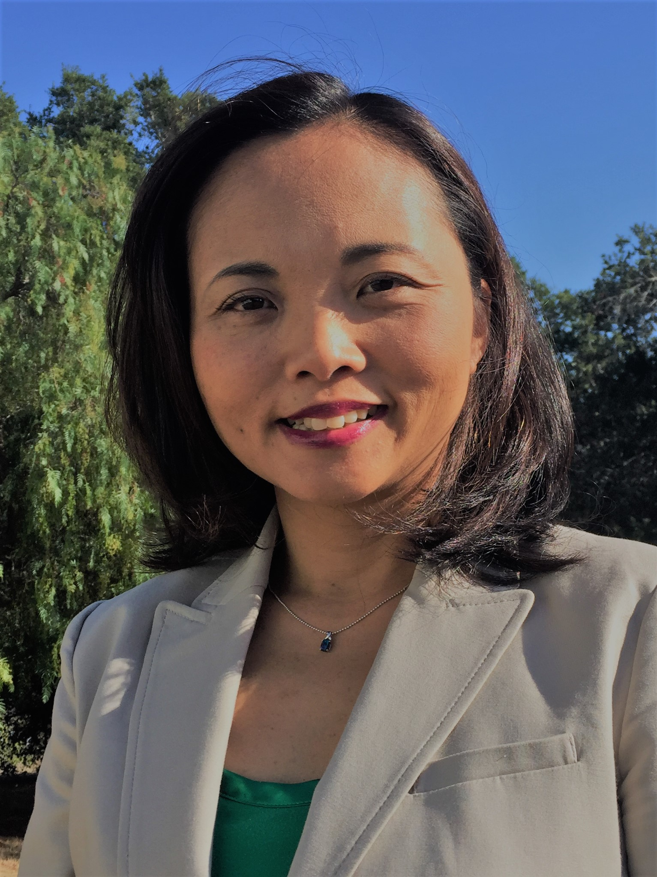
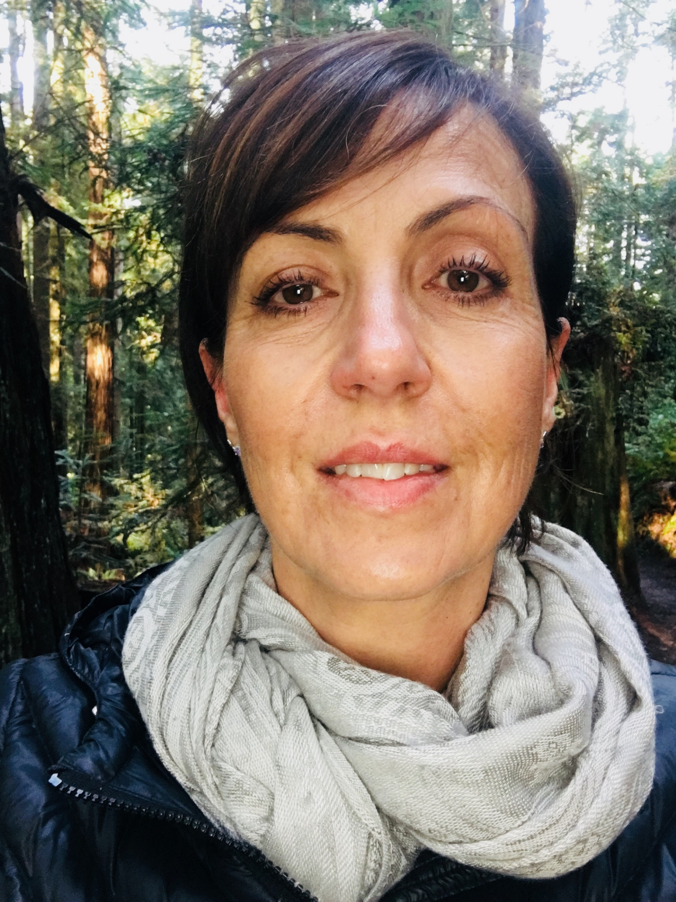
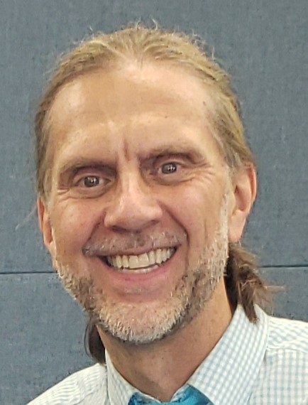
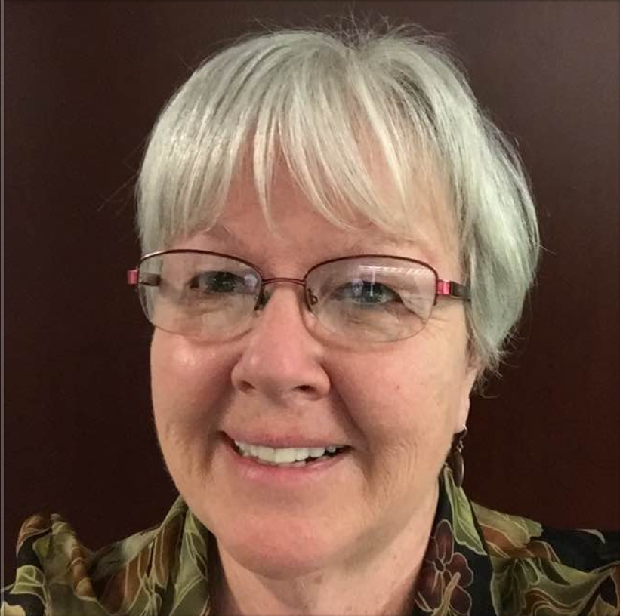
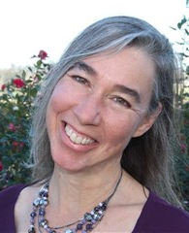
Presenters
Marian Thacher, AIR | Sachiko Oates, Santa Barbara City College | Kerry Marini, Folsom-Cordova Adult School | Ingrid Bairstow, MiraCosta College | Bill Hrycyna, Los Angeles USD Division of Adult and Career Education | Carolyn McGavock, San Diego Community College Continuing Education

Slide 4
Persistence
“Adults staying in programs for as long as they can, engaging in self-directed study when they must drop out of their programs, and returning to their programs as soon as the demands of their new lives allow.”
--Comings et. al

Slide 5
How do we measure persistence?
CASAS – the percent of students with a pre and post test

Slide 6
Learner Goals
The point of persistence is to reach a personal goal – educational, career, or personal
Students with specific goals are more persistent than those without
Persistence is good for students…and good for programs!

Slide 7
Your experience
CHAT
What is your experience with persistence?
Is it a problem in your program?
Is there a particular time when more students drop out?
How do you know?

Slide 8
What Supports Persistence in the Classroom?
Learner motivation, persistence, success
Encouraging collaboration and cooperation
Modeling literacy and learning strategies
Use of assessment results
Feedback for growth mind-set
Setting appropriate goals
Finding value in learning
Addressing stereotypes
Choice and autonomy
Overcoming systemic barriers

Slide 9
What Supports Persistence in the Classroom?
Encouraging collaboration and cooperation
= Teamwork
Overcoming systemic barriers
Feedback for growth mind-set
Choice and autonomy
Modeling literacy and learning strategies
Learner motivation, persistence, success
Addressing stereotypes
Use of assessment results
Finding value in learning
Setting appropriate goals

Slide 10
Why is teamwork important
It’s an employability skill – “Understands teamwork and works with others” (Employability Skills Framework)
Most work is done in teams
Frequent reason for getting fired is not being able to work well in a team

Slide 11
Why do people get fired
POLL
Not performing the required job – includes asking too many questions, lacking a sense of urgency, and using poor judgment.
Taking too much time off
Arriving late and leaving early, too many breaks, too much socializing
Insubordination, including obstructionist behavior or arguing or stalling
Dishonesty and lying, falsifying records
Having inappropriate or bad relationships at work
Stealing from the company
Using company computer for personal business or conducting personal business on company time
Gossiping and badmouthing
Drugs and alcohol
Notes:
Which of these might be improved with better teamwork skills? Type the numbers in the chat

Slide 12
How does teamwork increase persistence?
We feel accountable to others on our team
We are more committed if we know others better, and feel known
We want to do a better job if others are relying on us
Commitment to a team goal helps us persist
Evidence shows that students working in a cohort have better persistence

Slide 13
Short-term Team Activities

Slide 14
What does teamwork look like?
Short term
Short class activities
Related to a learning objective
Team members have a common goal
Teams may or may not compete with each other
A variety of grouping strategies used

Slide 15
Sachiko Oates, Santa Barbara City College
sooates@pipeline.sdcc.edu

Slide 16
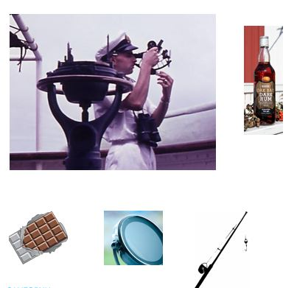
What We Did
Lost at Sea- Team Building
Team size: 3-5 People
Time: 1-1.5 hours for ESL (30-40 min for ASE/CTE)
Working toward a common goal
Challenging
Fun
Learn about each other

Slide 17
Successes
Challenges
Authentic Situation-Multiple Skills
EL Civics – Emergency
Academic Discourse: expressions for Negotiation/Persuasion/Reasoning
Employability Skills
Time Management
Quiet students
We should move on. We are running out of time.
We all concluded that...
I understand what you are saying, but I think...because...
We haven’t heard from you, yet. What do you think?
Based on what we heard, I think...

Slide 18
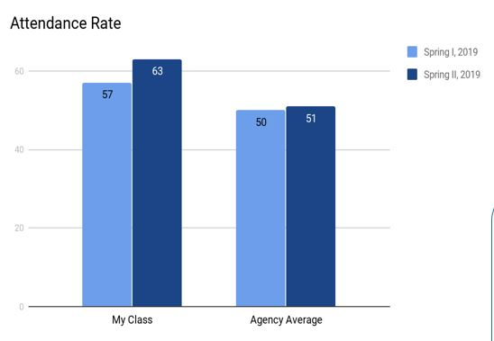
How my project built a sense of community and encouraged students to stay in class
Quantitative Data
Qualitative Data-From Student Reflections
It was fun. I am changing my soccer practice schedule (to come to class).
Our team did well. I am proud.
My teammate encouraged me to share my opinion.
I feel more comfortable in class.
Next time, I want to use more expressions from the list.

Slide 19
Kerry Marini, Folsom Cordova Adult School Kmarini@fcusd.org

Slide 20
Activity # 1- Getting Ready To Read
Discovering through partner, small group, and independent activities.
Reading for Summarization - Discovering what students think through partner, small group, and independent activities. Students have previously completed the process of writing a summary of the first of two articles read as a class and are preparing to write another summary with similar theme.
Watching a series of 3 youtube.com clips about Growth Mindset—a manner of thinking about learning. After watching each clip, students individually respond to the following quick write prompts:
1. What does each video mean to you?
2. How does it speak to you?

Slide 21
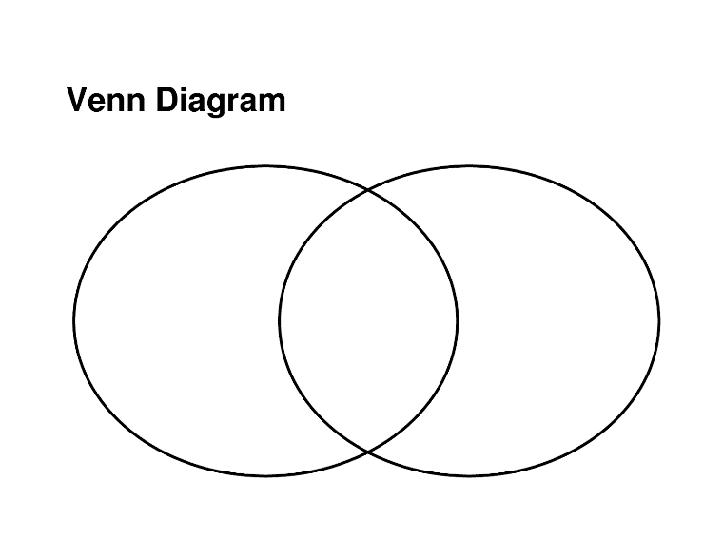
Activity # 2 - Synthesizing Information
In small groups or teams:
Discuss quick writes with each other.
Students may add additional insights to their personal quick writes based on the group discussion.
After discussion, each group creates and presents a VENN DIAGRAM on large chart paper to the rest of the class. The Venn Diagram will organize the group’s information/input for comparing the gist of the three videos, similarities, and differences.

Slide 22
Activity # 3 - Connecting Reading and Writing
In pairs, students used a Summary Guide to identify information needed when composing a draft.
Example:
____________ cautions that attaining a growth mindset is _____________________ even if the
(author's last name) (describe author’s cautionary remarks)
misconceptions are corrected because ___________________________ .
(list the potential obstacles)
In a Round Table Format, students took turns reading their classmate’s first rough draft using a Rubric as guidance and sticky notes for editing suggestions.
After partners gathered information using a Summary Guide, edited as a roundtable group, students individually composed a summary.

Slide 23
Challenges
Model Role Assignments prior to assigning tasks. My students have worked in partners, small groups, and structured cooperative groups with the roles of Facilitator, Recorder, Reporter, Presenter, and Strategy Analyst. If we had not practiced team roles thus taking risks within their group, they would have had difficulty honestly and confidently sharing opinions.
My adult students required a few “practice runs” using a team or group format to gain trust in their environment and with their peers.

Slide 24
Successes
Students were able to use a new technique in organizing and synthesizing information in a way that was interesting and fun. (Venn Diagram)
Encouraged individual accountability to the team.
Allowed students to strengthen communication skills with teammates and in whole class presentation.
Encouraged a common group to work without stereotypical or gendered role identity.
Each expressed that the Venn Diagram is a tool they will use in the future. (Yay!)

Slide 25
Building a Sense of Community
With the support of the team and instructor, students have learned to take academic and personal risks in order to learn more about the subject presented.
Working as a community each student is able to take different roles in a small group.
By taking on different roles and responsibilities within the team students evaluate their own learning style while collaborating with others of similar or different styles.
Role playing various jobs or tasks with a set goal to meet, each group member discovers what is most comfortable and successful for the assignment at hand.

Slide 26
Grouping Strategies

Slide 27
Grouping Strategies
CHAT
When you have students work in groups, what are some of the ways you break them into groups?
Type 1 or 2 ways in the chat

Slide 28
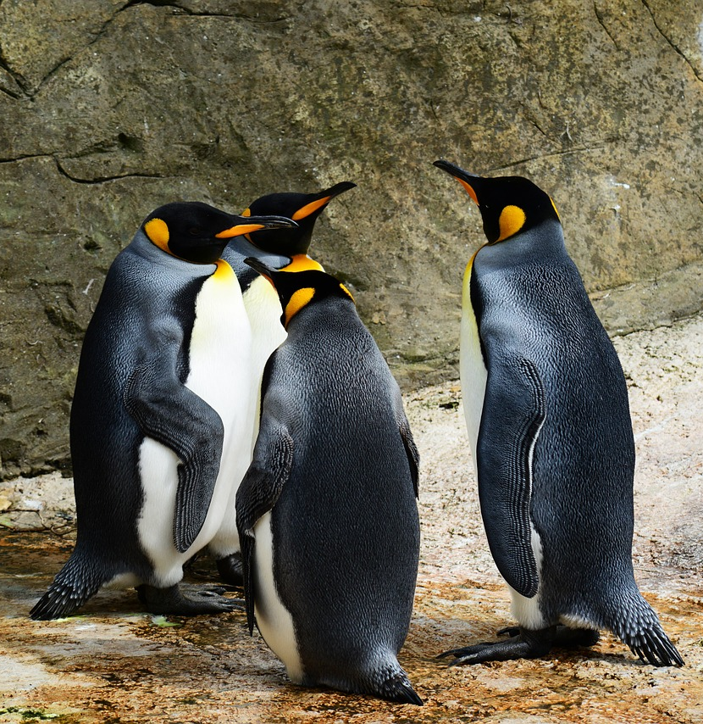
Grouping Strategies: Teacher-Assigned Groups
Turn and talk
Random or pre-assigned
Same skill level or mixed levels
Classroom management
According to interest
According to the task
Rotation system
Day of the week

Slide 29
Grouping Strategies: Students Choose Groups
Choose own group
Choose own group with exceptions
Choose between a few options
Choose based on interest
Choose based on response to a survey or question
Based on the clock

Slide 30
Grouping Strategies: Randomized
Draw names from a hat
Use a grouping app like Group Sort (groupsort.com)
Pick a colored index card
Count off
Use playing cards
Use vocabulary cards
Line up by height, birthday, length of hair

Slide 31
Longer-term Team Activities

Slide 32
Long Term Team Projects
Project-based learning: teams engage in a longer project like a presentation or a research paper
Assign roles
Scaffold the process
Can be interdisciplinary
Can be tied to real-world activities
Research supports increased skills and learning outcomes

Slide 33
Ingrid Bairstow, MiraCosta College ibairstow@miracosta.edu

Slide 34
When you serve together, you cooperate together:
Cooperative learning via service learning
Ingrid Sbacchi Bairstow
MiraCosta College

Slide 35
What we did: service learning projects
My cooperative learning took place via service learning projects:
Beach clean-up project
Environmental literacy project
With service learning, students engage in ‘real-life’ projects with ‘real-life’ interactions in their community.
Students work in teams on a project that impacts the community.
There is a lot of organizational cooperation that goes into this, such as scheduling, sending emails, creating materials, etc.

Slide 36
What we did: service learning projects
We brainstormed on tasks that needed to be accomplished for the project.
Students organized themselves into teams: t-shirt design team, brochure design team, sharing with the school at break team, map team, email team, overall supervisor (captain)
This allowed for different strengths to be used—those who were technologically savvy worked on the brochure; the artistic students worked on t-shirt design; those who liked to speak did the outreach with other students.
I set guidelines: every person had to contribute at least one thing to the team and every person had to write a reflection paragraph.

Slide 37
Challenges
1. Adult student schedules are difficult to predict. Not everybody could attend the actual community presentation of the project. Teams were ‘fluid’ because of attendance.
2.Controlled chaos at the beginning of the project. This type of learning is different than sitting at a desk and filling out workbooks. Students were unsure of what to do.

Slide 38
Successes
1.Confidence and enthusiasm followed the initial period of frustration and chaos. When students understood they had ‘permission’ to create the project and there was no one right answer, they blossomed. Natural leaders, natural organizers, and even followers bloomed as they gained confidence that their ideas and contributions were used in the project.
2. Increased retention and assessment scores. I do not have explicit data, however, students attendance and final assessment scores seem to jump every time I do a service learning project. They feel part of a team. They learn to engage with their community and feel a sense of empowerment that adds to confidence and learning real communicative English.

Slide 39
Team Activities in IET
POLL

Slide 40
Integrated Education and Training
Basic skills and technical teacher plan and work together
Teachers create a common set of learning objectives
Basic skills instruction supports success in the CTE class
Creates equity for students with limited language skills or basic skills to participate in career pathways

Slide 41
Bill Hrycyna, Los Angeles USD Adult Education wch6370@lauds.net

Slide 42
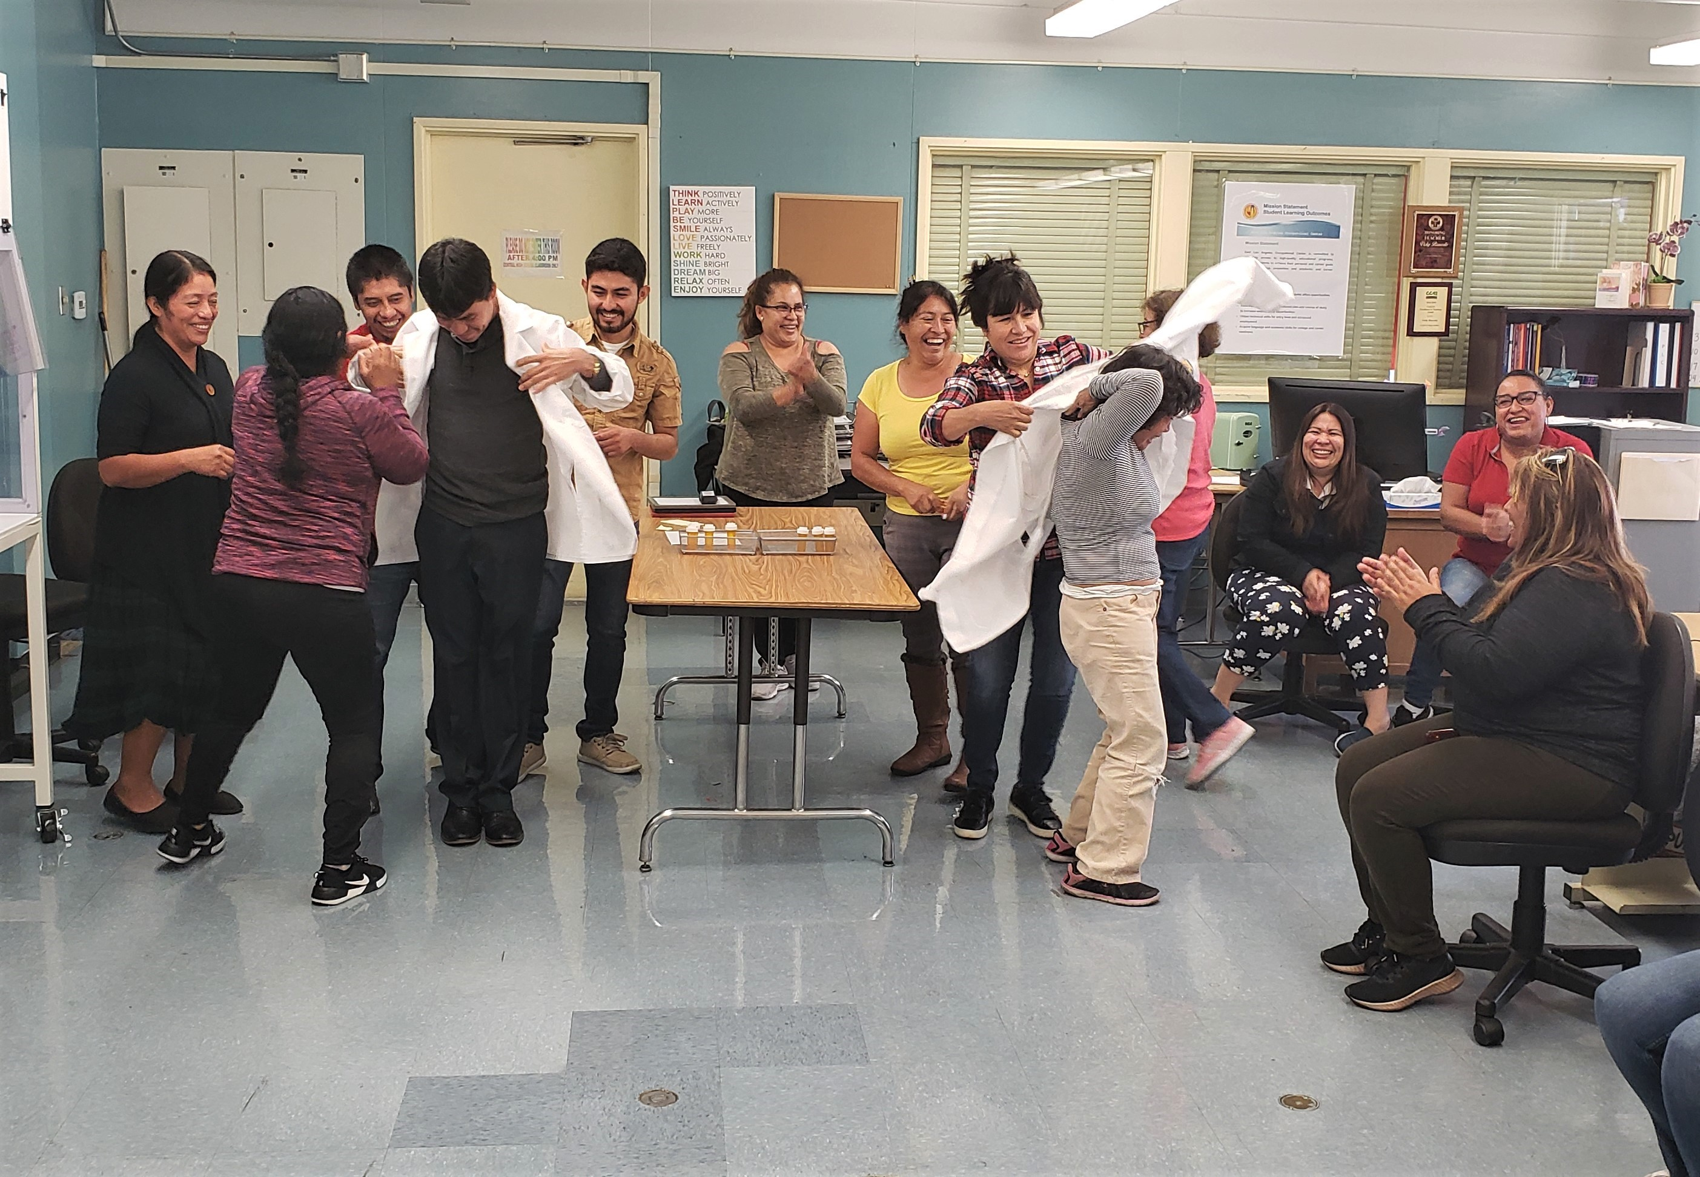
Prescription Filling Relay Race
Objective: practice skills and related language
Small teams line up
Tasks: put on lab coat, run to filling station, read & fill prescription, take to out-window, take off lab coat
Team helps to put on/take off lab coat
Team shouts out encouragement, directions, reminders: "You can do it!"; "Stand on the pad when handling the medication!"; "Don't forget to put the label on the vial!"

Slide 43
Challenges & Successes
It can get a little frenetic.
They experience the "stressful" conditions of a busy workplace setting.
Students can't pass on the lab coat until the task is done correctly.
It's fun and purposeful, so everyone is engaged.
Everyone is very focused on their own actions; they are also very focused on the actions of their teammates – they have a vested interest in the success of everyone on their team.

Slide 44
How my project builds a sense of community:
Students feel team pride after completing this group task … whether or not they are the identified "winners“!
They talk about it for days afterwards.
Students feel closer to one another and are more willing to share personal info and take risks outside of comfort zone.
Teacher shares photos and/or video snippets of activity with students via Remind app to remind them of what they did, who they did it with, what they learned and how much fun they had.

Slide 45
Carolyn McGavock, San Diego Community College Continuing Education cmcgavoc@sdccd.edu

Slide 46
From Homework to Teamwork
Carolyn McGavock
Active participation
Respectful disagreement
Be helpful
Act as a peer coach

Slide 47
What we did
Addressed anxiety about textbook work
Provided opportunities for students to be heard
Required textbook evidence to back up answers
Practiced helpful behaviors
A pg. 117
B pg. 117
C pg. 118
A pg. 119
? pg. 120
D pg. 120

Slide 48
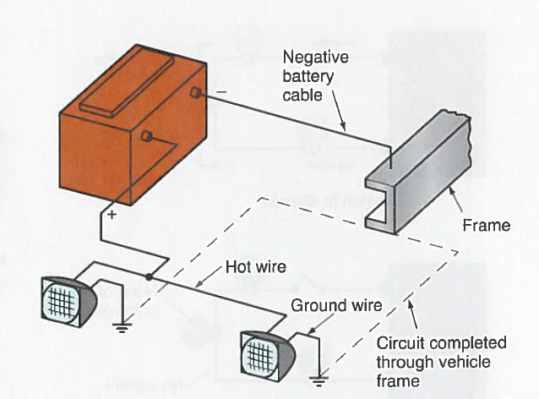
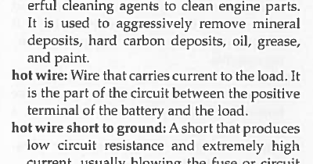
text
illustration
glossary

Slide 49
Challenges and successes
Some students couldn’t read well in English.
Some students felt that the textbook didn’t apply to real life.
Some students had to overcome a dislike of reading.
Some students had test anxiety.
Students became adept at working together in mutually beneficial ways.
Students increased accuracy in their work.
Students continued teamwork for textbook assignments in subsequent classes.

Slide 50
How this approach built a sense of community and encouraged students to stay in class
Students got to know each other better which fostered more respect and trust among classmates.
Acknowledged students’ experience outside of the textbook.
Students developed a desire to support each other in other components of the course.
Students had a plan and strategies for completing textbook assignments successfully in the future.

Slide 51
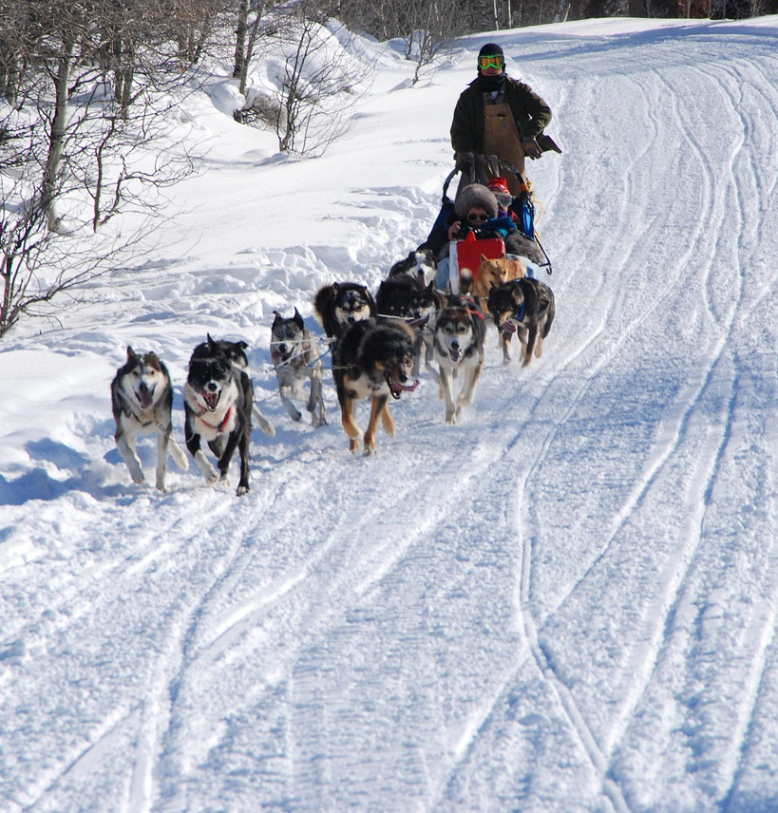
Conclusions
Teamwork strengthens instruction in several ways
It is an important way of supporting learners to persist
There are so many creative ways to use it!
I wish you the best in your future explorations!
Notes:
Image: https://pixabay.com/photos/dog-sledding-winter-snow-husky-dog-4364343/

Slide 52
Thank you!
Notes:
Image: https://pixabay.com/photos/way-path-outdoor-landscape-nature-918900/

