Slide 1
CAEP Fiscal Update
Neil Kelly – State CAEP Office
Veronica Parker – CAEP TAP

Slide 2
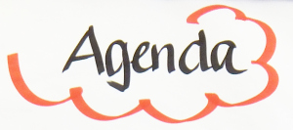
Agenda
CFAD’s importance
Allocations for 20-21
COLA
Brown Act/Public Meetings
CFAD Submission
Allocation Amendment Process
NOVA Basics/Reminders
Wrap Up & Additional Questions

Slide 3

Why is the CFAD important?
Public decision making on allocations for the next school year.
Allows the consortium to change it’s fiscal structure.
Allows the consortium to decide whether or not to fund members based on education code.
Provides the State CAEP Office the ability to set up statewide disbursement of CAEP funding.
Allows the State CAEP Office to meet statute for disbursement of funds.
Provides funding to local member districts in time for fall classes.

Slide 4

CAEP 2020-21 Allocations
2020-21 CFADs is due in NOVA by May 2, 2020.
CDE and the Chancellor’s Office approve interagency agreement for release of funds (May-June).
Governor’s Budget approved by July 1, 2020 *.
CAEP funds are released by August 2020 (in 11 installments) through May **.
*May Revise reductions/additions could affect schedule **CDE/Chancellor’s Interagency agreement needs to be approved.

Slide 5

COLAs
CAEP received a 2.29% or $12.3M COLA in the Governor’s proposed
budget for 20-21.
The new CAEP base for 20-21 will be $550,897,000.
All members are eligible for the COLA.
The COLA will be based on the member’s allocation percentage from the prior year's CFAD.
Consortia cannot vote to exclude or prevent a member from receiving a COLA (provided that the member received funding in the prior year).

Slide 6
EC 84914 – Increase/Decrease Allocations
(b) (1) For any fiscal year for which the Chancellor and the Superintendent allocate an amount of funds to the consortium greater than the amount allocated in the prior fiscal year, the amount of funds to be distributed to a member of that consortium shall be equal to or greater than the amount distributed in the prior fiscal year, unless the consortium makes at least one of the following findings related to the member for which the distribution would be reduced:
(A) The member no longer wishes to provide services consistent with the adult education plan.
(B) The member cannot provide services that address the needs identified in the adult education plan.
(C) The member has been consistently ineffective in providing services that address the needs identified in the adult education plan and reasonable interventions have not resulted in improvements.

Slide 7
Public Meetings
AB104 mandates public meetings for CAEP consortia decision making.
Governor suspends meeting safeguards in Brown and Bagley-Keene Acts in response to the coronavirus crisis.
The order authorizes state and local bodies to hold public meetings by teleconference and to make public meetings accessible telephonically or otherwise electronically to all members of the public seeking to attend and to address the local or state agencies.
Please see the Governor’s Executive Notice for more details.
https://cnpa.com/governor-suspends-meeting-safeguards-in-brown-and-bagley-keene-acts-in-response-to-coronavirus-crisis/

Slide 8
FAQs
Question: Can I wait until June to file my CFAD?
Answer: We understand that it may be tough to schedule public meeting, but any late filing will delay the processing of CAEP funding for the 2020-21 program year.
Question: What if my consortium has a fiscal agent, do I have to submit my CFAD by 5/2?
Answer: Yes, we still need the allocation amounts (and justification, if changed), the verification of the fiscal structure, and confirmation that there was a public process for decision making.

Slide 9
FAQs
Question: What if my consortium wants to hold money into a consortium pot for projects?
Answer: Because of CAEP education code, we would advise you create your project pot after the CFAD, and use the allocation amendment process.
Question: I have a new member, how will they receive funding?
Answer: If the consortium wants to fund new members that have no prior year funding, they should use the allocation amendment process after the CFAD is submitted.

Slide 10
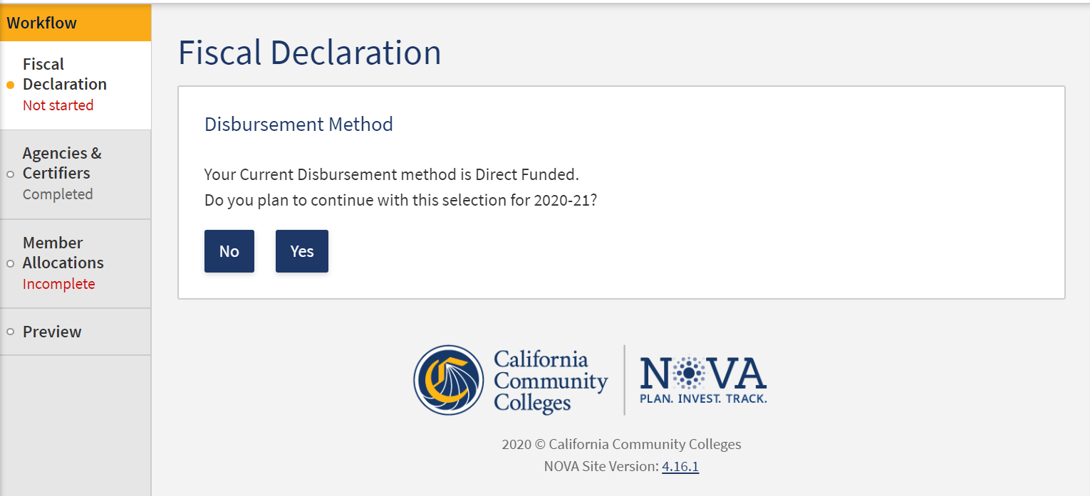
CFAD Process

Slide 11
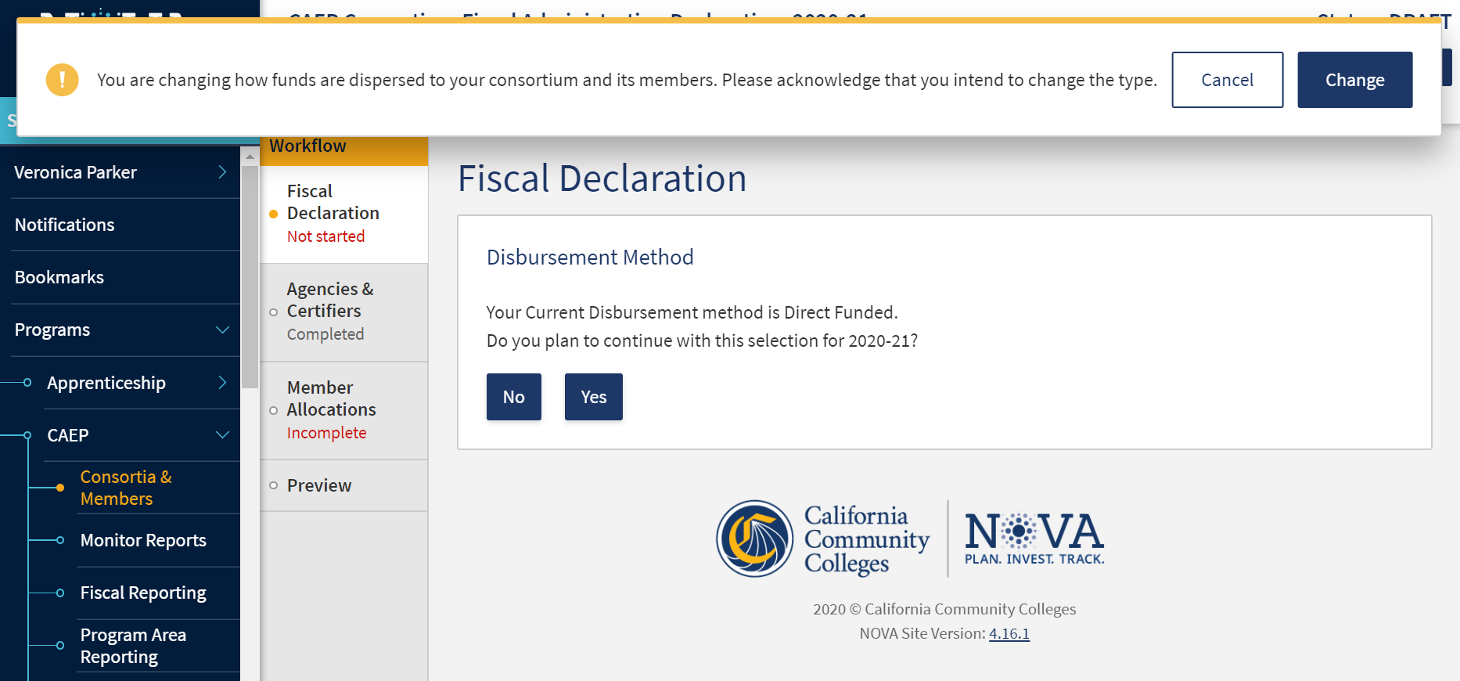
CFAD Process

Slide 12
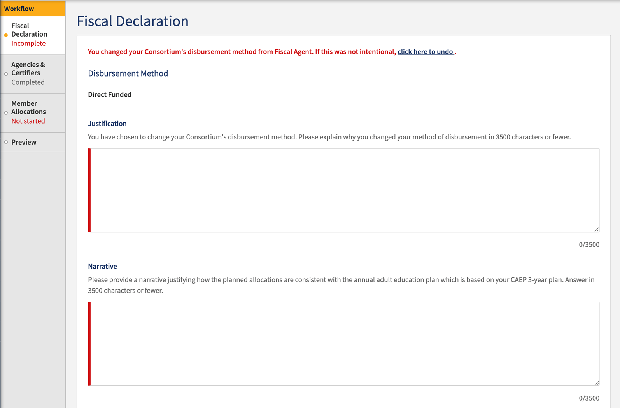
CFAD Process

Slide 13
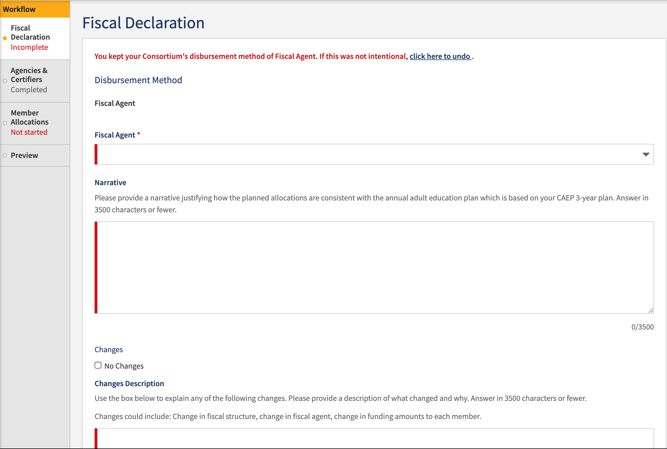
CFAD Process

Slide 14
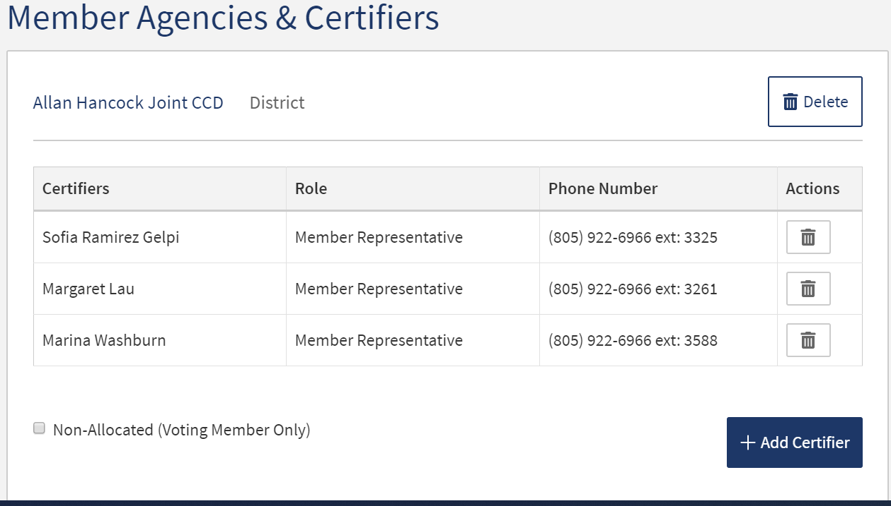
CFAD Process

Slide 15
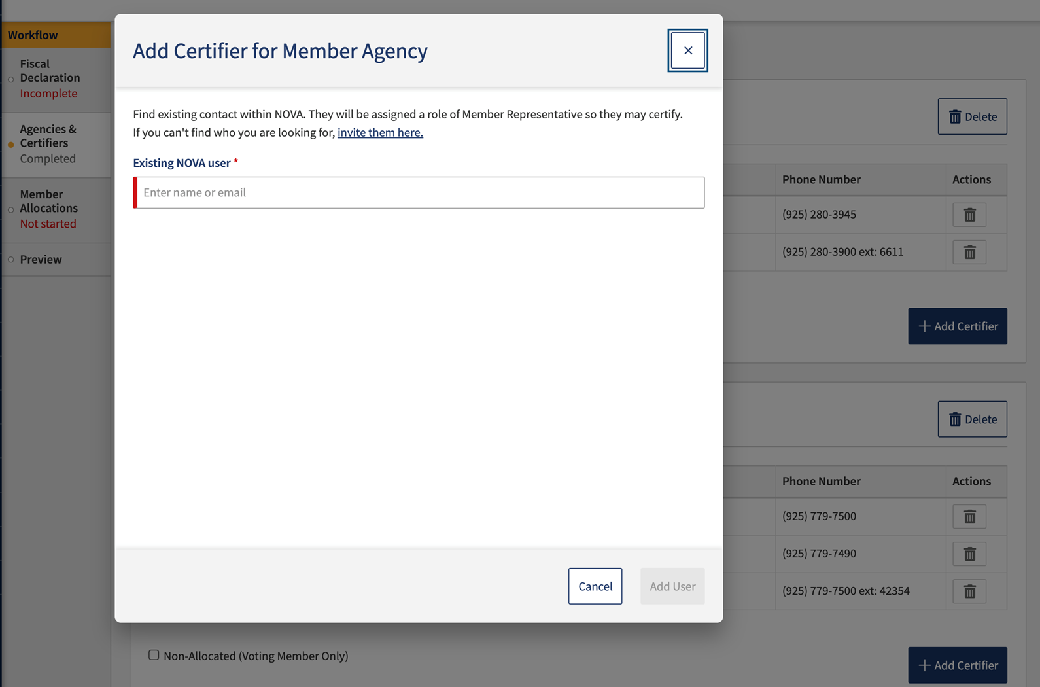
CFAD Process

Slide 16
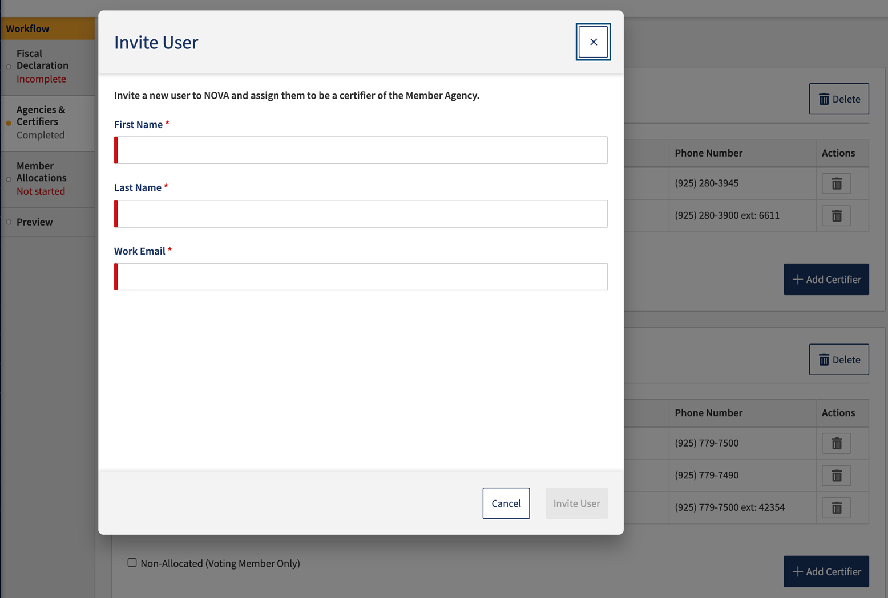
CFAD Process

Slide 17
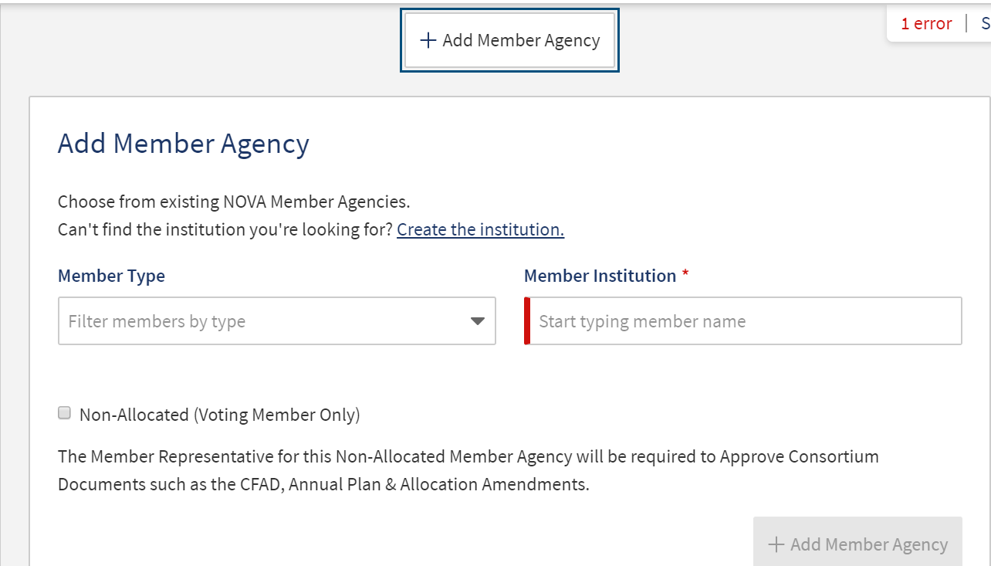
CFAD Process

Slide 18
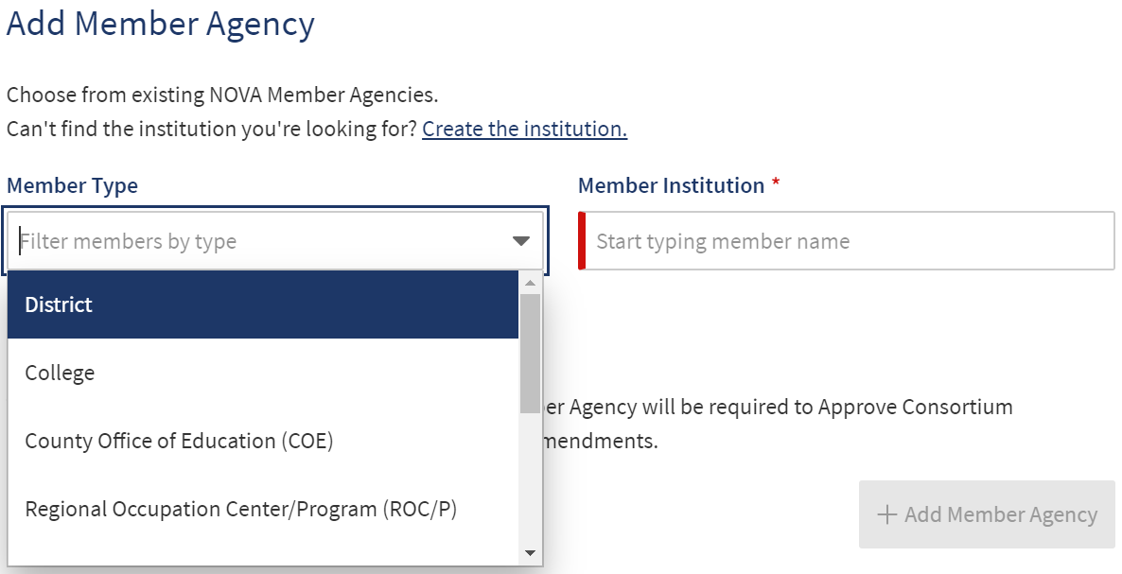
CFAD Process

Slide 19
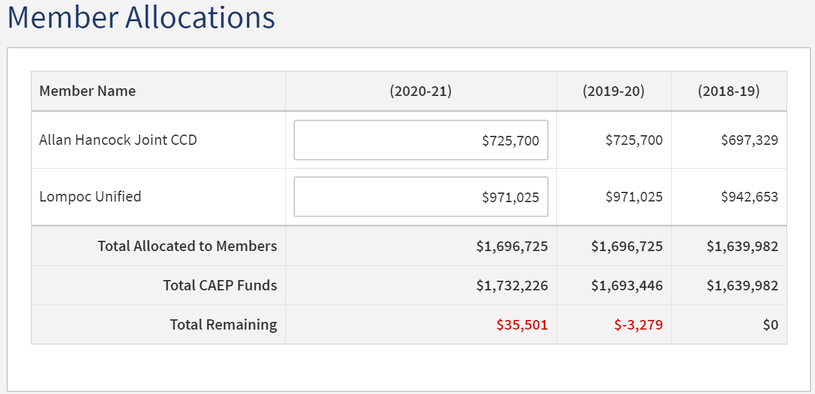
CFAD Process

Slide 20
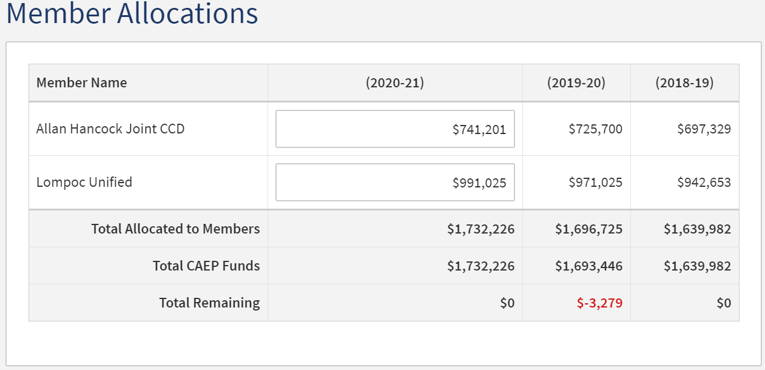
CFAD Process

Slide 21
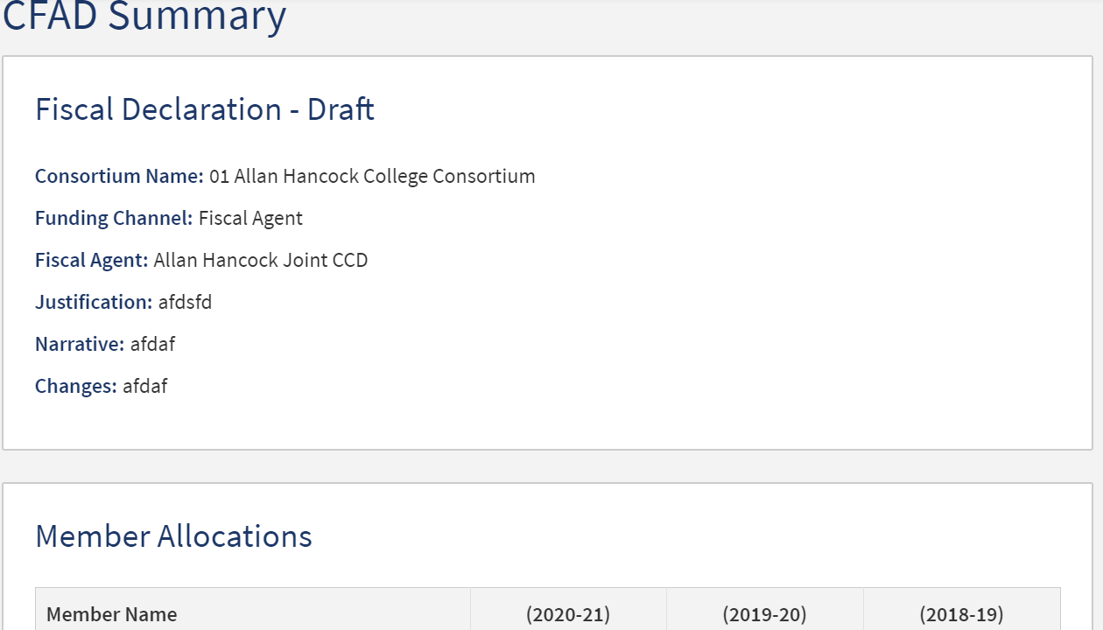
CFAD Process

Slide 22
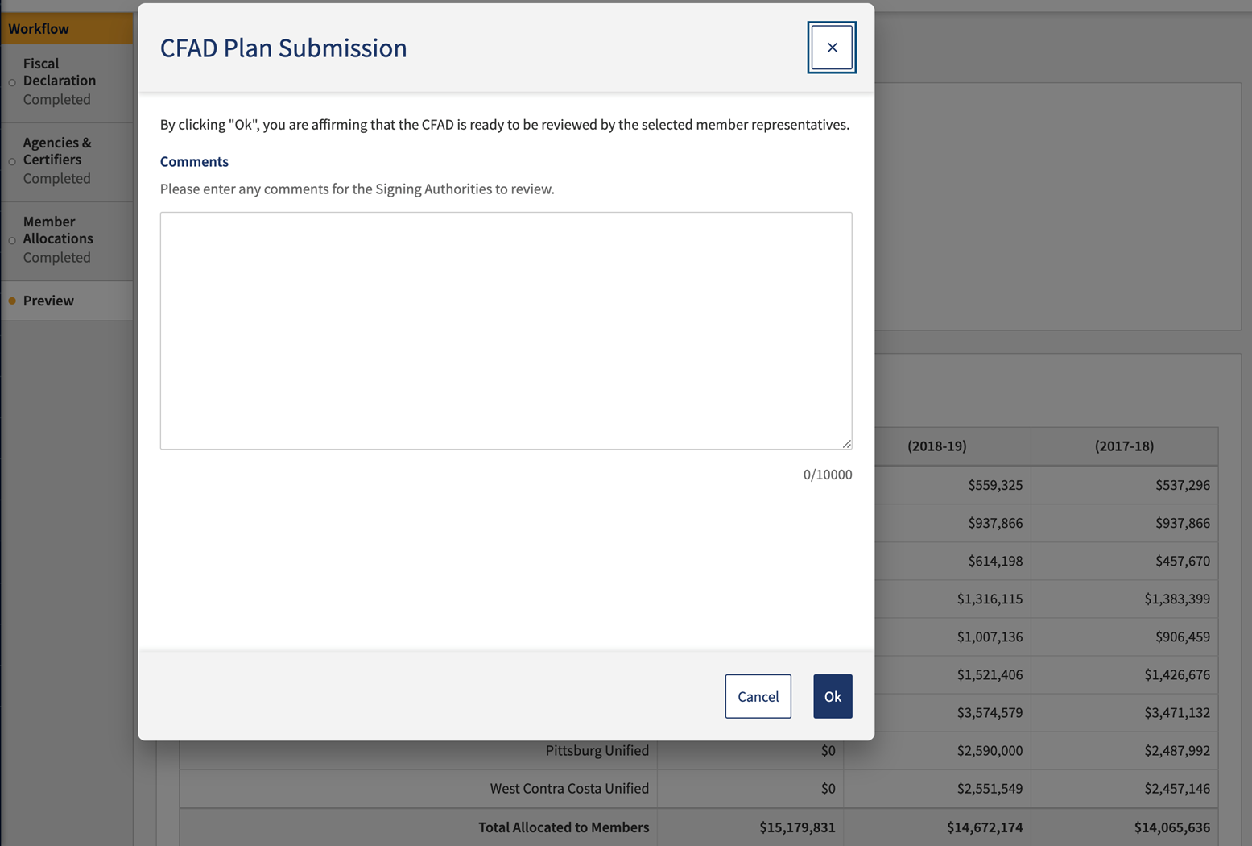
CFAD Process

Slide 23
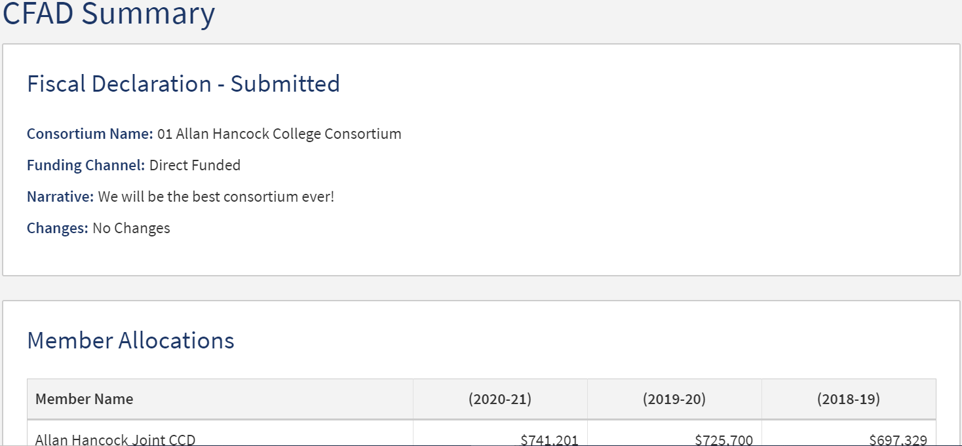
CFAD Process

Slide 24
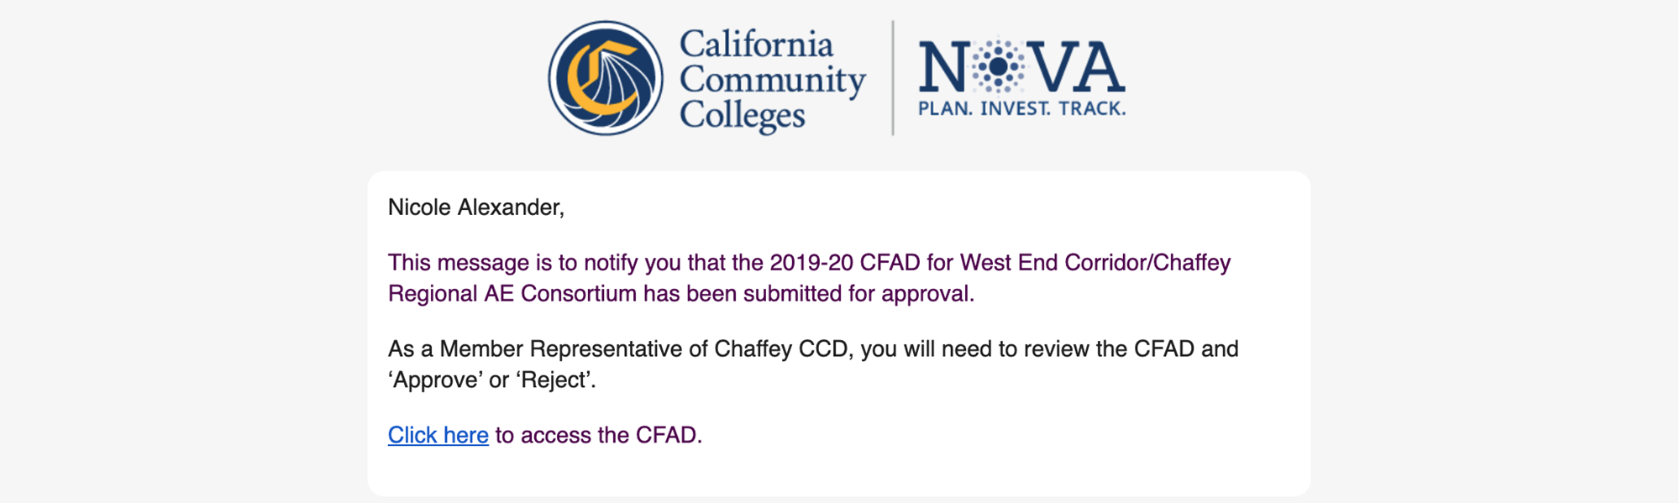
CFAD Process

Slide 25
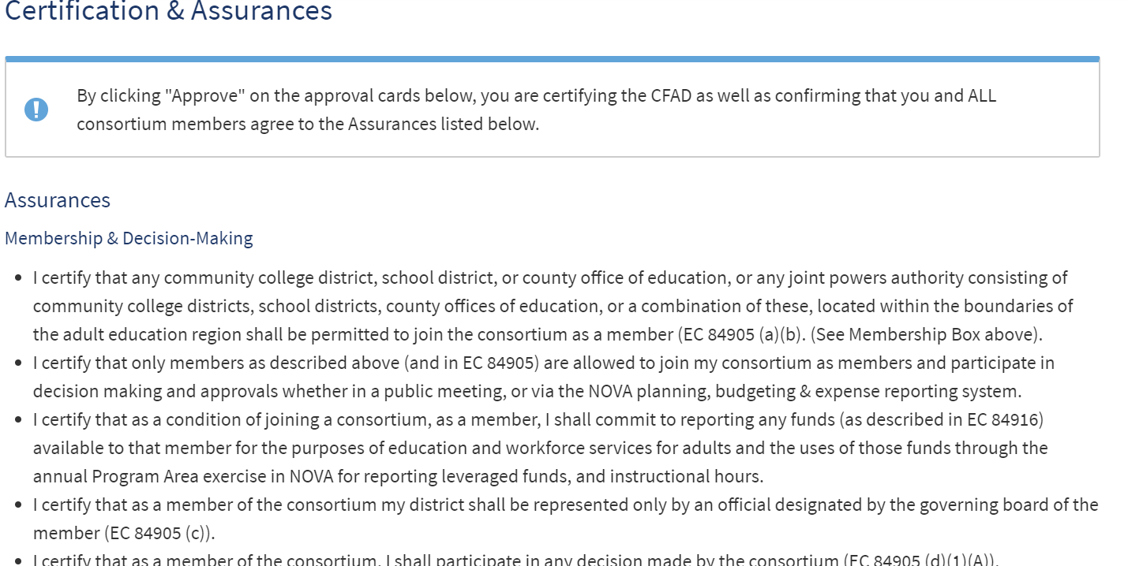
CFAD Process

Slide 26
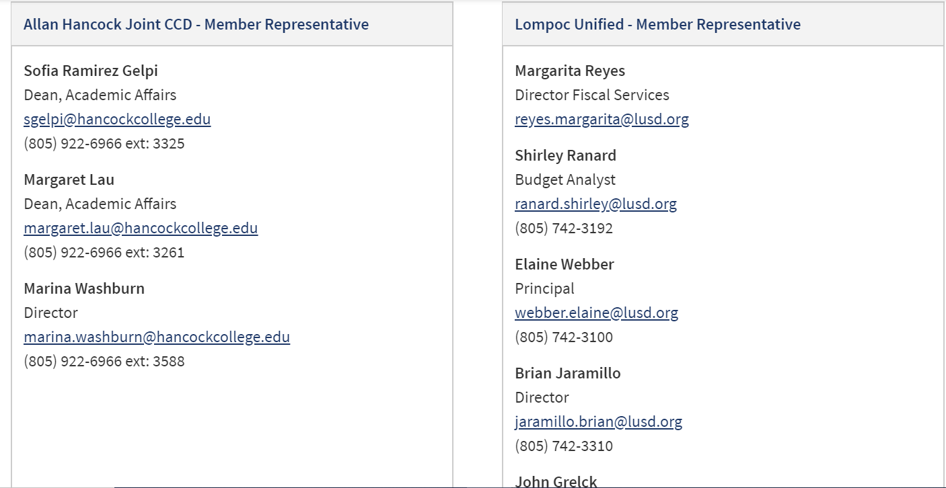
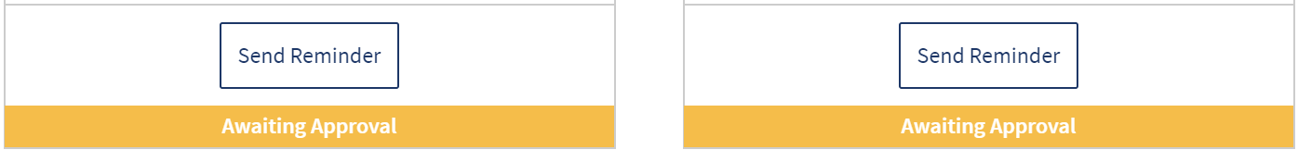
CFAD Process

Slide 27
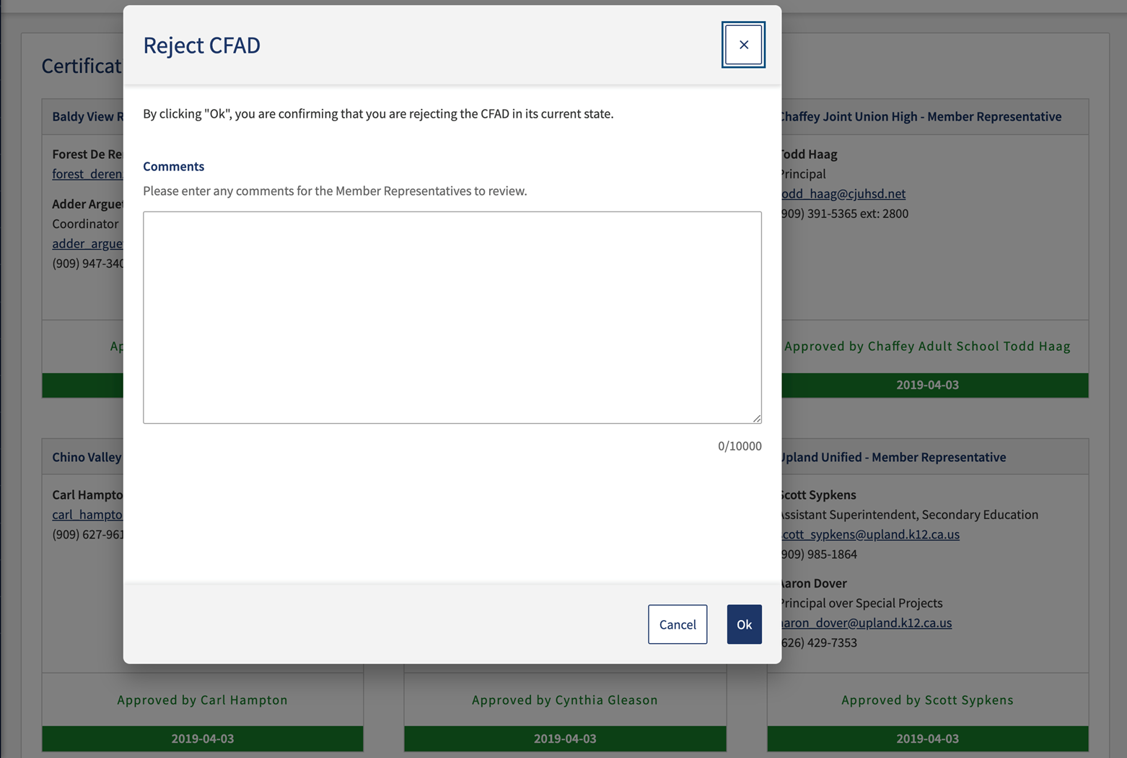
CFAD Process

Slide 28
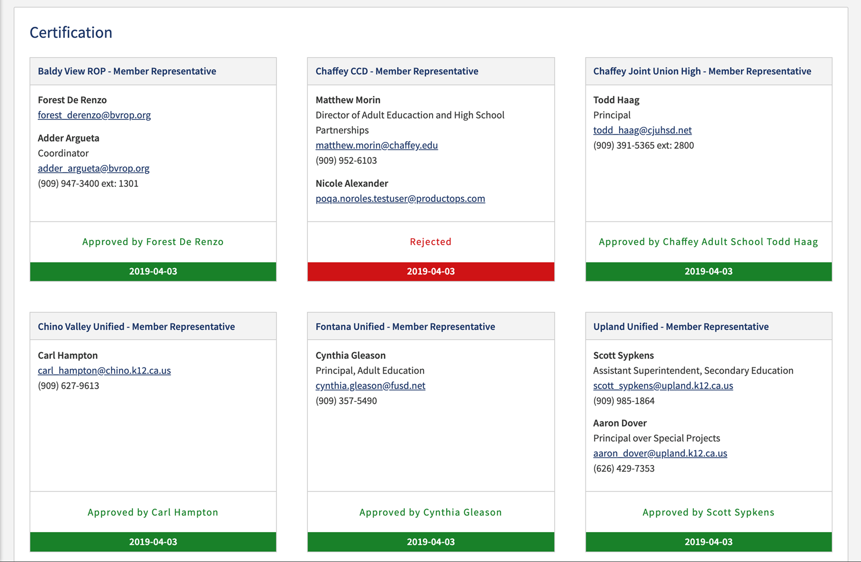
CFAD Process

Slide 29
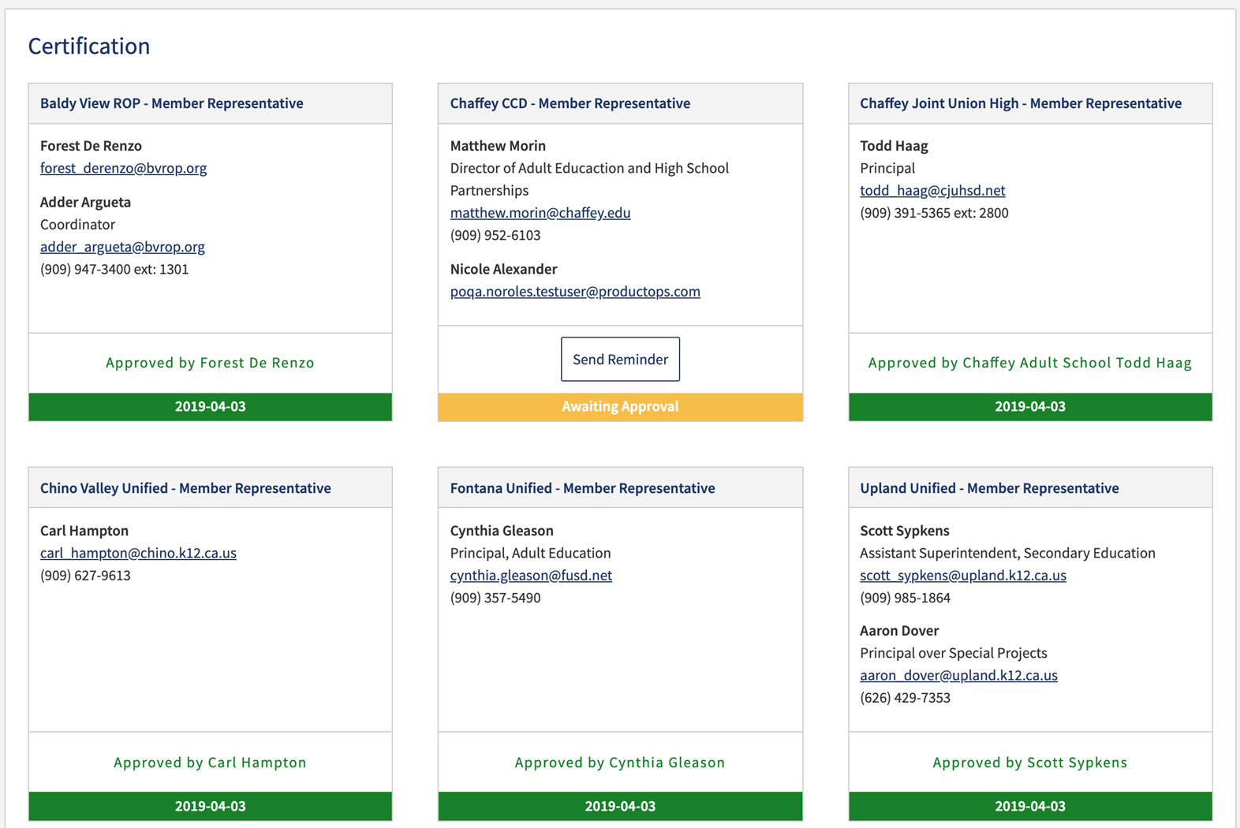
CFAD Process

Slide 30
Allocation Amendment Process
Allocation Amendments are a reallocation process in NOVA after the CFAD has been certified.
Must be approved/certified by all members in NOVA.
Allocation amendments do not affect your prior year allocation, and doesn’t impact future allocations.
Just a in-year reallocation of funds.
Some consortia have by-laws to support this process.
To impact future allocations, members must fall under the three criteria under EC 84914.

Slide 31
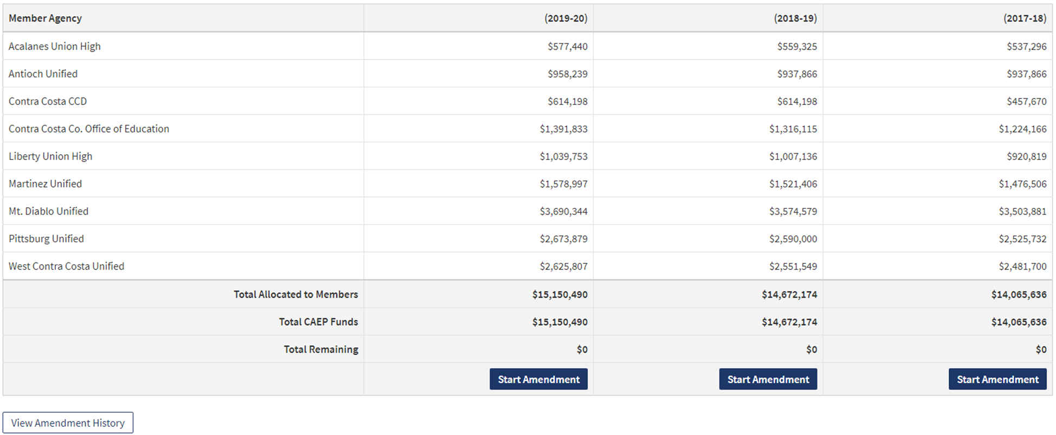
Allocation Amendment Process

Slide 32
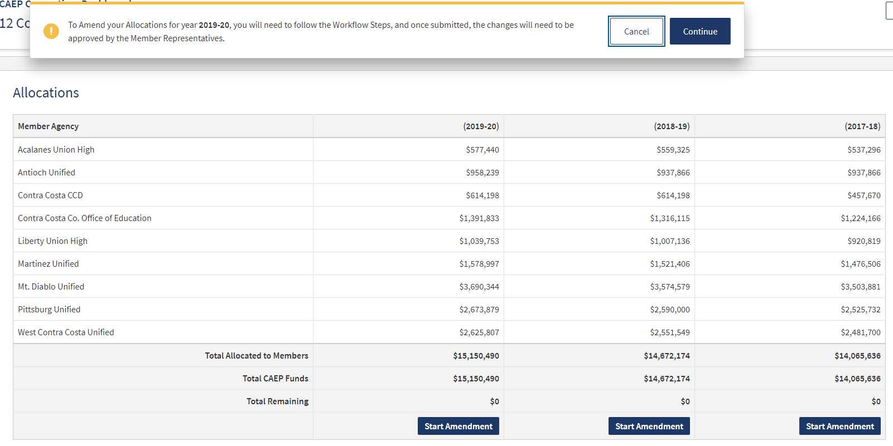
Allocation Amendment Process

Slide 33
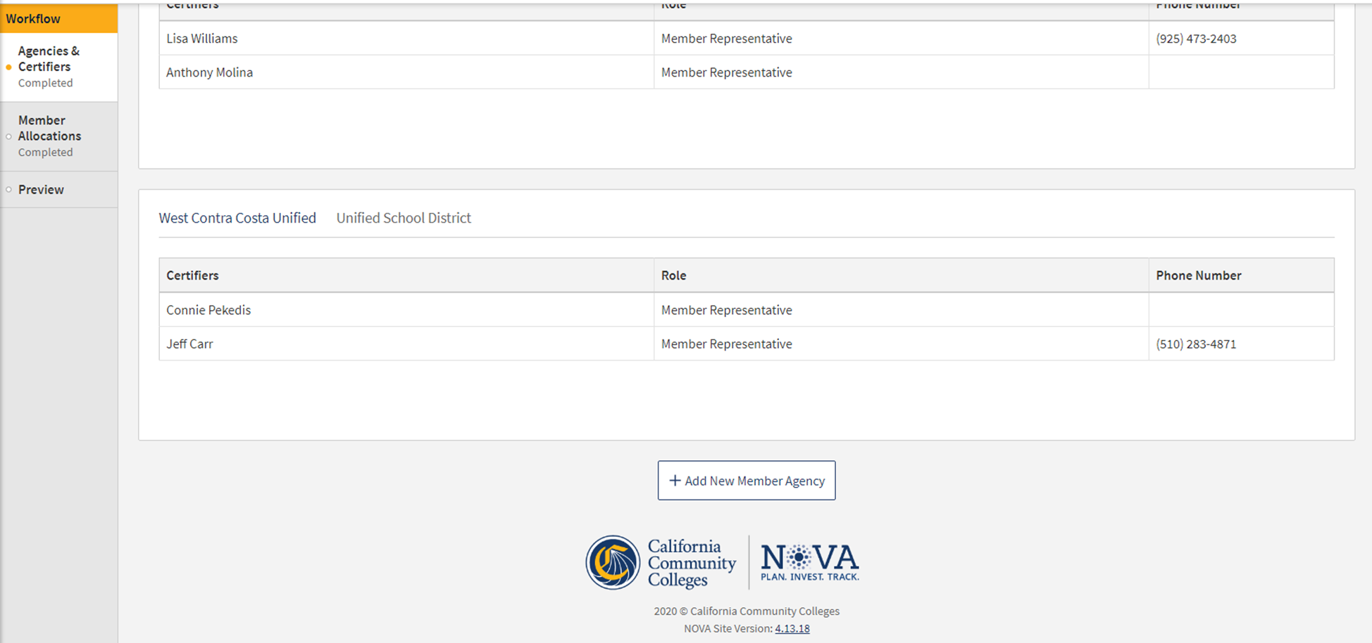
Allocation Amendment Process

Slide 34
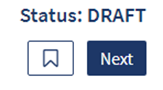
Allocation Amendment Process

Slide 35
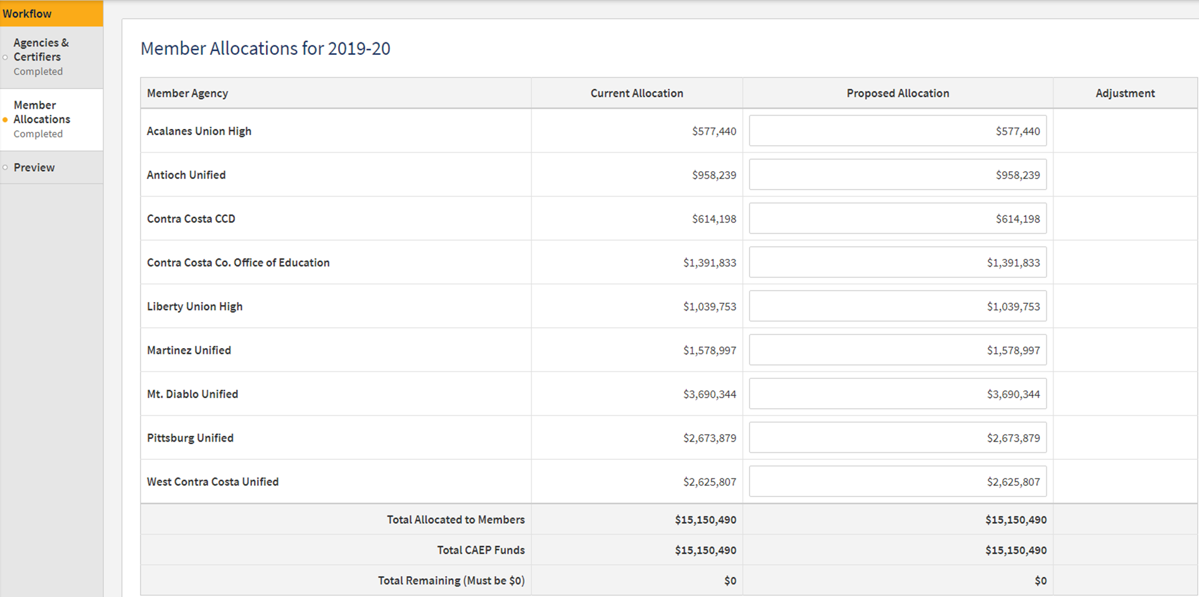
Allocation Amendment Process

Slide 36
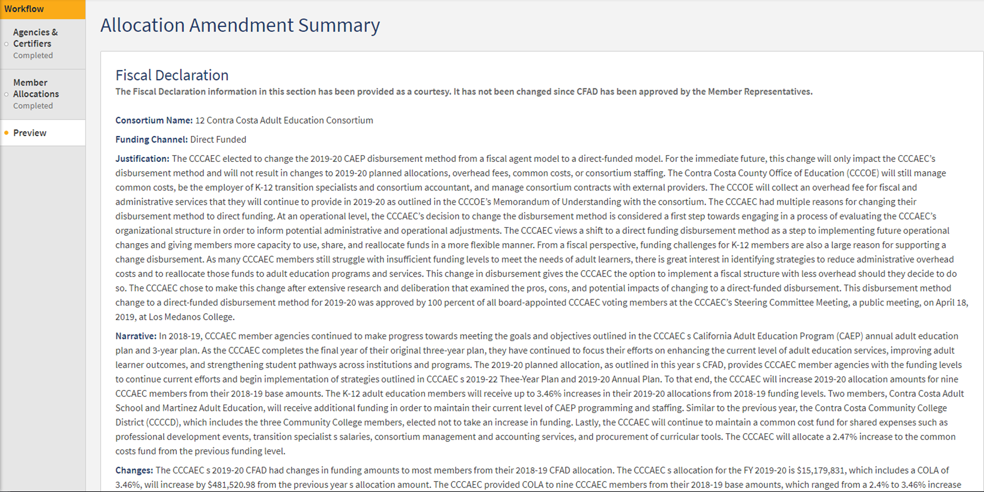
Allocation Amendment Process

Slide 37
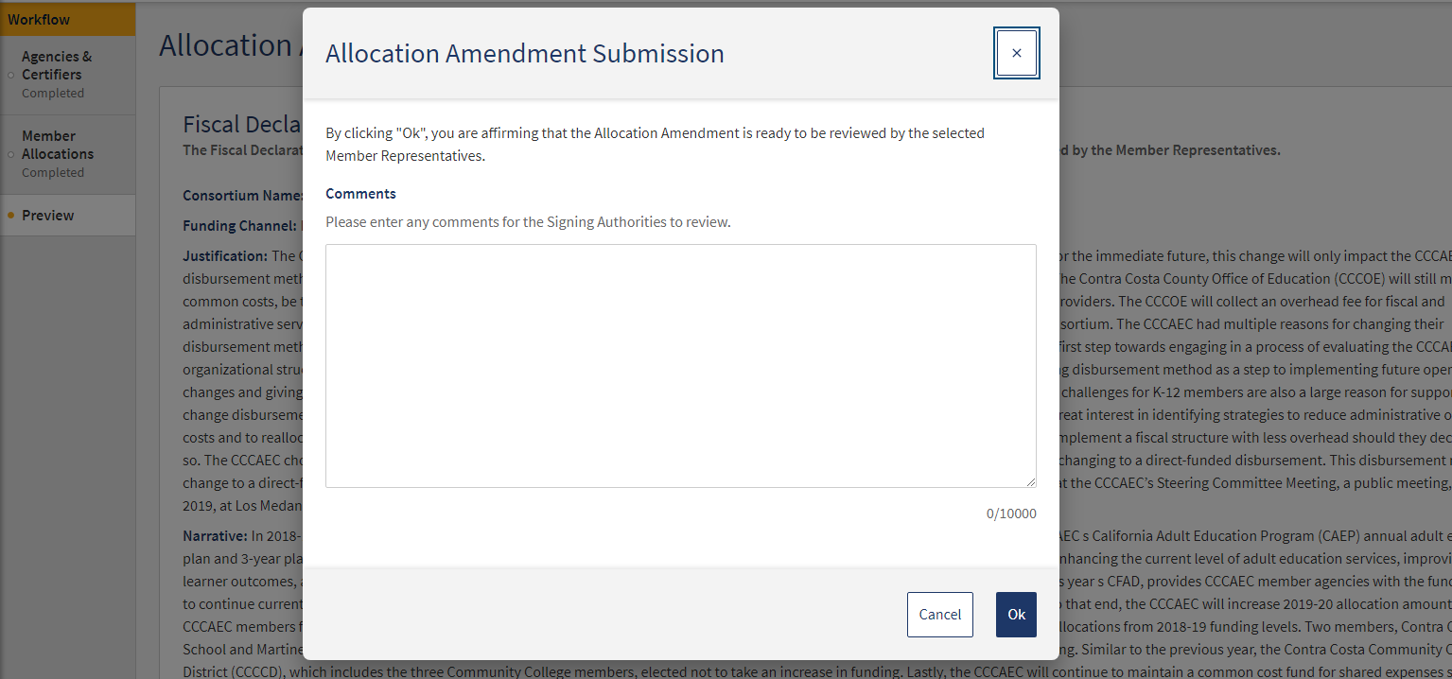
Allocation Amendment Process

Slide 38
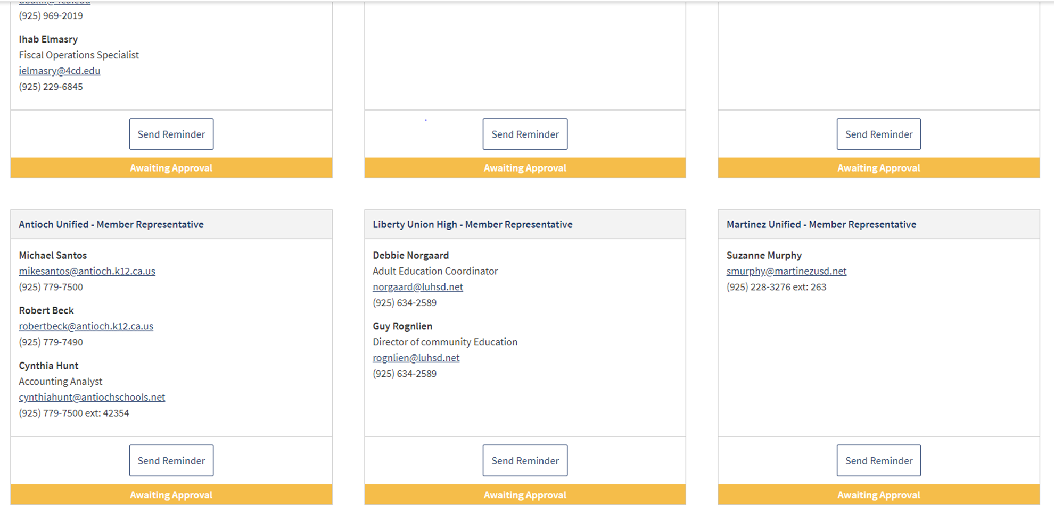
Allocation Amendment Process

Slide 39
NOVA Reminders
How to add a new member
How to update a consortium lead change
Training Resources for NOVA
How to request NOVA technical assistance
Others?

Slide 40

Wrap Up and Questions

Slide 41
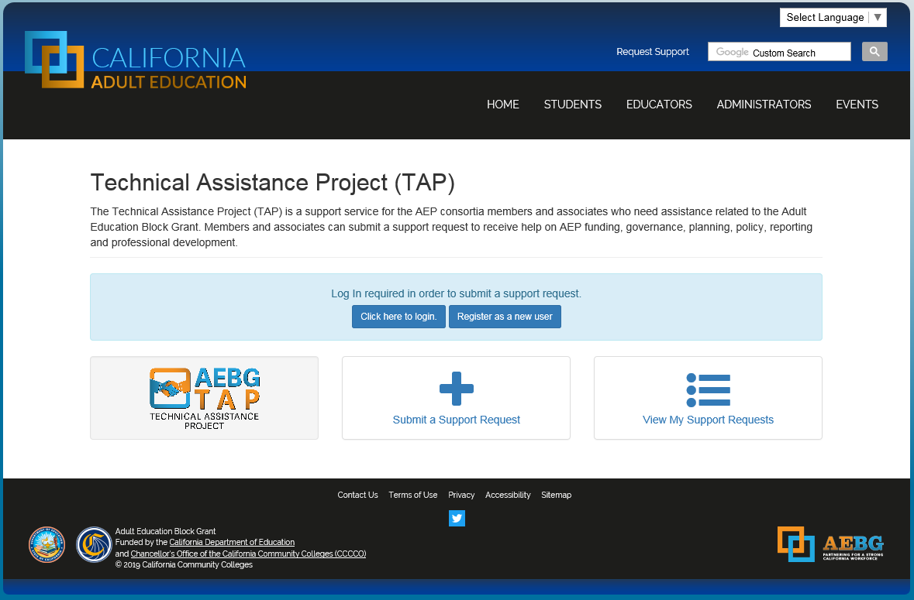
Request Support from CAEP TAP

