Slide 1
LaunchBoard Adult
Education Pipeline 3.0
May 27th, 2020
Randy Tillery, Program Director at WestEd
rtiller@wested.org
Karen Beltramo, Senior Project Manager at WestEd
kbeltra@wested.org

Slide 2
Main Objectives for Today
Overview of CAEP data universe, students, programs, and metrics
Adult Education Pipeline & what’s new in build 3
Demonstration of the Pipeline
Questions and Answers/Discussion
NOTE: Please type your questions into the chat box. We will be pausing after each section to answer.
Notes:
4 Outcomes from Legislation

Slide 3
Why CAEP?
Improve access to postsecondary education
Increase outcomes for adult learners in adult education and noncredit college programs
Increase access to employment, higher earnings, and economic mobility for low income adults, immigrants, and families

Slide 4
CAEP Students
Adult Education Student (Adults Served): Any student 16 or over served at a K12 adult school or a community college noncredit program with at least 1 instructional hour in a CAEP program area or who receives services
Adult Education Participant: Any K12 adult education or college noncredit student with 12 or more instructional contact hours over the program year (in any combination of programs). Outcomes are only reported for participants.
College Credit Students: Students enrolled in credit coursework are not considered adult education students unless they are co-enrolled in a K12 adult school or community college noncredit program.

Slide 5
Participants in English as a Second Language (ESL)
Participants in Adult Basic Education (ASE)
Participants in Adult Secondary Education (ASE)
CAEP Programs
Participants in Career Technical Education (CTE)
Participants in Programs for Adults w Disabilities
Adult Participants Training to Support Child School Success
3 CTE Sub-Program Areas
Short Term Vocational Training
Workforce Preparation
Pre-Apprenticeship

Slide 6
CAEP Student Metric Buckets
Participation
Adults Served
Participants
Programs
Progress
EFL Attainment
Workforce Prep
Occup Skills
Transition
ABE/ESL to ASE
Transition to Postsecondary
Completion
Diploma/HSE
Postsecondary Credentials
Employment
Employment
Wage Gains
Living Wage
CAEP Metric Disaggregation
Race/Ethnicity
Gender
Age
Program Area
First Time/Cont

Slide 7
The CAEP Metrics as a Student Journey
Completion by
Design Framework
Metric Buckets
Metrics
Activities

Slide 8
CAEP Data Universe
TOPSpro Enterprise
Quarterly and annual data collection from K12 adult schools and WIOA Title II Programs
Provide quarterly and end of year DIR reports to agencies for comparison with agency data
19 Colleges funded under WIOA Title II and a few other colleges report using MIS and CASAS
Provides validated EFL completion data using pre and post test data using CASAS test instruments
Uses Noncredit MIS, CASAS, and EDD data
Provides complete consortium level data combining K12 and CC enrollment records
Matches K12, College, and EDD data to track postsecondary transitions and employment outcomes
Updated annually
Used for AE consortia 3 year and annual plan updates
Financial Accountability and budget tracking
Posting of consortia 3 year plans and annual plan updates
Notes:
We’re closely aligned in some places and there are some places that the concepts do not translate. LB is going to be used as the source to document methodology for funding.

Slide 9
LaunchBoard
www.calpassplus.org/Launchboard/Adult-Education-Pipeline.aspx
LaunchBoard Development Team
Notes:
Major dashboards -

Slide 10
What is the LaunchBoard?
Statewide suite of public dashboards supported by the Community College Chancellor's Office and hosted by Cal-PASS Plus. LaunchBoard provides data on progress, employment, and earnings outcomes for community college pathways, adult education, and K14 career pathways and tracks important accountability measures for key educational reform initiatives
This information is intended to facilitate local, regional, and statewide conversations about how to foster economic mobility.
Notes:
Suite of dashboards; kind of data (actionable

Slide 11
Key Characteristics
Practitioner Driven – Designed to improve educational practice
Relevant: Aligned to Legislative and CO Priorities
Display Types – Student Journeys or Education Reform Key Metrics
Uses Public Data Sets – Leverages CC, AE, K12, EDD other data
Matches Data to Track Transition – AE/CC; K12/CC; CC/LMI
Compares institutions, regions, state level data
Disaggregated by ethnicity, age, gender, program

Slide 12
Accountability, Reform, & Student Journeys
Accountability Tools: Student Success, Strong Workforce Program
Reform Tools: Guided Pathways
Student Journeys: Community College Pipeline; Adult Education Pipeline
Notes:
Major dashboards -

Slide 13
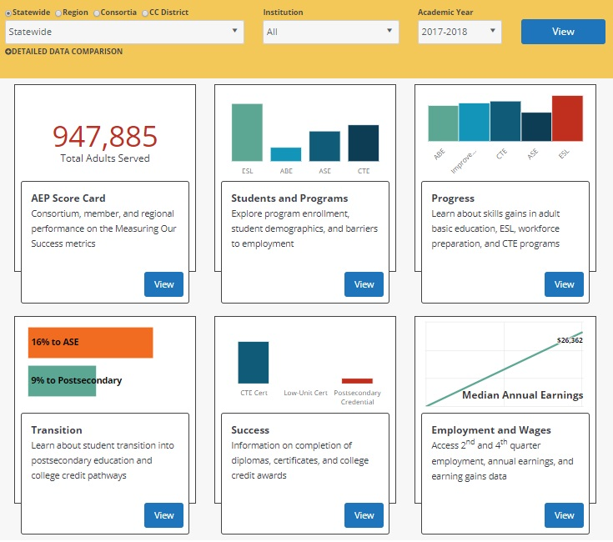
Adult Education Pipeline

Slide 14
Visualize by region, consortium institution, and program year
Six high level live metrics on (tiles) organized by student momentum points
AEP Score Card with Measuring our Success reporting metrics
Summary infographic in each page focused on a key data point or question
Detailed data charts and tables with:
Additional AE Key Metrics
Multiple disaggregations
Time trends
Comparison view in Detailed Data View

Slide 15
Data and Metric Alignment
Alignment with CASAS/TE Calculations
Aligned program, population, and outcome definitions
Lowered age to include 16 and over for TE and COMIS data
CASAS/WestEd review of TE calculations to validate AE 3.0 construction
Decision made NOT align to CAEP definition for Reportable Individuals since students with 0 < 1 program or contact hours are not included unless the student was flagged as receiving services
Alignment with Student Success Metrics
Alignment of Adult Ed/ESL and Short Term CTE journey metrics with existing CAEP definitions
Notes:
Added in d)

Slide 16
New Metrics and New View in Build 3
Adults served with 1-11 instructional contact hours
Service only students
Participants in Workforce Preparation
First Time Participants (by program area)
Returning or Continuing Participants
Participants taking courses in more than one program area
Participants taking courses at more than one adult school
Subsequently took transfer level math or English
Year to Year Persistence
Community College District view

Slide 17
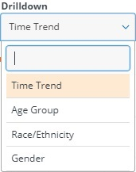
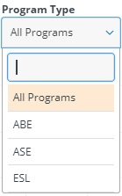
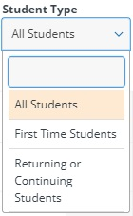
Disaggregations and Drilldowns
Age Group
Race/Ethnicity
Gender
Program (ABE/ASE/ESL/CTE)
First Time/Returning (3.0)
All
Metrics
Some
Metrics
Note: Drilldowns work together. Therefore, a user can see how many first time ASE students or returning ABE females students met the metric outcome
Notes:
Move to beginning of presentation

Slide 18
New Metrics and New View in Build 3
New to Student Barriers to Employment
Reportable Individuals who had >1 instructional contact hour or received support services in the selected year are broken up into two categories:
Ever Flagged - having barriers to employment at any time up to and including the selected year:
Cultural Barriers (SG18)
English Lang. Learner (enrolled in ESL)
Ex-Offender (SG15)
Foster Youth (SG03)
Low Income (SG14)
Low Literacy (SG20)
Flagged - having barriers to employment ONLY in the selected year:
Displaced Homemaker (SV05)
Homeless (SG16)
Long Term Unemployed (SG17)
Migrant Farmworker (SV09)
Seasonal Farmworker (SG19)
Exhausting TANF within 2 Years (SC18)
Single Parent (SV04)
NOTE: Make sure that the flags for the barriers only in the selected year are updated each year since students will need to be flagged in any term of the academic year to be included
Notes:
Review each term- if ever terms are flagged once and other terms are refreshed every term. Organize if ever and once per term.

Slide 19
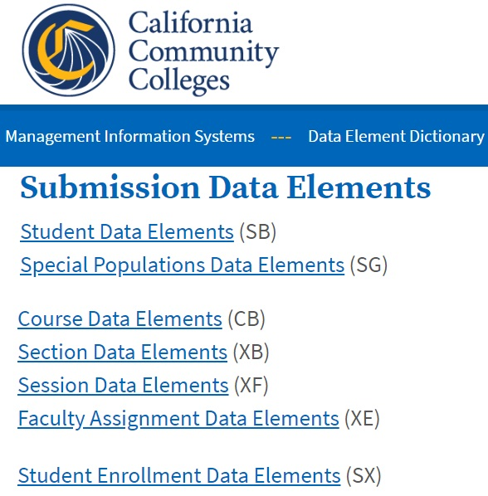
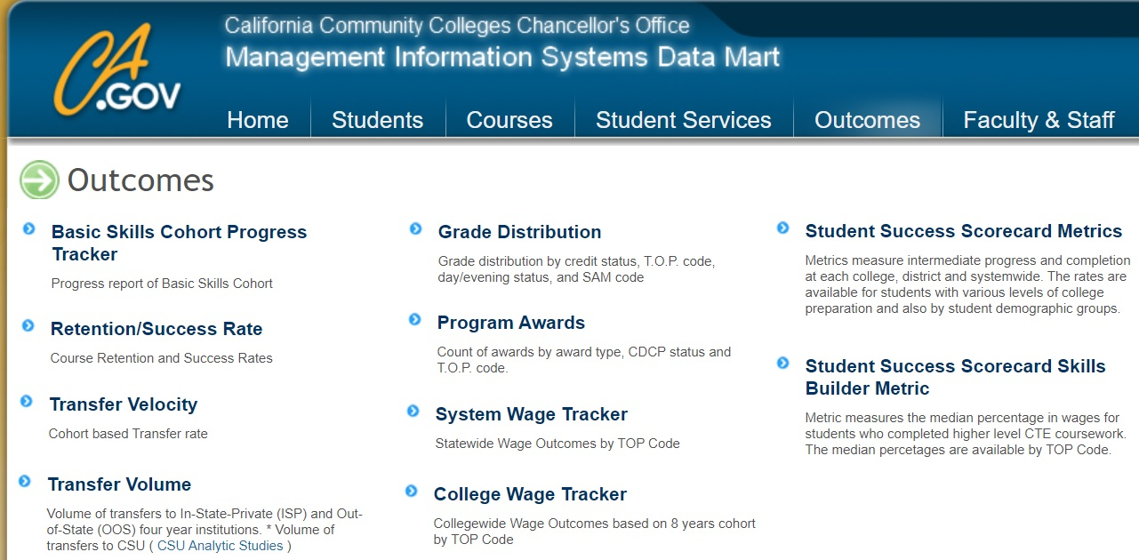
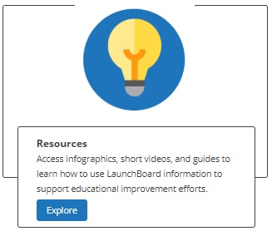
Resources
COMIS Data Element Dictionary (back on the CO website) https://webdata.cccco.edu/ded/ded.htm
California Adult Education https://caladulted.org
Chancellor’s Office Datamart
https://datamart.cccco.edu/Outcomes/Default.aspx
CASAS https://casas.org
LaunchBoard Resources
https://launchboard-resources.wested.org/resources?t_id=all
LaunchBoard and Noncredit FAQ Available this week on LaunchBoard Resources, caladulted.org, and RP listservs
Notes:
MIS DED link is live!!!

Slide 20
Live Demo

Slide 21
User Interface & Resource Improvements
User Interface support enhancements to improve understanding of metrics and calculations
Better dedicated AE resources to improve reporting & understanding of data processes and usage
Professional Development – 20/21
Using LB Data for Program Improvement and Planning
Noncredit Code Alignment: Improving noncredit program and student coding to improve outcomes
CB21 and AB705: Creating stronger course sequences to college level courses and programs
CTE Pathways: Using the adult ed CTE mapping data to improve adult education career outcomes
AE Pipeline
2020 -2021
Metrics
Cohort based metrics
Instructional content hours and student services

Slide 22
If you have any further questions, please contact:
Randy Tillery, Program Director at WestEd
rtiller@wested.org
Karen Beltramo, Senior Project Manager at WestEd
kbeltra@wested.org
Aurora King, Senior Project Manager at WestEd
aking@wested.org

